Slide 1


VDM Tutorial
John Fitzgerald, Newcastle University
www.into-cps.org

Slide 2



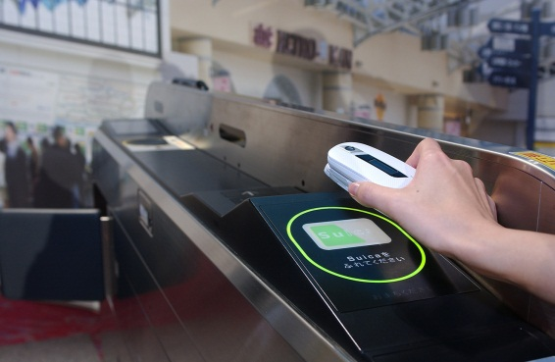

VDM Background
Our goal: well-founded but accessible modelling & analysis technology
VDMTools → Overture → Crescendo → Symphony
Pragmatic development methodologies
Industry applications
VDM: Model-oriented specification language
Extended with objects and real time.
Basic tools for static analysis
Strong simulation support
Model-based test

Slide 3
VDM (Vienna Development Method)
A formal method for specification of software
Three flavours
VDM-SL (Specification Language)
VDM++ adds object-orientation
VDM-RT adds real-time features (clock and deployment)
Model-oriented specification language
Simple, abstract data types
Invariants to restrict membership
Functional specification:
Implicit specification (pre/post)
Explicit specification (functional or imperative)
Notes:
The modern car has more than 40 subsystems.
And, in a competitive market such as the one we live in, industries cannot afford to develop all these subsystems sequentially.
In a concurrent development, it is very important to measure how the design decision made in one component affect the other parts of the system.
The later this is done, the worse.
To aggravate the situation, some subsystems are not developed in house: there are independent suppliers that develop them which means that some design decisions and the full specification of the subsystems will not be made available to protect their IP.

Slide 4
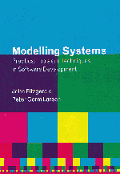
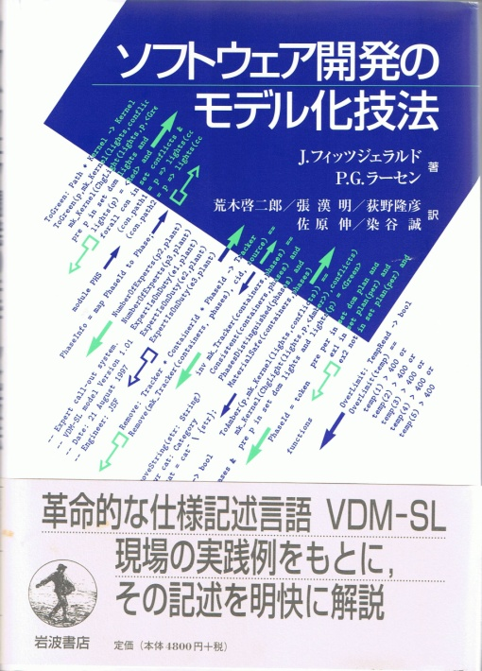
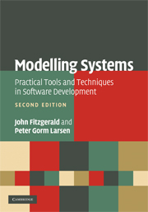
VDM-SL Module Outline
module <module-name>
definitions
end <module-name>
imports
exports
...
Interface
state
types
values
functions
operations
...
Definitions
Notes:
4

Slide 5
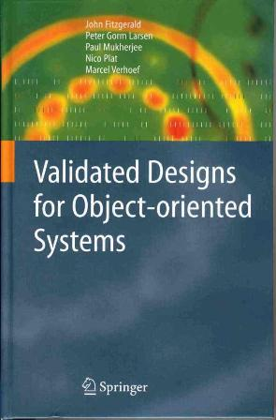

VDM++ Class Outline
class <class-name>
end <class-name>
instance variables
...
Internal object state
types
values
functions
operations
Definitions
thread
...
Dynamic behaviour
sync
...
Synchronization control
traces
...
Test automation support
Notes:
5

Slide 6
Data Types
Basic types
Boolean
Numeric
Tokens
Quote types
Characters / String
Compound types
Set types
Sequence types
Map types
Product types
Record types
Union types
Optional types
Type | Values
nat1 | 1, 2, 3, ...
nat | 0, 1, 2, ...
int | ..., -2, -1, 0, 1, ...
real | -12.78356, ..., 0, ..., 3, ..., 1726.34, ...
flag: bool := false;
flag := true
id: token := mk_token(5);
id := mk_token(“ken”)
<RED>
<BLUE>
x = y (equality) and x <> y (inequality)
letter: char := ‘k’;
name: seq of char := “ken”
x = y (equality) and x <> y (inequality)
s: set of int := {1,5,8,3};
1 in set s -- true
s: seq of int := [1,5,5,8,3];
s(4) -- 8
m:map int to real := {1 |-> 3.14};
m(1) -- 3.14
Pair = nat * real;
x: Pair := mk_(1, 3.14); x.#1 -- 1
Pair :: a : nat b : real;
x: Pair := mk_Pair(1, 3.14); x.a -- 1
Colour = <RED> | <GREEN> | <BLUE>;
c: Colour := <RED>
Type = [nat] equivalent to
Type = nat | nil

Slide 7
Type Invariants
DT
inv_DT
Even = nat
inv n == n mod 2 = 0
SpecialPair = nat * real – the first is smallest
inv mk_(n,r) == n < r
DisjointSets = set of set of A
inv ss == forall s1, s2 in set ss &
s1 <> s2 => s1 inter s2 = {}

Slide 8
Set Types
Unordered collections of elements
One copy of each element
The elements themselves can any type
e.g.
set of int
{1,5,8,3};
{}

Slide 9
Overview of Set Operators
e in set s1 Membership (∈) A * set of A -> bool
e not in set s1 Not membership (∉) A * set of A -> bool
s1 union s2 Union (∪) set of A * set of A -> set of A
s1 inter s2 Intersection (∩) set of A * set of A -> set of A
s1 \ s2 Difference (\) set of A * set of A -> set of A
s1 subset s2 Subset (⊆) set of A * set of A -> bool
s1 psubset s2 Proper subset (⊂) set of A * set of A -> bool
s1 = s2 Equality (=) set of A * set of A -> bool
s1 <> s2 Inequality (≠) set of A * set of A -> bool
card s1 Cardinality set of A -> nat
dunion s1 Distr. Union (∪) set of set of A -> set of A
dinter s1 Distr. Intersection (∩) set1 of set of A -> set1 of A
power s1 Finite power set (P) set of A -> set of set of A

Slide 10
Sequence Types
Could also be called lists
Not fixed length like Java arrays
Ordered collections of elements
Numbered from 1 (not 0 like Java)
Access element with () and not [], e.g. list(1)
Multiple copies of each element allowed
The elements themselves can be any type
e.g.
seq of int; seq1 of int (non-empty)
[1,5,5,8,1,3]; []

Slide 11
Overview of Sequence Operators
hd l Head seq1 of A -> A
tl l Tail seq1 of A -> seq of A
len l Length seq of A -> nat
elems l Elements seq of A -> set of A
inds l Indexes seq of A -> set of nat1
l1 ^ l2 Concatenation seq of A * seq of A -> seq of A
conc ll Distr. conc. seq of seq of A -> seq of A
l(i) Seq. application seq1 of A * nat1 -> A
l ++ m Seq. modification seq1 of A * map nat1 to A -> seq1 of A
l1 = l2 Equality seq of A * seq of A -> bool
l1 <> l2 Inequality seq of A * seq of A -> bool

Slide 12
Mapping Types
Unordered collections of pairs of elements (maplets) with a unique relationship
mapping keys to values
like Python dictionary
The elements themselves can be any type
e.g.
map int to real

Slide 13
Overview of Mapping Operators
dom m Domain (map A to B) -> set of A
rng m Range (map A to B) -> set of B
m1 munion m2 Merge (map A to B) * (map A to B) -> (map A to B)
m1 ++ m2 Override (map A to B) * (map A to B) -> (map A to B)
merge ms Distr. merge set of (map A to B) -> map A to B
s <: m Dom. restr. to set of A * (map A to B) -> map A to B
s <-: m Dom. restr. by set of A * (map A to B) -> map A to B
m :> s Rng. restr. to (map A to B) * set of A -> map A to B
m :-> s Rng. restr. by (map A to B) * set of A -> map A to B
m(d) Map apply (map A to B) * A -> B
inverse m Map inverse inmap A to B -> inmap B to A
m1 = m2 Equality (map A to B) * (map A to B) -> bool
m1 <> m2 Inequality (map A to B) * (map A to B) -> bool

Slide 14
Specifying Behaviour
Specifications in terms of post-conditions define a contract sqrt(x: nat) r: real post x = r ∗ r
Explicit version sqrt: nat -> real sqrt(x) == Math`sqrt(x)
Pre-condition and post-conditions sqrt: int -> real sqrt(x) == Math`sqrt(x) pre x > 0 post x = RESULT ∗ RESULT
Implicit definition, not executable
Explicit definition can be executed

Slide 15
A Simple Controller Class
class Controller
instance variables
private measured: RealPort;
public setpoint: real;
protected err: real;
output: RealPort;
operations
public Step: () ==> ()
Step() == (
m := measured.getValue();
err := setpoint – m;
output.setValue(P(err));
);
functions
private P: real -> real
P(err) == err * Kp
values
Kp = 2.0
thread
periodic(2E7, 0 , 0 , 0)(Step);
end Controller
Divided into sections (e.g. instance variables, operations, etc.)
Inheritance supported
class Controller is subclass of Parent
Objects created with
new Controller
Constructors also similar to Java
public Controller: real * real ==> Controller Controller(a,b) == ( x:= a; y := b );
Sections can be repeated and mixed
Comments are
Two dashes: -- comment
Or: /* block comment */
COE synchronises these to other models

Slide 16
Instance Variables
class Controller
instance variables
private measured: RealPort;
public setpoint: real;
protected err: real;
output: RealPort;
operations
public Step: () ==> ()
Step() == (
m := measured.getValue();
err := setpoint – m;
output.setValue(P(err));
);
functions
private P: real -> real
P(err) == err * Kp
values
Kp = 2.0
thread
periodic(2E7, 0 , 0 , 0)(Step);
end Controller
Give the state of the object
Note syntax for giving the type
private double measured;
private measured: real;
Visibility similar to Java (added here for illustration only)
Defaults is private is no visibility given
Can be assigned when defined

Slide 17
Functions
class Controller
instance variables
private measured: RealPort;
public setpoint: real;
protected err: real;
output: RealPort;
operations
public Step: () ==> ()
Step() == (
m := measured.getValue();
err := setpoint – m;
output.setValue(P(err));
);
functions
private P: real -> real
P(err) == err * Kp
values
Kp = 2.0
thread
periodic(2E7, 0 , 0 , 0)(Step);
end Controller
Are pure
No side effects
Cannot access instance variables
No return keyword, defined with expressions that return the correct type
Useful for auxiliary / helper calculations
Note signature above definition
real * int * bool -> real
No loops, must use functional programming techniques
Can call other functions

Slide 18
Operations
class Controller
instance variables
private measured: RealPort;
public setpoint: real;
protected err: real;
output: RealPort;
operations
public Step: () ==> ()
Step() == (
m := measured.getValue();
err := setpoint – m;
output.setValue(P(err));
);
functions
private P: real -> real
P(err) == err * Kp
values
Kp = 2.0
thread
periodic(2E7, 0 , 0 , 0)(Step);
end Controller
Similar to functions, but...
Can access instance variables / have side effects
Are imperative like Java
Can use while, for loops etc.
Must use return keyword when returning a value
Can call other operations and functions
Can define local variables but only at the start
Step() == ( dcl x: real := 0;
Note parentheses () not {}
Note different arrow to function
real * int * bool ==> real

Slide 19
Values
class Controller
instance variables
private measured: RealPort;
public setpoint: real;
protected err: real;
output: RealPort;
operations
public Step: () ==> ()
Step() == (
m := measured.getValue();
err := setpoint – m;
output.setValue(P(err));
);
functions
private P: real -> real
P(err) == err * Kp
values
Kp = 2.0
thread
periodic(2E7, 0 , 0 , 0)(Step);
end Controller
Used to define constants
Note = is used, not :=
Do not need a type
but can have one Kp: real = 1.24;
Can be set as Shared Design Parameters
Are static, can be accessed from other classes (if public)
Controller`Kp

Slide 20
Threads
class Controller
instance variables
private measured: RealPort;
public setpoint: real;
protected err: real;
output: RealPort;
operations
public Step: () ==> ()
Step() == (
m := measured.getValue();
err := setpoint – m;
output.setValue(P(err));
);
functions
private P: real -> real
P(err) == err * Kp
values
Kp = 2.0
thread
periodic(2E7, 0 , 0 , 0)(Step);
end Controller
Threads are defined in the class
Definition could be operation call; will run once
thread Step();
Or a loop
thread while true do Step();
Starting
ctrl: Controller := new Controller(); start(ctrl)
Or a special, periodic definition (as on the left)
will call Step operation once every 2e7 nanoseconds (20 milliseconds; 0.02 seconds; 50Hz)

Slide 21
The HardwareInterface Class
class HardwareInterface
values
-- @ interface: type = parameter, name="minlevel";
public minlevel : RealPort = new RealPort(1.0);
-- @ interface: type = parameter, name="maxlevel";
public maxlevel : RealPort = new RealPort(2.0);
instance variables
-- @ interface: type = input, name="level";
public level : RealPort := new RealPort(0.0);
instance variables
-- @ interface: type = output, name="valveState";
public valveState : BoolPort := new BoolPort(false);
end HardwareInterface

Slide 22
The System Class
system MySystem
instance variables
-- controller
public static ctrl: Controller;
-- Hardware interface variable required
-- by FMU Import/Export
public static hwi: HardwareInterface :=
new HardwareInterface();
-- CPU
private cpu: CPU; := new CPU(<FP>, 1E6)
operations
public MySystem: () ==> MySystem
MySystem() == (
ctrl := new Controller();
cpu.deploy(ctrl)
)
end MySystem
Special class for CPU and deployment
Can only define instance variables and a constructor
CPU speed in (simulated) MIPS
getting a model within ~20% of the real thing is typically “good enough”

Slide 23
The World Class
class World
operations
-- run a simulation
public run: () ==> ()
run() == (
start(System‘ctrl);
block();
);
-- wait for simulation to finish
block: () ==> ()
block() == skip;
sync per block => false;
end World
Entry point for code execution
Start threads and wait for end of simulation

Slide 24
Concurrency
Concurrency in VDM-RT is based on threads
Threads communicate using shared objects
Synchronization on shared objects is specified using permission predicates
sync per <operation name> => predicate
Operation is blocked when the predicate is false
mutex(A, B)
History counters
#req op | The number of times that op has been requested
#act op | The number of times that op has been activated
#fin op | The number of times that op has been completed
#active op | The number of active executions of op
#waiting op | The number of waiting executions of op

Slide 25
VDM-RT Features (1)
VDM-RT has extensions for modelling real-time systems
An internal clock
in nanoseconds from simulation start
accessible with the time keyword, e.g.
dcl now: real := time/1e9 -- time in seconds
All expressions advance the clock
default is two simulated cycles
Can be altered with cycles(number)(expression) or duration(number)(expression)
Cycles used to compute duration

Slide 26
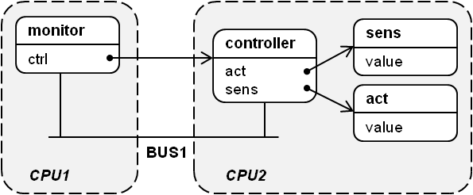
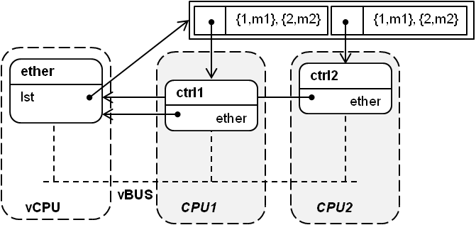
VDM-RT Features (2)
Also models of CPUs and BUSes to try to model real code execution
objects are “deployed” to CPU with a given speed
execution duration depends on the modelled CPU speed
also a virtual CPU that doesn’t advance the clock

Slide 27
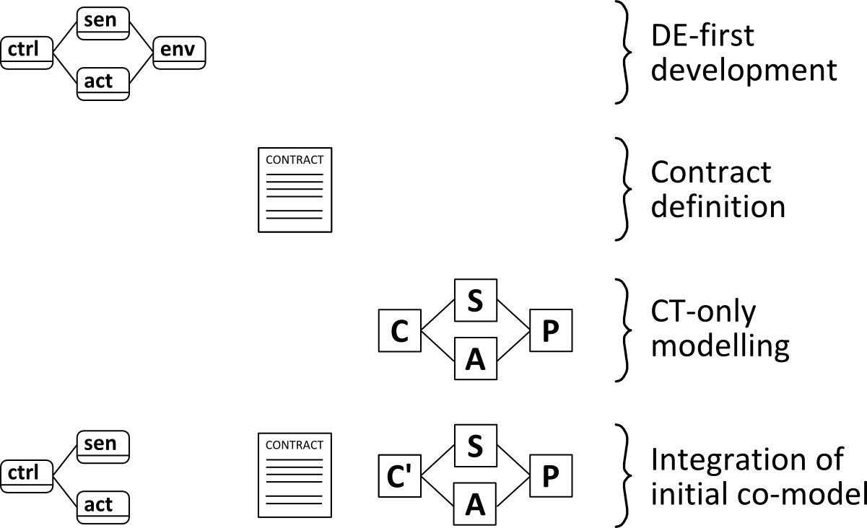
DE-first Modelling
DE-first (DE-only) model:
Controller, sensor and actuator classes
Environment model
DE approximation
FMI
Interface definition
FMI
Integration of initial multi-model

Slide 28
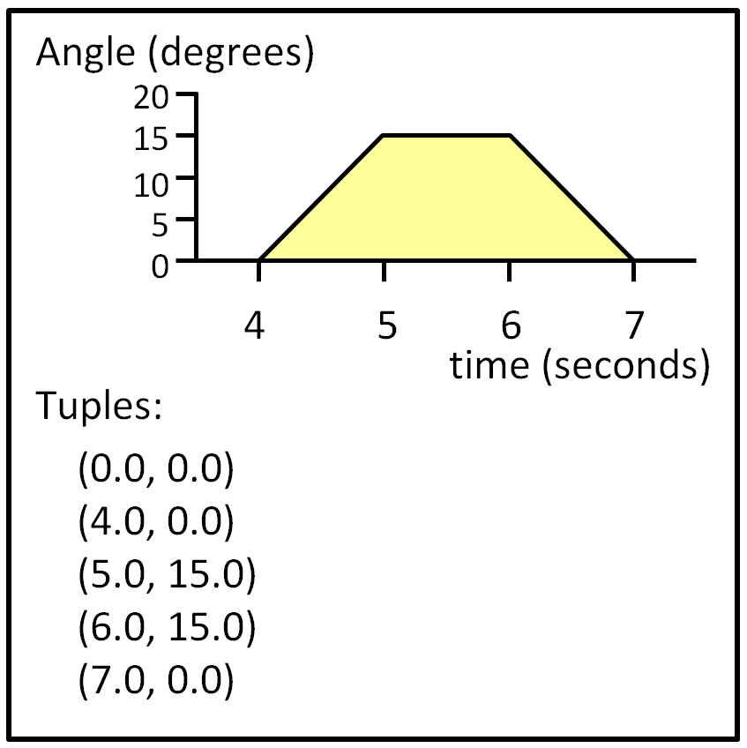
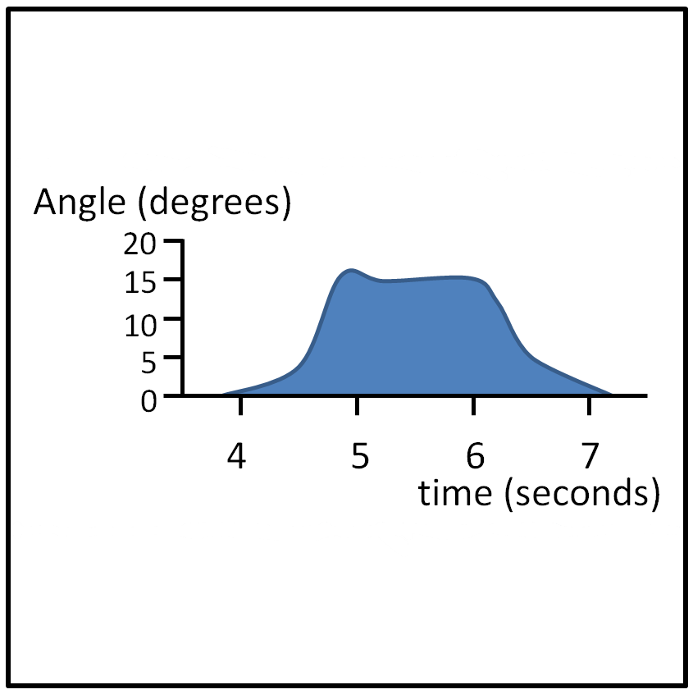
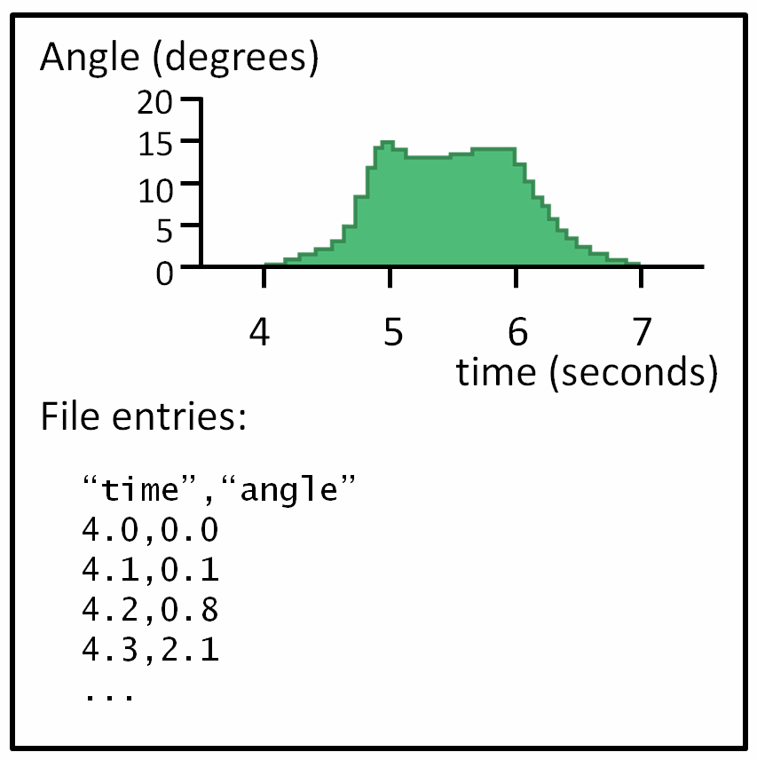
Approximating CT Behaviour
Linear approximations
Simple integration: position = position + velocity * dt; velocity = velocity + acceleration * dt;
Approximation of non-linear behaviour
Data input
Tuples

Slide 29
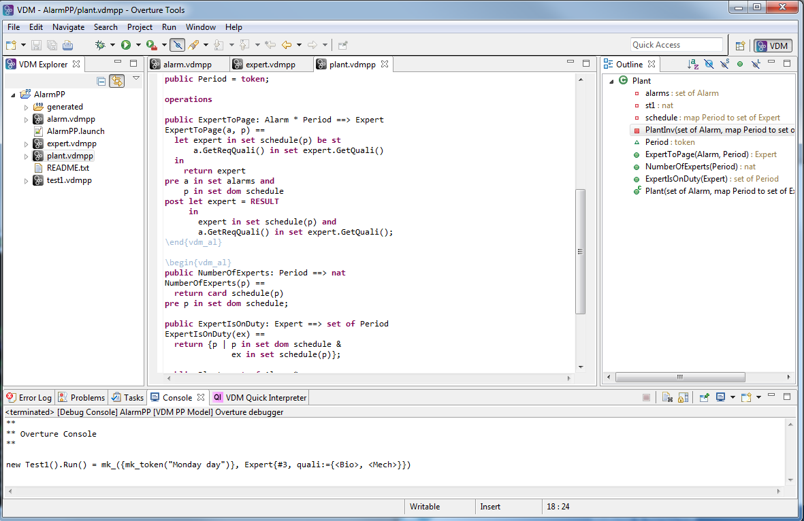
The Overture Tool
Open-source tool for analysing VDM models
Eclipse/Java based
Current stable version 2.5.4 (November 2017)
Visit us at http://overturetool.org/
Useful references
Examples can be imported
Language manual
Tool users manual
Install the FMI Exporter
Install the C code generator

Slide 30
Overview of the Tool Features (1)
Simulation of VDM models
Debugging
Combining VDM with executable code
Model validation
Static analysis (e.g. type-checking)
Unit testing
Adding visualisation to a VDM model
System-level timing constraints (VDM-RT trace viewer)
Realising a VDM model
Generate Java, C from subsets of VDM dialects
Notes:
Debugging is a methodical process of finding and reducing the number of bugs
- Debugging allows the user to execute the model step by step and inspect the state of the model as it gradually being executed

Slide 31
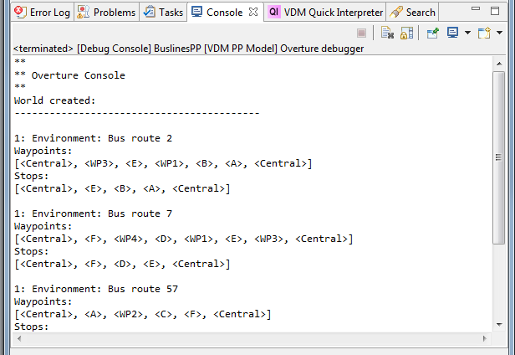
Overview of the Tool Features (2)
VDM standard libraries
IO: For file and console input/output
CSV: For working with CSV-based data
MATH: Provides commonly used math functions
VDMUnit: A unit testing framework for VDM
VDMUtil: For converting between VDM values

Slide 32
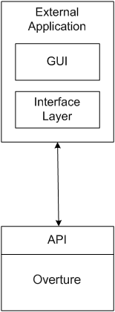
Combining VDM with Executable Code
Two types of external interfacing
External Call Interface
From the VDM model to an external interface
Remote Control Interface
Allows for external calls into a VDM Model
Used to implement the VDM libraries
public static sqrt: real -> real
sqrt(a) ==
is not yet specified
pre a >= 0;

Slide 33
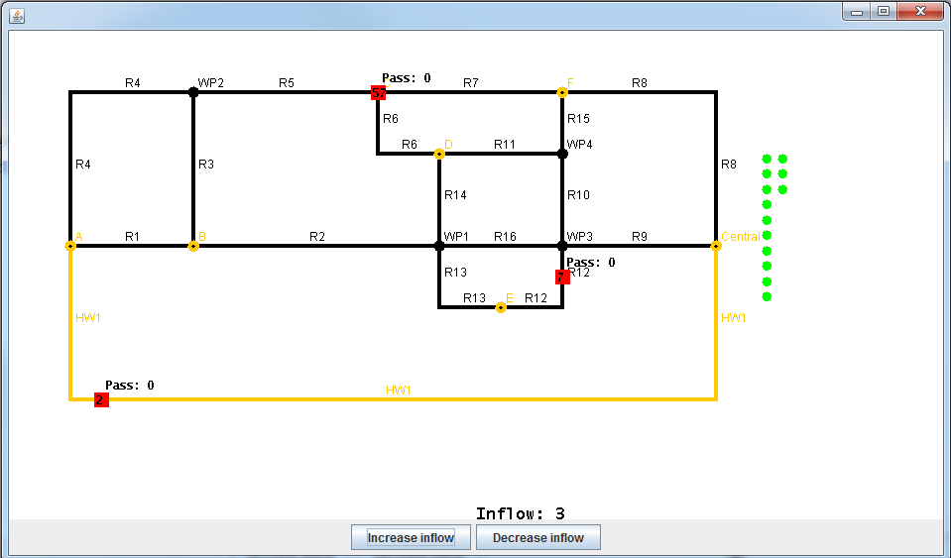
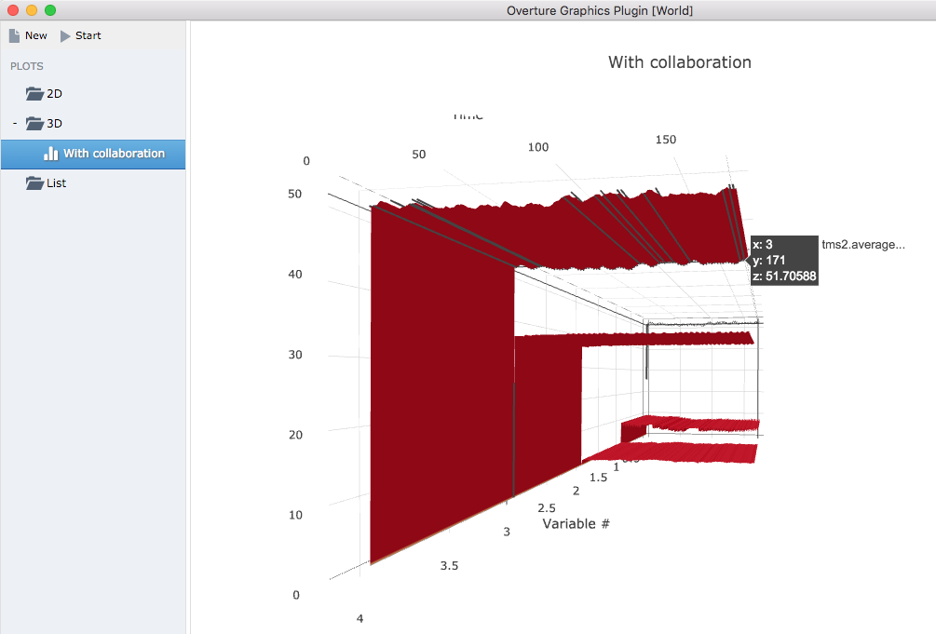
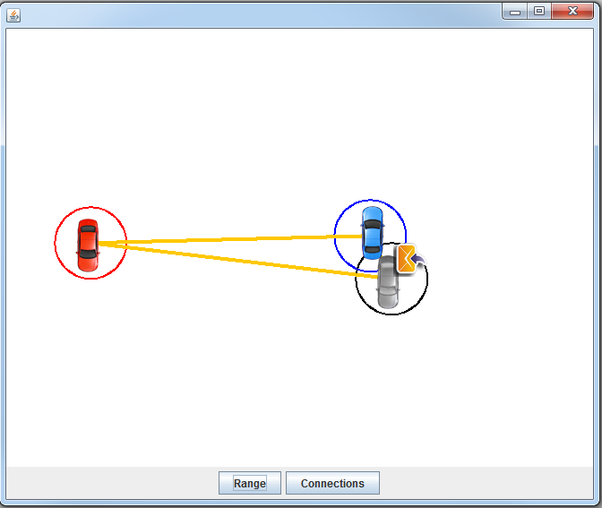
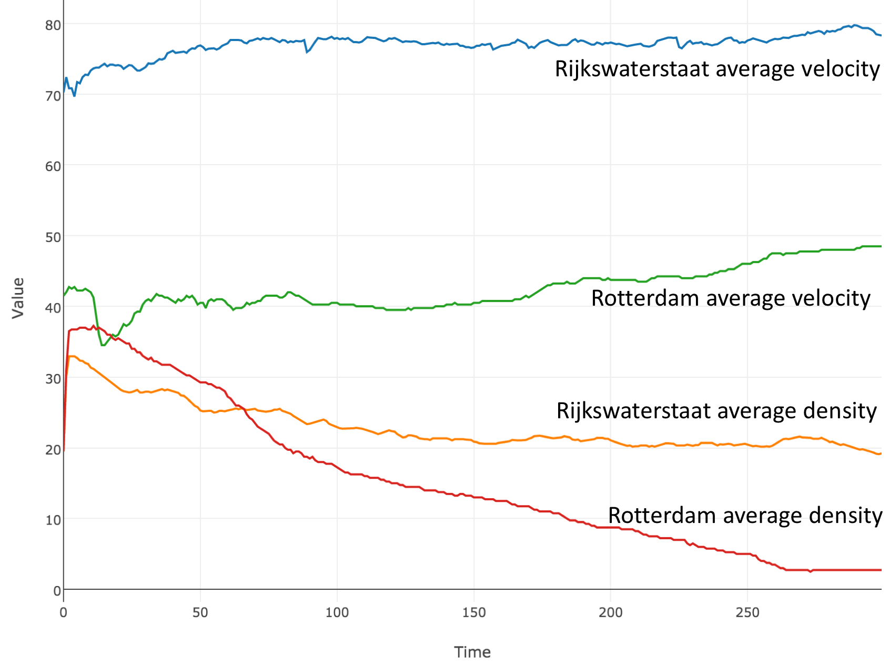
Visualising a VDM model
Understanding a formal model can itself be difficult
Especially for a non-technical stakeholder
Validating a model with a domain expert

Slide 34
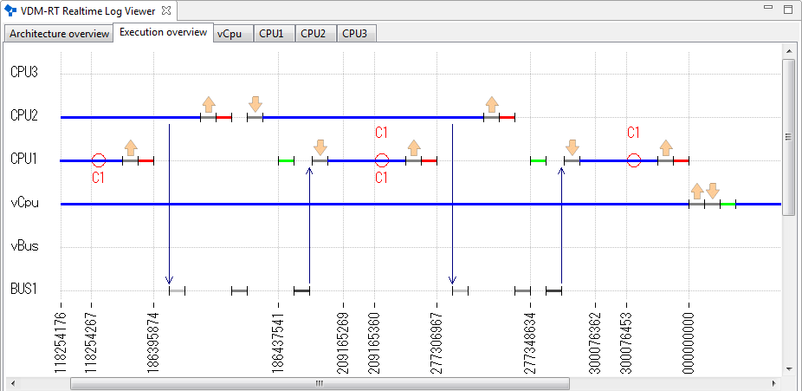
VDM-RT trace viewer
VDM-RT models a distributed architecture
CPUs are connected via buses
Objects are deployed on CPUs
A trace records the VDM-RT model execution
Message exchange between objects
Validation of system-level timing constraints

Slide 35
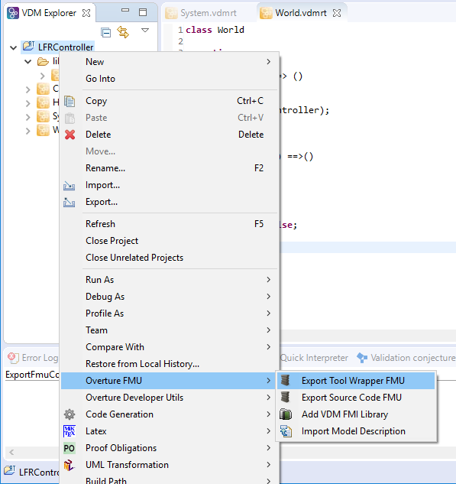
Functional Mockup Units (FMUs)
Import model description to make skeleton model
Creates system class
Creates World class
Creates HardwareInterface class
Export to FMU
Tool wrapper
Source code (in C)

