Slide 1

Token Taxonomy & Classification Framework
Log Token

Slide 2
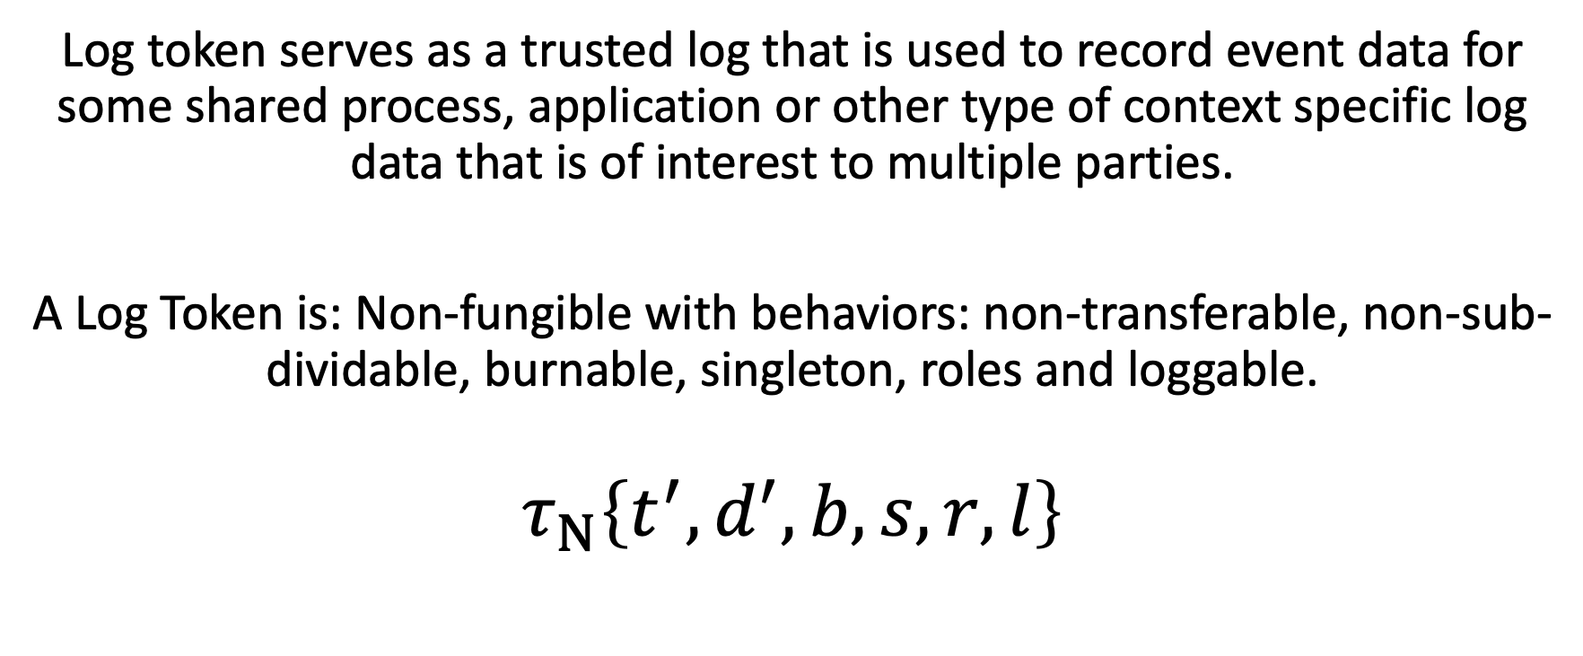
Log Token
Log token serves as a trusted log that is used to record event data for some shared process, application or other type of context specific log data that is of interest to multiple parties.
A Log Token is: Non-fungible with behaviors: non-transferable, non-sub-dividable, burnable, singleton, roles and loggable.
$$τ_{Ν}\left\{t^{′},d^{′},b,s,r,l\right\}$$

