Slide 1
Credit Risk Fundamentals
March 18, 2025

Slide 2
Table of contents
Section 1 – Introduction
Section 2 – Credit Risk Overview
Section 3 – Regulatory Capital and RWA
Section 4 – More on Credit Risk
Section 5 – Estimation of PD
Section 6 - Summary

Slide 3
Section 1
Introduction

Slide 4
Brainstorming
What do you know about credit risk?
What do you think are the following?
PD
EAD
ECL
LGD
DEFAULT
RWA

Slide 5
Section 2
Credit Risk Overview

Slide 6
What is credit risk?
Risk of a loss due to the failure of a counterparty to honour contractual obligations
It comes in different flavours:
Default risk
Downgrade risk
It is omnipresent in the portfolio of a typical financial institution
Related to core activities of most banks
Highly relevant to insurance companies
Its management involves a wide range of tasks
Determination of capital that should be held to absorb possible losses due to credit risk
Managing credit risk on institution’s balance sheet
Diversification of the portfolio of credit-risky instruments
Control of the counterparty credit risk (very important in the aftermath of the 2007-9 crisis)

Slide 7
Credit-risky instruments (1) – loans and bonds
Loans (retail, corporate, interbank, sovereign) and bonds (corporate bonds, treasuries, sovereign bonds, convertible bonds) are the simplest credit-risky instruments
Sum of money (principal) advanced to borrower for a particular term in exchange for a series of defined interest payments.
Loans:
Private agreements between the borrower and lender
Secured / unsecured
Bonds:
Publicly traded securities issued by companies and governments
Exposure is the value of the outstanding principal and interest payments

Slide 8
Credit-risky instruments (2) - derivatives
OTC derivatives:
Over the counter (OTC) derivatives make a significant portion of all derivative transactions
OTC is a contract between two parties, there is no central clearing counterparty (organized exchange) hence such derivatives are subject to counterparty credit risk.
The size of counterparty credit exposure is not known a priori (e.g. interest-rate swap between A and B)
Risk-mitigation techniques such as netting and collateralization are used.
Credit Default Swaps (CDS):
Securities used for hedging and trading of credit risk.
Promised pay-off in case of a default event.
Proteciton againg losses or speculative motives – often more liquid than bond markets.

Slide 9
PD, LGD, and EAD
Key inputs to the Basel formula:
EAD = exposure at default
Outstanding amount the borrower (obligor) has yet to repay to the lender at the time of default.
PD = probability of default
Probability that the borrower will default over a given time horizon.
LGD = loss given default
Percentage loss the lender suffers given the default of a borrower.
ECL = expected credit loss
Any possible problems with this formula?
ECL = PD · LGD · EAD

Slide 10
Section 3
Regulatory Capital and RWA

Slide 11
Regulatory framework
Why a need for global capital requrements / regulations?
1980s: fast increase of derivative trading + banks competing globally
Regulations are introduced:
To strengthen stability of international banking system.
To provide a level-playing field by use of uniform regulations.
Milestones:
1988: Basel I – introduction of minimum ratio of capital / RWA of 8%
2004: Basel II – establisment of the three-pillar system of regulation
2011: Basel III
increase of the required capital quality and amount,
ratios to ensure sufficient funding liquidity, etc

Slide 12
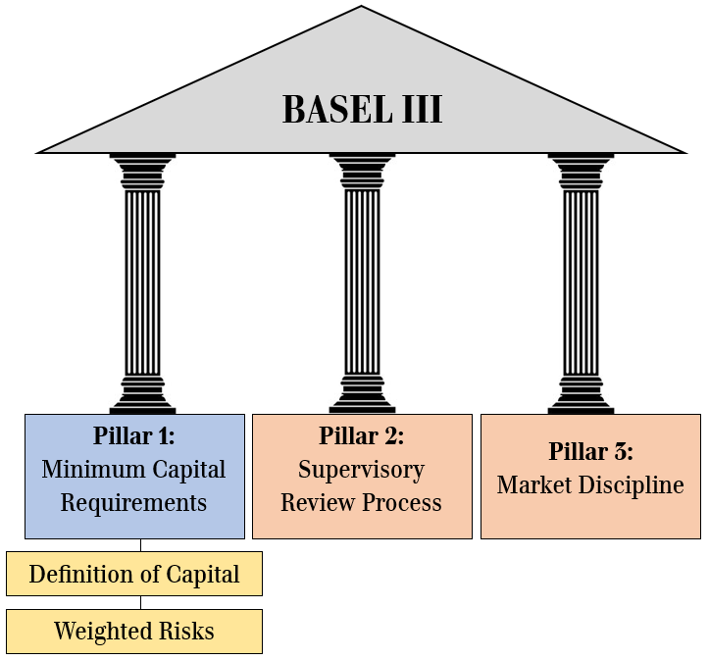
The Three Pillars of Basel III
Pillar 1: Minimal Capital Requirements
Banks need to have capital for covering losses.
Credit risk is one of the most important risks in banks’ balance sheets
Pillar 2: Supervisory Review Process
Regular self-assessment of risk profiles
Adequate risk management practices
Pillar 3: Market Discipline
Comprehensive set of disclosure requirements – banks need to disclose their risk management practices, capital adequacy, and other key financial information to the public

Slide 13
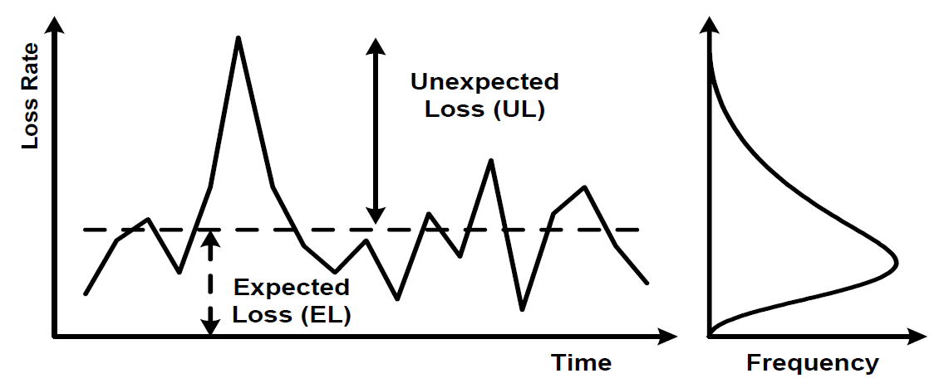
Expected and unexpected losses (1)
Credit business:
losses of interest/principal occur all the time
Losses vary year-to-year
Expected Losses (EL) = average level of credit losses within a one-year horizon
Unexpected Losses (UL) = losses above expected level (do not occur every year, can be severe)
Expected losses – forecasted by banks and covered through pricing of credit exposures and provisioning
Unexpected losses – need to be covered by banks’ capital => capital requirements

Slide 14
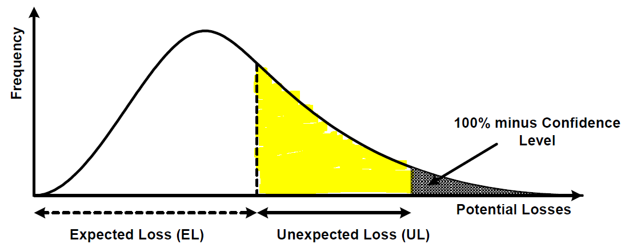
Expected and unexpected losses (2)
Likelihood of losses as a function of magnitude
Small losses (around and slightly below EL) more frequent than large losses
Unexpected losses should be covered by bank’s profits and capital (yellow area)
Likelihood that losses are kept within EL and UL is equal to 100% minus (assumed) confidence level
Likelihood that losses exceed EL and UL is equal to the (assumed) confidence level (grey area)

Slide 15
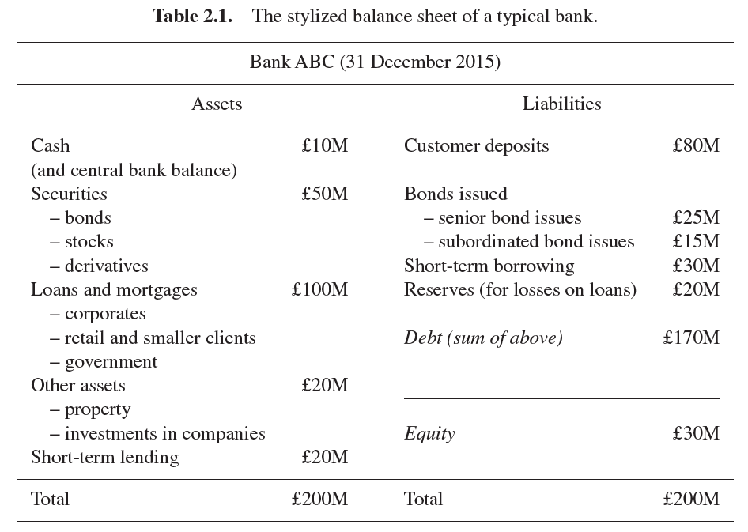
Capital requirements - example
Sample balance sheet of a bank (source: [1], sec. 2.1)
Bank needs to keep enough capital to cover unexpected losses – regulatory capital framework specifies the amount of capital necessary to continue operations

Slide 16
Definitions of capital and capital ratios
Basel Committee sets international standards to monitor banks’ capital adequacy
Capital types:
Tier 1 capital; further split
CET1 = Common Equity Tier 1: core capital (common shares, retained earnings)
AT1 = Additional Tier 1: financial instruments that can be converted into equity in crisis event
Tier 2 capital:
Financial instruments representing supplementary capital.
Three main capital ratios and minimum capital requirements
Supervisors can impose additional requirements on top of the minimum capital ratios

Slide 17
Section 4
More on Credit Risk

Slide 18
Credit risk – why bother?
The size and number of default events in a given year is unknown
However, we know that the size of such losses can increase in stress periods
Two main types of risk that affect portfolio:
Systematic risk = risk related to broad macroeconomic events, such as:
- COVID-19 crisis
- Global Financial Crisis (2007-2009)
- Oil Crisis (1973)
Idiosyncratic risk = risk related to specific features of the borrower; it includes
- Concentration risk
- Liquidity risk

Slide 19
Credit risk - examples
Default risk: the risk that the borrower is unable/unwilling to make payments
Result: loss of wither principal, interest payments, or both
Examples of obligors:
Company has borrowed money from a bank.
Company has issued bonds.
Household borrowed money from a bank to buy a house (a mortgage).
Bank has entered a billateral financial contract (e.g. an interest-rate swap) with a large corporation.
Examples of defaults:
Company goes bankrupt and is unable to repay the loan.
Company fails to pay a coupon for some of its issued bonds in the agreed time.
Household fails to pay amortisation or interests on their mortgage.
A large goes bankrupt and is unable to deliver on agreed interest-rate payments.

Slide 20
Credit risk – how to measure?
Standardised approach
Exposures classified into various vategories based on the counterparty or the underlying
Different Risk Weights (RWs) applied, depending on the category counterparties belong and their rating
Ratings provided by external credit-rating agencies
Internal Ratings-Based (IRB) approach
Introduced in Basel II framework for capiutal adequacy
Enables banks to use own internal models to estimate PD, EAD, and LGD for individual counterparties.
Enables banks to more accurately assess credit risk and allocate capital accordingly.
This approach is subject to regulatory oversight (certain minimum requirements have for data quality, model development, validation)

Slide 21
Credit risk – Standardised approach
Risk weights according to category and rating
Rating | Sovereign | Banks | Corporate | Retail | Real Estate
[AAA, AA-] | 0% | 20% | 20% | 75% | [35%, 100%]
[A+, A-] | 20% | 50% | 50%
[BBB+, BBB-] | 50% | 50% | 100%
[BB+, BB-] | 100% | 100% | 100%
[B+, B-] | 100% | 100% | 150%
[CCC+, CCC-] | 150% | 150% | 150%
No Rating | 100% | 50% | 100%

Slide 22
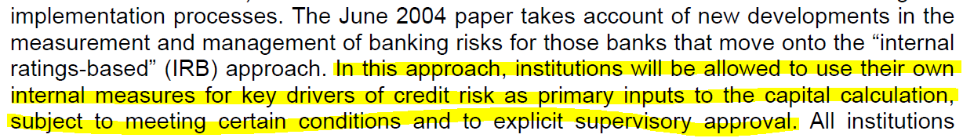
Credit risk – IRB approach
Basel I, 1988 – important step towards minimum capital standards but…
The appraoch was coars (three crude categories – governments / regulated banks / others).
Basel II, 2004 – banks are allowed to use internal-ratings-based (IRB) approach
Finer, more risk-sensitive appraoach to assessing risk of banks’ credit portfolios.
In particular, (source [3]):

Slide 23
Credit risk – Default probabilities
Probability of default:
The likelihood of a borrower or counterparty defaulting on its financial obligations over a specified period of time (e.g. one year)
Key input used in credit-risk models to estimate expected losses of a portfolio.
Used to calculate regulatory capital requirements under the Basel Accords.
How to calculate it?
Needed for the project.

Slide 24
Section 5
Estimation of PD

Slide 25
Models for PD estimation
Types of models for PD estimation:
Credit-scoring models:
Statistical analysis based on a set of economic and financial indicators (weighted)
Credit score is a numerical value representing the borrower’s likelihood of default (PD)
Capital-markets models:
Analysis of market data to compute borrower’s PD
Various types of models:
Structural models: Merton model, KMV model
Reduced-form models: Jarrow-Turnbull model
Credit Default Swap (CDS) models

Slide 26
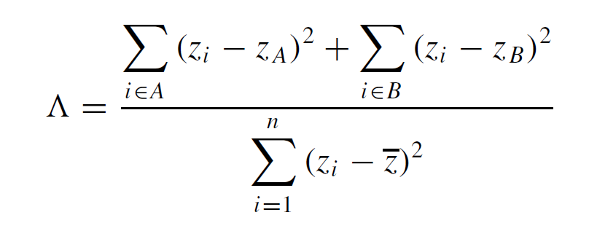
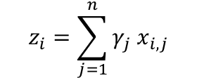
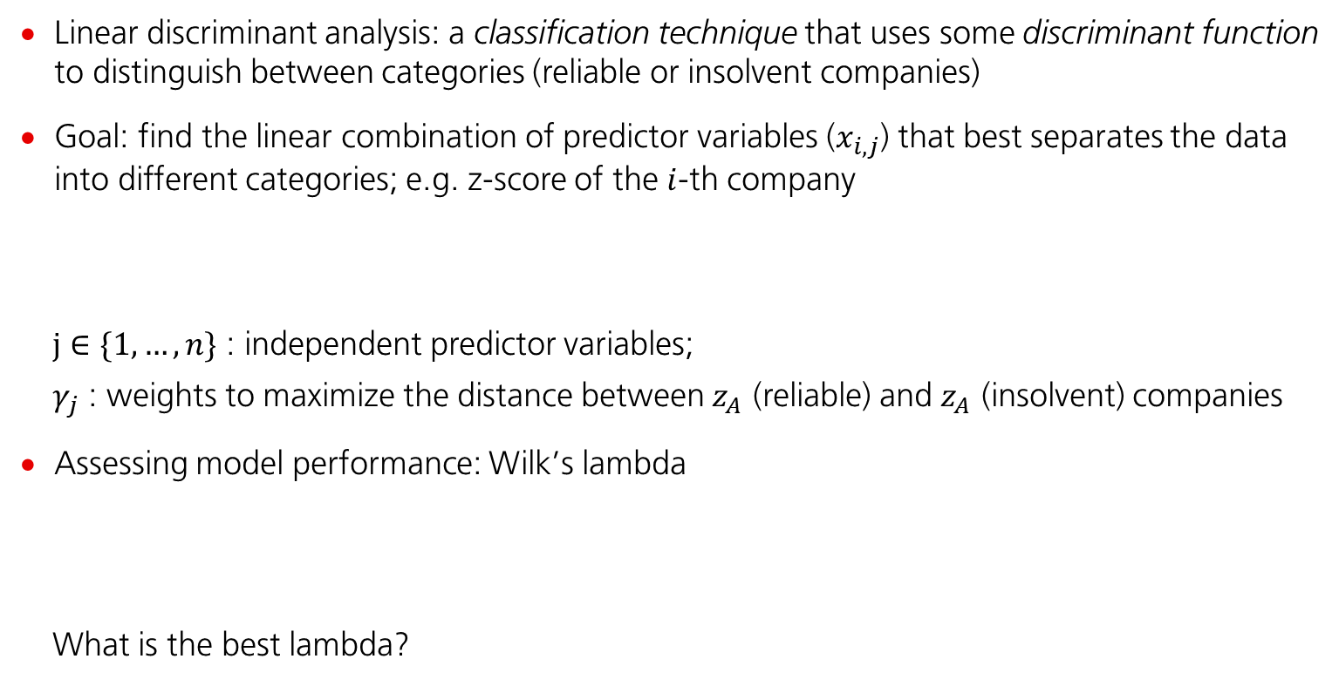
Credit Scoring – Linear Discriminant Analysis (1)
Linear discriminant analysis: a classification technique that uses some discriminant function to distinguish between categories (reliable or insolvent companies)
Goal: find the linear combination of predictor variables ($x_{i,j}$) that best separates the data into different categories; e.g. z-score of the $i$-th company
$j∈\{1, …,n\}$ : independent predictor variables;
$γ_{j}$ : weights to maximize the distance between $z_{A}$ (reliable) and $z_{A}$ (insolvent) companies
Assessing model performance: Wilk’s lambda
What is the best lambda?
$$z_{i}=\sum_{j=1}^{n}{γ_{j} x_{i,j}}$$

Slide 27
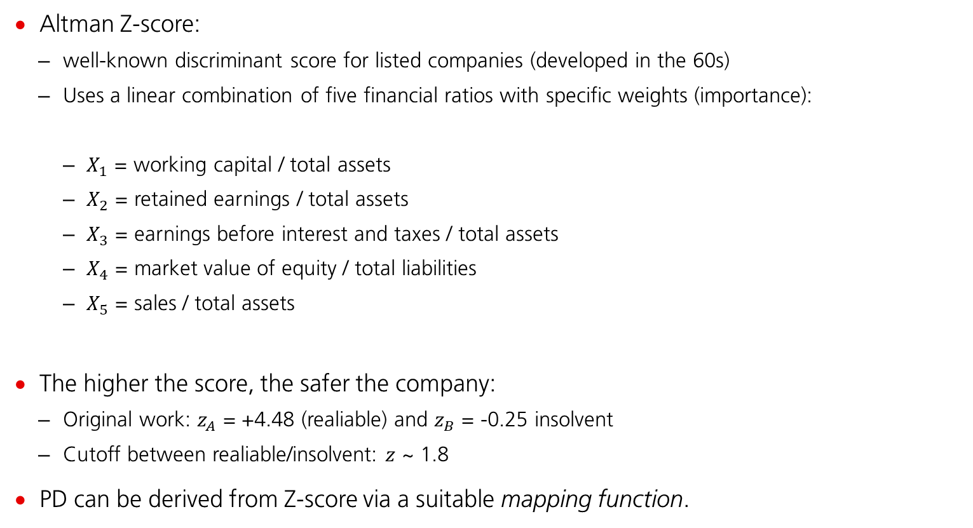
Credit Scoring – Linear Discriminant Analysis (2)
Altman Z-score:
well-known discriminant score for listed companies (developed in the 60s)
Uses a linear combination of five financial ratios with specific weights (importance):
$X_{1}$ = working capital / total assets
$X_{2}$ = retained earnings / total assets
$X_{3}$ = earnings before interest and taxes / total assets
$X_{4}$ = market value of equity / total liabilities
$X_{5}$ = sales / total assets
The higher the score, the safer the company:
Original work: $z_{A}$ = +4.48 (realiable) and $z_{B}$ = -0.25 insolvent
Cutoff between realiable/insolvent: $z$ ~ 1.8
PD can be derived from Z-score via a suitable mapping function.
$$Z=1.2 X_{1}+1.4{ X}_{2}+3.3{ X}_{3}+0.6{ X}_{4}+1.0 X_{5}$$

Slide 28

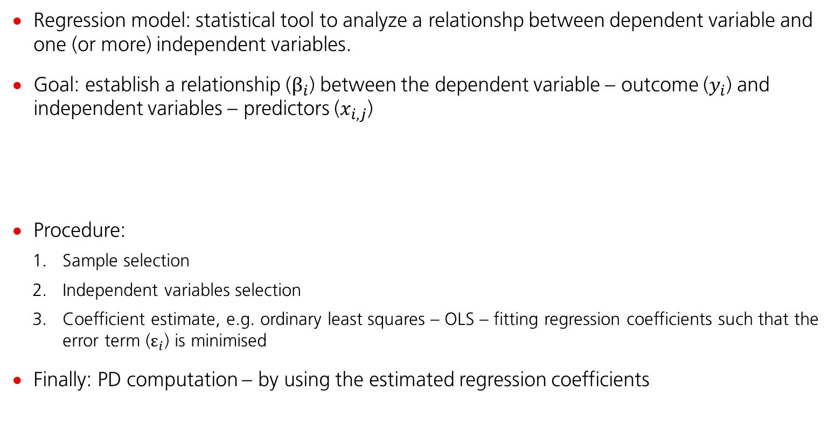
Credit Scoring – Regression Models (1)
Regression model: statistical tool to analyze a relationshp between dependent variable and one (or more) independent variables.
Goal: establish a relationship ($β_{i}$) between the dependent variable – outcome ($y_{i}$) and independent variables – predictors ($x_{i,j}$)
Procedure:
Sample selection
Independent variables selection
Coefficient estimate, e.g. ordinary least squares – OLS – fitting regression coefficients such that the error term ($ε_{i}$) is minimised
Finally: PD computation – by using the estimated regression coefficients
$$y_{i}=α+\sum_{j=1}^{n}{β_{j} x_{i,j}}+ε_{i}$$

Slide 29
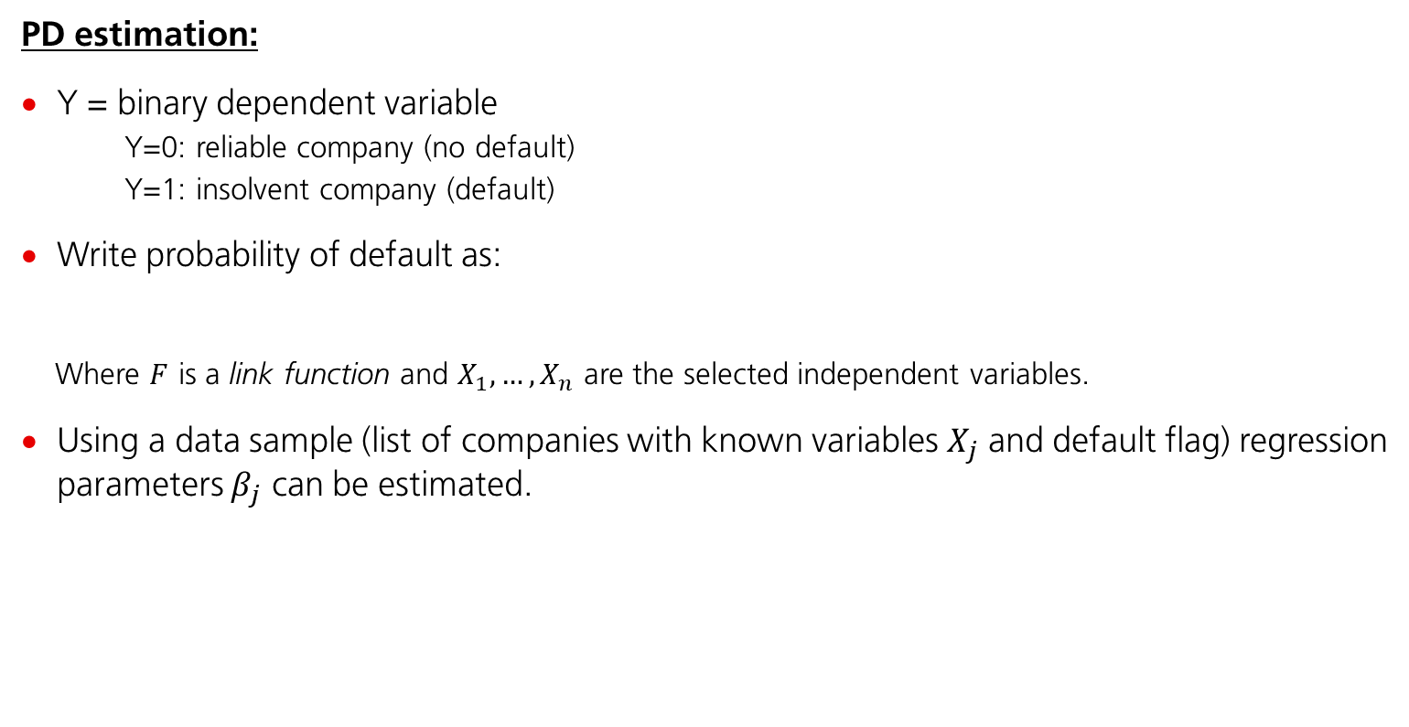
Credit Scoring – Regression Models (2)
PD estimation:
Y = binary dependent variable
Y=0: reliable company (no default)
Y=1: insolvent company (default)
Write probability of default as:
Where $F$ is a link function and $X_{1}, …,X_{n}$ are the selected independent variables.
Using a data sample (list of companies with known variables $X_{j}$ and default flag) regression parameters $β_{j}$ can be estimated.
$$P(Y=1|X)=F(β_{0}+β_{1}X_{1}+β_{2}X_{2}+…+β_{n}X_{n})$$

Slide 30
Credit Scoring – Regression Models (3)
Binary logistic regression major assumptions:
The dependent variable should be dichotomous.
e.g. presence vs. absence, default vs. alive
There should be no outliers in the data.
This can be assessed by converting the continous predictors to standardized scores and removing extremely high/extremely low values.
There should be no high correlations among the predictor variables.
This can be assessed by analysis of a correlation matrix among the predictors. It is suggested that as long as correlation coefficients among variables are less than 0.9 the assumption is met.
Note:
Based on a choice of link function, different regression models can be obtained.
For PD estimation the most common choices include probit or logit models.

Slide 31
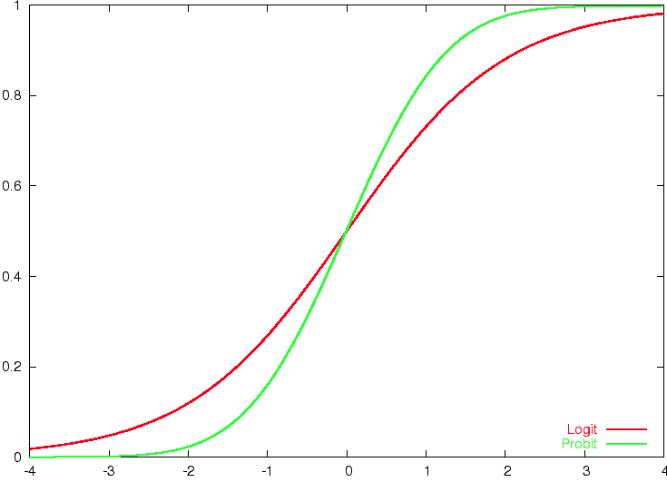

Credit Scoring – Regression Models (4)
Probit model: $F(x)=Φ(x)$, with $Φ$ being the CDF of standard normal distribution.
Logit model: $F(x)=1/(1+e^{x})$
Basic properties:
Logit has heavier tails
Probit is more centered
Which one is better?
Both will yield similar (but not identical) results. Details can differ for mode advanced setups.

Slide 32
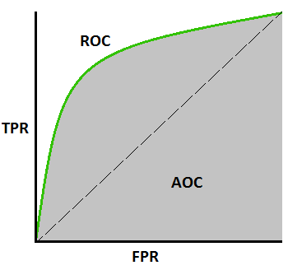
ROC – Receiver Operating Characteristic (1)
The ROC curve says how much the model is capable of distinguishing between classes.
Possible results:
TP = true positive (1 classified as 1); FP = false positive (0 classified as 1)
TN = true negative (0 classified as 0); FN = false negative (1 classified as 0)
Note: 1 = default; 0 = no default
Define: true positive rate and false positive rate
TPR = TP / (TP + FN) FPR = FP / (FP + TN)
Plot ROC curve: TPR vs. FPR
The higher the AUC (area under curve), the better predition power of a model.

Slide 33
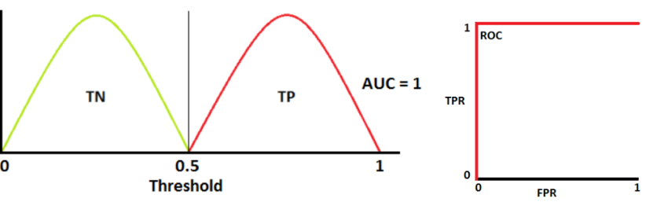
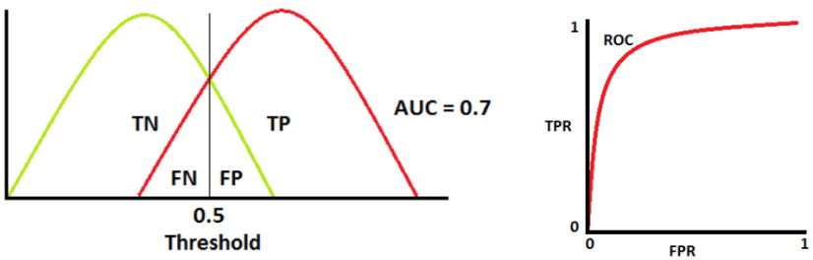
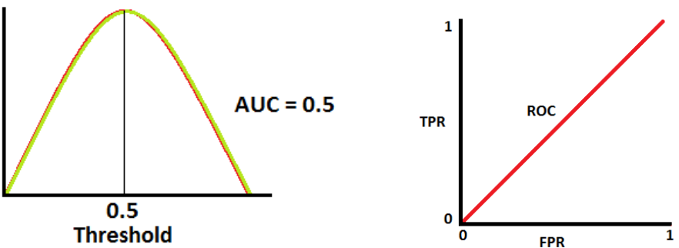
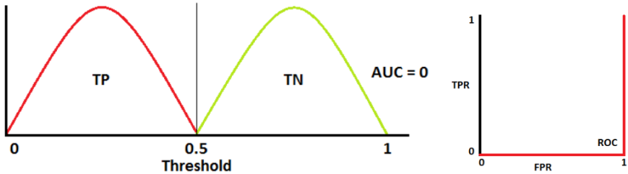
ROC – Receiver Operating Characteristic (2)
An ideal situation. When two curves do not overlap at all means model has an ideal measure of separability i.e., it perfectly distinguishes between 0s and 1s.
When two distributions overlap, we introduce type 1 and type 2 error. Depending upon the threshold, we can minimize or maximize them. AUC = 0.7 means there is a 70% chance that model will be able to distinguish between 1s and 0s.
This is the worst situation. When AUC is approximately 0.5, model has no discriminatory power to distinguish between 0s and 1s.
What does AUC = 0 mean?

Slide 34
Section 6
Summary

Slide 35
Summary
Credit risk is inherent to business for most financial institutions
Credit risk needs to be appropriately managed
International standards has been developed in order to
Strengthen stability of the financial system
Provide a level-playing field for all financial institutions
PD, LGD, EAD are key inputs for calculation of required capital
PD can be estimated in a numer of ways, we focused on statistical analysis of historical data with various econometric and financial indicators
Once a PD model is chosen and calibrated, its predictive power should be tested

Slide 36
References
[1] Quantitative Risk Management, Alexander J. McNeil, Rudiger Frey, Paul Embrechts, 2015
[2] Risk Management and Financial Institutions, John C. Hull, 2018
[3] An Explanatory Note on the Basel II IRB Risk Weight Functions, BCBS, 2005

Slide 37
Thank You
Good luck!
Questions?

