Slide 1
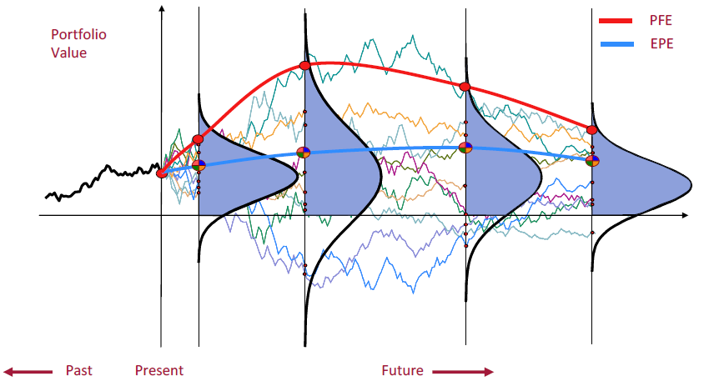
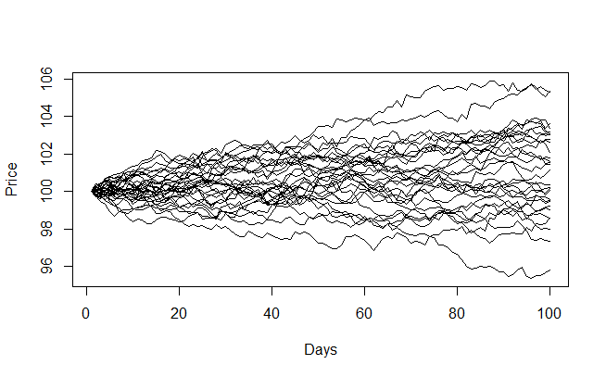
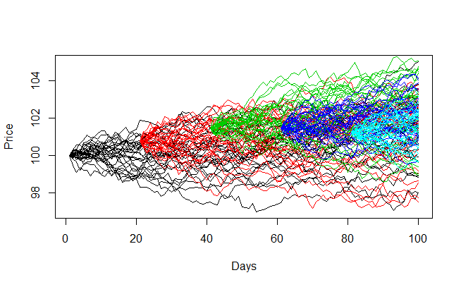
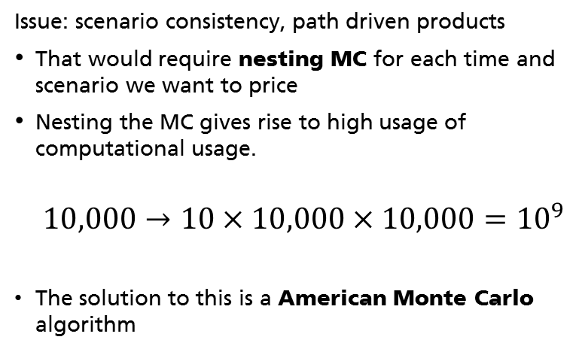
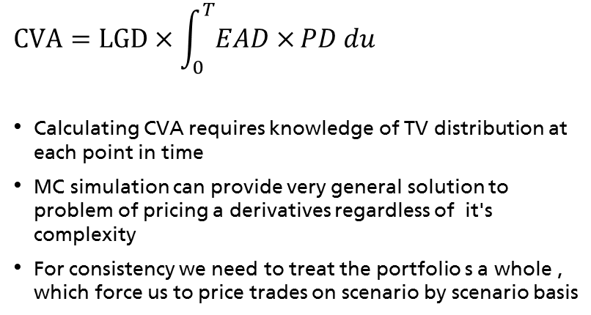
Motivation
Exposure At Default
$$CVA=LGD×\int_{0}^{T}{EAD×}PD du$$
Calculating CVA requires knowledge of TV distribution at each point in time
MC simulation can provide very general solution to problem of pricing a derivatives regardless of it's complexity
For consistency we need to treat the portfolio s a whole , which force us to price trades on scenario by scenario basis
Loss Given Default
Probability of Default
Issue: scenario consistency, path driven products
That would require nesting MC for each time and scenario we want to price
Nesting the MC gives rise to high usage of computational usage.
$$10,000→10×10,000×10,000={10}^{9}$$
The solution to this is a American Monte Carlo algorithm

Slide 2
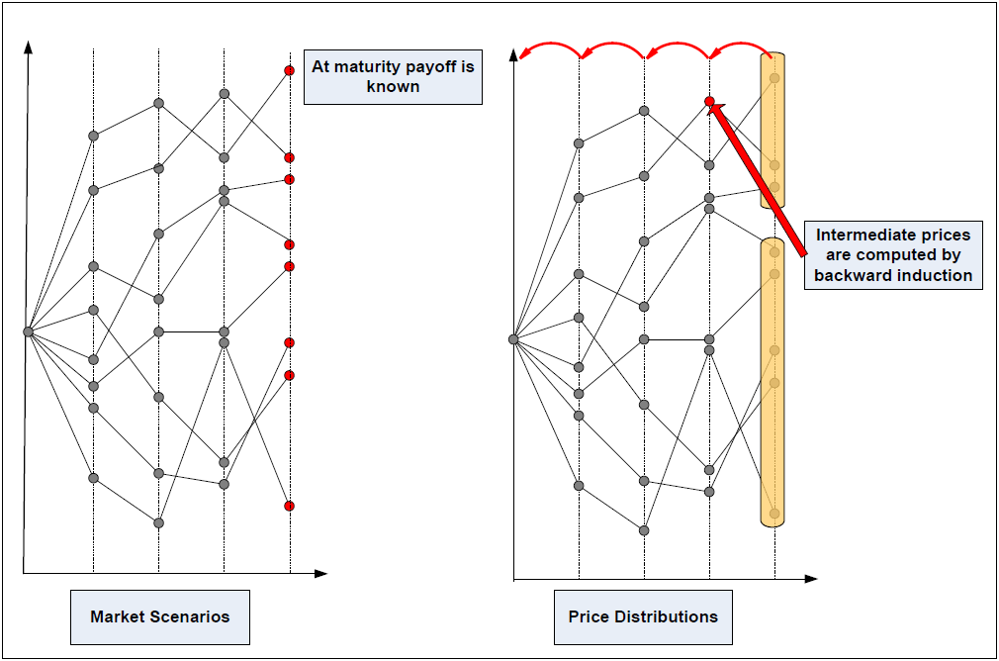
Origins
AMC originated as a solution to pricing callable derivatives, e.g. American Options.
Problem of finding the optimal exercise point
The Idea of Tsitsiklis and Van Roy is translate:
$$V=\sup_{τ∈T}{E[{\left(K−S_{τ}\right)}^{+}exp⁡(−\int_{0}^{τ}{r_{t}dt)]}}$$
𝑉=〖𝑠𝑢𝑝〗┬(𝜏∈𝑇)⁡〖𝐸[(𝐾−𝑆_𝜏 )^+ exp⁡(−∫_0^𝜏▒〖𝑟_𝑡 𝑑𝑡)]〗〗
$$V_{i−1}=\max_{}\{{h_{i−1}, E[D_{i−1,i}V_{i}}| F_{i−1} ]\}$$
𝑉_(𝑖−1)=〖〖𝑚𝑎𝑥〗┬ {〗⁡〖ℎ_(𝑖−1), 𝐸[𝐷_(𝑖−1,𝑖) 𝑉_𝑖 〗 | 𝐹_(𝑖−1) ]}
Exercise at maximal value
Make a decision to exercise or not at each step
Require knowledge of the trade value at next step
The price at maturity is known for each scenario
The distributions of future trade values provide us with the information on the current value.
If we start from single starting point it is trivial (MC)
At a given time 𝑡𝑖 we have multiple starting points: therefore the final distribution would be spread around the payoff function
Multiple mean of estimating a true payoff
E.g. Backward induction step driven by regression

Slide 3
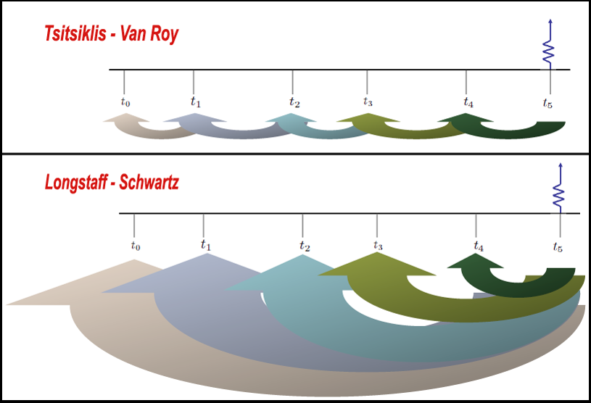
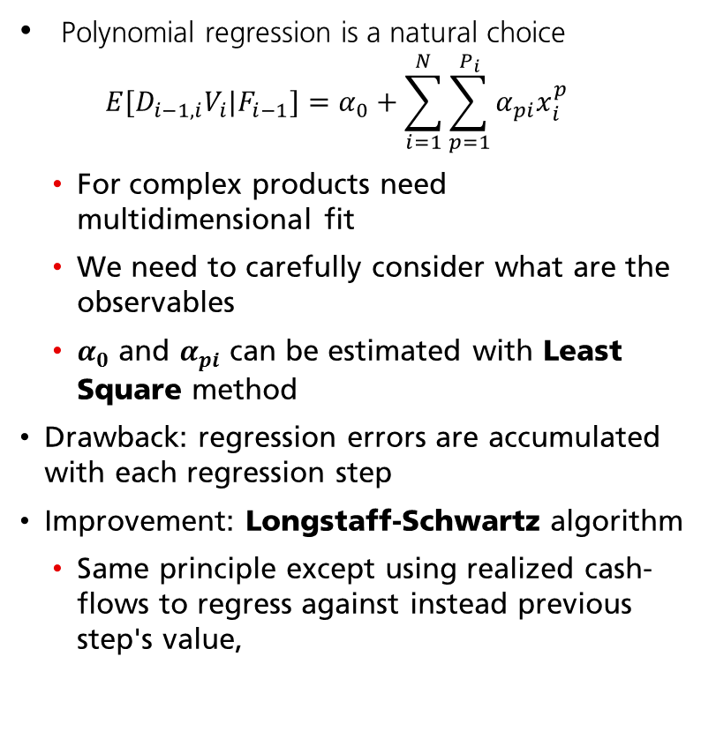
Regression and LS algorithm
Driven by the chosen observabkes
Polynomial regression is a natural choice
$$E[D_{i−1,i}V_{i}|F_{i−1}]=α_{0}+\sum_{i=1}^{N}{\sum_{p=1}^{P_{i}}{α_{pi}x_{i}^{p}}}$$
For complex products need multidimensional fit
We need to carefully consider what are the observables
$α_{0}$ and $α_{pi}$ can be estimated with Least Square method
Drawback: regression errors are accumulated with each regression step
Improvement: Longstaff-Schwartz algorithm
Same principle except using realized cash-flows to regress against instead previous step's value,

Slide 4
Summary
Summary
With various modifications and improvements
Algorithm is quite robust.
Mind the usual limitations:
Selected number of paths might not be enough in some cases
The out of the money products might generate a lot of numerical noise
TODO:
Implement the algorithm for simple IR swap.
To Read:
Tsitsiklis, Van Roy; Optimal stopping of markov processes; IEEE Transactions on Automatic Control, Vol44, 1999.
Longstaff, Schwartz; Valueing American Options in Simulations: A simple least-square aproach; The review of financial studies, Vol14, No1, 2001.
Tilley; Valuing American Options in a Path Simulation Process; Transaction of Society of Actuaries, Vol 45,1993.
Algorithm is widely used in the industry.

