Slide 1

CASE STUDY - 2
Data Preparation & Exploratory Analysis of Insurance Customer Data
Name: P Hemant Deo
Institution: Jain University Course: MCA

Slide 2
Introduction
The objective of this case study is to analyze and prepare insurance customer data for effective decision-making by focusing on data quality assessment, transformation, exploratory data analysis (EDA), and predictive modeling. The final report summarizes key findings and provides actionable insights for an insurance company. Since no predefined dataset was provided, a Kaggle dataset that aligns with the scenario was used. This dataset includes demographic information, policy details, and claim records, with the assumption that it represents a real insurance company's customer base and contains relevant attributes for meaningful analysis. Data preparation plays a critical role in ensuring accurate analysis, as poor data quality can lead to incorrect business insights, ultimately impacting pricing strategies, risk assessment, and customer segmentation.
Kaggle Link

Slide 3
Dataset Overview & Assumption
Since no predefined dataset was provided, I used a Kaggle dataset matching the scenario. The dataset contains details about insurance customers, including demographic information, policy details, and claim records. Assumptions made:
The dataset is representative of an actual insurance company's customer base.
All attributes have relevance to real-world insurance data analysis.
Kaggle for the Dataset which was used: Link

Slide 4



Methodology: Data Cleaning & Transformation
The methodology involves a structured approach to ensure data quality and relevance for analysis. The process includes data quality assessment, data cleaning, and feature engineering. Each step is designed to refine the dataset, making it suitable for exploratory data analysis and predictive modeling.
Data Quality Assessment
Data Cleaning
Feature Engineering

Slide 5


Data Quality Assessment
The initial step involves a thorough examination of the dataset to identify potential issues. This includes identifying missing values, duplicate records, and inconsistent formats. Categorical variables are checked for standardization, and outliers in numerical columns like age and premium charges are detected.
Missing Values
Identified gaps in the dataset
Duplicate Records
Detected redundant entries
Inconsistent Formats
Standardized categorical variables

Slide 6
Feature Engineering
Feature engineering involves creating new features from existing ones to enhance the dataset's analytical value. This includes extracting tenure (years since joining) from Date_Joined, creating new age categories (young, middle-aged, senior), and aggregating policy claims to provide an overview of customer behavior.
Tenure Extraction
years since joining
Age Categories
Young, middle-aged, senior
Policy Claims Aggregation
Overview of customer behavior

Slide 7
Exploratory Data Analysis (EDA)
EDA involves using descriptive statistics and visualizations to understand the dataset's characteristics. This includes providing an overview of numerical and categorical distributions and identifying trends in claim counts and policy types. Key visualizations include boxplots to detect outliers, histograms for age and tenure distribution, and heatmaps to analyze feature correlations.
Descriptive Statistics
Overview of Distributions
Key Visualizations
Boxplots, histograms, heatmaps
Business Implications
Identified regions with high claims

Slide 8
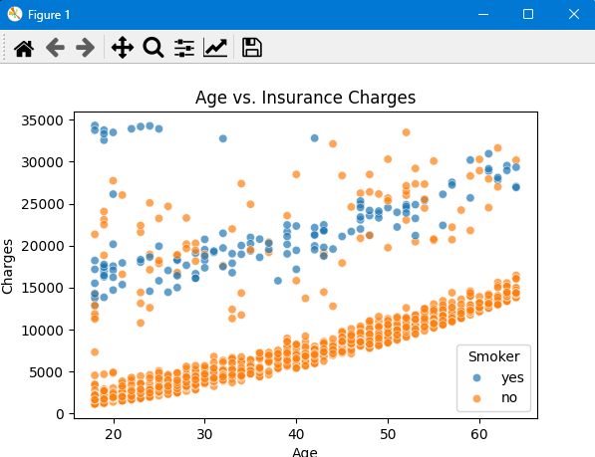
Key Visualizations & Insights
The EDA process yields several key visualizations that provide valuable insights. Scatter plots help visualize the relationship between age, BMI, and insurance charges. Box plots compare the distribution of charges between smokers and non-smokers. Histograms show the distribution of age, BMI, and charges. Heatmaps identify relationships between numerical variables.
Age vs Insurance Charges Graph
What it shows:
This scatter plot helps visualize the relationship between age and charges.
If older individuals tend to have higher insurance charges, we can infer that insurance costs rise with age.

Slide 9
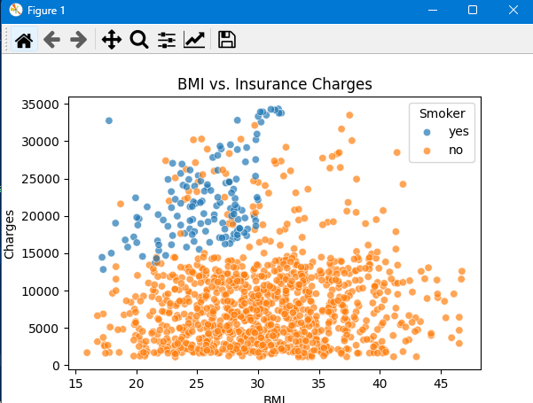
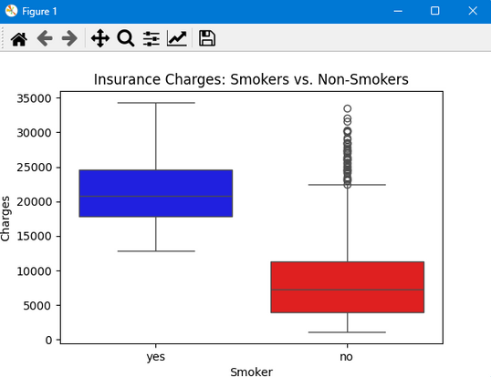
Key Visualizations & Insights conti..
BMI vs Insurance Charges
What it shows:
This graph illustrates the relationship between BMI (Body Mass Index) and charges.
A strong correlation could indicate that higher BMI individuals tend to have higher medical costs.
BMI vs Insurance Charges
What it shows:
A box plot allows us to compare the distribution of charges between smokers and non-smokers.
Smokers generally have higher insurance costs due to the increased health risks.

Slide 10
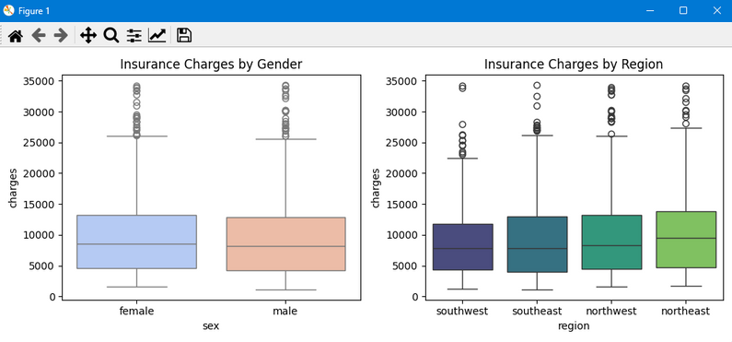
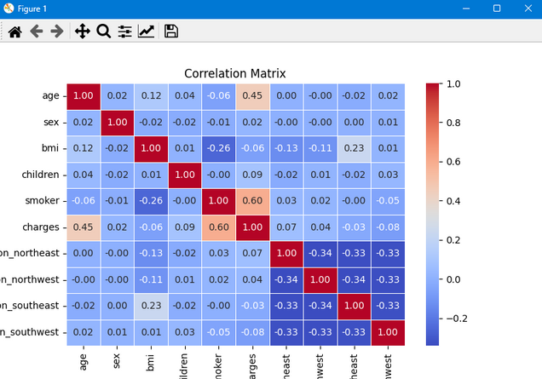
Key Visualizations & Insights conti..
Insurance Charges by Gender and by Region
What it shows:
Gender vs Charges: Whether men or women tend to pay higher insurance costs.
Region vs Charges: How medical costs vary across different geographic regions
Correlation Matrix
What it shows:
This matrix helps us identify relationships between numerical variables.
The correlation coefficient (from -1 to +1) tells us how strongly variables are related.

Slide 11
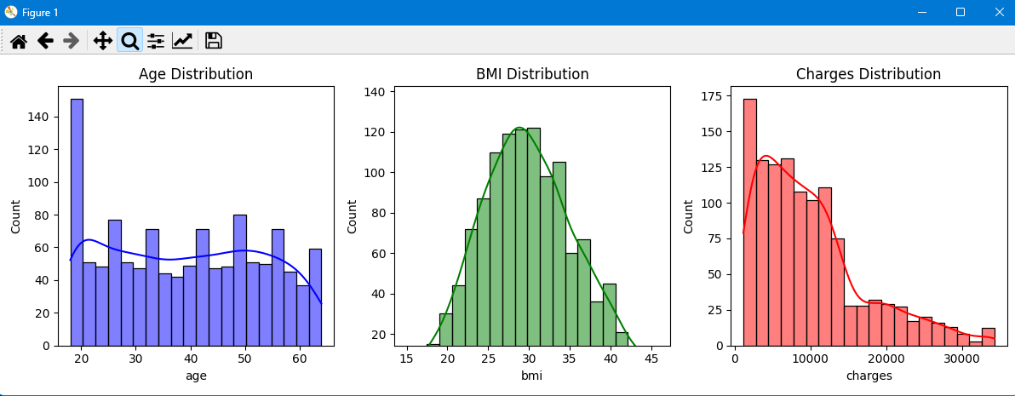
Key Visualizations & Insights conti..
Age Distribution, BMI Distribution and Charges Distribution
What it shows:
Age Distribution: Helps us understand the age demographics of the dataset.
BMI Distribution: Shows how BMI values are spread across individuals.
Charges Distribution: Highlights how insurance charges vary across different customers.

Slide 12

Predictive Modelling
Predictive modeling involves using statistical techniques to predict future outcomes. In this case study, Linear Regression is used to predict premium amounts. The data is split into training and testing sets (80-20 split), and the model is evaluated using MAE, RMSE, and R-squared scores. An R-squared value of 0.56 indicates moderate predictive power.
The model helps in setting premium prices and supports risk assessment by predicting high-claim customers.
Model Selection
Linear Regression
Model Performance
R-squared value of 0.56
Business Application
Setting premium prices

Slide 13



Conclusion
The exploratory data analysis of the insurance dataset has provided significant insights into the key factors influencing insurance charges. Age and BMI exhibit a clear relationship with medical costs, with older individuals and those with higher BMI generally facing higher insurance expenses. The impact of smoking on insurance charges is particularly evident.
Insurers can use this information to assess risk profiles more effectively, develop targeted policies, and encourage healthier habits among policyholders. Businesses in the insurance sector can leverage these findings to optimize pricing strategies and improve customer segmentation.
Smoking
Significant impact on insurance charges
Age & BMI
Clear relationship with medical costs.
Risk Assessment
Effective assessment of risk profiles

Slide 14
Thank you
For any queries or further discussions, feel free to reach out.
Email: hemantdeo.ranchi@gmail.com
Contact: +91 8340148266 GitHub Link for this case study: LINK

