Slide 1


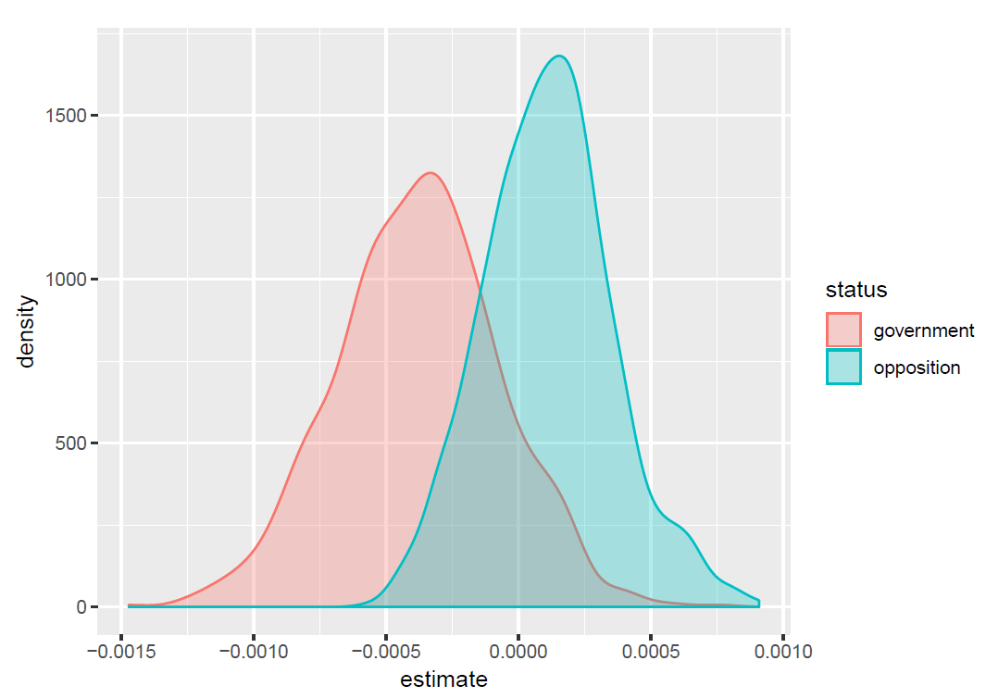
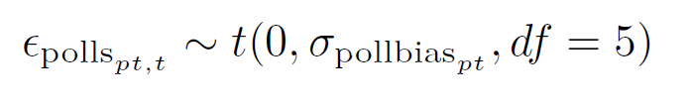
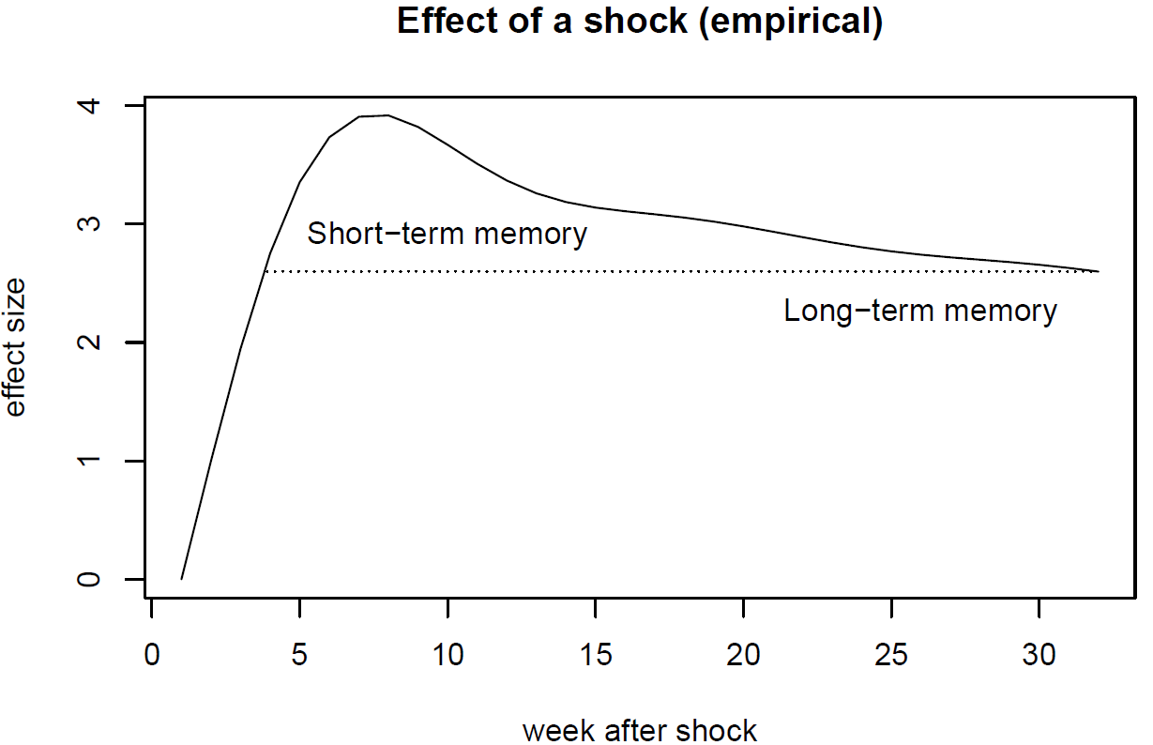
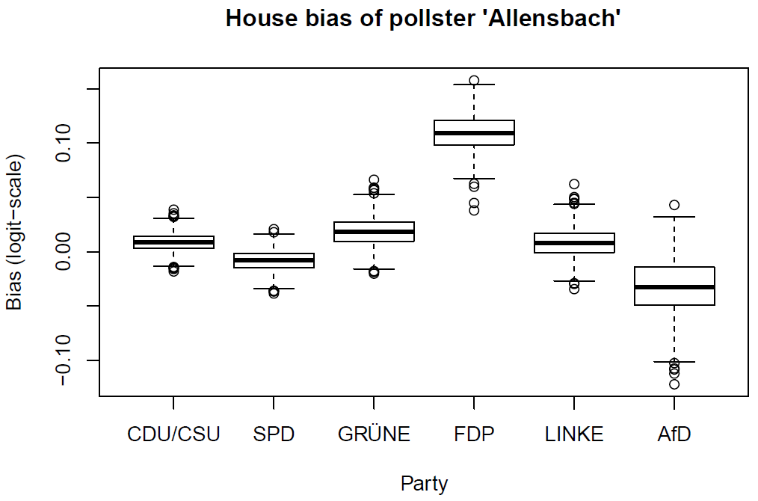
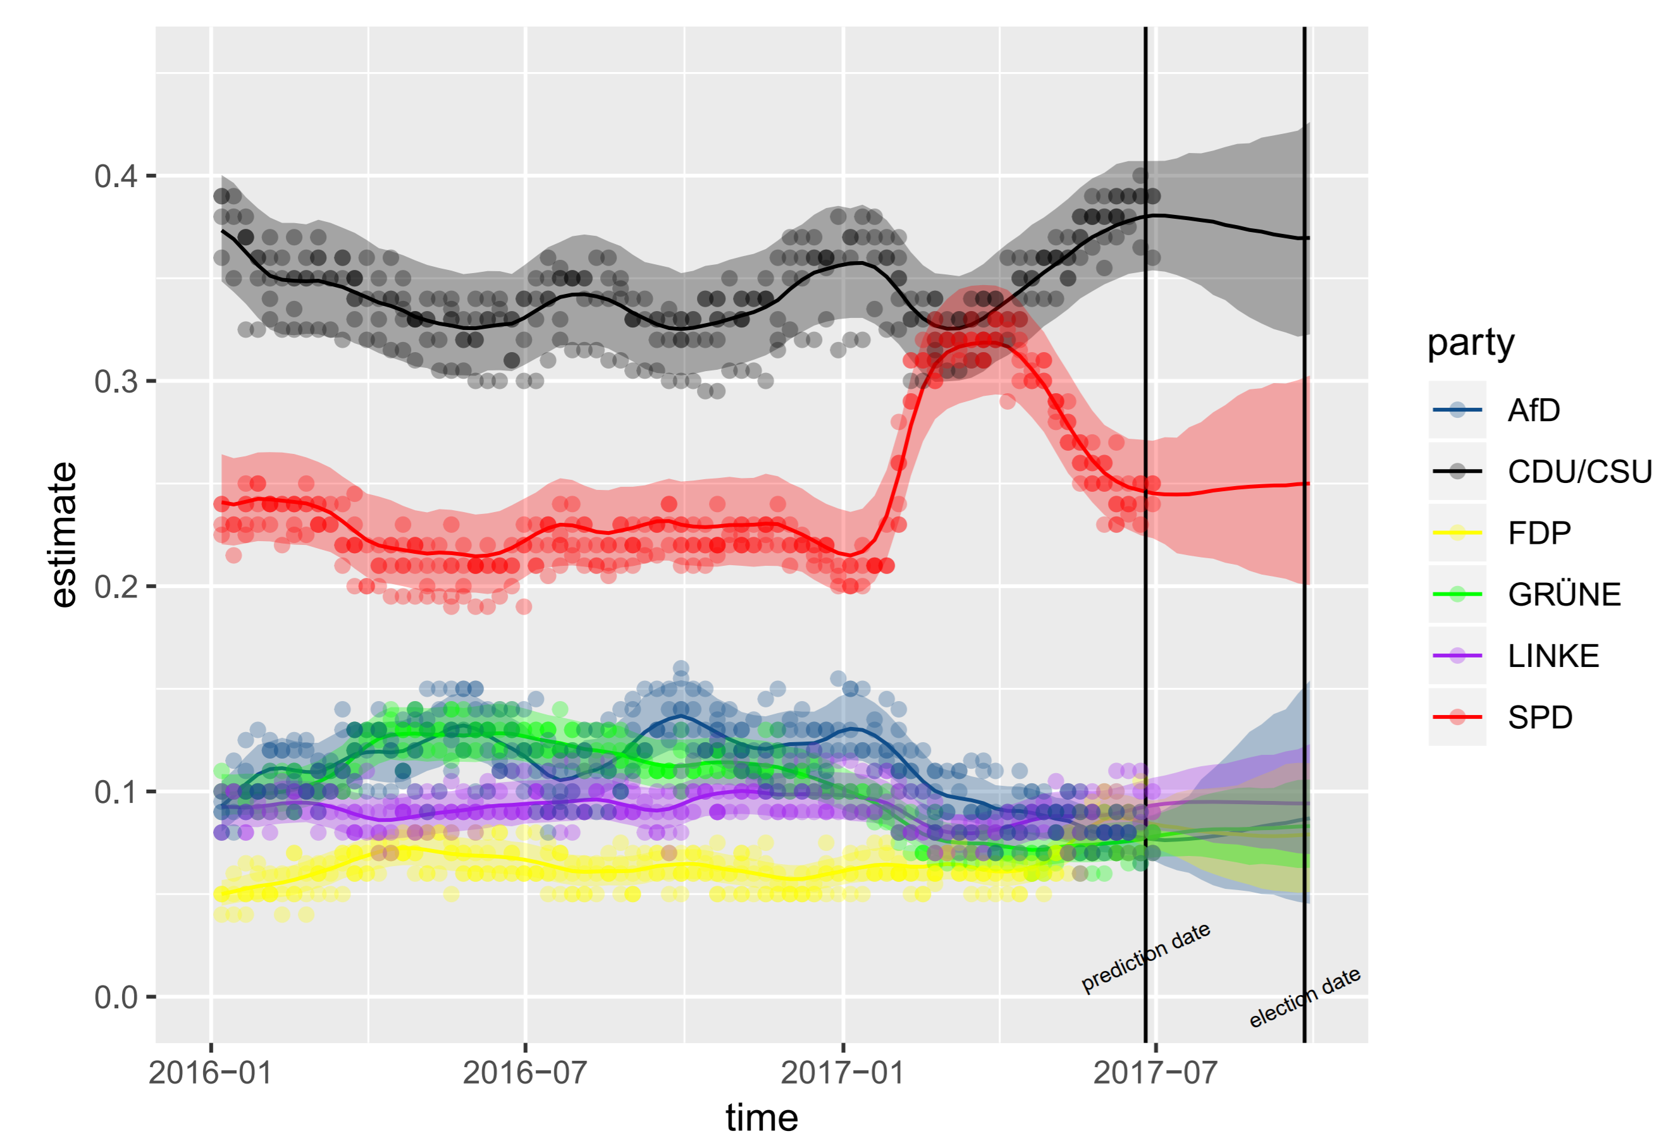
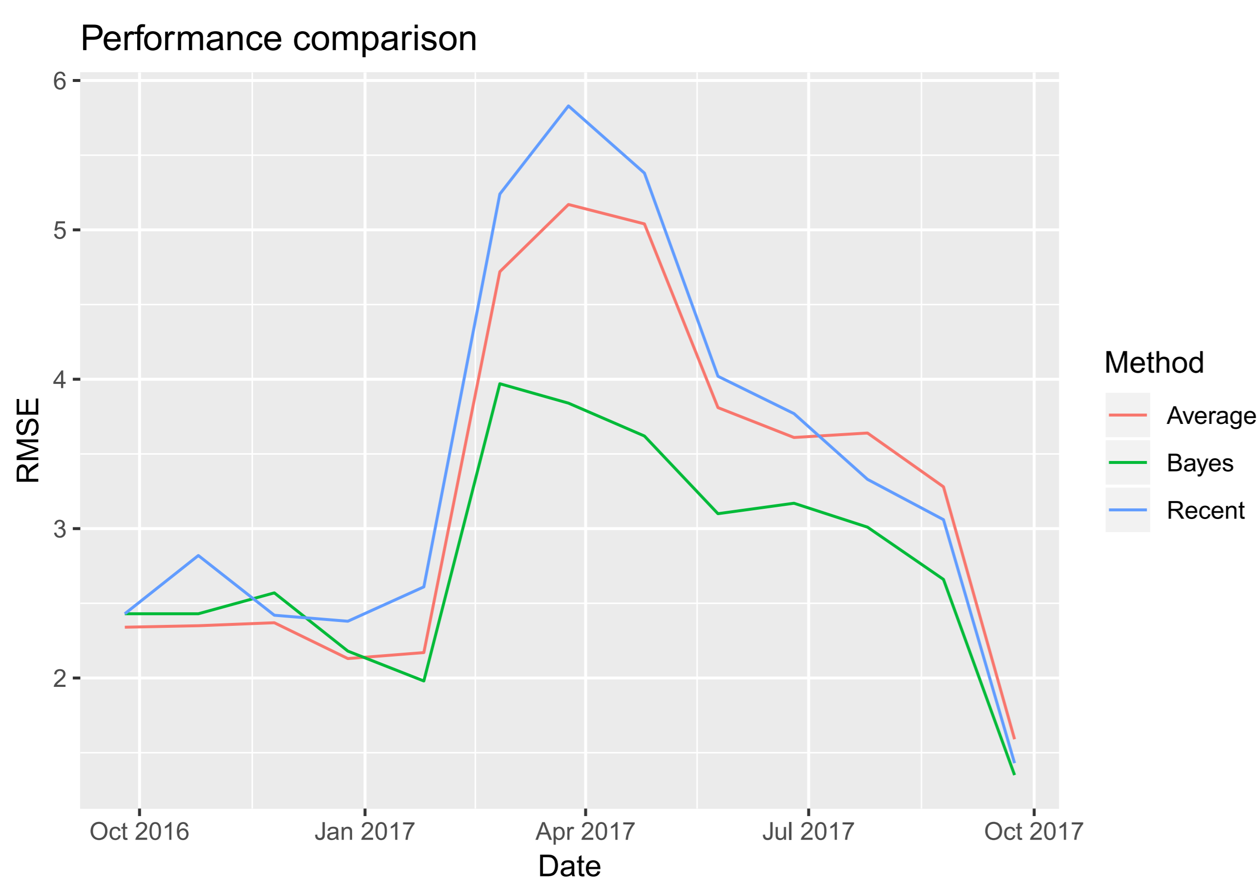
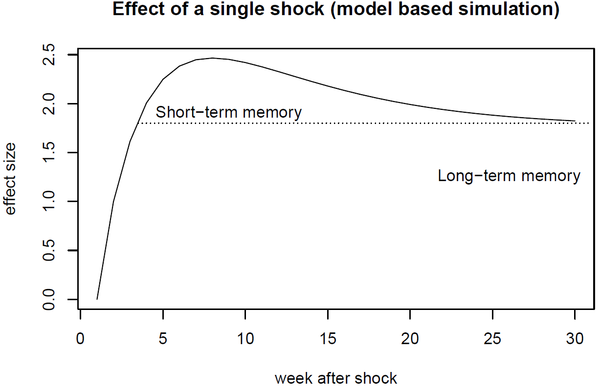


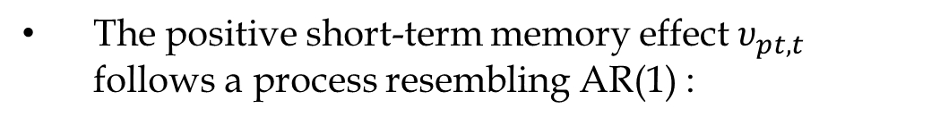

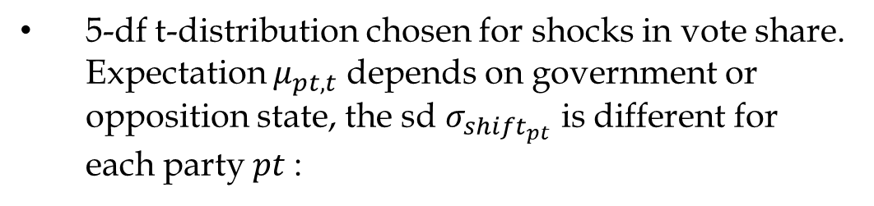
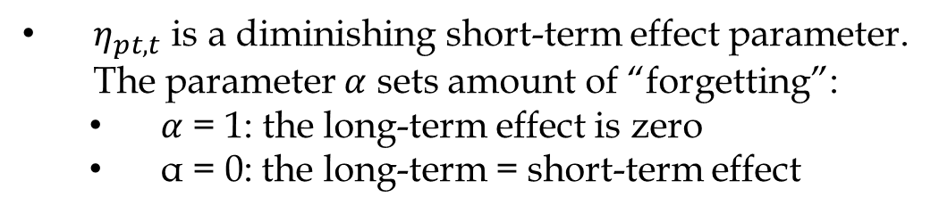
A long-short term event memory state-space model for multi-party elections with (R) tan
*
Marcus Groß
INWT Statistics GmbH, Berlin
Introduction
Common pollster bias follows AR1-process. Set to zero just after an election, as pollsters adjust for the bias afterwards:
State-space models are common choice for modelling voting intentions using poll data
Here: Go beyond random-walk approaches by introducing long-short term event memory effect
Vote shares tends to reverse to the party’s long-term trend after larger short-term movements
Empirical assessment by smoothing polls, calculating integrated acf’s on weekly differences:
Shifts in the common bias of the pollsters for a specific party follow a t-distribution with five degrees of freedom and a standard deviation $σ_{pollbias}$that is different for each party $pt:$
True vote shares $y_{pt,t}$ follow a random walk (with drift), but two additional terms $υ_{pt,t}$ and $η_{pt,t}$, modeling short and long-term memory effects:
Kernel density of government and opposition effect
5-df t-distribution chosen for shocks in vote share. Expectation $μ_{pt,t}$ depends on government or opposition state, the sd $σ_{{shift}_{pt}}$ is different for each party $pt$:
Empirical effect of single shock or event on vote share in time course
The positive short-term memory effect $υ_{pt,t}$ follows a process resembling AR(1) :
House bias estimates of „Allensbach“ pollster
Max effect around 7 to 8 weeks after initial shock - wears off in the following weeks.
Events influencing the vote share can be decomposed into:
A short-term effect due to e.g. media spreading
A smaller remaining long-term effect (new events, forgetfulness)
Government parties tend to lose voter share:
In 10/12 cases government parties lost vote share
In 15/20 cases opposition parties gained vote share
Sources of uncertainty in forecasting vote share:
Uncertainty about future events, i.e. shocks to vote share
Uncertainty in polling
Common bias of all pollsters for a specific party
House bias of a specific pollster for a specific party
Polling uncertainty of a specific pollster
Summary
$η_{pt,t}$ is a diminishing short-term effect parameter. The parameter $α$ sets amount of “forgetting”:
$α$ = 1: the long-term effect is zero
α = 0: the long-term = short-term effect
Model performance evaluation:
Fit model and forecast election each month for year prior to 2017 federal election
Two competitors:
Avg. of the most recent poll of the 7 pollsters
Most recent poll
In average, model outperforms poll average by 15% and by 20% compared to the most recent poll:
Results
Forecast three months prior 2017 election:
Data
> 4000 polls beweem 1994 and 2017 of German national elections (“Bundestagswahl”) , 7 pollsters (web-scraped) for 6 largest parties:
CDU/CSU (conservative, party of chancellor Angela Merkel)
SPD (social democratic party)
Die Grünen (green party)
FDP (liberal party)
Die Linke (left socialist party)
AfD (right populist party)
Election outcome data since 1998
Data on party status (government or opposition)
Solid lines: vote share estimates $y_{pt,t}$ + 95% credible bands, points: polls, vertical lines: date of prediction: 2017-06-25, election date (2017-09-24)
 | CDU | SPD | Grüne | Linke | FDP | AfD | RMSE
Bayes - Model | 36.96 | 25.01 | 8.31 | 9.42 | 7.91 | 8.69 | 3.17
ForschG | 39 | 25 | 8 | 9 | 8 | 7 | 4.02
Insa | 36,5 | 25 | 6,5 | 11 | 9 | 9 | 3.11
EMNID | 39 | 24 | 8 | 9 | 7 | 8 | 3.77
GMS | 39 | 23 | 7 | 11 | 9 | 8 | 3.52
Infra | 39 | 24 | 7 | 8 | 9 | 8 | 3.62
Forsa | 39 | 23 | 8 | 10 | 8 | 7 | 3.73
Allensbach | 40 | 24 | 7 | 8.5 | 10.5 | 6.5 | 4.16
Election Result | 32.9 | 20.5 | 8.9 | 9.2 | 10.7 | 12.6 | 0
Root Mean Square Error (RMSE) in monthly intervals for the proposed model (green), the average of the most recent polls (red) and the most recent poll (blue) for the year prior the 2017 german federal election.
Comparison of model forecast with most recent polls of pollsters and election result (in %)
Even unfair hindsight competitors (using best pollster for this particular election and best pollster for each prediction date) worse or on par with proposed model
Similar results for 2013 election
Troubleshooting and outlook
The model iterations exceed maximum tree size, for tree_depth < 18 (but results are o.k. for tree_depth larger than 15) ► very slow computation (ca. one week)
Usage of map_rect should speed up comptutation
Extension of model by multivariate t-distributions for both vote share shocks $ε_{pt,t}$ and common poll bias ${ε_{{polls}_{pt,t}}}_{}$
Introduction of mid-term effect seems to improve for modelling forgetting of events
Model predicts a mean-reversing trend for CDU/CSU (black) and AfD (blue), i.e. decrease/increase in vote share until election
AfD forecasts: much larger credible intervals compared to the other three smaller parties on election day (party founded some years ago, less stable)
Simulation of single shock effect with model parameters:
Very similar to empirical results!
Model
Features:
long- and short-term memory structure - mixture of a random walk and two contrasting AR-type processes
party status (government or opposition)
different sources of uncertainty (potential future events, common pollster error, pollster-party-house bias, polling uncertainty)
heavy-tail errors
correlations between errors (optional)
$y_{pt,t}$: true vote share for specific party,$pt$ time point $t$, if an election would be held (indexed on weekly basis).
No direct measure of vote share except on election days ► use of polling data ${poll}_{pt, t,pll}$ for party $pt$, time point $t$ and pollster $pll$
Logit scale to guarantee forecasts in (0,1) interval and variance regulation
Simulated effect of single shock or event on vote share in time course
* Stan-Code, examples and more on Github: https://github.com/INWTlab/lsTerm-election-forecast

