Slide 1
QASWA ERP
Product & Feature Presentation
The complete operating platform for finance, procurement, people, projects, service delivery and intelligent automation.
Prepared for: leadership, finance and investment reviewers | October 2026 | Commercial in confidence

Slide 2
Today's agenda
How this deck is organised
▸ 1 Why QASWA ERP — control, speed and evidence
▸ 2 The platform at a glance — 58 modules, one database
▸ 3 Finance — ledger, banking, receivables, payables, tax, budgets, close
▸ 4 Procurement — requisition to payment with three-way matching
▸ 5 Inventory, projects, service desk and people
▸ 6 Consolidation, security, AI and analytics
▸ 7 Implementation, return and next steps

Slide 3
The problem organisations are solving
Most run four to six products, none of which agree
▸ Month-end closed one to four weeks after the period because reconciling subledgers is manual.
▸ Duplicate supplier payments, owing to missing matching between order, receipt and bill.
▸ Leave, attendance and payroll living in separate files that never agree.
▸ No drill-through from a statement line to the document that originated it.
▸ Every report takes days because it is re-typed rather than drilled.

Slide 4
The platform at a glance
58 business modules on one controlled data model
58
modules
470+
data domains
12
header dashboards
30
named reports
▸ Single database, single login, single audit trail — no integration project between them.
▸ IBM Carbon design language: IBM Plex, flat blue, light and dark themes.
▸ Multi-company and multi-currency from the first day.

Slide 5
The numbers that matter to a board
58
modules
70%
less close time
99%
match accuracy
1
audit trail
0
licence per seat
24/7
automated posting

Slide 6
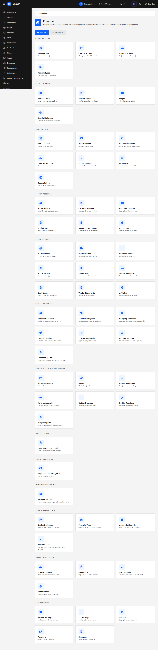
Finance — complete double-entry accounting
From the first journal to the signed-off statement
▸ Financial years and periods with open, closed and locked states.
▸ Chart of accounts with structure, accounts and posting rules.
▸ Five voucher types — the single controlled route into the ledger.
▸ Journal entry with balanced debits and credits, reversal instead of editing.
▸ General ledger with a running balance per account.
▸ GL journal audit and bank journal audit with statement-side detail.

Slide 7
Month-end and year-end close
A controlled event, not a project
▸ Reconciliation gate blocks close on any unreconciled subledger.
▸ Period control: no journal, invoice, bill, payroll, depreciation or even a reversal lands in a closed month.
▸ Closing checklist instantiated per period and per entity, with completion evidence.
▸ Adjustment journals with mandatory reversal dates.
▸ Year-end creates opening balances for the new year automatically.
▸ F13 group consolidation: validate, eliminate, translate, consolidate, approve.

Slide 8
Banking, budgets and tax
Cash, control and confidence
▸ Bank accounts, petty cash and inter-account transfers with opening balances.
▸ Bank reconciliation with an unmatched register and a clear / draft toggle.
▸ Budgets by department, account and period with versions, revisions and transfers.
▸ Encumbrance visible at posting; variance reporting to month end.
▸ Tax regimes: VAT, GST, sales and withholding, stacked in priority order.
▸ Tax register, accrual and output/input tax reconciliation.
▸ Live tax reports: summary, output, input, period and adjustments.

Slide 9
Procurement — need to approved payment in one chain
No orphan orders, no unbilled receipts
Requisition
Purchase order
Approval
Goods receipt
RFQ
Three-way match
Quotation
Bill
Award
Payment
▸ Approval matrix by company, department, priority and amount.
▸ RFQ deadlines, quotations compared with weighted criteria.
▸ Goods and service receipt with quantity, location and QC status.
▸ Three-way match on quantity and price with tolerance rules.
▸ Debit notes for returns and overcharging close the loop.

Slide 10
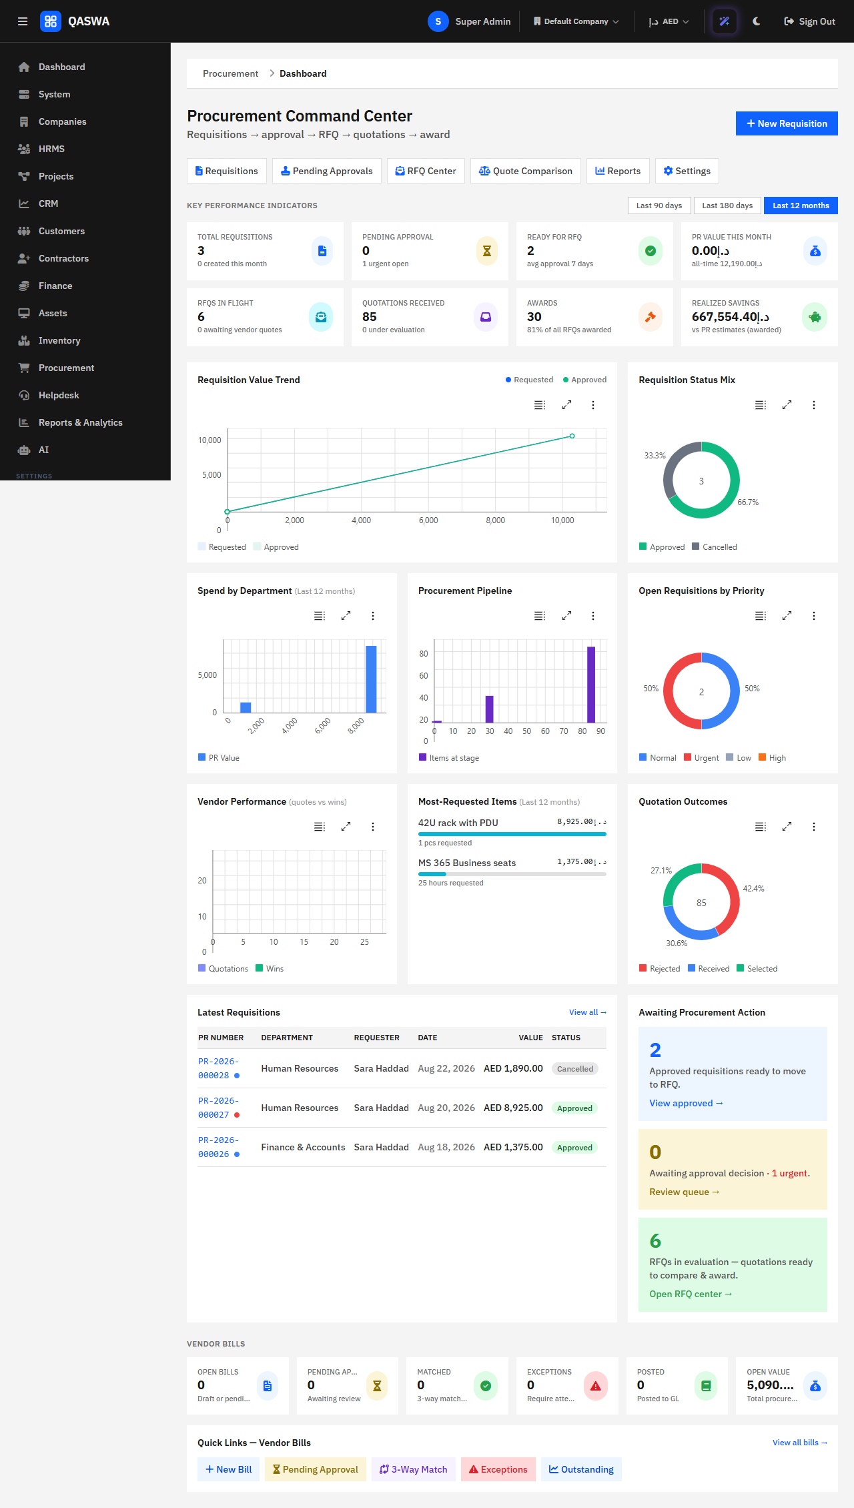
Procurement impact
What three-way matching stops

Slide 11
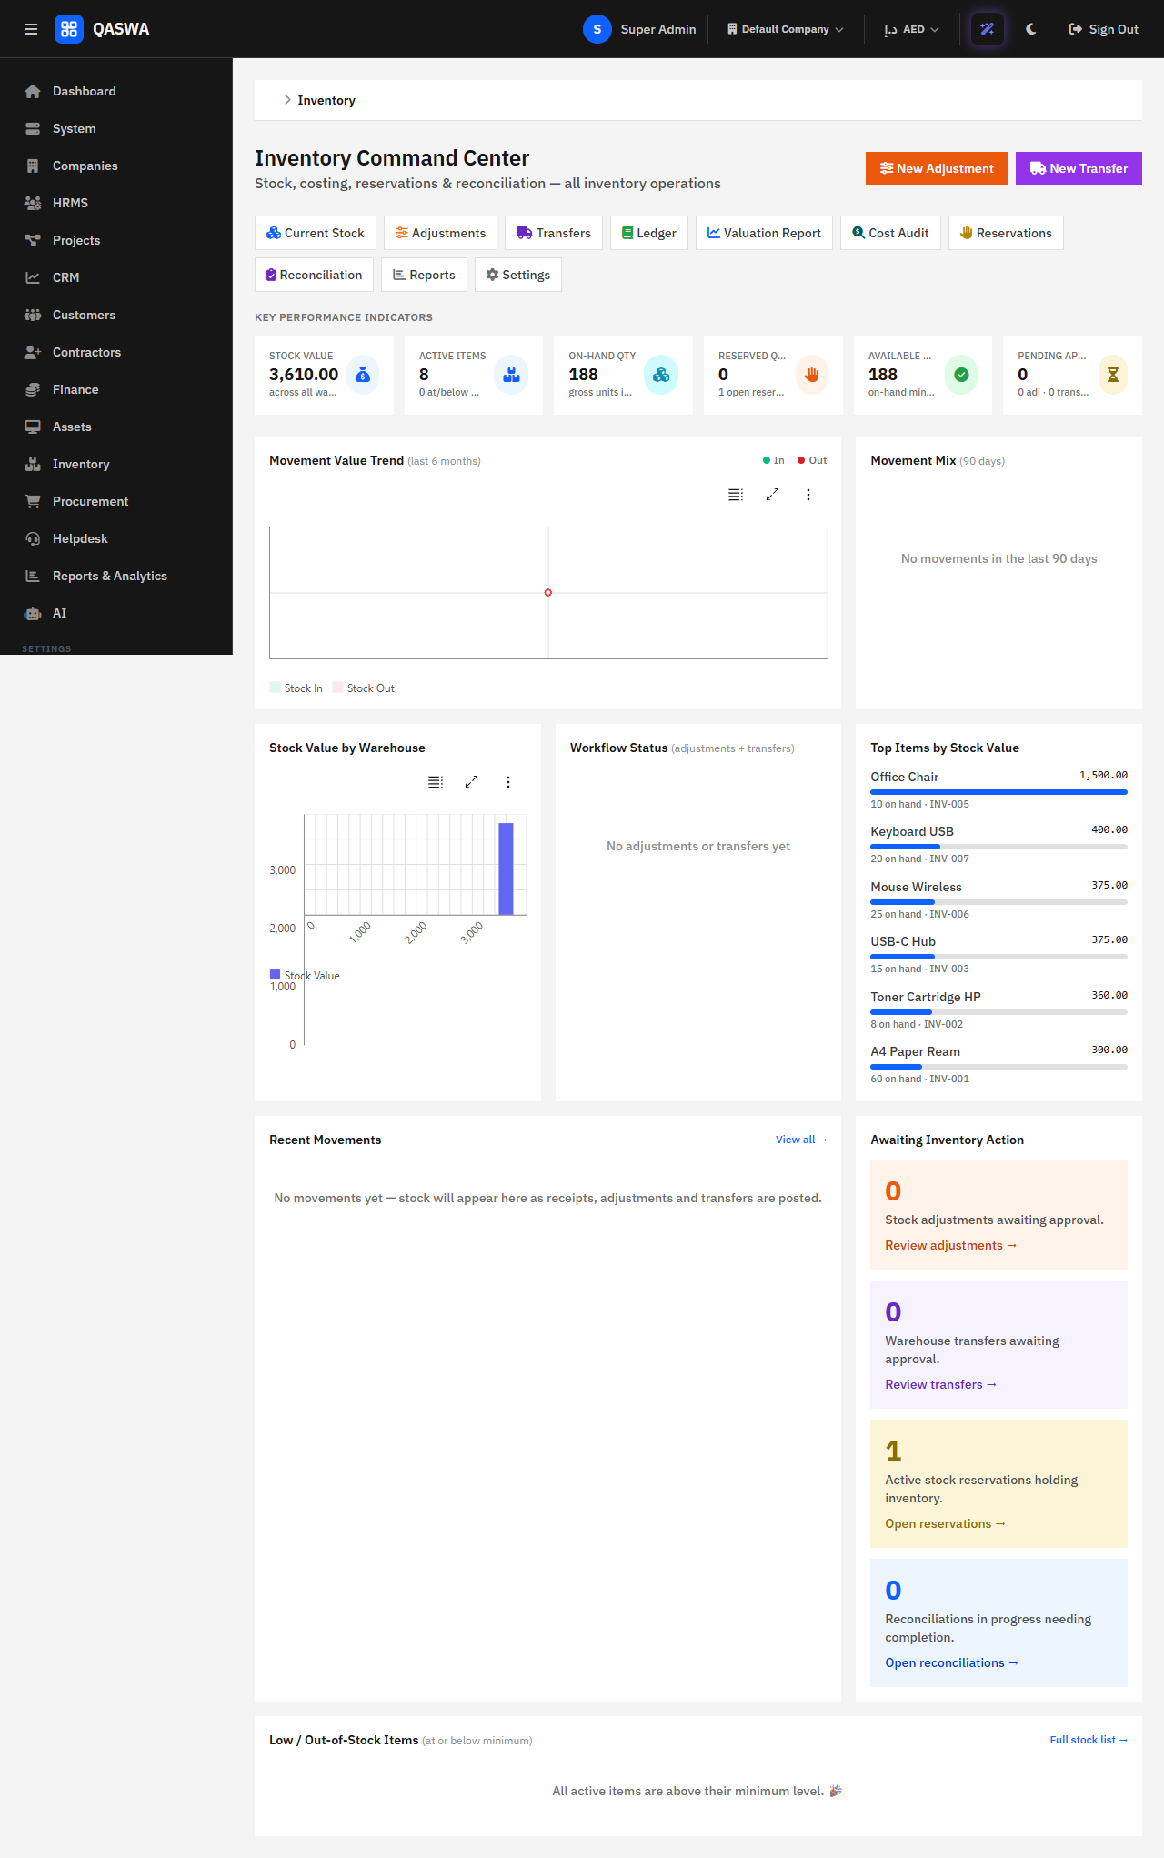
Inventory and fixed assets
What is in stock, where it is, what it is worth
▸ Item master with category, warehouse, location, unit, costing and reorder level.
▸ Immutable stock ledger: purchase receipt, sales issue, adjustment, transfer.
▸ Reservations against available quantity and a live command centre.
▸ Fixed assets: capitalisation, depreciation, impairment and disposal.
▸ Straight line, declining balance and double declining balance.
▸ Surplus returns, movements, maintenance and licences tracked.

Slide 12
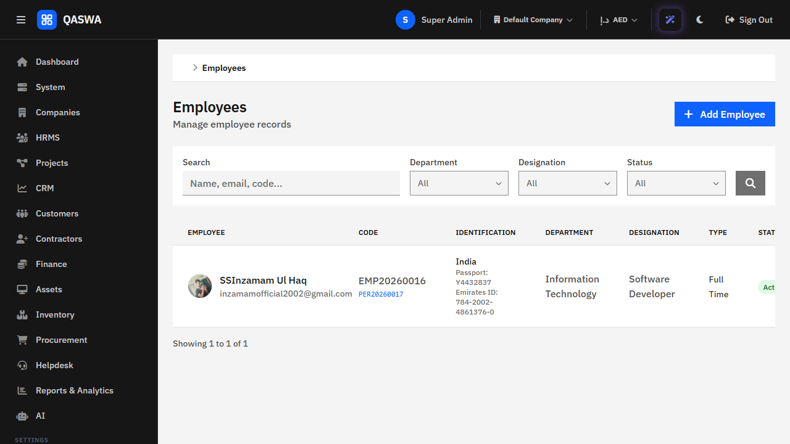
People — records, attendance and leave
One person record, one absence record, one payroll deduction
▸ Employee master with documents and immigration expiry watch.
▸ Attendance: present, absent, half day, leave, holiday, weekend.
▸ Leave types with annual entitlement, carry-forward and activation.
▸ Automatic day calculation, including 0.5 day, on requests.
▸ Approve, reject and balance deduction with an audit entry.
▸ Holidays, weekend and leave balance register per employee.

Slide 13
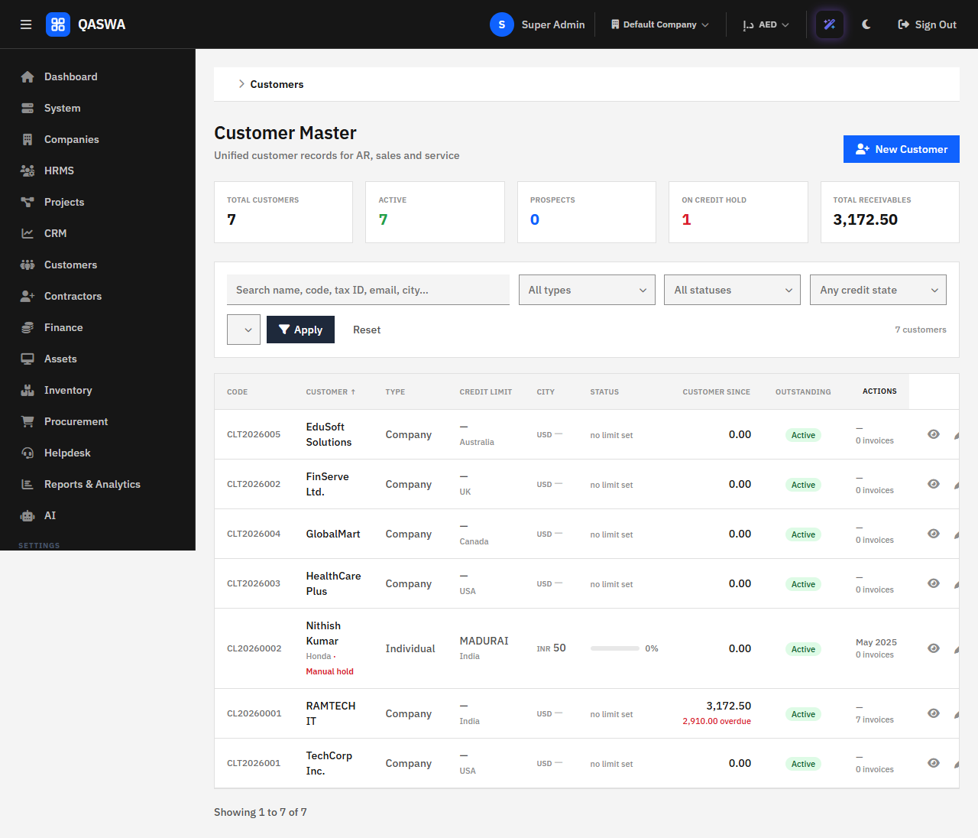
Customer relationship management
The customer record that drives every invoice and receipt
▸ Lead capture, qualification and follow-up register.
▸ Deal pipeline with probability and forecast.
▸ Customer master: segment, industry, country, credit limit, hold.
▸ Contacts, locations, notes and files attached to the customer.
▸ Customer 360 page: credit, receivables, recent activity, documents.
▸ Multi-currency billing and receivables ageing.

Slide 14
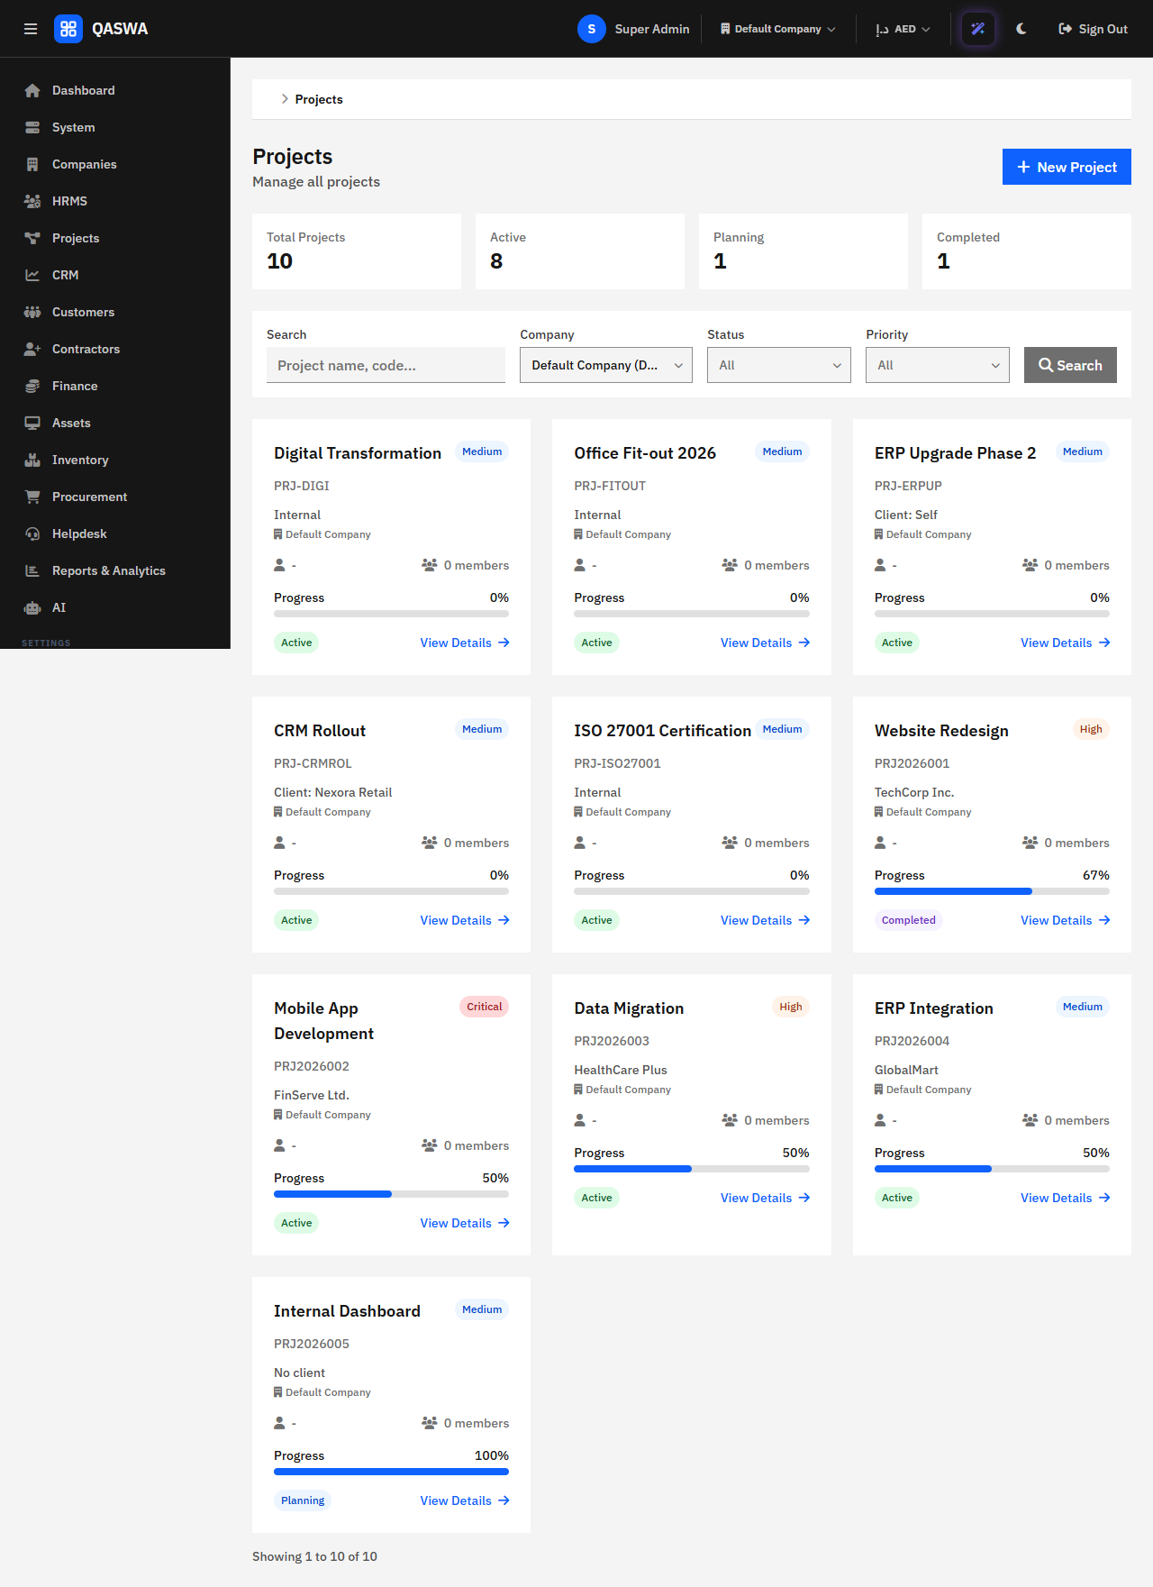
Projects and tasks
Table and Kanban, time against tasks, billing linked
▸ Project register with owner, type, status and milestones.
▸ Task board with drag-and-drop across buckets.
▸ Dependencies, priorities, due dates and attachments.
▸ Timesheets per employee, project and task.
▸ Hours feed project totals, budgets and HR reporting.
▸ Scratchpad attachment cleanup and board persistence.

Slide 15
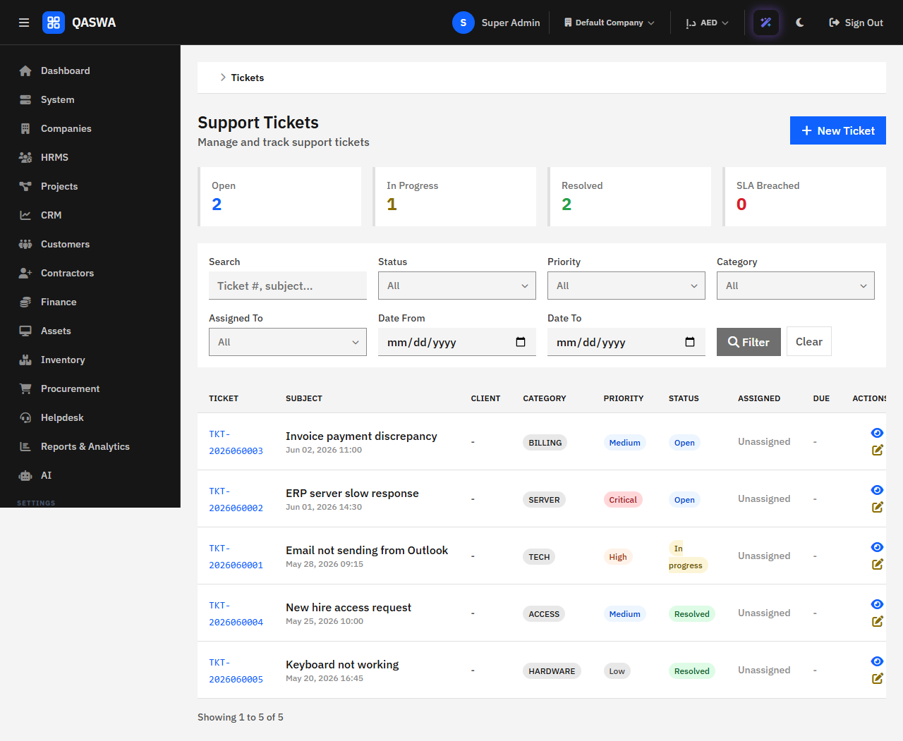
Service desk and knowledge
SLA timers that recompute while you watch
▸ Tickets raised with customer, priority, category and channel.
▸ First reply moves open to in progress and stamps first-response time.
▸ Owner assignment trail: from, to, who and reason.
▸ SLA policy define-when open, breach status live on the queue.
▸ Pause and resume support windows for SLA accuracy.
▸ Ticket categories and a published knowledge base.

Slide 16
Multi-company and consolidation
One login, many entities, one group view
▸ Active company selector in the header drives every screen.
▸ Permissions resolve which entities a user may see.
▸ Intercompany transactions: sale, purchase, service, expense, loan, interest, dividend.
▸ Match and reconcile across group entities.
▸ Period close and year-end per entity.
▸ F13 group consolidation: validate, eliminate, translate, consolidate, approve.
▸ Foreign currency translation at closing, average and historical rates.

Slide 17
Period close and year-end
The reconciliation gate before any month ends
▸ Financial dashboard: current year, period, remaining periods, checklist progress.
▸ Closed-period enforcement across every posting and even reversals.
▸ Accrual, prepayment, provision, depreciation and tax adjustment journals.
▸ Year-end closing: closing entries, opening balances, carried forward P&L.
▸ Tax subledger, payroll subledger, subledgers all attested before close.

Slide 18
Security and compliance evidence
Controls enforced, not recommended
▸ Session-based authentication with re-check on every request.
▸ RBAC: 58 permissions across modules, three shipping roles plus custom.
▸ XSS sanitisation, CSRF tokens, PDO prepared statements.
▸ Audit log per action with user, module, record, IP and timestamp.
▸ Report audit log with parameters hashed.
▸ Guarded maintenance console; production hides errors.
▸ Retention and housekeeping in the administrator's hands.

Slide 19
Intelligence that cannot go rogue
Governed AI, human-in-the-loop
▸ AI agents, tasks and workflows orchestrated under policy.
▸ Knowledge base with vector search for retrieval-based answering.
▸ Guardrails: kill switch, governance middleware, policy engine.
▸ Usage, metrics and security-event logging for every call.
▸ Document intelligence for extraction and review.
▸ Completely optional: the business works without it switched on.

Slide 20
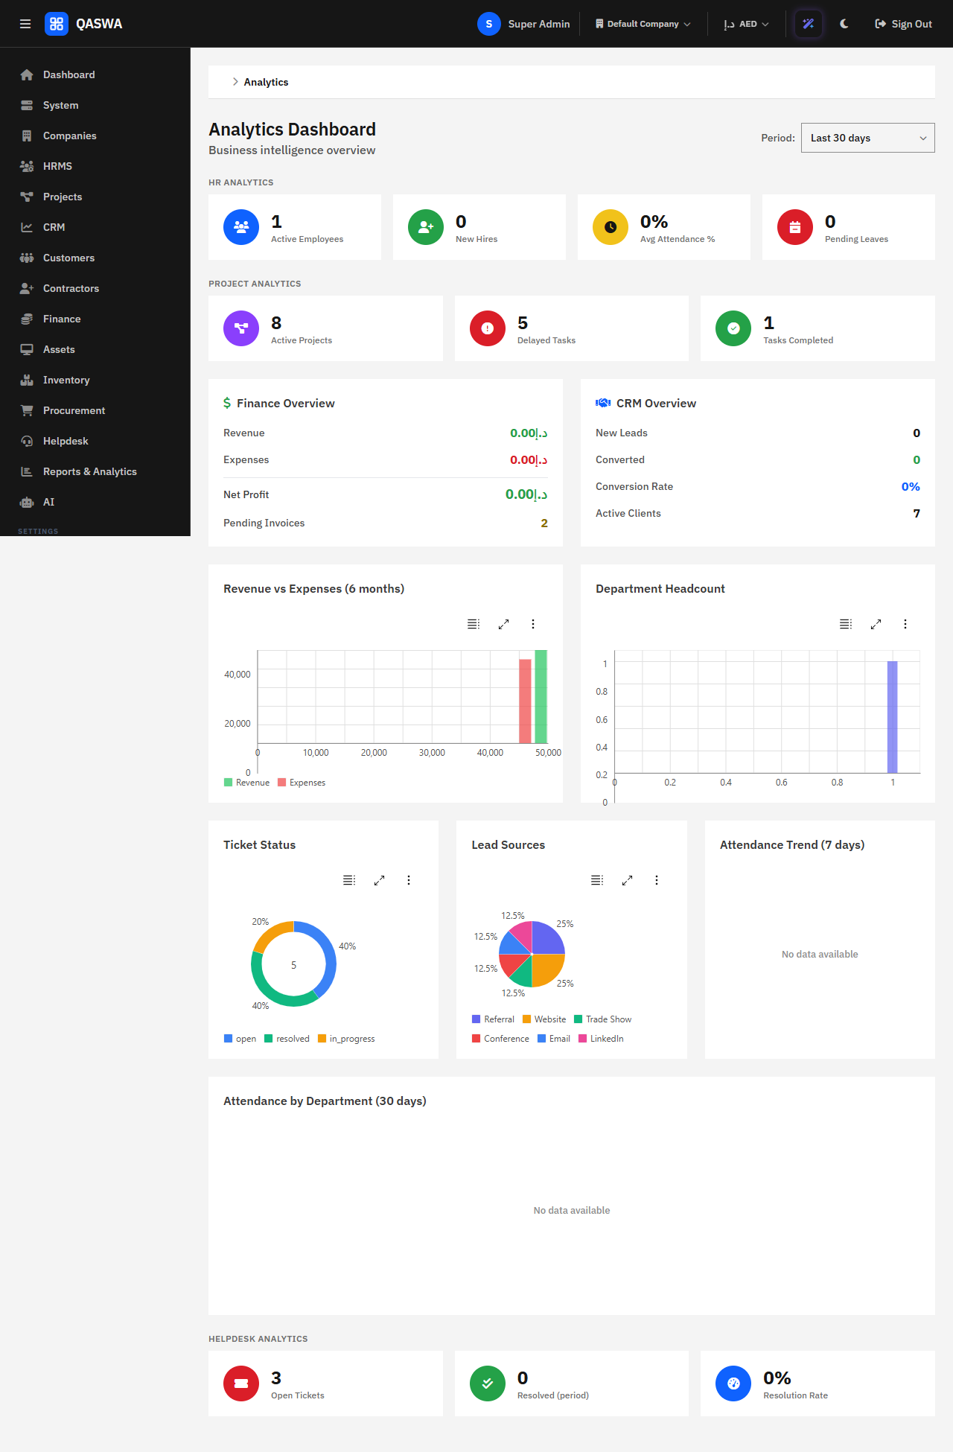
Dashboards, analytics and reporting
Eleven statement sets and drill-through both ways
▸ Report centre with saved reports and scheduled delivery by email or file.
▸ Financial statements: trial balance, P&L, balance sheet, cash flow.
▸ Drill from a statement line to journal to the originating document.
▸ Financial ratios: current, quick, debt to equity, margins.
▸ Integrity checker with pass / warn / fail reconciliation.
▸ Analytics workspace and an executive dashboard.

Slide 21
Implementation timeline
First live month-end in twelve to sixteen weeks
Week 1-2 Company, ownership, COA, currencies
Week 3-4 People, leave, attendance
Week 5-6 Items, warehouses, procurement
Week 7-8 Invoicing, receipts, first close
Week 9-10 Budgets, tax, SLAs, tickets
Week 11-12 Projects, timesheets, reports
Week 13-14 Approval matrix, consolidation
Week 15-16 Audit handover, steady state

Slide 22
The business return
Where the money comes from

Slide 23
Why QASWA ERP and not the alternatives
Control you can verify
▸ One controlled route into the ledger — voucher types, not free-form journals.
▸ Subledgers that must agree before a close can happen.
▸ No extra licence per seat; runs on standard hosting.
▸ Per-company document sequences, currencies, approval and audit.
▸ Delivered working, not as a toolkit or a configuration project.
▸ Plain-language documentation and a complete evaluation checklist.

Slide 24
Evaluation checklist — score us
Thirty lines, five-point scale
☐ Run your own month-end and inspect the trial balance
☐ Invite your auditor to the close demonstration
☐ Time the chart-of-accounts migration
☐ Procurement with a deliberate price variance caught in matching
☐ Test data export and ownership terms in writing
☐ Visit a live installation and speak to the controller

Slide 25
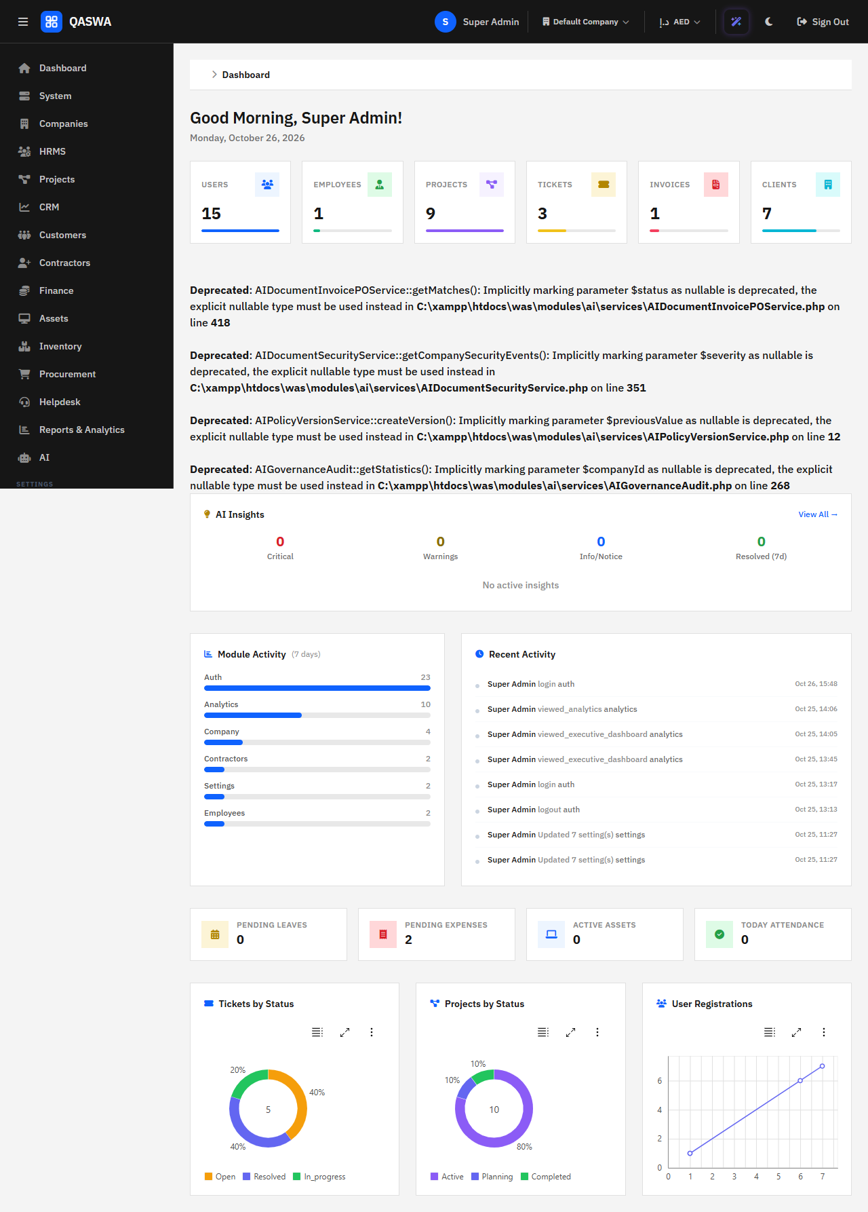
Recommended next steps
▸ 1 Book a ninety-minute scripted demonstration on your own numbers
▸ 2 Trial tenant prepared with your chart of accounts and currency
▸ 3 Auditor-led review of the period-close engine
▸ 4 Implementation and migration plan with dates against your calendar
▸ 5 Data ownership terms in writing before any engagement
QASWA ERP — built for the organisation that has outgrown its spreadsheets.
Contact: product office | Demonstration on request | Commercial in confidence.

