Slide 1

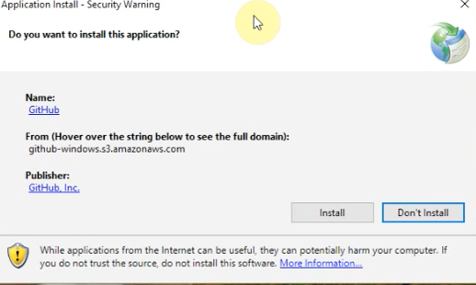
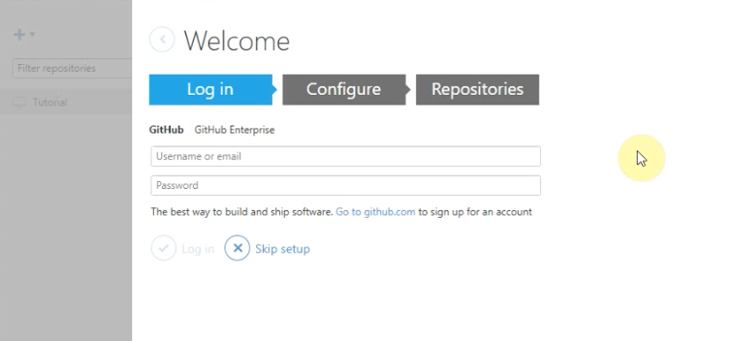
Github
Intro videos (part I and II): https://www.youtube.com/watch?v=1h9_cB9mPT8
Install Github via the shortcut on your desktop
Will get a welcome screen after installation and a couple “cat” icons that appear on your desktop
Create an account at the link provided on the welcome screen (github.com)
After logging in you may see a list of local repositories. Can skip this step
May see a tutorial repository on the left side of the dialog box (can delete or leave)

Slide 2
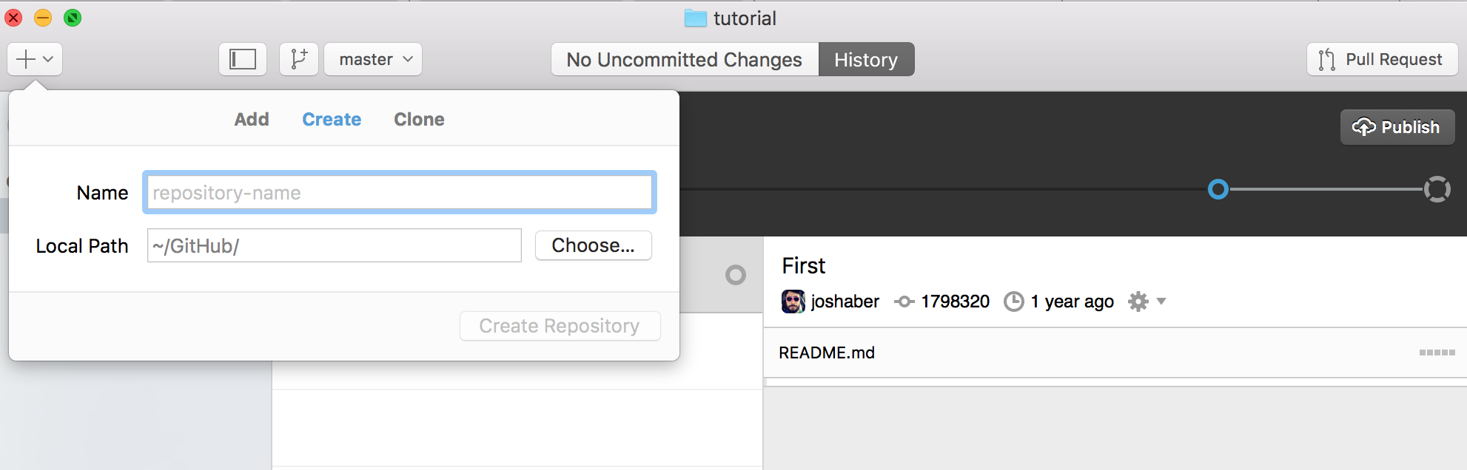
Github cont.
Click the ‘+’ in the upper left corner to create a repository
Name the repository (e.g. MauroExampleProject)
Change the path to Desktop (Browse to it)
Creates a folder of the repository name on the Desktop
Select the gitignore pulldown. Filter by Java. Will ignore the Java system files in the repository
Click on Create repository
Click Publish (upper right corner)
Will upload it to the Github cloud
Enter a good description!!

Slide 3
Github cont.
Open Github in browser (github.com) and sign-in
Will show the repository just created on right side
Click on the repository to see the details
One person in group will need to go through the repository creation step
Click settings then Collaborators (left side) and enter the usernames or emails from the group members (username or email that used when created github account)
Can create branches for each group member to work on their section (upper left)

Slide 4
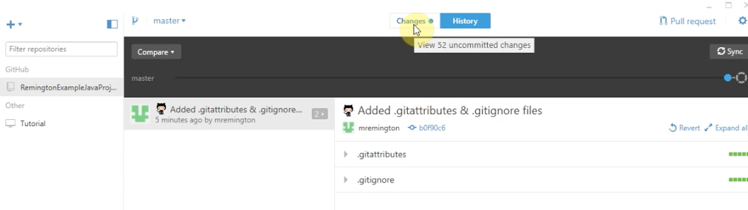
Github cont.
Open eclipse
Select File – Switch Workspace then browse to the repository folder created on your desktop
If you are a collaborator, you will not have the folder BUT will create one after the project is setup by the project lead and after “cloning” (see later slides)
Repository owner should create the new Java project in eclipse (e.g. MauroExample)
Create a package (right click on project and select package) and/or a java class to start (e.g. a hello world type class)
Open the repository folder on desktop. Should see
Git files (e.g. gitignore)
Eclipse files (e.g. metadata and java project folder)
Check out github desktop and should see changes in top banner
Click changes button

Slide 5
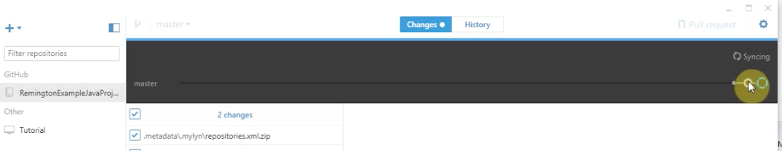
Github cont.
Should see the changes made to the repository (project added stuff)
Need to “commit” the changes in order to share with other collaborators
Type description in summary or description fields (be descriptive!!!)
Click “commit to master”
Click “syncing” in top right corner to sync the changes
Note the chain under the syncing button. These show the revisions (hollow while syncing). Right most is the current state (also called the “tip”). If click on the dots can see the history of that revision
Now check the cloud github and refresh to see the changes update

Slide 6
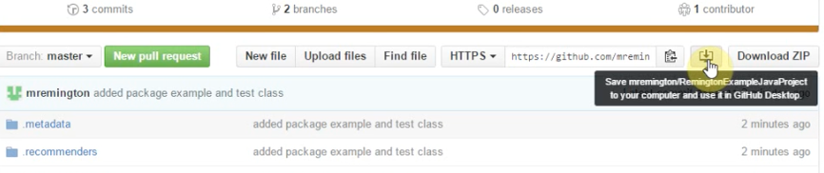
Github cont.
Create more stuff in your eclipse project
Desktop – see changes, commit, sync
Goto the cloud github and should see the updated changes
Will be repeating this for your development
Make sure know what doing on desktop github and where doing it on cloud github
If added a java file, you can click on the dot that has the revision, scroll down in history panel and click on the file to see it.
Now the collaborators can go to cloud github and search for the repository
“clone” the repository by click on the icon that looks like a download
Will create a folder on desktop, then can work on the files
If make changes then should follow the commit, sync workflow as before

