Slide 1
Games 2025
Robin D | Karim G | Nils B | Dominik N | Michael S
02. Mai 2025

Slide 2
Inhalte
01
02
03
04
Engagement Loop
Architecture
Analytics
Features
Demo
Lessons Learned
05
06
Notes:
Analytics: Nils -> Test durch Spieler -> Zudem sagen das durchschnittliche Kills pro Runde, Wellen überlebt -> Statistik am ende des games
Architekturen: Karim -> Bild auf Github, Still des Projekts
Engagement Loop: Michael -> Explore (Map erkunden) + Compete (Achivements) + Express create (Jeder kann seien eigenspielstil haben, dh. Nur in einem Raum, verschiedenen Waffen)
Demo: Erklärung (Robin) + Demo ausführen(Dominik)
Lessons Learned:

Slide 3
Outbreak

Slide 4
01
Engagement Loop
What makes you keep playing

Slide 5
Engagement Loop
Explore
Express
01
02
Different weapons and rooms allow for individual strategies.
Players decide how to approach the game — defensive or offensive
Personalization increases identification and engagement.
Players start a new round and explore the environment.
They search for weapons, resources, and strategic positions.
Discovery creates excitement and variety.
Repeat
Compete
Improve
Players reflect on what worked and what didn’t.
They may change their loadout, tactics, or movement patterns.
Learning and optimization keeps them engaged as they chase mastery and try new strategies.
03
04
Players earn achievements for special feats.
Leaderboards encourage them to improve and beat records.

Slide 6
02
Architecture

Slide 7
Architecture
Modular Design:
Wiederverwendbare Components
Effizienz und konsistenz
UE5 Reference Viewer
UML Diagramm

Slide 8
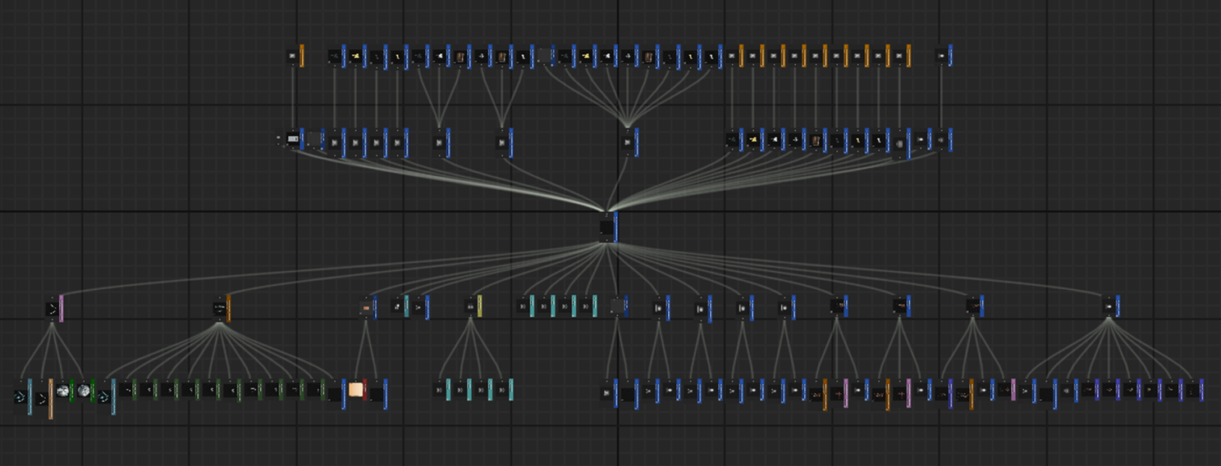
Game References

Slide 9
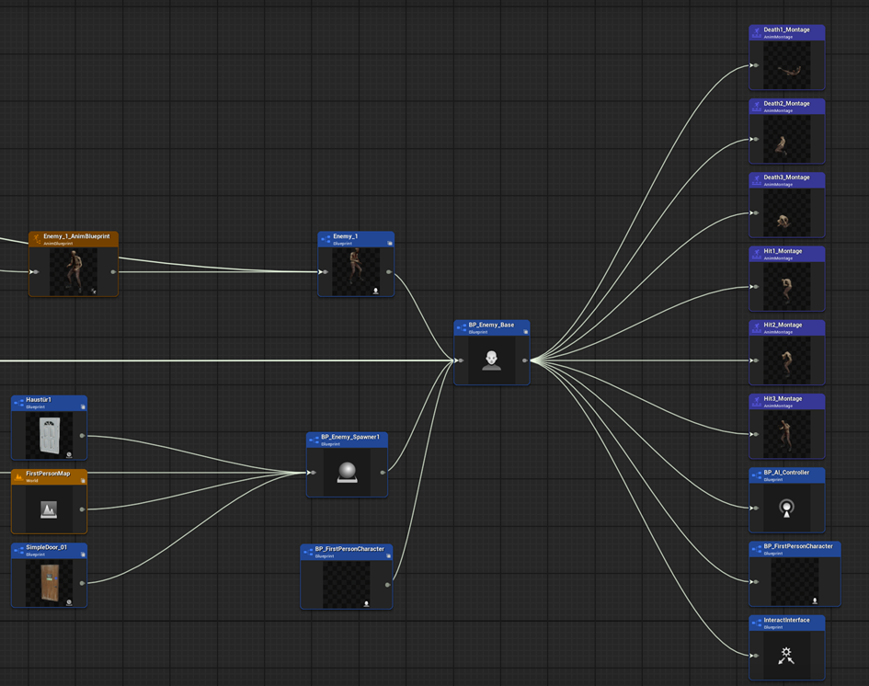
Enemy References

Slide 10
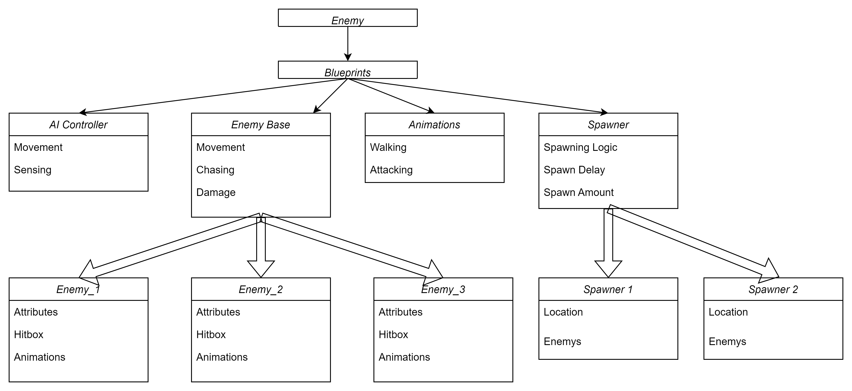
Enemy

Slide 11
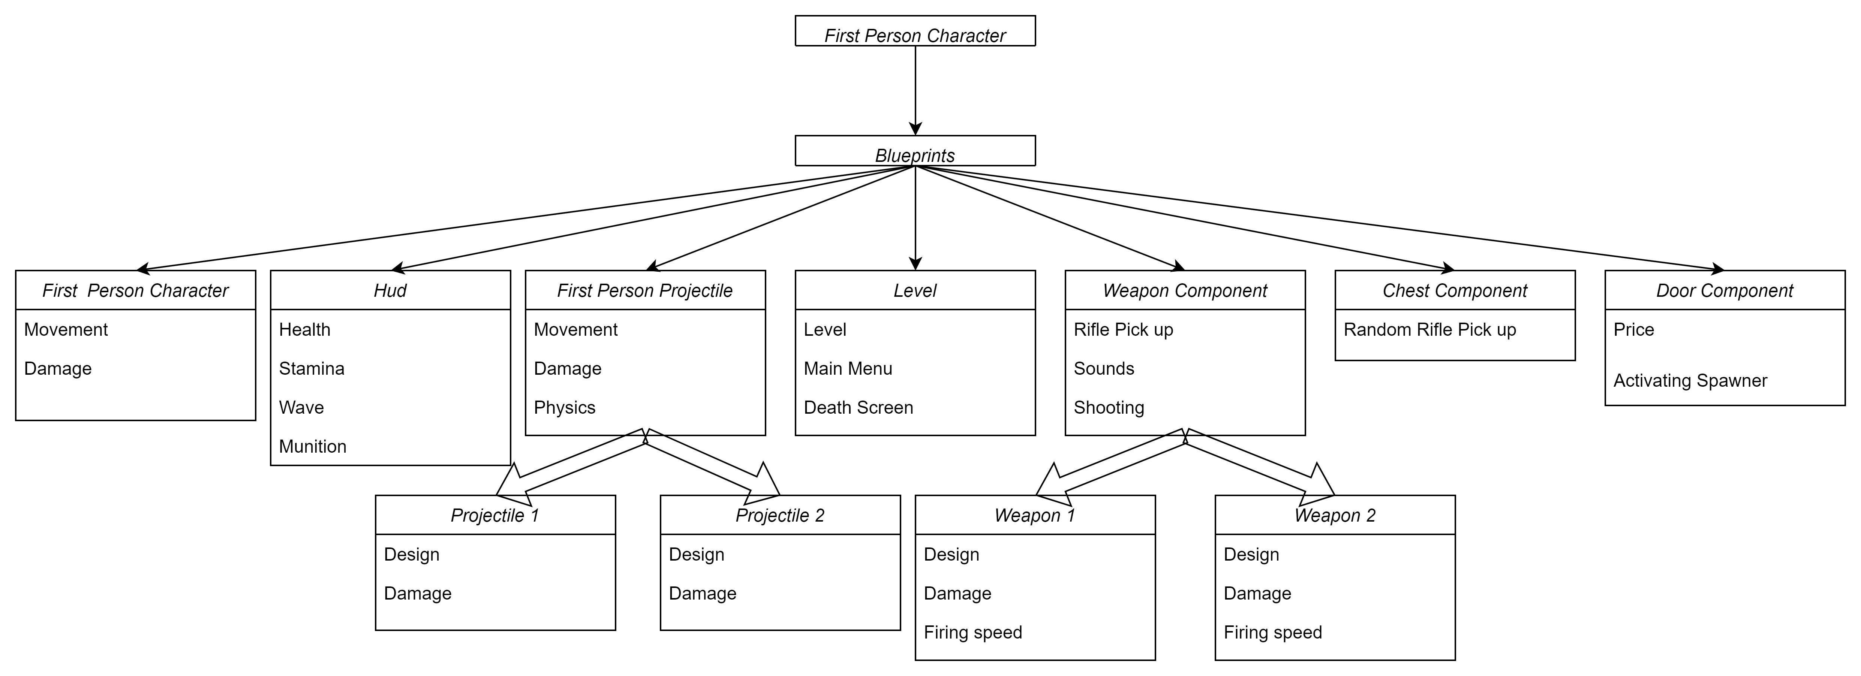
Character/ Level

Slide 12
03
Analytics
What makes you keep playing

Slide 13
Addiction Loop
Task
Action
01
02
Kill Zombies with starter weapon so they dont kill you
Players need to survive the zombie attack
Repeat
Reward
Challenge
By unlocking better gear, also the enemies get harder and players need to keep up.
03
04
Scores/ money that allows the unlock of new weapons and areas

Slide 14



Desired Emotions
Ambition
Tension
Pride

Slide 15
Ambition
Milestones
Give Players a goal to work towards
Competition
Progress
Make Players compete in whos better
Give Players the feeling to progress forward
Challenges
Game should get harder the further they get

Slide 16
Tension
Fear of losing
Create an actual consequence when losing
Ressource scarity
Pressure
Make Players hope to find healing/ammo somewhere or lock it behind sth
Players need to act, they cant rest for too long

Slide 17
Pride
High scores
Challenge
Make Players see when they beat their best and improved
Give players the feeling they earned their progress, not got it random
Achievements
Make the player reach goals they work for

Slide 18
Tracking Plan

Slide 19
Tracking Plan
Game Balance
Achievements
Challenges & Goals

Slide 20

Game Balance
Enemy Power
Is there a type of Zombie players die often to?
Weapon Strength
Is a weapon never used?
Is a weapon especially strong in a certain level?
Weapon/Room costs
Are there rooms that are entered more often?

Slide 21

Achievements
Fun after failing
Amount of games per session
Duration between Tries
Near Miss Events
Divergence between normal rounds and "very good rounds"
Quick Fail rounds
Divergence between normal rounds and "very bad rounds"

Slide 22

Challenges & Goals
Achievements & Duration
Does a player play Long after they unlocked an achievement?
Do players make active "achievement runs"?
Do players keep playing after getting an achievement?
Games after High score
Do players keep playing after beating their highscore?

Slide 23
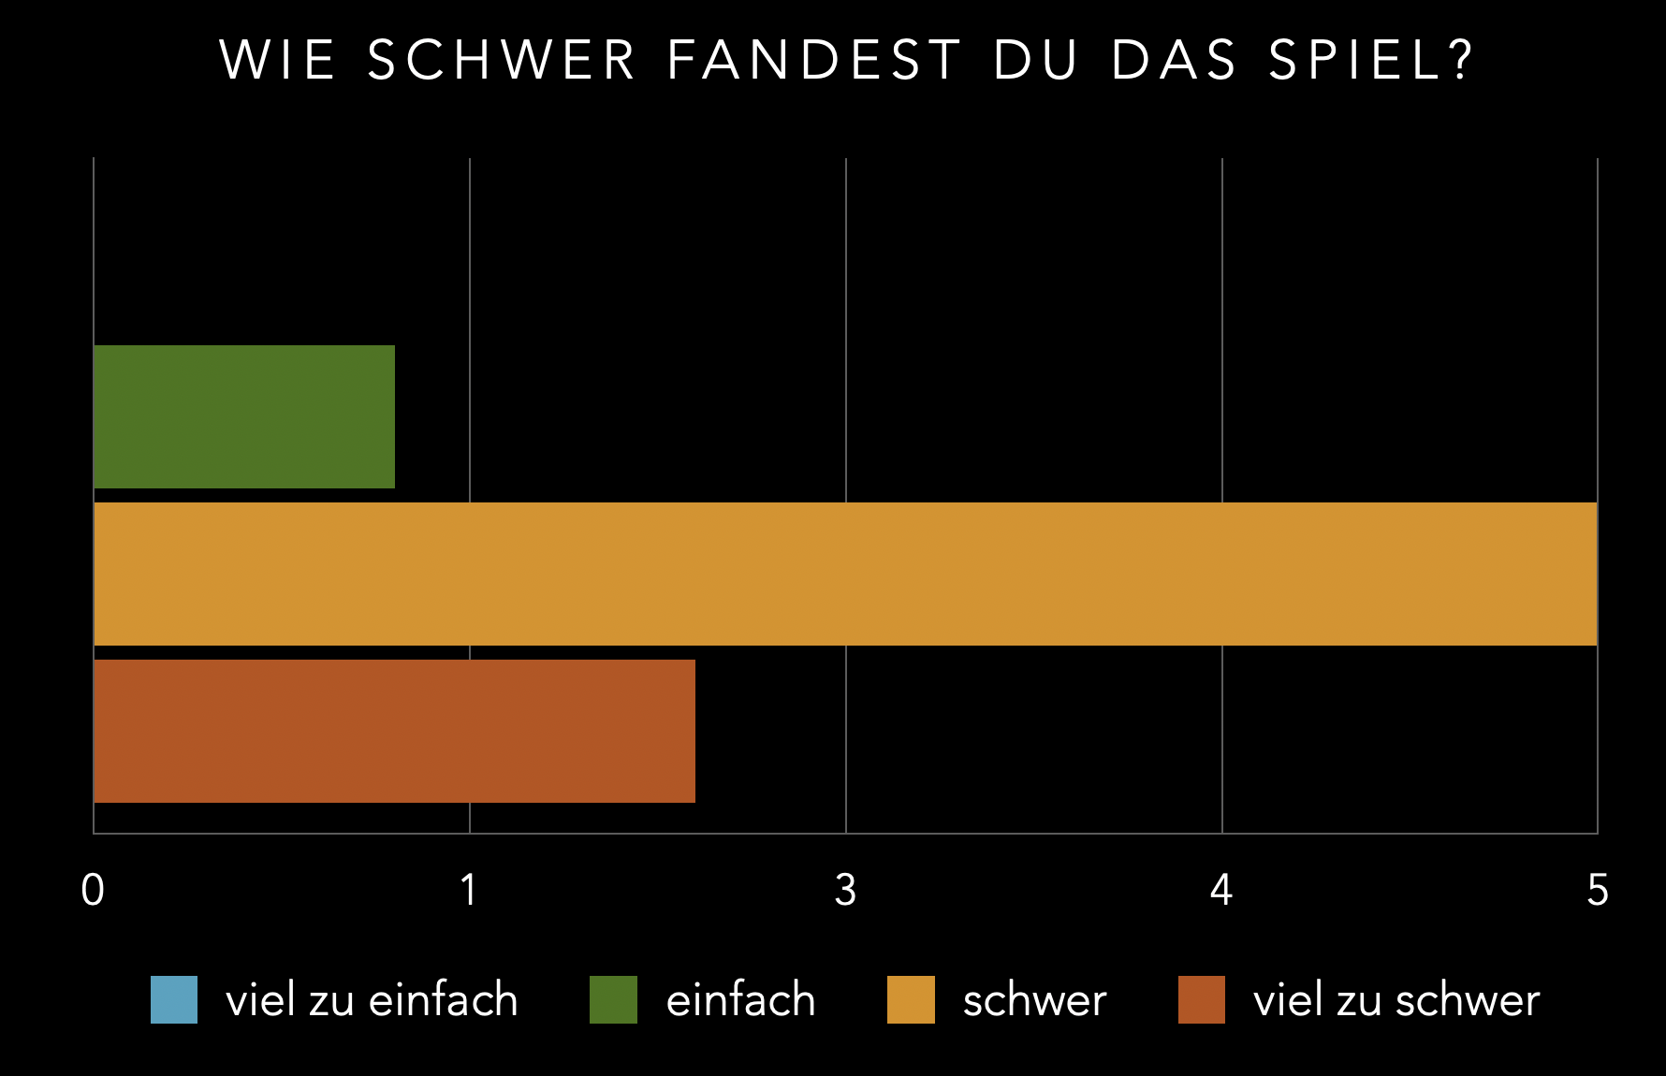

Slide 24
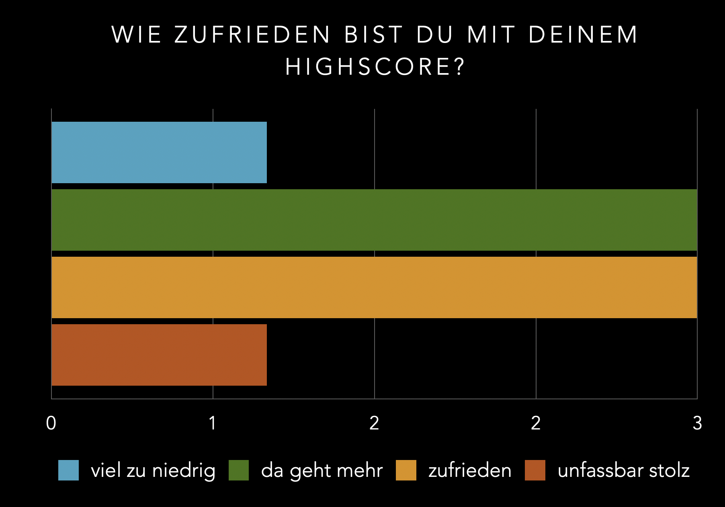

Slide 25
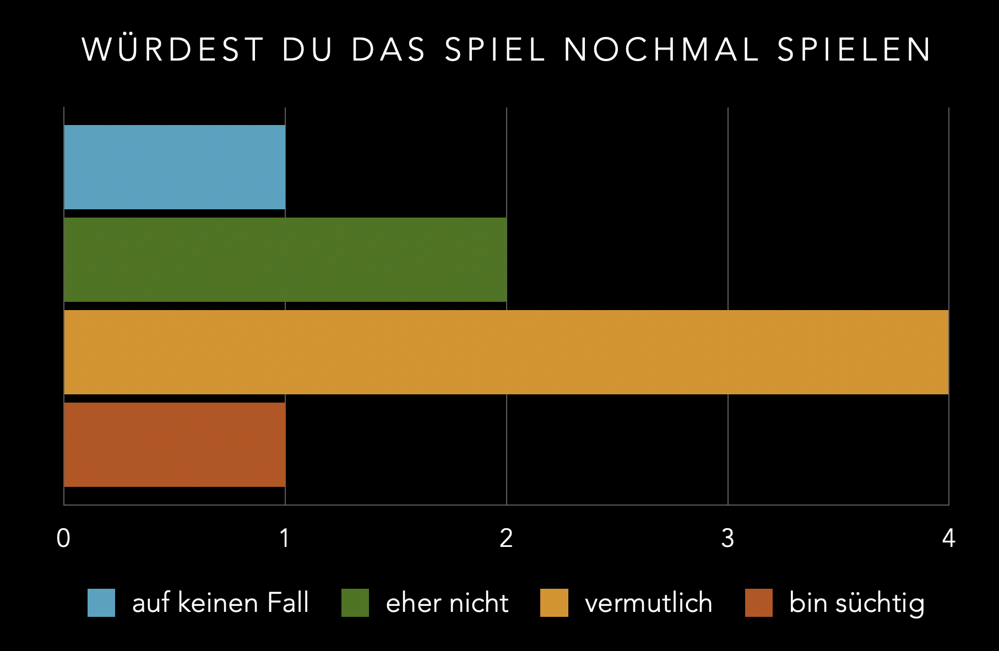

Slide 26
04
Features

Slide 27
Features
Movements
Killcounter
HUD
Verschiedenen Movements, wie Sprinten, Springen, Scchleichen und co.
Killcounter anhand von Punkten, um Waffen und co. zu erwerben
Anzeige des Lebens, der Ausdauer oder Munition
Waffen
Erkundbare Map
Errungenschaften
Verschiedene Waffen die während eines Spiellaufes verwenden werden können
Eine Map die vom Spieler erkunded werden kann, bei Bedarf beliebig erweiterbar
Errungegnschaften die den Spieler dabei unterstützen weiterzuspielen

Slide 28
Gameplay Demo

Slide 29
Lessons Learned
Kommunikation
Unreal Engine
Fab
1x Weekly die Woche Pflicht
Steile Lernkurve
Übersichtlicher Marketplace zum finden von Inhalten
Perfromance
Bug Fixes
Spaß
Starke Performance Probleme während der Entwicklung
In der Spileentwicklung hat dieser Teil sehr viel zeit in anspruch genommen
Spielenwicklung ist seher heruasfordernd, jedoch auch sehr amüsant

Slide 30
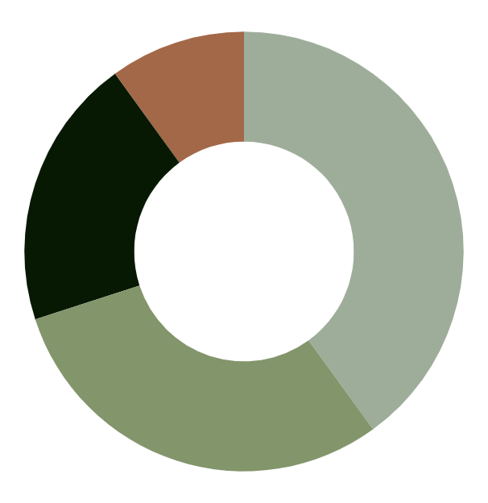
Zeitaufwände
10%
40%
Entwicklung
Aufgaben für die VL
20%
30%
Bug Fixes
Planung

Slide 31
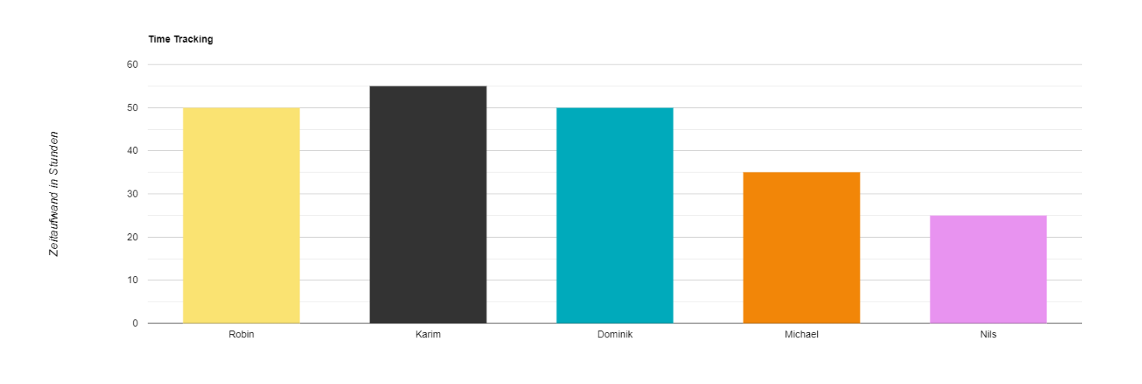
Zeitaufwände
Link zum Projekt: https://github.com/INeeedADoc/Outbreak

Slide 32
Vielen Dank für Eure Aufmerksamkeit!

