Slide 1
CVE-2019-18634
Gaining root privileges through sudo vulnerability
Brănaci Șerban-Mihai, Butum Andrei, Nițu Iulia-Elena

Slide 2
Introduction
CVE-2019-18634 is a vulnerability in sudo program
The issue occurs when pwfeedback is enabled in /etc/sudoers
Out-Of-Bounds Write vulnerability leads to Buffer Overflow attack
It happens in the BSS segment
The scope is to gain privileged access
static code review + dynamic testing
fix - in sudo version 1.8.31 by resetting a critical pointer value and disabling pwfeedback option

Slide 3
Theoretical aspects
sudo - allows users to run commands as superuser
pwfeedback - displays password as asterisks (“*”)
Buffer Overflow - occurs when a program writes more data to a fixed-size buffer
Privilege Escalation (MITRE Technique) - gaining higher-level permissions on a system
pseudo terminal (pty) - software interface that emulates a physical terminal (virtual terminal)

Slide 4
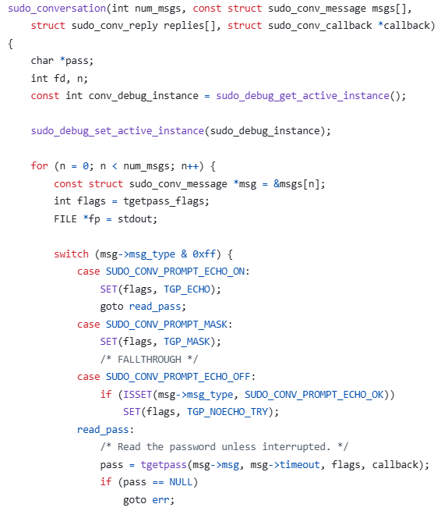
Flow to vulnerability
The analysis mainly focus on tgetpass.c source and getln() - the function that contains the vulnerable buffer
To get to the possible breach, the attacker has to explore 2 sources: conversation.c and tgetpass.c
Function trace:
  main()
  policy_check()
  sudoers_policy_main()
  check_users_interactive()
  auth_get_path() #
  sudo_conversation()
  tgetpass()
  getln()

Slide 5
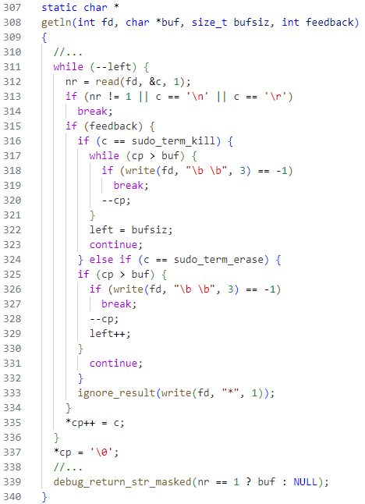
The vulnerable function
(sudo v1.8.25)
Variables:
  char* buf - buffer which holds the password
  size_t left - number of available characters in the buffer (256 initially)
  char* cp - buf iterator
  int feedback - used to determine if pwfeedback is enabled/disabled
Special characters:
  sudo_term_kill - NAK (Negative Acknowledge) - "delete all characters”
  sudo_term_erase - DEL (Delete) - "delete one character”

Slide 6
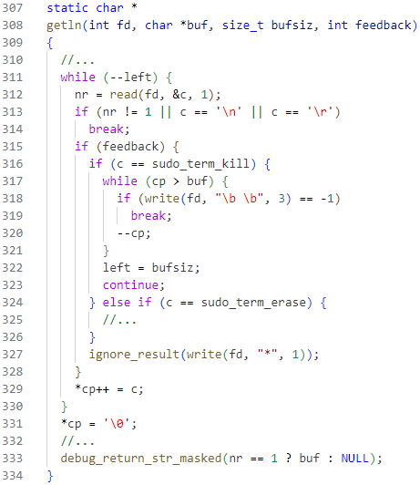
Vulnerability explained
input NAK to clear the password
try to delete all the characters in buf
while loop may stop when trying to write in a read-only location
reset password length (left = bufsiz)
cp is left pointing inside buf
loop resets - write another 256 characters
left reset, but cp not

Slide 7
Checking for Buffer Overflow
(up to sudo v1.8.25)
For the exploit to be successful, it needs to meet 3 conditions:
enabled pwfeedback
sudo_term_kill character included when using /dev/tty, its value = 0x0
payload sent using -S option (writes the prompt to stderr, reads from stdin)

Slide 8
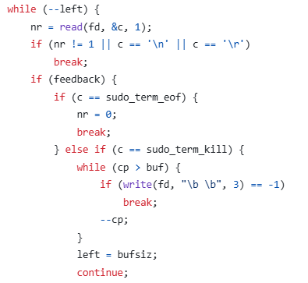
The vulnerable function
(sudo v1.8.26 up to sudo v1.8.30)
change in sudo 1.8.26: the introduction of sudo_term_eof
it stops processing the input
when the input is from /dev/tty: sudo_term_eof is 0x0
sudo_term_eof breaks the loop
the sudo_term_kill path is no longer reached
what value should c have in order to enter the “else if” branch???

Slide 9
Checking for Buffer Overflow
(sudo v1.8.25 up to sudo v1.8.30)
when reading from /dev/tty, sudo_term_eof (= 0x0) interferes now with the value for sudo_term_kill (= 0x0)
using a pseudo-terminal (pty), the value for sudo_term_kill is 0x15 and for sudo_term_eof is 0x04 (NAK AND EOT in ASCII)
using socat, in order to create a pty, the same vulnerability can be recreated

Slide 10
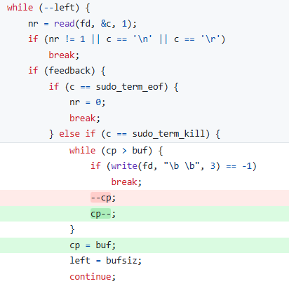
Patch added in sudo v1.8.31
The important fix here refers to:
cp = buf;
Using this line, even though the loop is closed when using the fd as stdin (conflict with write), the current pointer is reset to the start of the buffer.
The new password starts properly from the start of buf now => no cause for BOF

Slide 11
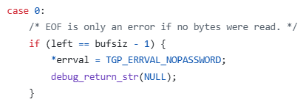

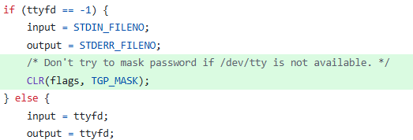
Additional changes added in sudo v1.9.0
the program tried to read the password input and display “*” from the same data stream
no terminal available (ttyfd = -1)
getln() attempted to write to stdin => error
solution: flip the pwfeedback flags when the input comes from a source different than tty

Slide 12
Crafting the exploit:
Getting root privileges

Slide 13
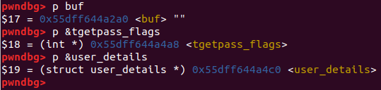
What we need (recap)
pwfeedback option in /etc/sudoers
sudo_term_kill character in payload
breaking the write() function
tgetpass_flags and user_details are after buf in bss

Slide 14
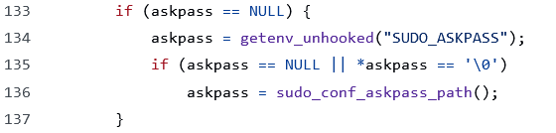
sudo “-A” option
normally sudo reads the password from the user’s terminal
the helper program (which will be executed) is user-controlled. It is given to sudo via the SUDO_ASKPASS environment variable
askpass is executed with the user’s uid
can we force sudo to execute askpass?

Slide 15
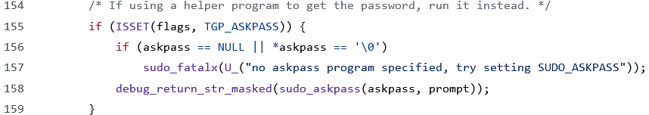
tgetpass_flags
when option -A is used, third bit of tgetpass_flags (TGP_ASKPASS) is flipped
we can overwrite the flags using the buffer overflow and set the TGP_ASKPASS

Slide 16
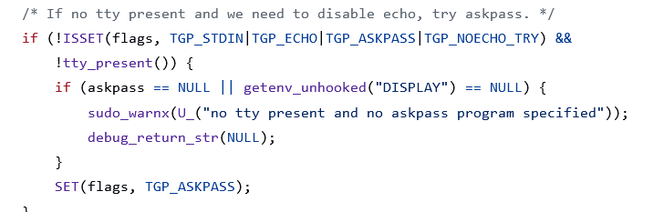
The issue with tgetpass_flags
sudo V1.8.25

Slide 17
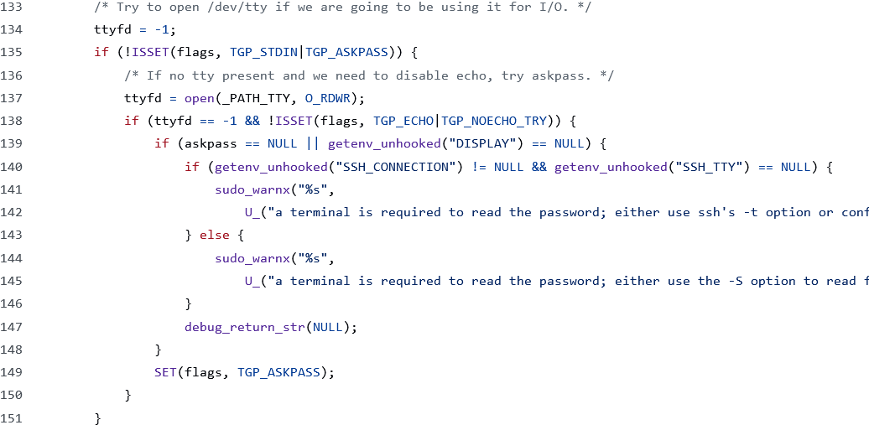
The issue with tgetpass_flags
sudo v1.8.27

Slide 18
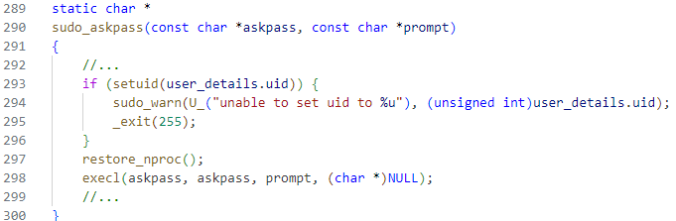
user_details
why is user_details relevant to the exploit?
if we change the uid to 0 then askpass would run as root

Slide 19
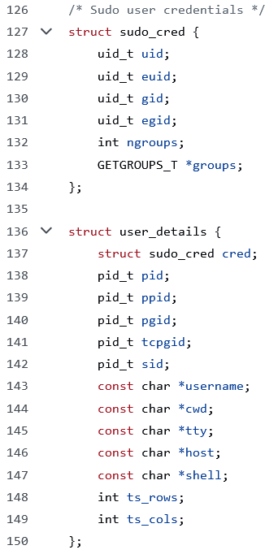
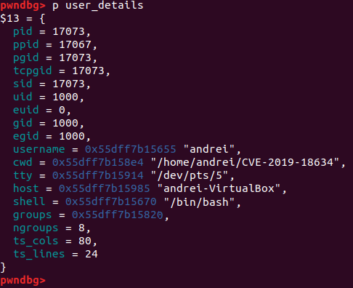
Structure of user_details
what is overwritten until we reach uid?
do we need to keep the other values before uid?

Slide 20
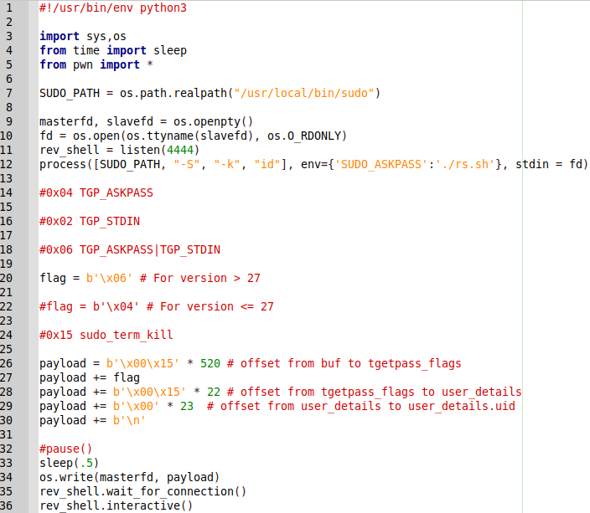
Script
The exploit script
rs.sh
(script sent via SUDO_ASKPASS)

Slide 21
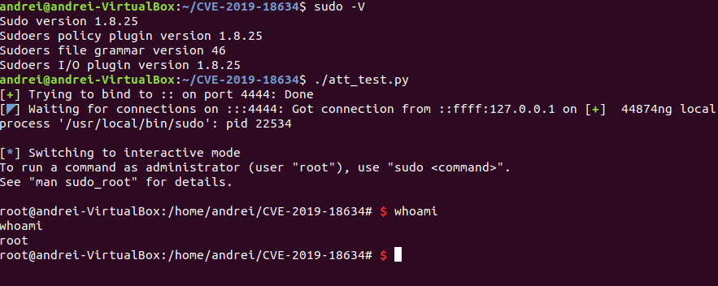
Shell in sudo v1.8.25

Slide 22
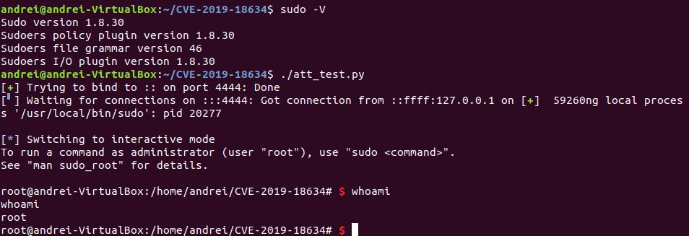
Shell in sudo v1.8.30

Slide 23
Thank you

