Slide 1
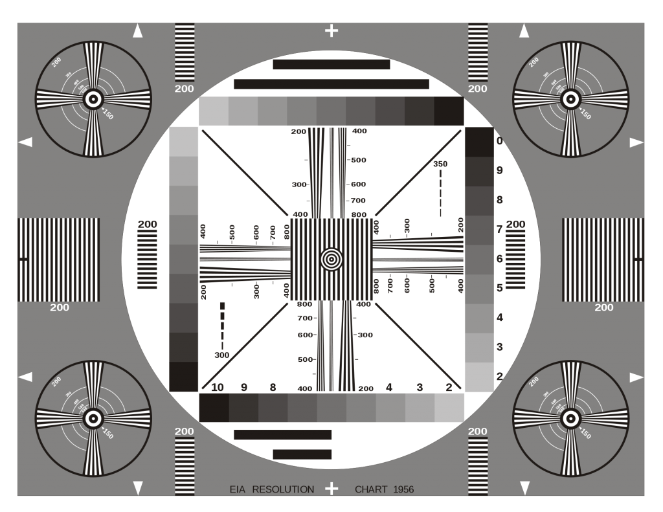
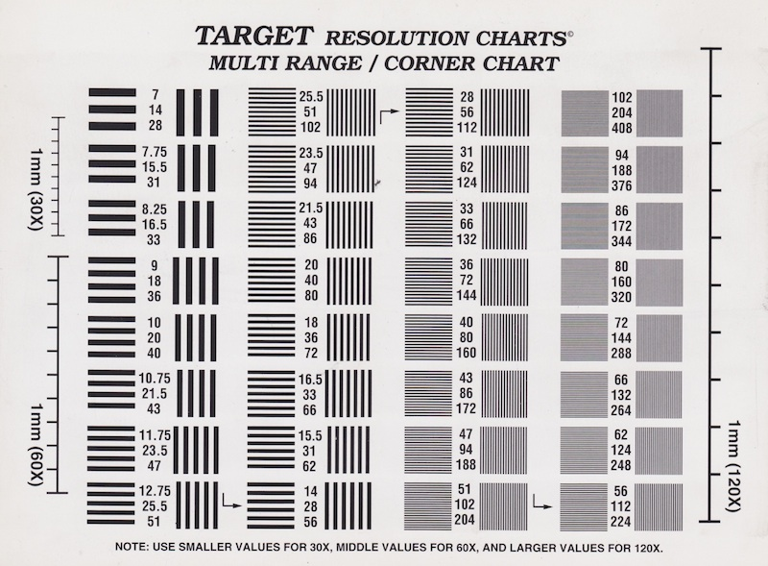
2.0 mm
1.0 mm
0.5 mm
0.2 mm

