Slide 1


SC19 Machine Vision inspection applications
Institut d’Optique
Formation Continue
Julien VILLEMEJANE

Slide 2
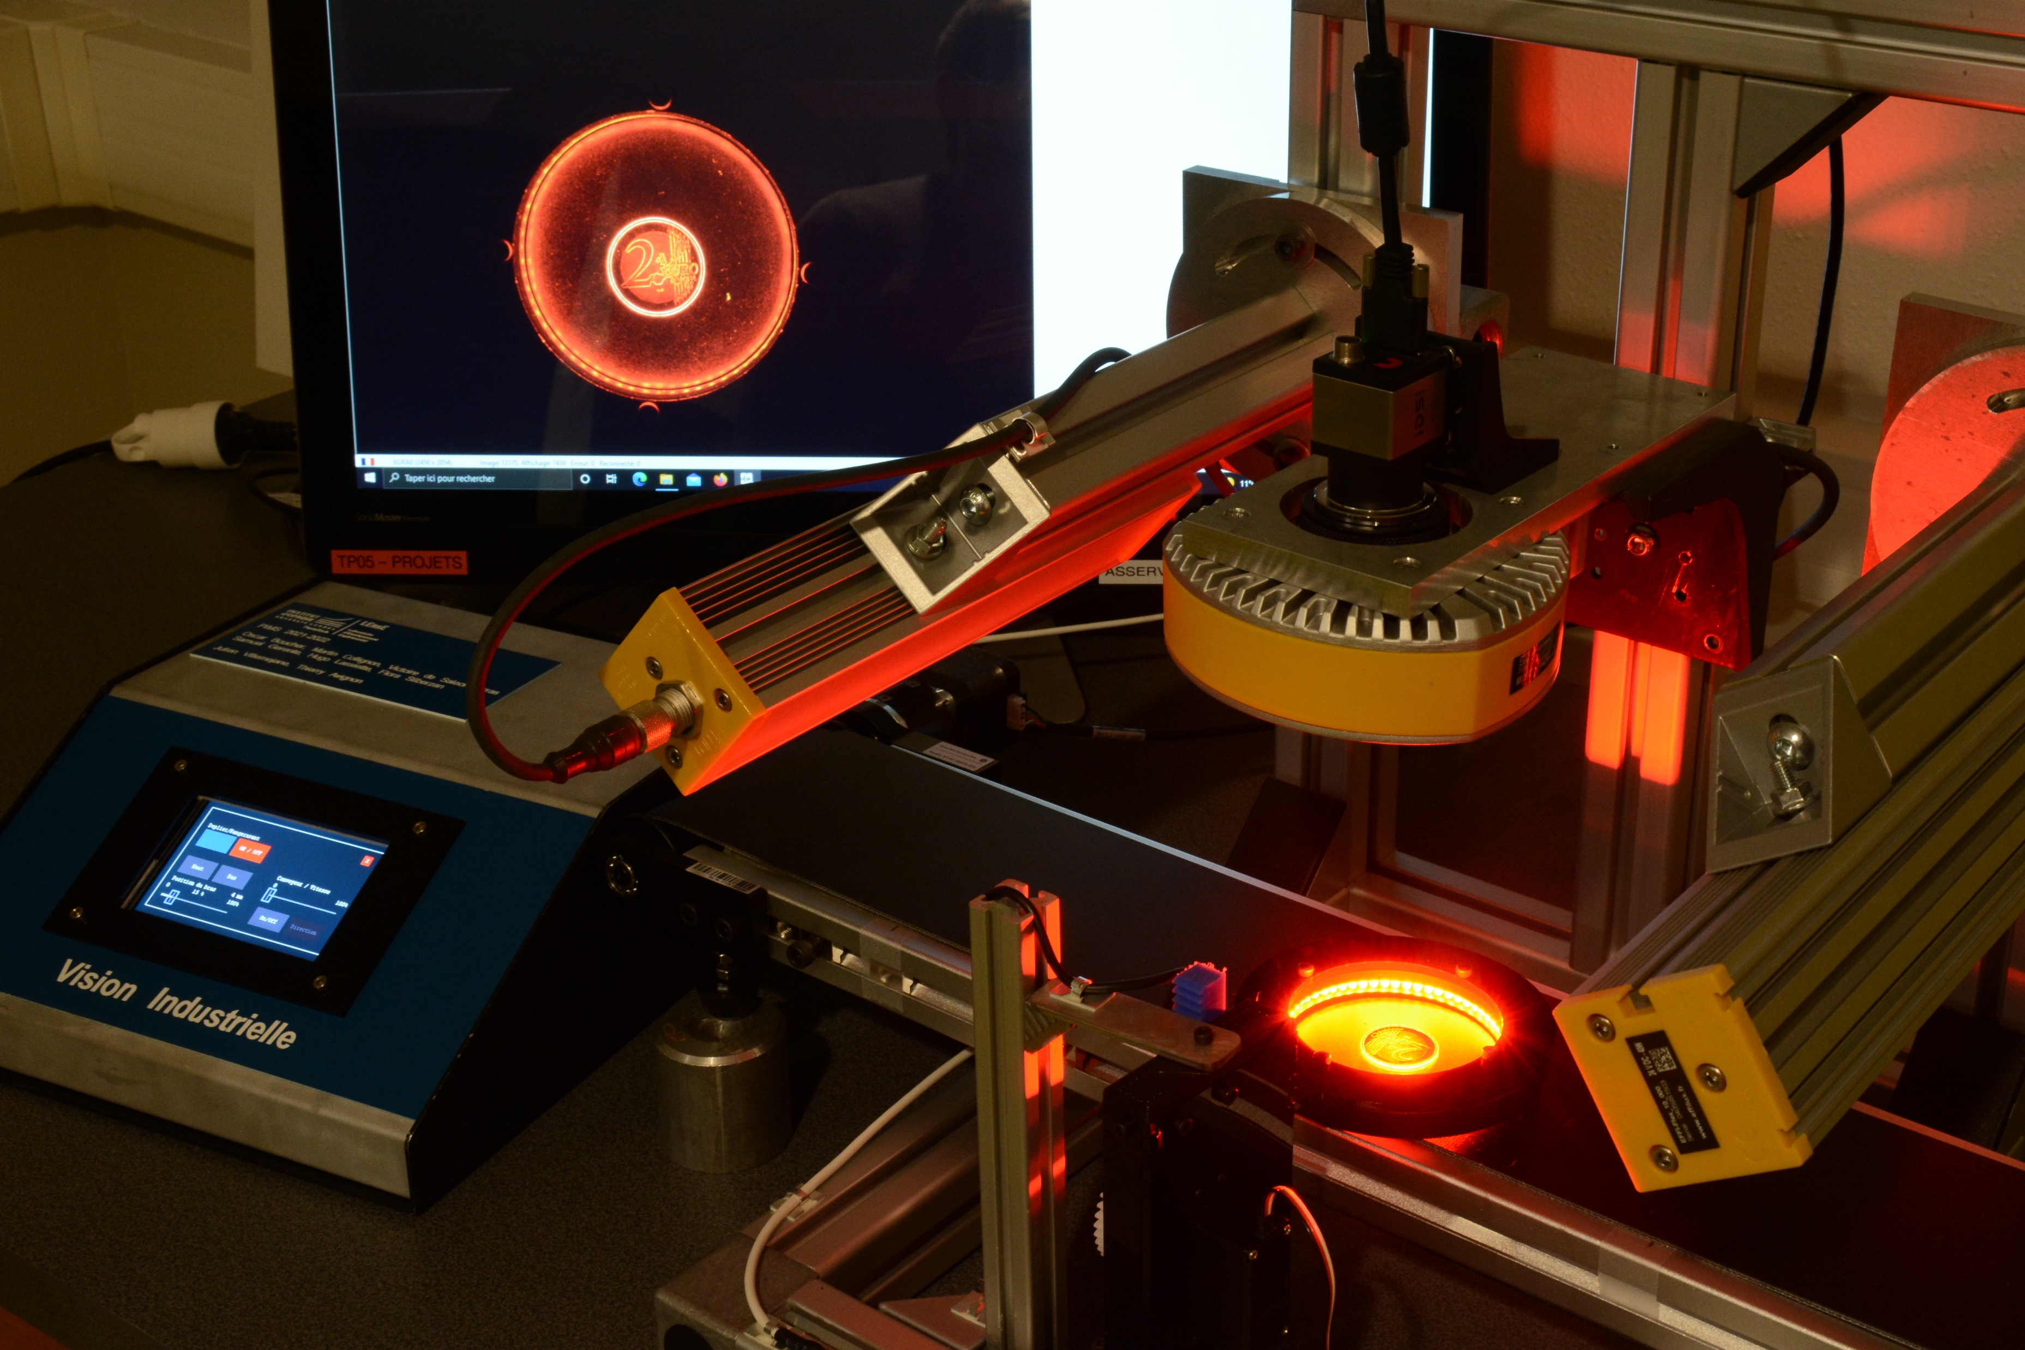

SC19 – Machine Vision
At the end of this training, the learners will be able to:
Describe the goal and the limits of each element of a machine vision chain
AOP
Lighting
Optics
Camera
Image processing

Slide 3
SC19 – Machine Vision for Inspection applications
Goal of a machine vision chain
Machine Vision System
Automating the process of inspecting products or materials in order to ensure quality, consistency, and accuracy in manufacturing or production environments
AOP
Quality Control / Sorting products
- Detect defects or irregularities
- Ensure product consistency
- Count and sort products
Increased Efficiency and Repeatability
- High-speed inspection
- Continuous operation
Making a decision !

Slide 4
SC19 – Machine Vision for Inspection applications
Elements of a machine vision system
Lights
Making a decision !
AOP
Optics
Sensor
Sensor
Camera
Processing Unit
Display
Data

Slide 5
SC19 – Machine Vision for Inspection applications
Step by step
Lighting
Ensuring consistent and accurate image capture, helping highlight defects or features
C
White, RGB, UV, IR ?
Transmitted, reflected light ?
Off-axis low angle, direct ?
Uniformity ?

Slide 6
SC19 – Machine Vision for Inspection applications
Step by step
Lighting
Ensuring consistent and accurate image capture, helping highlight defects or features
Optics
Optics
Ensuring that the camera can acquire high-quality images that accurately represent the objects being inspected on the sensor surface
Camera
Focal length, aperture…
Depth of field
Field of view
Magnification

Slide 7
SC19 – Machine Vision for Inspection applications
Step by step
Lighting
Ensuring consistent and accurate image capture, helping highlight defects or features
Optics
Ensuring that the camera can acquire high-quality images that accurately represent the objects being inspected on the sensor surface
Camera
Camera
Color ? Resolution ?
Matrix or linear ?
Framerate ? Exposure time ? Black Level ?

Slide 8
SC19 – Machine Vision for Inspection applications
Step by step
Lighting
Ensuring consistent and accurate image capture, helping highlight defects or features
Optics
Ensuring that the camera can acquire high-quality images that accurately represent the objects being inspected on the sensor surface
Camera
Camera
Image processing
Reducing noise and enhancing image
Object detection
Processing Unit
Display
Data

