Slide 1

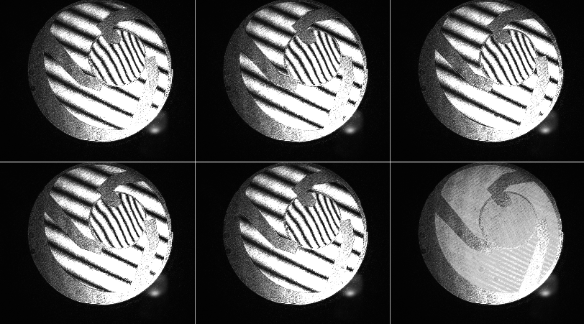
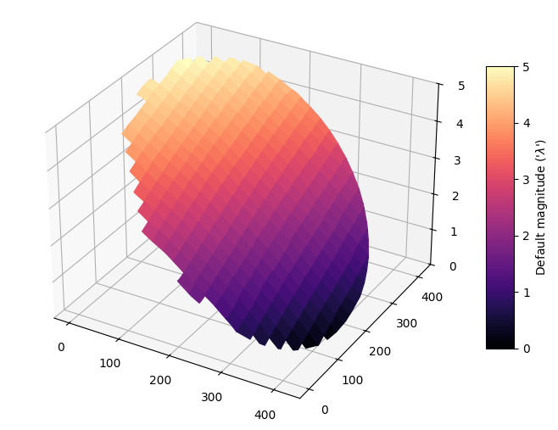
Zygo v3
PyQt6
Zygo Steps for acquisition and analysis
Get Images
Images are intensity measurements of interferences. A set of 5 images is necessary to be demodulated by the Hariharan phase demodulation algorithm.
They can be obtained by Acquisition process (required Hardware) or by opening a MAT file.
Data can be stored in MAT file, containing "Images" (set of 5 arrays in 2 dimensions), "Masks" objects (array(s) in 2 dimensions - same size as images) and "Masks_Type" list.
Acquisition
A set of 5 images are acquired through an IDS camera after moving a piezo actuator at 5 different position : 0, λ/4, λ /2, 3 λ/4, λ - where λ is the wavelength of the source. Optical system must be aligned !
Add Masks
Masks allow to select a part of the images. A set of different masks can be added (circular, rectangular, polygonal).
Process Phase
Images are masked and then used for processing phase (wavefront) by the Hariharan phase demodulation algorithm.
A first step calculates the wrapped phase. A second step calculates the unwrapped phase.
Analyses
Different kinds of analyses can be performed on the wavefront :
Simple view of the wavefront (2D or 3D)
Correction of the wavefront (based on Zernike coefficients)
PSF, MTF, circled energy calculations and displays

Slide 2
ZygoApp
+ data_set
+ main_widget
+ main_menu
+ mode_manager
Zygo v3
PyQt6
MVC pattern
Models
DataSetModel
ImagesModel
MasksModel
PhaseModel
Views
MainView
MainMenu
Surface3D
Surface2D
Surface3Dx2
ImageView
CoefficientsTable
MasksManagerView
MaskZoomView
AcquisitionZoomView
HtmlView
ProgressionBar
…
Controllers
ModesManager
ImagesController
Controllers manage submenu
Modes : Acquisition, Images, Masks, Analysis, Aberrations, Simulation, Correction, Help, Options

Slide 3
Zygo v3
PyQt6
Modes
Acquisition
Camera, Piezo, Zoom for acquisition, Simple Acquisition, Multiple Acquisition
Images
Open a set of images, Diplay a set of images
Masks
Open a mask, Display masks, Manage/Create new masks (C, R, P)
Analysis
Process Wrapped and Unwrapped phase, PV and RMS calculations, Tilt Correction (via Zernike)
Aberrations
Process Zernike/Seidel coefficients, Strehl ratio, PSF, MTF, Circled energy
Help
Display help pages (Alignment, Zygo, aberrations…)
Options
Change langage, change lambda
Correction
???
Simulation
Create simulated wavefront from Zernike coefficient

Slide 4
Zygo v3
PyQt6
Views / MainWidget
MainMenu
Top_left
Top_right
Bot_left
Bot_right
Submenu
Options1
Options2

Slide 5
Zygo v3
PyQt6
Views / MainMenu
options_list
Allows to unactive buttons in the main menu depending on the model (hardware, data, analysis)
+ nocam : No camera is connected (acquisition is not possible)
+ nopiezo : No piezo is connected (acquisition is not possible)

Slide 6
Zygo v3
PyQt6
Acquisition
Images
Masques
Analyse Simple
Aberrations
Simulation
Options
Piezo

Slide 7
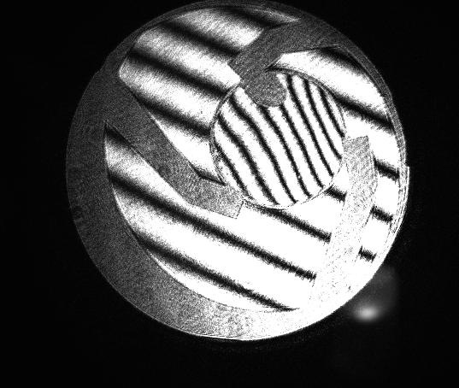
Zygo v3
PyQt6
??
Acquisition
Images
Masques
Analyse Simple
Aberrations
Aide
Ouverture Set
Simulation
Set
Gestion Set
1
2
5
Masques
Sauvegarde
1
Options
Piezo

Slide 8
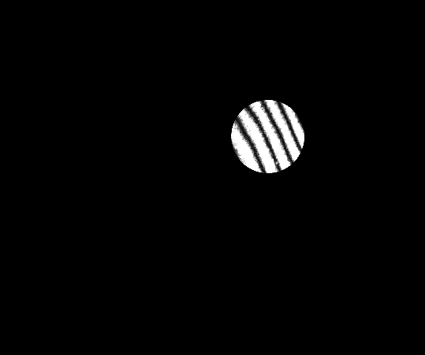
Zygo v3
PyQt6
Acquisition
Images
Masques
Analyse Simple
Aberrations
Aide
Liste des masques
Circulaire
G [SHOW] [INVERT] [DEL]
Simulation
Rectangulaire
1 [SHOW] [INVERT] [DEL]
Polygonal
Options
Piezo

Slide 9
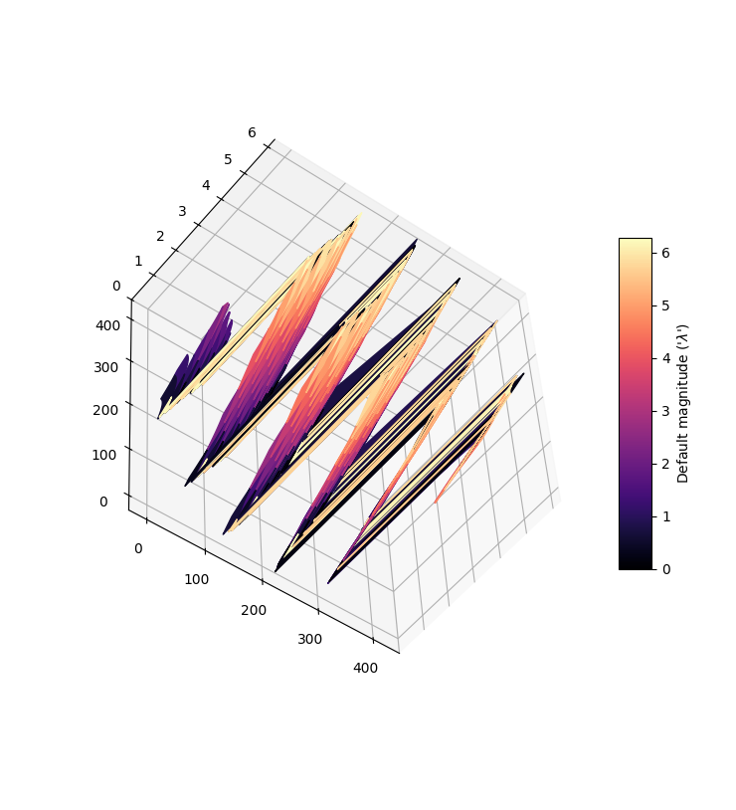
Zygo v3
PyQt6
Acquisition
Images
Masques
Analyse Simple
Aberrations
Wedge Factor […]
Non déroulée
Simulation
PV RMS
Phase Déroulée
1 5,4 1,3
Options
Piezo

Slide 10
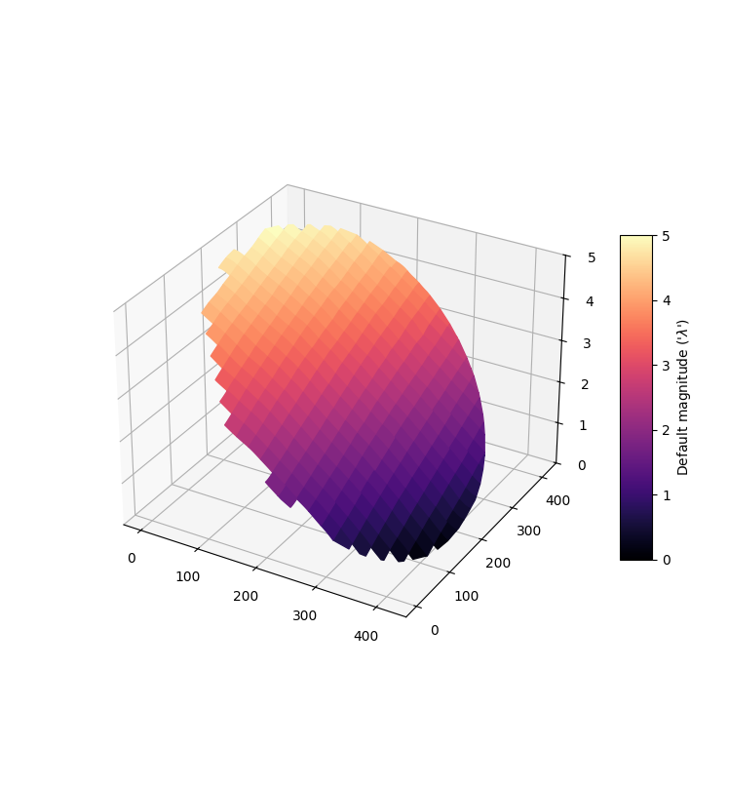
Zygo v3
PyQt6
Acquisition
Images
Masques
Analyse Simple
Aberrations
Wedge Factor […]
Correction
Non déroulée
[] Tilt
Simulation
PV RMS
Phase Déroulée
1 5,4 1,3
PV RMS
1 5,4 1,3
Options
Piezo

Slide 11
Zygo v3
PyQt6
Non corrigée / PV = 5,4 - RMS = 1,3
Acquisition
Images
Masques
Zernike (0 -> 36)
Analyse Simple
Aberrations
Coefficients (table)
Zernike
Simulation
Seidel
Options
Piezo

Slide 12
Zygo v3
PyQt6
Non corrigée / PV = 5,4 - RMS = 1,3
Caméra
Images
Masques
Acquisition
Zernike (0 -> 36)
Analyse Simple
Correction
Corrigée/ PV = 5,4 - RMS = 1,3
Aberrations
[] Tilt
[] Defocus
[] Astigmatisme
Correction
[] 3 [] 5 [] 7 [] 9
[] Coma
Analyse Poussée
[] 3 [] 5 [] 7 [] 9
[] Ab. Sphériques
[] 3 [] 5 [] 7 [] 9 [] 11
[] Trefoil
Options
[] 5 [] 7 [] 9
Piezo

Slide 13
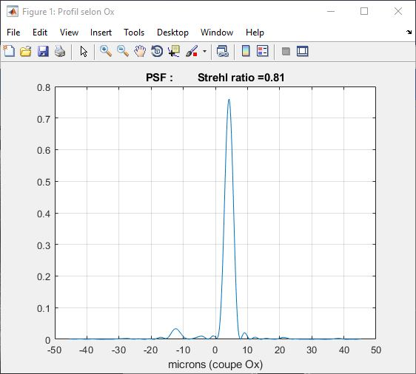
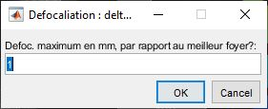
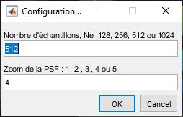
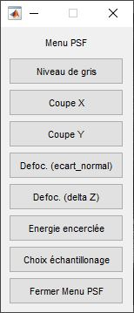
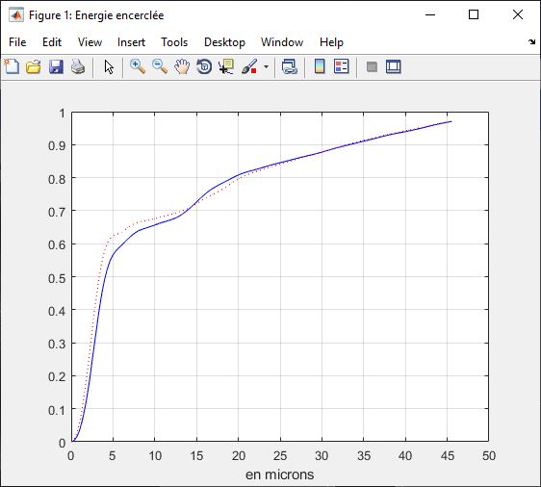
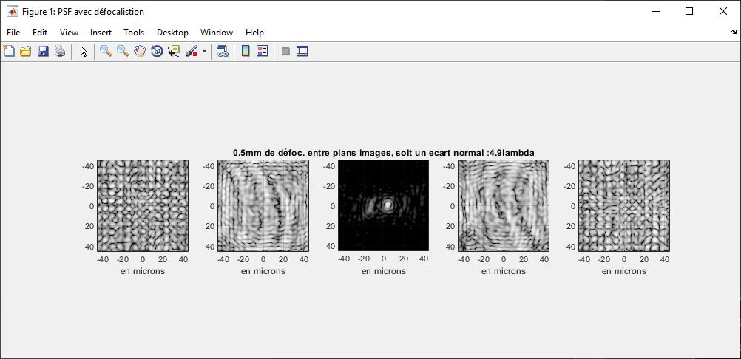
Zygo v0
OLD

Slide 14
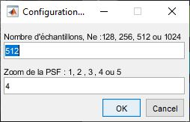
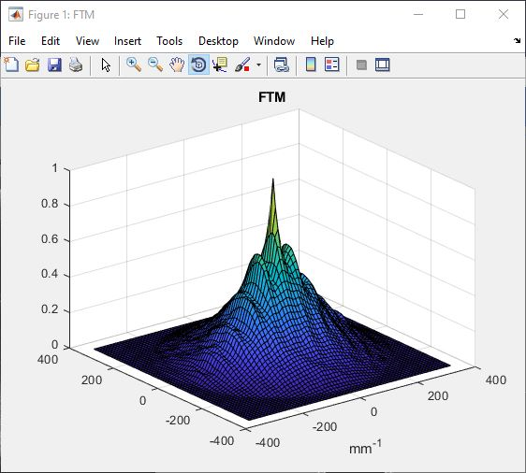
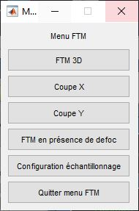
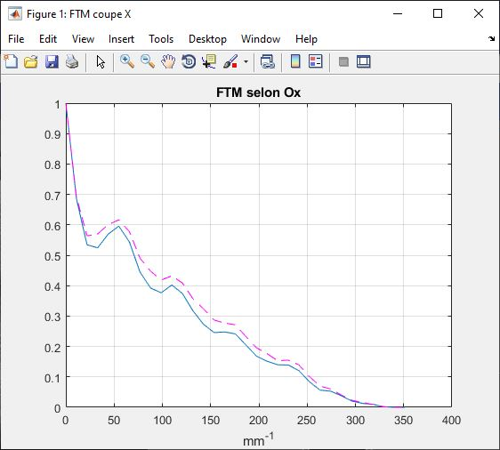
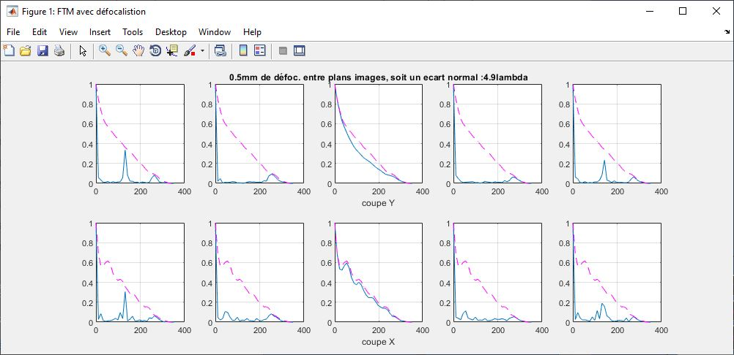
Zygo v0
OLD

Slide 15
Zygo v2
PyQt6
Caméra
Images
Masques
Acquisition
Analyse Simple
Aberrations
Spot Diagram
Correction
PSF
Analyse Poussée
FTM
Options
Piezo

Slide 16
Zygo v2
PyQt6
Caméra
Images
Masques
Acquisition
Analyse Simple
Aberrations
Correction
Analyse Poussée
Options
Piezo

