Slide 1

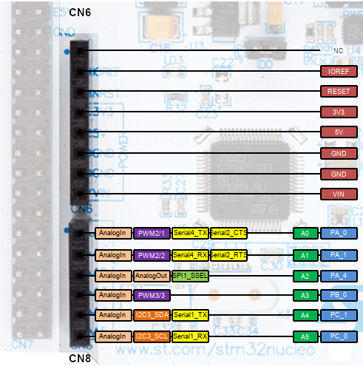
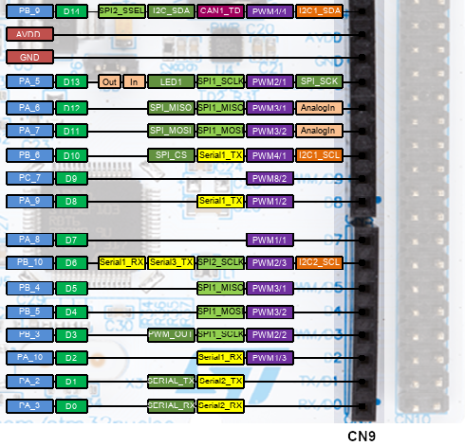
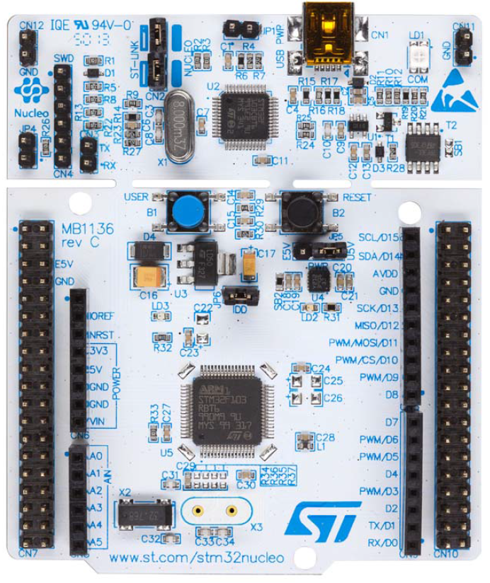
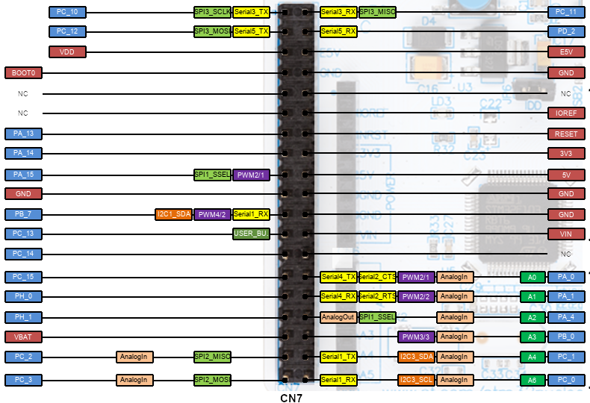
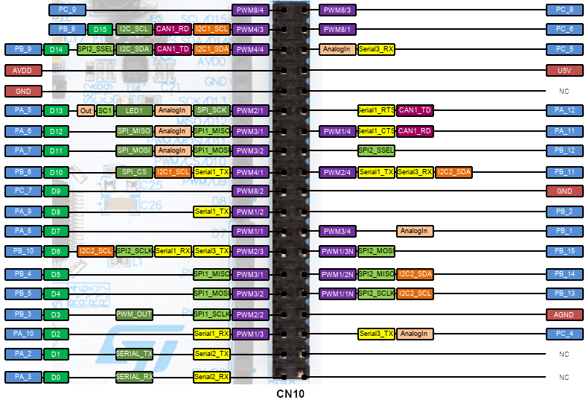
LEnsE.tech
Nucléo-64 board / STM32L476 / Pins
BUTTON1
MINI-USB
LED1
CONNECTOR
ARDUINO 1
CONNECTOR
ARDUINO 2
CONNECTOR
MORPHO 1
CONNECTOR
MORPHO 2

