Slide 1
FT
f
-Fs
-Fs/2
0
Fs/2
Fs
FT
f
-Fs
0
Fs

Slide 2
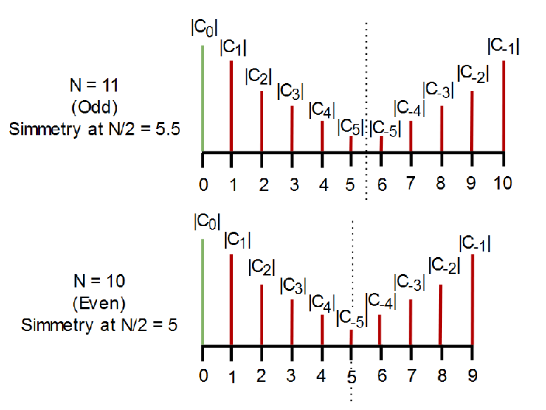


Fourier Transform of a sampled signal
$$∆f=Fs/N$$
FT
X[N-1]
X[0]
X[k]
f
0
Fs
$$k×∆f$$
N samples

