Slide 1
Computer Vision / L476 board
Control of computer vision bench / Dobot conveyor
Functions
Step Motor Control (x2)
Step Motor Driver – TMC2100
RF data transmission
RN41/42 – Evaluation Board XV
Position sensor SEN0239 (x3)
Light control (x3 – R / G / B)
PROJECT VERSION
Based on Nucleo L476RG board

Slide 2
Computer Vision / L476 board
Control of computer vision bench / Dobot conveyor
TX
PC_10
Morpho Gauche / Nucléo
PC_11
RX
POUSS. 3
PC_9
Morpho Droit / Nucléo
PC_8
POUSS. 2
PC_12
PD_2
GPIO2_STATUS
PB_8
PC_6
POUSS. 1
E5V
PB_9
PC_5
GND
AVDD
U5V
GND
nRF24 / SCK
PA_5 / SCK
PA_12
PA_13
nRF24 / MISO
PA_6 / MISO
PA_11
LED 1
PA_14
3.3V
nRF24 / MOSI
PA_7 / MOSI
PB_12
PA_15
5V
D10 / CS
PB_11
LED 2
GND
GND
nRF24 / CSN
PC_7
GND
RESET_N
PB_7
GND
nRF24 / IRQ
PA_9
PB_2
PC_13
Vin
nRF24 / CE
PA_8
PB_1
MOT1_CFG3
CAPT 1
PC_14
MOT2_EN
PB_10
PB_15
MOT1_CFG2
CAPT 2
PC_15
PA_0
MOT2_STEP
PB_4
PB_14
MOT1_CFG1
CAPT 3
PH_0
PA_1
MOT2_DIR
PB_5
PB_13
MOT1_EN
ECLAIR 3
PH_1
A2
V_OUT_REF
MOT1_DIR
PB_3
AGND
Not Used
PB_0
MOT1_STEP
PA_10
PC_4
MOT1_STEP*
ECLAIR 2
PC_2
PC_1
D1
Digital Output
ECLAIR 1
PC_3
PC_0
D0
Digital Input
Analog Input
Analog Output
* Must be set as input

Slide 3
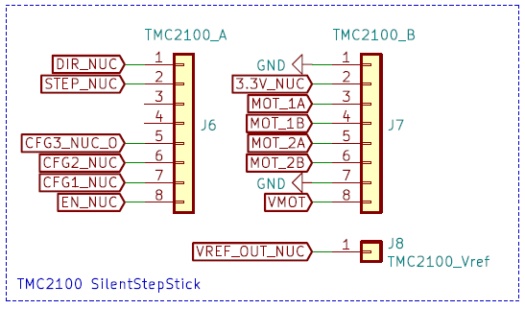
TMC2100 – Step Motor Driver
Step Motor Driver / Motor 1 / TMC2100
MBED6 Library : https://github.com/IOGS-LEnsE-embedded/MBED6_SupOpLibraries/tree/main/TMC2100
Nucleo Board
TMC2100 / Motor1
GND
3.3V
PB_3
MOT1_DIR
PA_10
MOT1_STEP
PB_1
MOT1_CFG3
PB_15
MOT1_CFG2
PB_14
MOT1_CFG1
PB_13
MOT1_EN
PC_4
PWM
MOT1_STEP
A2
V_OUT_REF
Not Used
Digital Output
Digital Input
Analog Input
Analog Output

Slide 4
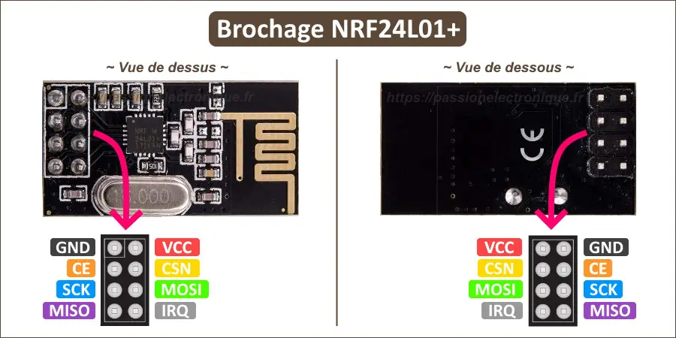
nRF24 – RF transmission
nrF24L01 module for RF data transmission
MBED6 Library : https://github.com/IOGS-LEnsE-embedded/MBED6_SupOpLibraries/tree/main/nRF24
Nucleo Board
GND
nRF24L01 / RF
3.3V
PA_9
IRQ
PA_8
CE
PC_7
CSN
PA_6 / MISO
SPI
MISO
PA_7 / MOSI
MOSI
PA_5/ SCK
CLK
Not Used
Digital Output
Digital Input
Analog Input
Analog Output

