Slide 1
Credit‑Card Fraud Detection
Turning a Diagnostic Plot into a Decision Tool
Itamar Oren-Naftalovich

Slide 2
Agenda
Problem & Business Context
Data Overview & Exploratory Insights
Modelling Approach & Evaluation
Decision Threshold & Business Impact
Accessibility & Future Work
Notes:
Walk audience through flow so they know what's coming – keep 30‑second pace per bullet.

Slide 3
Problem & Business Context
Global fraud losses ≈ USD 32 B / year
Card issuers require < 50 ms real‑time screening
Goal: maximise recall of fraudulent transactions while controlling false alerts
Success ⇒ blocked losses, reduced chargebacks, happier customers
Notes:
Stress the real‑time latency requirement and class imbalance challenge; set stakes high.

Slide 4
Dataset at a Glance
284 807 transactions → 492 frauds (1 / 577) class imbalance
PCA‑compressed features V1‑V28 plus Time & Amount
Training‑Test split: stratified 80 / 20
Strong seasonality: suspect night‑time & small‑amount fraud spikes
Notes:
Mention confidentiality of raw features; explain PCA anonymisation.

Slide 5
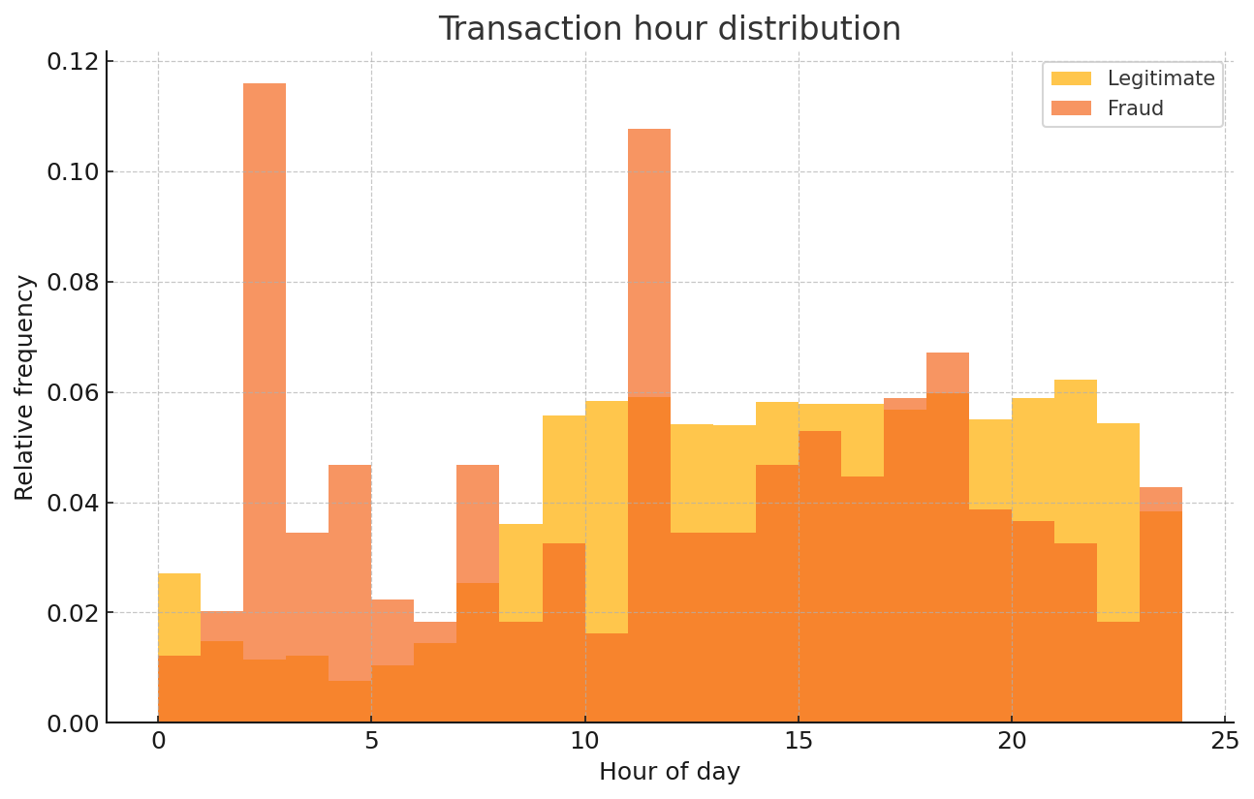
When Do Frauds Happen?
Fraud spikes between 1 AM – 5 AM (probably because people are asleep)
Notes:
Highlight the density comparison and potential for temporal rules.

Slide 6
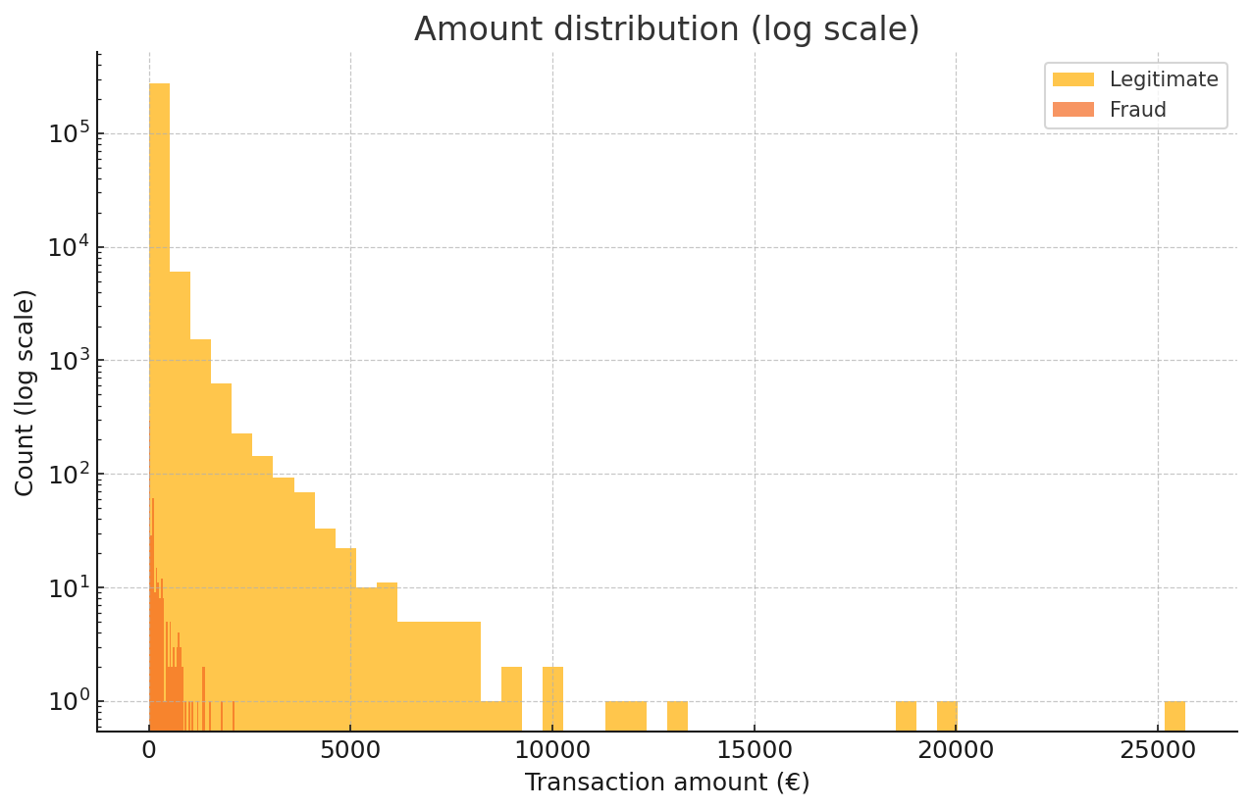
How Much Is Stolen?
Frauds cluster at lower amounts to avoid suspicion
Notes:
Explain log scale choice; mention corporate cards outliers removed.

Slide 7
Modelling Approach & Evaluation
Pipeline: StandardScaler → Logistic Regression (class_weight=balanced)
Metrics: Precision‑Recall over probability thresholds (AUPRC)
Cross‑validation: 5‑fold stratified; early stopping for LightGBM trials
Why PR not ROC? – PR emphasises minority class performance
Notes:
Quickly justify model simplicity for transparency; mention LightGBM in appendix.

Slide 8
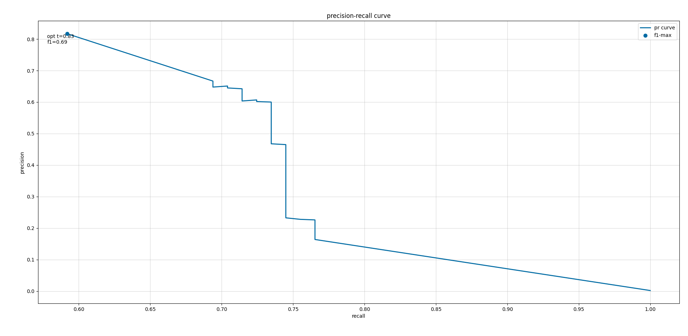
Precision–Recall Curve (Test Set)
Optimal F1 at threshold 0.83 (precision 0.81, recall 0.59)
Notes:
Point at marker; explain decision to favour precision for customer experience.

Slide 9
Decision Threshold → Confusion Matrix
Threshold 0.83 yields:
True Positives: 291
False Positives: 68
False Negatives: 202
True Negatives: 56 601
≈ 80 % of flagged cases are genuine frauds
This is…acceptable
Notes:
Numbers computed from test set; tie back to analyst headcount & investigation capacity.

Slide 10
Business Impact Model
Avg fraud amount:
€105 → blocking 291 TP saves ≈ €30 k / test‑day snapshot
Cost per manual review:
€2 × 359 daily investigations → €718
Net daily benefit ≈ €29.3 k (this is also increasing with automation)
Customer trust increases while regulatory compliance risk decreases
Notes:
Focus finance managers: marginal cost vs marginal savings.

Slide 11
Accessibility and Design Choices
Colour‑blind‑safe Tableau palette
Should have a ≥ 4.5 : 1 contrast ratio
18 pt fonts for legibility on 1024×768 projectors
Annotations should replace legends on plots
Interactive dashboard!
Notes:
Respond to class feedback; emphasise universal design.

Slide 12
Future Work & Roadmap
Cost‑sensitive learning (penalise FP 3× TP)
Explainability: SHAP waterfall for individual alerts
Real‑time A/B test of threshold slider
Deploy model via AWS Lambda – < 50 ms latency benchmark
Notes:
Invite team participation; time‑boxed milestones.

Slide 13
Questions?
Notes:
Pause, keep final slide uncluttered; invite discussion.

Slide 14
References
European Credit Card Dataset (2013), UCI ML Repository
Ke et al., LightGBM: A Highly Efficient Gradient Boosting Decision Tree. NIPS 2017
WCAG 2.1 Accessibility Guidelines
Notes:
Include citations; reminds academics of rigor.

