Slide 1
WEB DEV SIG

Slide 2
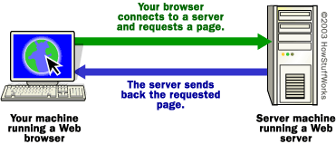
Simplified Explanation of Web browser and Web Server
The content on the Web is available because the Web is a network of computers all over the world.
The interconnected devices on the Web use a communication standard known as http (hypertext transfer protocol).

Slide 3
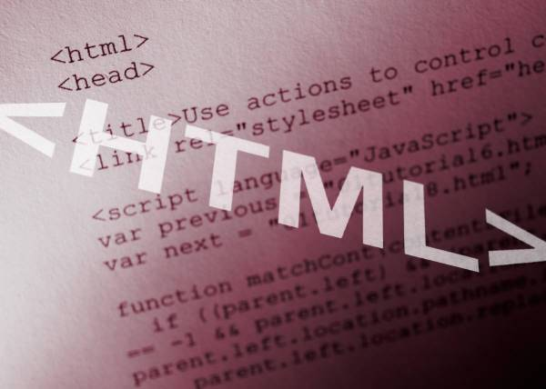
What are Web Pages
A web page is a document which can display text, graphics, audio, video and other elements through a web browser.
Web pages are documents stored on web servers.
Web pages contain instructionson how to display content. The most common instructions are in hypertext markup language (HTML).

Slide 4

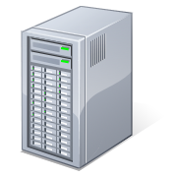



You request a web document through your Web browser.
DNS Server
Checks domain name and finds address of web server
Client computing device
Web Host or Web Server
Sends requested document to your browser

Slide 5
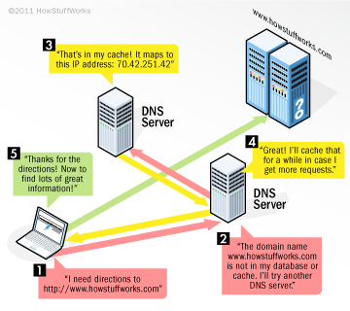
DNS Servers and IP addresses

Slide 6
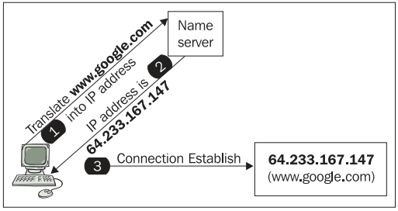
IP addresses are required
An IP address is a unique string of numbers separated by periods that identifies each computer using the Internet Protocol to communicate over a network

Slide 7

Role of the Web Server
Web servers are also called web hosts.
The web server fetches pages by request and sends them to the client’s browser.

Slide 8

Role of the Web Browser
HTML code is interpreted by a web browser. (a software application designed to retrieve and present content on the Web)
The web browser displays the page by reading the instructions in the web document.
It fetches a Web page from a server by a request. A standard http (hypertext transfer protocol) request includes a page address. For example: http://www.w3.org/standards/about.html

Slide 9

A Web site is a collection of related webpages with a starting point or home page.
What is a Web site?
Web pages are organized in a directory structure on a web server. The web server runs special software to serve up the content by responding to requests.
The content on the Web is available because the Web is a network of computers all over the world.

Slide 10
HTML (hypertext markup language) is a mark up language which means that special codes are used to define elements. It is not a scripting or a programming language.
HTML Defined
HTML code is often referred to as source code. HTML can be coded using a plain text editor.

Slide 11
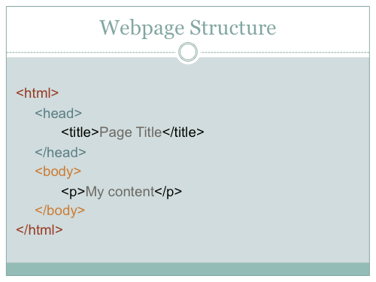
HTML Structure

Slide 12

Web Address
An address or Uniform Resource Locator (URL) is the method for locating a document on the Web. The URL typically points to the home page or default page (often index.html) that is located in the root folder of the website.
The Domain Naming System (DNS) translates the domain names in the URL to IP addresses (Internet Protocol). Every device on the internet has an IP address. IP address are how devices find each other on a network.

Slide 13
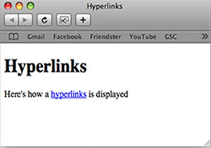
Hyperlinks
The documents within a web site are typically hyperlinked and a navigation system (or menu) permits the user to move between pages.
A simple website could be organized in just one folder, but large websites need to be organized in some manner because of the large number of files.

