Slide 1


Slide 2
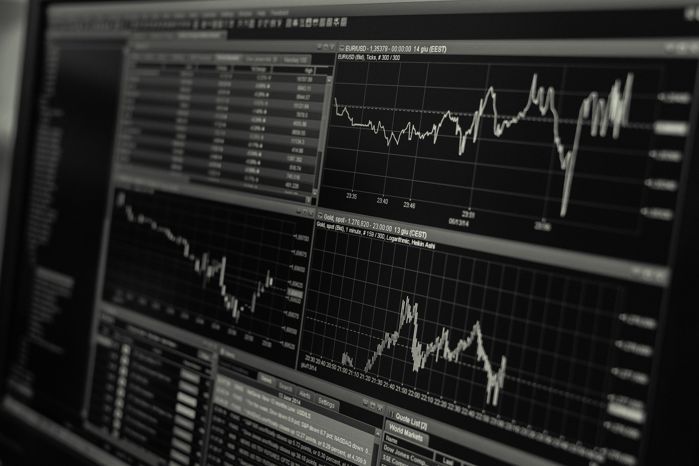
Everyone can be a fund manager
Invest with same-class of investors
Hertz

Slide 3


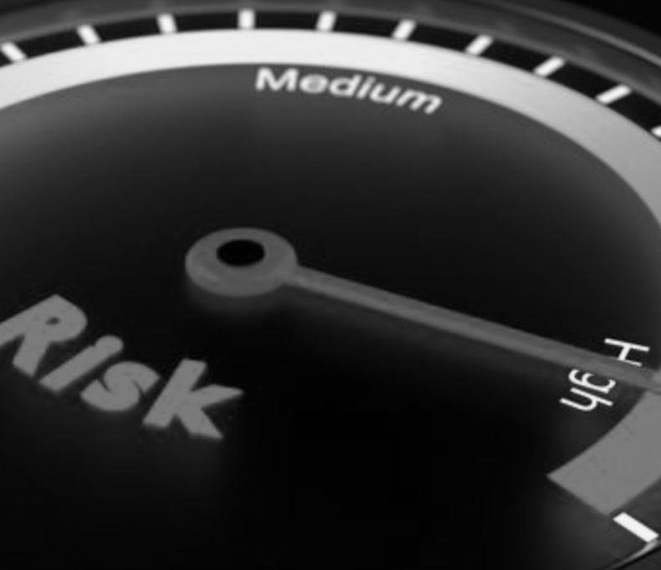



1. High standard of being an investment manager
2. Complicated vetting is needed for investors
3. Investors' money is in the hands of the investment company, so there is risk involved
4. The products in the portfolio are unknown
Traditional Asset Management Platforms
High standard of being an investment manager
Complicated vetting is needed for investors
Investors' money is in the hands of the investment company, so there is risk involved
The products in the portfolio are unknown
Hertz
Hazima nail
Hazima nail
Designer.
Designer.
The project encompasses every design interior
The project encompasses every design interior
The project encompasses every design interior
Hazima nail
Designer.

Slide 4
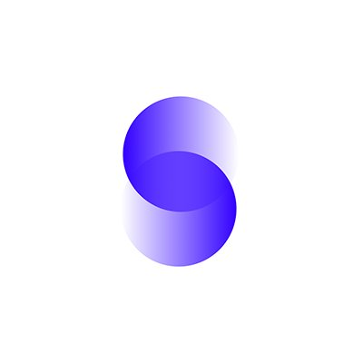
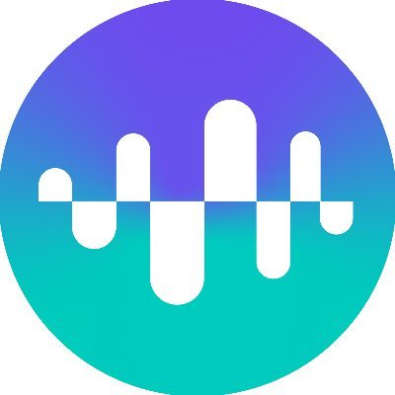
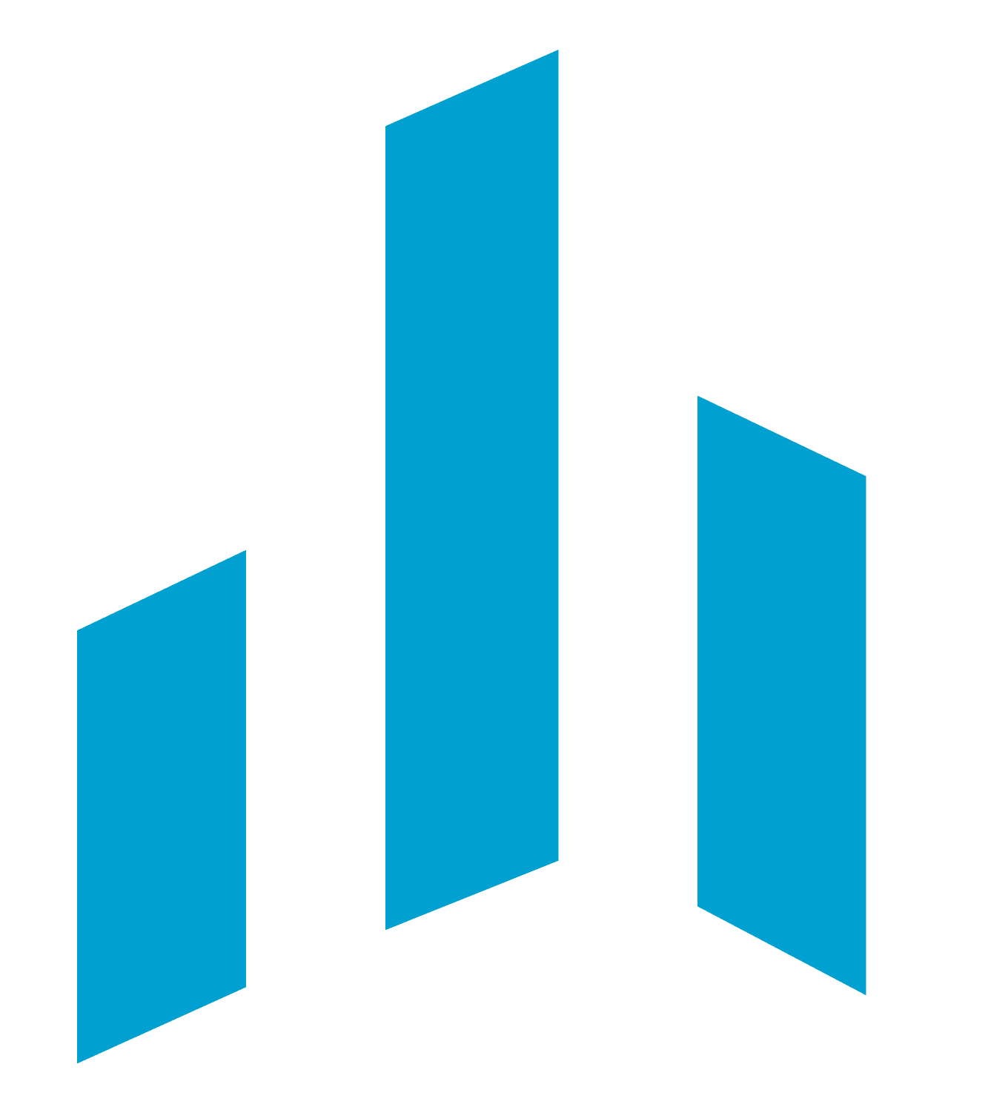
1.Enzyme、Dhedge、TokenSets
2.Extremely high gas costs with poor using experience
3.Homogeneous kinds of investments
4.Lack of interaction and social intercourse between users
5.Low Total Value Locked
Asset Management Platforms in Blockchain
Extremely high gas costs with poor using experience
Homogeneous kinds of investments
Lack of interaction and social intercourse between users
[Enzyme、Dhedge、TokenSets]
Low Total Value Locked
Hertz

Slide 5
1. Provide new investment products
2. Reduce gas costs and enhance using experience
3. Found more playing methods, attract more users and highlight the social intercourse
Issues need to be addressed
Provide new investment products
Reduce gas costs and enhance using experience
Found more playing methods, attract more users and highlight the social intercourse
Hertz
Reduce gas costs and enhance using experience

Slide 6
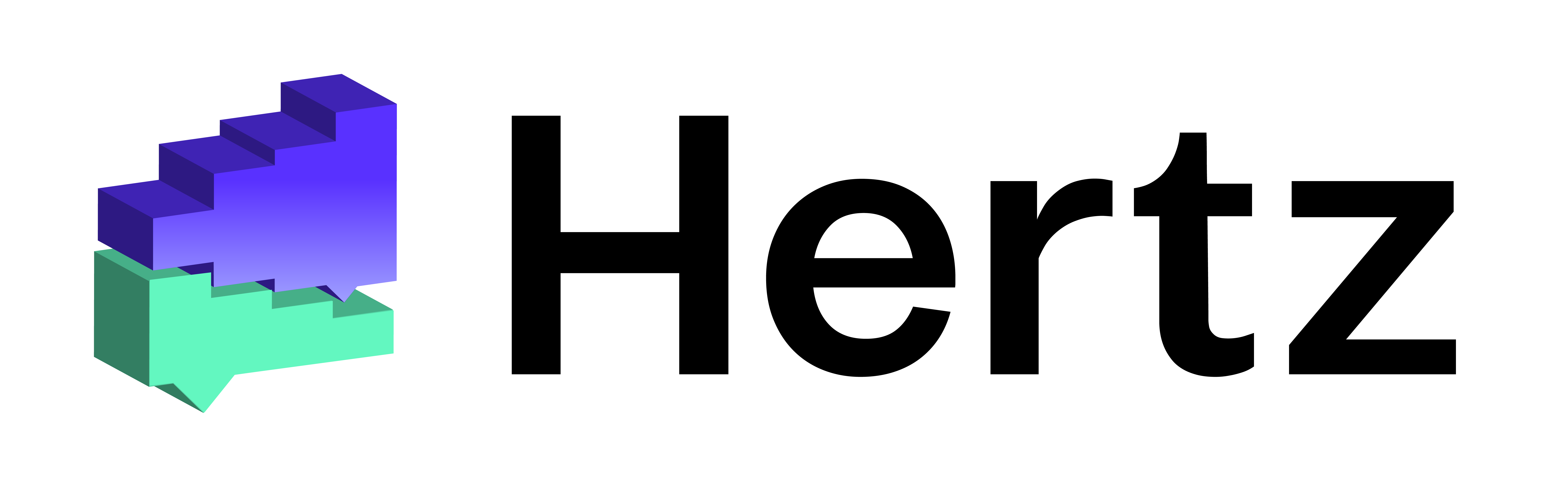
Hertz
1.The l2 asset management platform deployed on MATIC
2.Composite assets in sushi100 and Synthetix is acceptable
3.No entry barrier, but large investments need to be examined
4.Secure, price quoted using Chainlink and all assets are in trust to smart contracts
5. Multiple playing methods, pledges, airdrops, IDO, governance voting, lottery
网页超链接
Composite assets in sushi100 and Synthetix is acceptable
No entry barrier, but large investments need to be examined
The l2 asset management platform deployed on MATIC
Secure, price quoted using Chainlink and all assets are in trust to smart contracts
Multiple playing methods, pledges, airdrops, IDO, governance voting, lottery
Hertz
https://hertzfinance.github.io/hertz-dapp/#/

Slide 7
Rosonance is a portfolio created by the investment manager on the platform. There will be two divisions：
The first division is a no-threshold portfolio with a maximum of $300,000 to invest.
The second division is a Gold zone verified by Hertz-team, without investment cap
Each Rosonance has a posting board where investors can communicate with each other and meet the same-class investors
The first division is a no-threshold portfolio with a maximum of $300,000 to invest.
Rosonance is a portfolio created by the investment manager on the platform.
Each Rosonance has a posting board where investors can communicate with each other and meet the same-class investors
The second division is a Gold zone verified by Hertz-team, without investment cap
Hertz

Slide 8

Users are free to create a portfolio without any threshold
Select a maximum of 10 investments and set the ratio randomly
The investment manager needs to link his/her personal Twitter and supplement your social watchlist
Customized charge for management fees, profit fees, access fees
Lottery available for portfolios under management up to $100,000
Investment Manager
Hertz

Slide 9

Users are free to create a portfolio without any threshold
Select a maximum of 10 investments and set the ratio randomly
The investment manager needs to link his/her personal Twitter and supplement your social watchlist
Customized charge for management fees, profit fees, access fees
Lottery available for portfolios under management up to $100,000
Able to see the historical performance of the investment manager
Invest in any portfolio arbitrarily
Charge fees of fund managers and a 2% service fee
Can leave messages to investment managers or investors under the message board to communicate
A lottery ticket will be given when invest over $3000
Investors
Hertz

Slide 10
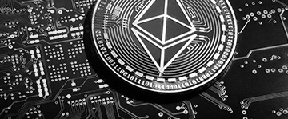
Hertz Index
The Hertz Index is a collection of the top 20 profitable portfolios on the Hertz platform
The Hertz Index snapshot of the underlying portfolio will be taken every Sunday
The Hertz Index is managed by a robot which will track all the portfolios on the platform automatically
Score = Sortino Ratio * SQRT (7-day average pool value)
The Hertz Index is an active ETF which will track the best-performing investment manager on the platform to generate more profits for investors.
Hertz

Slide 11
Robust low-risk portfolios published on the Hertz platform
Using the Hertz smart contract sdk, the algorithm was developed by the Hertz development team
Invest by seeking external investment portfolios which are break-even
Operated by robots, looking for arbitrage opportunities in the chain
Hertz Fixed Income Portfolio
Robust low-risk portfolios published on the Hertz platform
Using the Hertz smart contract sdk, the algorithm was developed by the Hertz development team
Invest by seeking external investment portfolios which are break-even
Operated by robots, looking for arbitrage opportunities in the chain
Hertz

Slide 12

Platform Profit Model
Hertz Index: the platform charges a 1% commission fees and 10% profit (5% profit can be deducted for using governance tokens)
Various portfolios: 2% commission fees are charged by the platform (1% can be deducted for payments with governance tokens)
Platform Profit Model
Hertz Index: the platform charges a 1% commission fees and 10% profit (5% profit can be deducted for using governance tokens)
Various portfolios: 2% commission fees are charged by the platform (1% can be deducted for payments with governance tokens)
Hertz

Slide 13
Hertz Lottery
Investment Manager Lottery Pool and Investor Lottery Pool
Bonus from: 20% of platform commission income
Hertz Lottery
Hertz Lottery
Investment Manager Lottery Pool and Investor Lottery Pool
Bonus from: 20% of platform commission income

Slide 14
Investor Lottery
Investor Lottery
The l2 asset management platform deployed on MATIC
The price is 75% of the pool
Weekly run
The price is 25% of the pool
Specific awards
Weekly run
Specific awards
Investment Manager Lottery Pool
Investor Lottery
The price is 25% of the pool
The price is 75% of the pool
Weekly run
Weekly run
Specific awards
Specific awards

Slide 15
IDO
“
Based upon the traffic and users on the Hertz platform
Provide high-quality project research, market analysis, and the opportunity to invest in early-stage private sales.
Hertz

Slide 16
Team member
[ Seabook ] Product Designer, Solution architecht and Smart Contract Developer.
[ Victor] Product Manager, Designer and Owner. Will be responsible for the pitch.
[ Michael ] ReactJS, Web3JS + UI developer
[Nami] UI and UX Designer
THANK YOU

