Slide 1





Hands On IoT
09 de maio – 09:30 – Main Hub
Windows 10 IoT
João Almeida
@jalmeida

Slide 2
Agenda
Contents:
Windows 10 IoT
Tryout Athens on Rpi2

Slide 3

Convergence
Windows Embedded Standard 8
Converged
OS kernel
Windows Embedded 8.1
Windows Embedded 8
Converged
app model
Windows 10
Windows Embedded 8.1 Handheld
Windows Embedded 8 Handheld
Windows Embedded Handheld 6.5
Windows on Devices
Notes:
[Purpose of this slide: Set the context that when we say “Threshold” we mean the converged platform.]
Nothing shows “One Windows” more than the way our platforms are converging, a journey which ends with Windows “Threshold”
With the release of Windows 8 we laid the foundation.
Windows Phone 8 took advantage of this. And, Xbox One was built on top of Windows 8 and even uses the same runtime.
With the release of Windows Phone 8.1 the runtimes from phone and desktop came together. Over 90% API convergence.
Threshold brings EVERYTHING together, the foundation is the same, kernel, drivers etc. – from PCs to phones, to IoT devices
And the application platform is the same across all of these devices.

Slide 4
Win10 Platform
Standard
Windows 10 “Industry”
POS Terminals
Thin Clients
Specialized Devices
ATM
Mobile POS
Kiosks
Mobile
Windows 10 “Mobile”
Handheld Terminals
Compact
Windows 10 “Athens”
Windows Embedded Compact
Printers
Logic Controllers
Micro Kiosks
IoT Gateways
Diagnostic Test Equipment
Micro
.NET Micro Framework
Smart Sensors
Vending Machine
Wearables

Slide 5
Win10 “Industry”
Bringing Windows to a Standard Class of IoT Device
Built on x86/x64
The full version of Windows with advanced lockdown capabilities, Win32 compatibility and modern app support for standard industry devices.
Universal App & Driver Support
Windows 10 “Industry”

Slide 6
Win10 “Mobile”
Bringing Windows to a Mobile Class of IoT Device
Built on ARM or x86
A version of Windows for Industry Devices that need mobility, rich recognizable user experiences, excellent battery life.
Universal App & Driver Support
Windows 10 “Mobile”

Slide 7
Win10 “Athens”
Bringing Windows to a Compact Class of IoT Device
Built on ARM or x86/x64
An optimized small footprint version of Windows for resource and cost constrained devices with the full power of modern application development with Universal App and Driver support.
Windows 10 “Athens”

Slide 8
Editions
Requires desktop or desktop apps– Win32, .NET, WPF, etc. ?
Windows Industry
Desktop Shell, Win32 apps
1 GB RAM, 16 GB Storage
Windows “Device Services”
On all Windows IoT clients
Extends value of Windows Services to OEMs
High value scenarios
-Auditing, updating, telemetry, flighting
Requires a Shell experience, multiple applications, Windows first-party applications, or mobile voice?
Windows Mobile
Modern Shell
Mobile Chassis requirement
512 MB RAM, 4 GB storage
Otherwise
Windows ”Athens”
Dedicated devices
No Shell/Store/MS Apps
256MB RAM, 2GB storage
Universal Apps

Slide 9
Feedback oriented
Feedback we’ve heard in the past!
Feedback | Windows 10 “Athens”
Products are fragmented, tools are out of date. It’s difficult to develop apps because of the variety of OS offerings. | Consolidating onto Threshold OS core, tools & processes and one standardized Windows 10 “Athens” image for all products
Activation is a blocker | No activation required
Must NOT have any Windows / Microsoft UI – period | Windows 10 “Athens” has no specific “Windows UI” – No explorer / shell, No pre-loaded Apps or branding
A significant percentage of new IoT devices will be headless and UI will be remoted to Smartphones, Tablets and web UI. | Node.JS, Python, .net, Cloud connectivity
The ability to build consistent app experiences across multiple devices | Universal App Platform, XAML, HTML5, Cloud Connectivity
OS must be secure and maintainable over time, kept current with other OS offerings | Windows security. Supports update/servicing scenarios

Slide 10
Supportability “Athens”
Small footprint version of Windows 10
Provides capabilities customers already love & expect with Windows: security, update, tools, apps, manageability targeting devices
Uses the same development tools for all Windows 10 devices
Universal app & Driver support across Windows client devices – PC, Phone, Xbox, IoT Clients
Targeting a wide range of low cost IOT devices
Common image, common SDK: no more costly & confusing custom images and custom SDKs
Support for wide range of devices with different capabilities and price points
SoCs and developer boards widely available
Low cost and small footprint enables a range of low cost SoCs/boards
Low cost hobbyist devices and tools (eg. Raspberry Pi 2)

Slide 11
Supportability “Athens”
Supports x86, x64 and ARM chipsets
Ships initially with chipsets supported by Mobile and Desktop Windows with more support coming online post RTM.
A “BSP kit” will be made available so other SV / OEMs can bring up chipsets & systems on their own supporting Windows 10 “Athens”.
Minimum Hardware Requirements
400 MHz or faster. (x86 requires PAE, NX and SSE2 support.)
Headless
256M RAM (128 MB free to OS) / 2 GB Storage
Headed
512 M RAM (256 MB free to OS) / 2 GB Storage

Slide 12
Supportability “Athens”
Athens is a single image that can be configured to boot with (headed) or without (headless) display support
Configured at image creation time with ICD
In headed mode Windows video stack & UI components will be launched
Multiple headed and headless applications can be installed on the device.
The shell infrastructure,
Will launch all configured Startup Tasks from all installed headed and headless apps
Will, in headed mode only, launch the one UAP application configured to provide the OEM user experience.
The shell will monitor launched apps and tasks and auto restart any that have unexpectedly terminated.

Slide 13
Features
Shell Host Bluetooth Busses APIs GPIO/I2C/SPI Multimedia DirectX Warp Graphics Codecs - Audio (Microsoft) Codecs - Video (Microsoft) App Development UAP UI Framework App Runtime XAML Core CLR10 Core CRT120 Browser Control Core networking Ethernet over USB Firewall | QoS NTP Time Synchronization RAS/VPN Support RAS Connection Manager Routing Information Protocol Services for NFS SMB/CIFS File Sharing Connection Sharing WLAN WIFI DNS-SD Cellular Data Only SD Partitioning and Boot Fonts Biometrics Input Processors HID | Pen Input Active Directory On Screen Keyboard Device Management SCCM Agent Intune support Live-ID (Cloud Login / MSA) Lockdown USB, Keyboard filters MSXML6 Sensors Location Services NFC AllJoyn Servicing Update Components Logging & Telemetry Boot from WIM Secure Startup | UEFI Secure Boot TPM USB Function & Host Visual Studio Discovery WOW Support (64 Bit) PNP Local and Online UPnP Client and Server Inbox Driver Selection Others can be injected Developer Package*: Kernel Debugger & Transports Windows Powershell Cmd Disk Format TPM Simulator
Notes:
Summary
Based on the Threshold common core with Universal App support
Rich OS capabilities to develop Modern, immersive, user experiences.
Supports both ARM and x86
Single image configurable to run in both a headed and headless mode.
Configured with a reg key.
No certification requirements
Low hardware requirements
Contains NO Microsoft branding or Windows UI
No Windows shell or apps, No explorer, No IE, No MS in-box APPs
Custom branded, end to end device experiences.
Shell “hosting” infrastructure
APPX Lifecycle Management - Install, start, stop, recover, uninstall.
Access the functionality of hardware from Modern applications.
Background app capabilities to host services and servers.
e.g. monitor sensors, provide remote access, etc.
Servicing model & device mgmt.
Supporting Makers, hobbyists in addition to traditional Embedded partners.

Slide 14
Features
Developer Story:
Athens App Model = Win10 App Model
Universal Apps
Headed or Headless Apps
Modern UI framework
Apps with rich UX
Support for universal UI frameworks (HTML/XAML/DirectX) for low and high resolution display
VS templates (UAP + Headless) with integrated support for IoT Suite and Arduino
Tools
Remote shell and admin tools enable developers configure and administrate headed and headless devices
Apps that run like a continuous background service
Same app investment across Athens, Mobile, Desktop, Xbox, ….
Notes:
Do Athens apps run on Mobile Business and Desktop “London”?
Yes, because Athens apps are UAP
Embedded APIs will be deployed across Athens, Mobile Business, and Desktop “London” (aka “IOT Editions”)
Our goal is not to have Athens-specific APIs (knowing there inevitably will be exceptions)
Example: Are Busses APIs available on Mobile Business and Desktop London?
Yes. Apps on MBM should be able to access GPIO pins regardless of IOT Edition
OEM-level privileges will be needed to access these APIs. Makers will have access to that level of privilege
Is Win32 supported on Athens?
Full desktop Win32, GDI etc., is NOT supported
OneCoreUAP exposes a subset of Win32 APIs , which are available on Desktop but not exposed to ISVs on Mobile
We plan to expose this subset to enable certain key apps, such as Node.JS

Slide 15
Features
App portability
Deployment and Packaging (APPX)
Identity and privileges
Lifecycle management
Driver development
Common SDK and API surface across OneCoreUAP based products: Xbox, Desktop, Mobile, and Athens
Simple and declarative app package enables OEMs and Enterprise ITPros to perform low friction deployment and update through 1st party (SCCM or InTune) or 3rd party solutions.
Apps run in a sandbox configurable by OEMs and Enterprise ITPros, increased app trust
OEMs and Enterprise ITPros can control app execution behavior and setup which app to run at startup, etc
Developers can build device drivers for Athens using WDK and Visual Studio

Slide 16



IoT Market
Healthcare | IA | Retail | Auto | Comm | Energy | Tablets | Consumer
Patient Monitoring Blood analyzers Diagnostic equipment EKG Imaging systems | PLC Data acquisition Motion controls Operator HVAC | POS Devices Kiosks Vending ATMs | IVI Auto control systems Navigation Telematics In Dash Displays | Switches Routers Transmission equipment Wireless AP Call center equipment PBX | Power Conversion & Inverter Transformers Energy Control & Monitoring Charging Stations | Ruggedized Mobile touch screen devices | Audio equipment Digital still cameras Digital TV/displays Portable audio/video devices Set-top boxes
XILINX TI CYPRESS INTEL NVIDIA AMD CAVIUM | STMICRO TI FREESCALE ALTERA XILINX INTEL MICROSEMI | Intel TI VIA Freescale AMD | Freescale Renesas Cypress Xilinx NVIDIA Broadcom Intel | Broadcom Spreadtrum Freescale Altera Xilinx Intel AMD | Renesas AppliedMicro Cavium Freescale Intel AMD Broadcom | Samsung Qualcomm Intel Fujitsu Marvell Mediatek Freescale | Marvell Cypress Sigma Designs STMicro Freescale NVIDIA

Slide 17
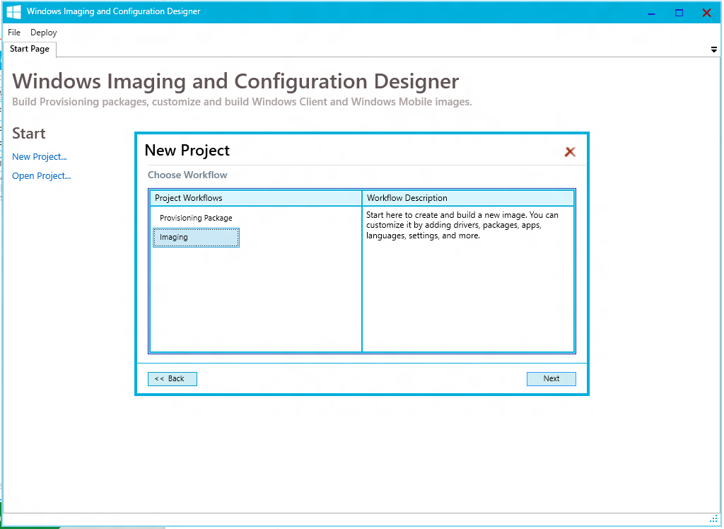
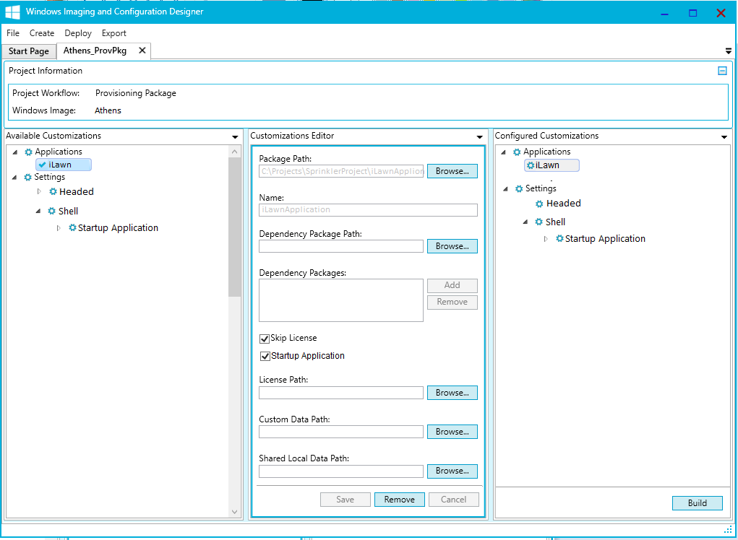
Provisioning
Configure OS to create your device experience
Image Configuration Designer (ICD) making it easier for OEM partners to create industry devices
Customize with Universal Applications, Drivers, Configuration settings
Design-in Lockdown settings
Customize experience including startup screen
Test experience on target device
Provisioning Package
Industry
Mobile
wim / ffu
Image
Image Configuration Designer
Athens
One tool for all your OS configuration needs

Slide 18
Activation
No activation issues with Windows 10
No activation for “Mobile” and “Athens”
Industry activation works both online and offline
Has never connected to the Internet
Windows 10
“Industry”
☺
Internet connectivity
Windows Product Key is injected or installed into each device during manufacturing
Device deployment
☺

Slide 19
Activation
Build Connected Devices with Athens
Mobile Broadband
USB class driver supported
Cell core stack supported
No voice support
Wi-Fi
Core Wi-Fi capabilities
Connection Management
Connection prioritization MBB, Wi-Fi, & LAN
Bluetooth/BLE

Slide 20



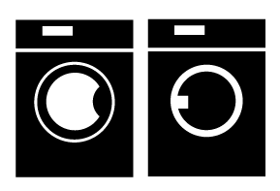





Activation
AllJoyn support in all Windows 10 Editions
Discovery
Cross Platform
Management
Interoperability
Security
Open Source
I can send notifications.
I have a clock interface
I can send notifications
I display notifications.
I have the clock interface!
Your Devices Work Together
Across Protocol and Ecosystem Barriers
I display notifications.
I have the clock interface!
I can send and display notifications
72°
120
80
I can send notifications
I display notifications.
I have the clock interface!
I have lighting interface
Notes:
Join the AllSeen Alliance / Get Involved
Integrate AllJoyn into your devices and roadmaps
Build Windows 10-based AllJoyn products in UAP
Build user-facing applications as AllJoyn Consumers
Build Windows IoT products with AllJoyn Consumers and AllJoyn Producers
Certify your devices ‘Designed for AllSeen’

Slide 21
Lockdown
Consistent and predictable device lockdown across form factors
Write Filters and Overlays
USB Filter
Dialog and Notification Filters
Input Filters
AppLocker and Layout Control
Shell and App Launcher
Easily create read only devices. Improve system uptime
Only allow approved USB peripherals
Block Pop-up Dialog Boxes and system notifications
Block hotkeys and edge gestures to prevent system access
Control which apps are visible and can run
Enable single Win32 or Modern app experience on device

Slide 22
Windows 10 Athens
Let’s Try Out !
Notes:
Connectivity Examples: “Application Services” allows different applications on the same machine to easily communicate with each other while the Windows 10 Alljoyn APIs make it easy to talk to any devices that support the Alljoyn protocols
SysAdmin Examples: Wireless network password settings, Bluetooth device pairing, system time
zone, power management

Slide 23
Windows 10 Athens
dism.exe /Apply-Image /ImageFile:flash.ffu /ApplyDrive:\\.\PhysicalDriveN /SkipPlatformCheck
net start WinRM
Set-Item WSMan:\localhost\Client\TrustedHosts -Value MINWINPC
remove-module psreadline -force
Enter-PsSession -ComputerName MINWINPC -Credential MINWINPC\Administrator
Visual Studio Remote Debugging Monitor
schtasks /run /tn StartMsvsmon
Notes:
Connectivity Examples: “Application Services” allows different applications on the same machine to easily communicate with each other while the Windows 10 Alljoyn APIs make it easy to talk to any devices that support the Alljoyn protocols
SysAdmin Examples: Wireless network password settings, Bluetooth device pairing, system time
zone, power management

Slide 24
UWP IoT Extension SDK
Device and Bus Access
APIs for controlling devices attached through common IoT busses
Supported now: GPIO, SPI, I2C, UART, Serial
Connectivity
APIs for communicating with between apps on different machines and on the same machine
System Administration
Take over some of the OS administration APIs;
Windows 10 “Athens” includes APIs to give this control to apps on these IoT Devices
Notes:
Connectivity Examples: “Application Services” allows different applications on the same machine to easily communicate with each other while the Windows 10 Alljoyn APIs make it easy to talk to any devices that support the Alljoyn protocols
SysAdmin Examples: Wireless network password settings, Bluetooth device pairing, system time
zone, power management

Slide 25
Hands On IoT
09 de maio – 09:30 – Main Hub
Windows 10 IoT
João Almeida
@jalmeida

Slide 27

Hands On IoT
Windows 10 IoT
Electricity basics
Treta1
Treta2
Imagens alinhadas à direita!

