Slide 1
YALI SKILLS LAB 4.0
FROM IDEA TO
ENTERPRISE
Strategy, structure and execution for sustainable business growth.
Emmanuel Tarfa
Partner and Co-founder, Enzo Krypton & Company. Management consultant.
U.S. Consulate General, Lagos · 10 August 2026
Notes:
Cover. Hold this slide while the room settles.
Open on the tagline: ideas are common, enterprises are built — the gap is a discipline, not a secret.
TO DO BEFORE THE SESSION: replace the logo placeholder bottom-right with the YALI and U.S. Mission logos.

Slide 2
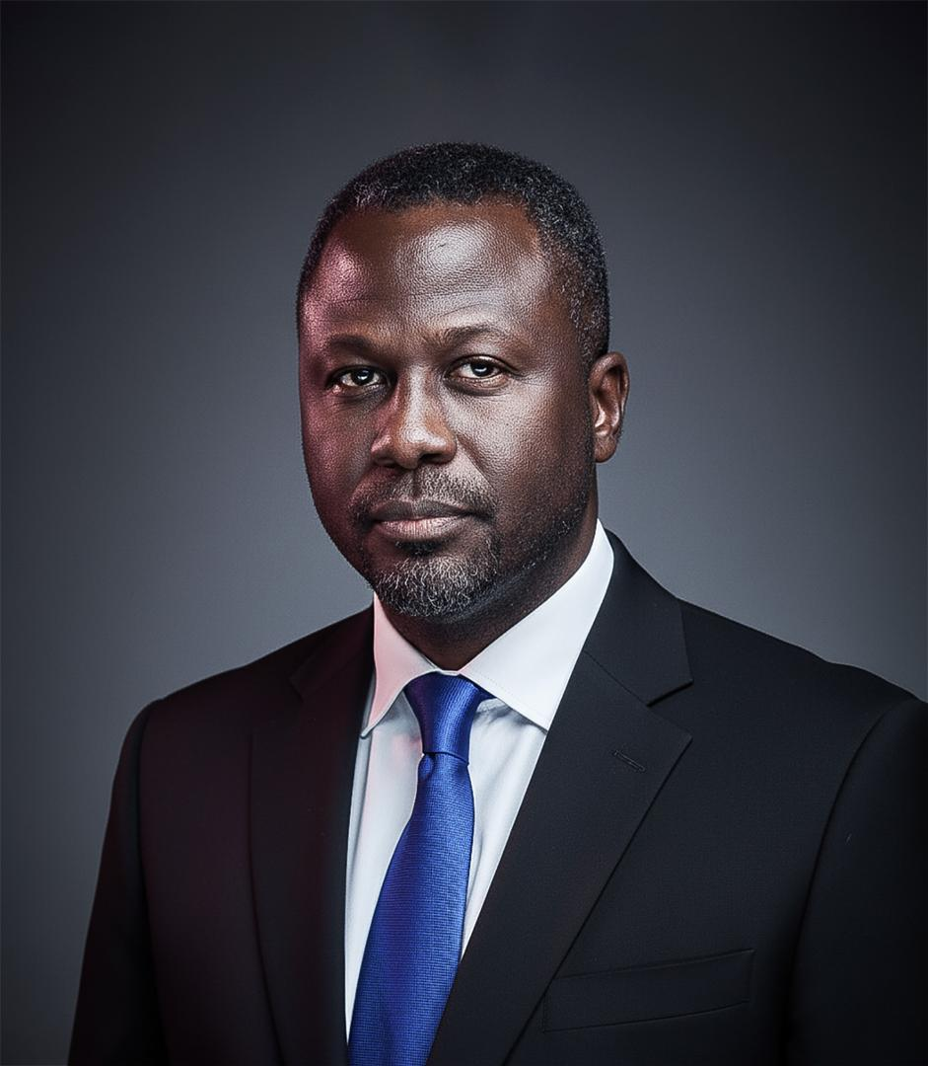
Emmanuel Tarfa
Partner & Co-founder · Business Strategist · Management Consultant · Entrepreneur
“18 years turning strategy into structure — for firms, founders, and the people who run them.”
18
180+
10
YEARS CONSULTING
COMPANIES ADVISED
YEARS IN PARTNERSHIP
PROFESSIONAL
ENTERPRISE
Trained under the leadership of the Global Big 4
Co-founder, Kryptr — employability startup building the infrastructure behind Africa's largest graduate training programme
Former Mastercard Foundation EdTech Fellow (Africa)
PRACTICE
Partner & Co-founder, Enzo Krypton & Company — advisory practice marking 10 years in partnership this year
Selected clients: Bamboo Invest · Helium Health · iFitness · Lagos State Government
PLATFORM
Public speaker and training expert
Signature programmes: Macroeconomics for Dummies · Critical Thinking & Problem Solving
GOVERNANCE
Board Advisor — HOW Foundation; Ruff 'n' Tumble, Nigeria's premier kids fashion brand
2
Notes:
Profile. Eight seconds of reading, then talk over it — credibility comes from what you say next, not from the CV.
Land the 180+ number: the pattern across 180 businesses is what you are about to teach.
TO DO BEFORE THE SESSION: drop your portrait into the left panel; confirm the four client names are cleared for public naming (consider logos instead of text); confirm whether the Mastercard Foundation EdTech Fellowship supported you personally or Kryptr.

Slide 3
Agenda
Three parts to this session
01
Enterprise Types
The six vehicles, and what each one costs you.
02
Some Fundamentals
Ten things that decide whether the thing survives.
03
My Personal Counsel
What I would tell you if we were sitting alone.

Slide 4
SECTION ONE
Enterprise Types
4

Slide 5
Types of Entities
For the sake of an entrepreneur's journey, I will classify all business endeavours into six categories.
01
02
MSME
Start-up
A neighbourhood bakery.
A mobile payments application.
Where most of us operate
03
04
Professional Service
Development Organisation
A dental clinic.
Youth empowerment organisation
05
06
Corporate
Public Sector
A listed cement manufacturer.
A state ministry of commerce.
My focus in this session: MSME, Start-up and Professional Service.
5

Slide 6
DIAGNOSIS 01 · MICRO, SMALL AND MEDIUM ENTERPRISE
MSME
FEATURE
THE UPSIDE
THE COST
Strategic intent
Low pressure. You set the pace yourself.
Easy to drift and never leave.
Funding
Your own money, so nobody sets deadlines.
Growth is capped by your own pocket.
Market
Proximity or a licence can lock rivals out.
A red ocean the day that access goes.
Business model
You can choose value or volume.
Family pricing keeps you stunted.
Exit
Quiet incubation can attract a buyer.
No records means no valuation, no sale.
6

Slide 7
DIAGNOSIS 02 · BUILT TO SCALE, BUILT TO SELL
Start-up
FEATURE
THE UPSIDE
THE COST
Strategic intent
Built to be sold or listed one day.
The clock starts and never stops.
Funding
Other people's money buys you speed.
You own less each round, and can be removed.
Market
A big market repays the risk you take.
Without product-market fit the money burns.
Business model
Margins and network effects compound.
Operations break before you are ready.
Exit
Equity can pay far more than salary.
Most do not make it, and the model expects it.
7

Slide 8
DIAGNOSIS 03 · LICENSED, REGULATED, TECHNICAL
Professional Service
FEATURE
THE UPSIDE
THE COST
Strategic intent
The licence is your entry ticket.
It also ties the income to your presence.
Funding
Fees fund you. No investor required.
Banks lend on cash flow, not on ideas.
Market
Regulation keeps the crowd out.
Everyone inside holds the same certificate.
Business model
Judgement is priced high, not hours.
Your hours cap the size of the practice.
Exit
A firm with systems can be sold.
A personal practice walks out with you.
8

Slide 9
DIAGNOSIS 04 · FOUNDER-LED, CAUSE-DRIVEN, DONOR-FUNDED
Development Organisation
FEATURE
THE UPSIDE
THE COST
Strategic intent
You start from a cause you believe in.
The payer is not the person you serve.
Funding
Grants fund work you could never self-fund.
When the cycle closes, the work stops.
Market
Depth in one issue earns the next grant.
Chasing every call raises small money.
Business model
Evidence you can prove is what you can raise.
Donor priorities quietly rewrite your plan.
Exit
Influence, access and standing at any age.
No equity. Nothing to sell or hand over.
9

Slide 10
SECTION TWO
Some Fundamentals from Idea to Enterprise
10

Slide 11
SECTION TWO
What we will cover
01
Strategic Intent
02
Self-awareness
Why you are in business, and at what pressure.
Personality, character and an honest self-read.
03
Market and Industry
04
Business Model
The problem, the offer and positioning.
Something original, or a copy of what exists.
05
Team
06
Artificial Intelligence
Co-founders, partners and top talent.
AI-enabled, or AI-native.
07
Operations
08
Funding
Systems that run without you.
Bootstrap, investment or grants.
09
Risk
10
Exit
Balancing your excesses.
Scale, sell or go public.
11

Slide 12
FUNDAMENTAL 01
Strategic Intent
Mission
Vision
Your purpose and your why. To support your husband/Wife, or to change the World. Both are valid, but they are not the same business.
The destination you are walking towards. To build a house, or to become a monopoly.
Strategic Objectives
Core Values
Mini-visions across the metrics that matter: revenue, customers, people, reach.
Your true capability and identity. Not the words on the wall, but how you behave when it costs you.
12

Slide 13
FUNDAMENTAL 01 · STRATEGIC INTENT
Pressure – A matchstick can light a forest, but cannot directly boil meat.
You cannot accomplish anything without pressure. There’s too much competition or poverty. If you do not have results, you will be disrespected even in family meetings
Matchstick
Candle
Small burner
Large burner
If you’re not born with it, then submit to a system that will compel it – investors, board, partners etc.
13

Slide 14
FUNDAMENTAL 02 · SELF-AWARENESS
Do you actually know yourself? “Ray Dalio”
DISC (what I know)
Myers-Briggs Type Indicator
Dominance, Influence, Steadiness, Conscientiousness. Fast, practical, and it tells you how you behave under pressure and how you land on other people.
Sixteen types. How you take in information and how you reach a decision. Useful for understanding why your co-founder frustrates you.
The Big Five
CliftonStrengths
The most research-backed of the lot: openness, conscientiousness, extraversion, agreeableness and emotional stability.
Names your top talents so you build on what you already do well, instead of spending years repairing your weaknesses.
But a founder who is not self-aware will hire wrong, price wrong and quarrel out of business.
14

Slide 15
FUNDAMENTAL 02 · SELF-AWARENESS
Where your strength meets your opportunity
What the business demands
What you are actually strong at
Every business is heavy in one thing. Some are sales and marketing businesses. Some are technical. Some are relationship and access businesses. Name yours honestly.
Not what you wish you were. What people already call you for, and what you do well on a bad day when nobody is watching.
When the two line up, you will look like a genius.
When they do not, you will work twice as hard for half the result, and people will call it bad luck.
15

Slide 16
FUNDAMENTAL 02 · SELF-AWARENESS
Three capabilities you must have
Functional expertise
1
You understand the technical requirements of your business and how the work should actually be done, including across functions.
General management
2
The broader competence to run a business: people, operations, finance, technology and the core technical work behind it.
Leadership
3
The ability to influence a whole system, and the people inside it, to deliver results. This is the one that decides how far the business goes.
A weak functional expert can hire. A weak manager can be supported. A weak leader takes the whole business down with him.
16

Slide 17
FUNDAMENTAL 03 · MARKET AND INDUSTRY
The MSME route: where you play
Proximity
Access somebody else cannot get
You are the only bakery in the estate. The market is the street, and for now the street is enough.
A distributorship, a licence, an allocation. The access itself is the business, so protect it.
An unserved gap
The gift of small
A product people already buy, but nobody nearby sells it well, or sells it at all.
You can incubate quietly, with no board and no noise, until the thing looks attractive to a partner, a bigger player or a buyer.
This room is not about extra income for the family. Be an MSME if you choose, but be a distinguished one.
17

Slide 18
FUNDAMENTAL 03 · MARKET AND INDUSTRY · MSME
Small start, serious finish
Win Win Kitchen
Elizade
Froze meat pies, fish pies and chicken pies out of a bedroom. Outgrew the freezers, built a proper factory with real manufacturing equipment, and ended up supplying Shoprite.
Michael Ade-Ojo walked away from a secure job at British Petroleum and sold cars on commission. Elizade followed in 1971, and the family firm became the Toyota business in Nigeria.
LAPO
Beloxxi
Godwin Ehigiamusoe started LAPO in 1987 as a small non-profit lending to poor households. It won a Central Bank microfinance licence in 2010 and a national licence in 2012.
Obi Ezeude imported biscuits from 1994. When imports were banned he built his own factory in 2006, and in 2016 sold a minority stake for eighty million dollars.
Own the recipe. Own the access. Serve the underserved. Replace the import.
18

Slide 19
FUNDAMENTAL 03 · MARKET AND INDUSTRY
The start-up route: problem, solution, position
1
2
3
The problem
The solution
The position
Usually something you have lived, not something you read. It does not have to be passion.
What you actually build, and why it answers the problem better than whatever people are using today.
How yours is different, and who it is different for. Not better in general. Better for somebody specific.
If you cannot say why yours is different in one sentence, you do not have a business yet. You have a preference.
19

Slide 20
FUNDAMENTAL 03 · MARKET AND INDUSTRY · START-UP
Built to be bought or go public
Paystack
Andela
Two Nigerians solving one problem: letting a business take payment online. Y Combinator backed them, and Stripe bought the company in 2020 for a reported two hundred million dollars.
Founded in Lagos in 2014 to train African engineers and place them with global companies. In September 2021 a two hundred million dollar round led by SoftBank made it a unicorn.
Flutterwave
Airbnb
Started in 2016 building payment rails across African markets. By March 2021 a one hundred and seventy million dollar round valued it above one billion dollars.
Three men rented air mattresses in their own flat because they could not pay rent. Y Combinator took them in, and the company listed on the public market in 2020.
Three Nigerian, one foreign. All four started small, and all four were built to be owned by somebody else.
20

Slide 21
FUNDAMENTAL 03 · MARKET AND INDUSTRY
The professional service route: where you play
The licence draws the boundary
Reputation is your distribution
The regulator has already defined your market. Your competition is everybody else holding the same certificate.
Referral, not advertising. Your last client is your next client, and your worst job travels faster than your best.
Niche beats general
Sit close to the money
The dentist who does implants. The lawyer who does energy contracts. Narrow practices charge more and argue less.
Position where the fees actually are: corporates, regulated sectors, institutions with a budget line for you.
In a licensed market everybody has the certificate. The one known for one thing gets paid the most.
21

Slide 22
FUNDAMENTAL 03 · MARKET AND INDUSTRY · PROFESSIONAL SERVICE
From practitioner to institution
Schubbs Dental Clinics
Aluko & Oyebode
Dr Bode and Dr Laite Karunwi opened a single dental chair in Apapa in 1988. It is now an upscale chain across Apapa, Ikeja and Ikoyi, with one founder running management rather than the chair.
A partnership formed in 1993 grew into one of Nigeria's largest full-service law firms, acting for banks, oil companies and multinationals. The name outlives any single partner.
Tony Robbins
Phillips Consulting
One man speaking in a room became live events, books, courses, a coaching faculty trained in his method, and a portfolio of businesses.
Foluso Phillips set up in 1992, selling training and systems to the banks. It became the largest indigenous management consulting firm, with its own outsourcing subsidiary.
You’re building a reputation and a brand
22

Slide 23
FUNDAMENTAL 03 · MARKET AND INDUSTRY
The development route: where you play
The need is not the market
One issue, one place
Need is everywhere. Funding is not. Learn the funder's priorities for this cycle before you design anything.
Depth is what earns the second grant. A scattered organisation looks busy and raises nothing.
Evidence is your product
Partnership is your entry
Numbers, records, photographs, reports. What you can prove is what you can raise next year.
A letter from the local government, a school, a bigger organisation. Standing opens doors that budgets cannot.
Do not chase every call for proposals. A scattered organisation raises small money and dies tired.
23

Slide 24
FUNDAMENTAL 03 · MARKET AND INDUSTRY · DEVELOPMENT ORGANISATION
Doing good, built properly
LEAP Africa
Fate Foundation
Ndidi Nwuneli started it in 2002 to build leadership in young Africans. Programmes, books and a large alumni network now carry the work beyond her.
Fola Adeola started it in Lagos in 1999 to train and support Nigerian entrepreneurs. Decades of alumni now carry the brand for it.
Tony Elumelu Foundation
ACT Foundation
Committed one hundred million dollars in 2015 to fund ten thousand African entrepreneurs, with seed capital, training and mentoring at scale.
A grant-making foundation born of banking wealth, funding health, education, environment and entrepreneurship across Africa. It gives money rather than chasing it.
Train the people, build the brand, or fund at scale. Anything but waiting.
24

Slide 25
FUNDAMENTAL 04 · BUSINESS MODEL
The MSME plays that actually built businesses
Own the access
Own the recipe
Find a specialty product abroad, secure the sole distributorship, and build the business on access nobody else has.
Manufacture your own formula, grow the brand deliberately, and make yourself worth buying to a corporate.
Supply the corporate
Plug into money that pays
Sit down with a big company and become their contractor. A small, faithful window into a very large pipeline.
Oil and gas servicing, banks, institutions, wealthy clients. Serve people who can afford your invoice.
The trap is starting with family and friends and staying there. An MSME that is afraid to charge will stay stunted.
25

Slide 26
FUNDAMENTAL 04 · BUSINESS MODEL
Value or volume. Pick one.
VALUE is Mercedes
VOLUME is Amazon
Fewer customers, higher price
Customised quality, every time
Serve only those who can afford you
Reputation carries the pricing
Many customers, thin margin
You win on cost, not on charm
It only works at real scale
Know your point in the value chain
Positioning in the value chain (don’t do all)
Design, ideation and advisory
Production and manufacturing
Sales and distribution
Customer service and technical support
Deliver Mercedes and charge Amazon, and you will burn out and go broke.
26

Slide 27
FUNDAMENTAL 04 · BUSINESS MODEL · START-UP
Design the model for growth (according to Reid Hoffman)
Market size
Distribution
Big already, or growing fast, and reachable. Sizing ride-hailing on the taxi market is like sizing cars on the horse market.
A good product with great distribution beats a great product nobody can reach. Build the channel into the model.
High gross margins
Network effects
Margin is what pays for your own growth. Thin margin means somebody else must fund every customer you add.
The product gets more useful to everybody each time one more person joins. That is what makes the lead permanent.
The two limiters that kill the run
No product-market fit, and an operation that cannot carry the weight when the demand arrives.
27

Slide 28
FUNDAMENTAL 04 · BUSINESS MODEL · START-UP
The discipline underneath the model
Build something people want
Charge money early
The only rule that survives every pivot. Talk to a small number of users until you know their problem better than they do.
Revenue is the fastest proof that the problem is real. Free users will praise you and still not pay you.
Know your unit economics
Pick one growth number
What one customer costs to win, and what one customer returns. If that sum does not work small, it will not work large.
Grow one metric weekly and let it govern the week. Be default alive before you try to be default rich.
Start with a small market you can dominate. Nobody scales out of a market they never owned.
28

Slide 29
FUNDAMENTAL 04 · BUSINESS MODEL · START-UP
Nine business models that keep showing up
SaaS
Transactional
Marketplaces
Software as a service. Cloud subscriptions.
Salesforce
You take a commission on payments.
Paystack
You connect buyers and sellers.
Airbnb
Hard tech
Usage-based
Enterprise
Advanced engineering businesses.
SpaceX
You charge by the volume consumed.
Twilio
Software sold to large organisations.
Oracle
Advertising
E-commerce
Bio
Revenue from displaying adverts.
Google
Goods sold online.
Jumia
Biotechnology and life sciences.
Moderna
Source: Y Combinator
29

Slide 30
FUNDAMENTAL 05 · TEAM
Who you build with
Hire people smarter than you
Know when you need a partner
The insecure founder hires people he can control, then wonders why nothing in the business runs without him.
A co-founder is not a favour to a friend. It is a gap you cannot fill yourself and cannot afford to leave open.
Ours generation shares better
Be secure enough to be outshone
Our parents built alone and kept everything. Ours is far more willing to split ownership. That is an advantage, so use it.
If you are always the sharpest person in the room, you hired badly. Pay for judgement, not for loyalty.
You cannot build an enterprise with people who only agree with you.
30

Slide 31
FUNDAMENTAL 05 · TEAM
How serious builders hire
Mark Zuckerberg
Brian Chesky
His rule, said plainly in 2015: he will only hire someone to work directly for him if he would be happy to work for that person. He named Sheryl Sandberg as the example.
Airbnb's founder sat in the interviews himself in the early years, and probed whether people believed in the mission. Hiring was his job, not something he delegated.
Netflix
Steve Jobs
A team, not a family. Adequate performance earns a generous severance, and managers apply the keeper test: would you fight to keep this person if they resigned?
A players hire A players, B players hire C players. You do not hire smart people to tell them what to do. You hire them so they can tell you.
None of them treated hiring as paperwork. It was the work.
31

Slide 32
FUNDAMENTAL 06 · ARTIFICIAL INTELLIGENCE
Enabled or native. Decide which.
AI-enabled
AI-native
You keep your business and put artificial intelligence inside it. Proposals, adverts, customer replies, records. Same model, lower cost, faster hands.
The product itself cannot exist without it. A different animal that needs data, technical talent and patient money from day one.
Start where the pain is
The real threat
Automate the task you repeat every week and quietly hate. Not the clever thing that impresses people on the internet.
Not that the machine replaces you. That a competitor half your size serves twice your customers with the same staff.
Artificial intelligence does not fix a weak business. It scales whatever you already are.
32

Slide 33
FUNDAMENTAL 07 · OPERATIONS
Systems, not heroics
Write down what only you know
One page for each process
If the process lives in your head, you cannot delegate it, you cannot audit it, and nobody can buy it from you.
Trigger, steps, who checks it, and what good looks like. If it will not fit on a page, it is not yet understood.
Let the machine draft it
Replicate yourself on purpose
Artificial intelligence can write the first version of every manual in a weekend. A named human still owns the outcome.
Train a second person to do the thing you do best. Until somebody else can do it, you do not have a business.
Great people build great systems. Great systems then outlast the people who built them.
33

Slide 34
FUNDAMENTAL 08 · FUNDING
Money has a spectrum
Customer money
Family, friends and grants
The cheapest money there is. It costs no ownership, asks no permission, and proves the business at the same time.
Patient and cheap, but slow, and easily poisoned when the terms are never written down. Put it in writing anyway.
Debt
Equity
Banks lend against cash flow and collateral, not against an idea. The cost is predictable and the schedule does not care about your excuses.
Investors buy tomorrow. They bring speed, networks and pressure, and they leave with a piece of the house.
The funding craze has cooled. Build value first, then raise when money buys speed you can already use.
34

Slide 35
FUNDAMENTAL 09 · RISK
Balancing your excesses
Know your own appetite
Survivable or fatal
Some people sleep well owing money. Some cannot. Neither is wrong. Pretending to be the other one is what ruins people.
A bad month is survivable. One customer who is most of your revenue, or one supplier with no alternative, is fatal.
Know what you have pledged
Name the three killers
Personal guarantees, family money, the house. Write down exactly what is on the line and who else is standing on it.
List the three things that would end this business, and write what you would do in the first week each one arrives.
The market punishes the reckless and the frozen equally. Consciousness beats courage.
35

Slide 36
FUNDAMENTAL 10 · EXIT
Scale, sell or go public
Scale and hold
Sell
You keep it and grow it. Your reward arrives as cash flow every year instead of one cheque.
Somebody buys what you built. Only possible when the business is a system, not a person. Records make the price.
Go public
Hand it over
The market buys a piece of it. That money comes with governance, disclosure and a great deal of patience.
Succession to family or to management. The most common exit in this room, and the one nobody plans for.
You do not have to want an exit. You do have to be able to have one.
36

Slide 37
SECTION THREE
My Personal Counsel
37

Slide 38
SECTION THREE · MY PERSONAL COUNSEL
The big three
1
2
3
Mentorship
Personal Development
Personal Effectiveness
The people who shorten your road.
What you become while you build.
The habits that protect your hours.
38

Slide 39
THE BIG THREE · ONE
Mentorship
Do not chase celebrity mentors
Never fewer than three
Unless you carry something a senior person actually needs, the famous name will not answer you.
Different mentors for different parts of your life. No single person can cover all of you.
Mentors change with seasons
Honour them properly
The people you need at twenty-five are not the ones you need at forty. Refine the roster.
Go beyond taking their time. Gifts, support for their interests, showing up where it matters.
Be genuine, or be a leech
What they are actually worth
People can smell extraction. Give before you ask, and keep giving after you have received.
They save you years and money you would have burned, and they open doors you cannot knock on.
A good mentor shortens the road. A great one tells you the road is wrong.
39

Slide 40
THE BIG THREE · TWO
Personal Development
Finish books, not fast-food apps
Curate free sources
Seek hard work on purpose
Balanced library, not all self-help
Audio, e-book or paper. No excuses
One a month is twelve in a year
LinkedIn, podcasts, YouTube, blogs
Few channels, chosen for this season
Tie them to this year's priorities
Understand the power of results
For expertise, do it free if you must
Teaching others makes you a master
Eighty per cent of what you read should match the season you are actually in.
40

Slide 41
THE BIG THREE · THREE · PERSONAL EFFECTIVENESS
Find your hack
People, in my case
Where you come from
I surround myself with people who cover my gaps, and I stay vulnerable enough to be mentored. That is my hack.
Home applies its own pressure. If you must show up in the village at Christmas, that deadline is already working for you.
The people you love
Say it out loud
A spouse, a child, a parent. Some of us only move when somebody else is depending on the result.
Commit publicly to people who will ask you about it. A date announced is far harder to abandon than a date written down.
You already know what to do. The hack carries you on the day you do not feel like it.
41

Slide 42
Q&A
Thank You
For further conversations
emmanueltarfa@gmail.com
Instagram: tarfaemmanuel
LinkedIn: emmanueltarfa

