Slide 1
All-Synthesizable 6Gbps Voltage-Mode Transmitter for Serial Link
Young-Ho Choi, Kihwan Seong, Byungsub Kim, Jae-Yoon Sim, and Hong-June Park
Department of Electrical Engineering
POSTECH, Pohang, Korea

Slide 2
Outline
Motivation
− Fully synthesizable transmitter
Proposed voltage-mode TX
− With 2-tap FFE
Measurement results
Conclusion

Slide 3
Motivation
Advantages of the synthesizable circuit
− Good portability with process
− High compatibility with other digital blocks
Fully synthesized circuits are implemented
− ADCs
− PLLs
− CDRs
There is no high-speed synthesizable TX

Slide 4
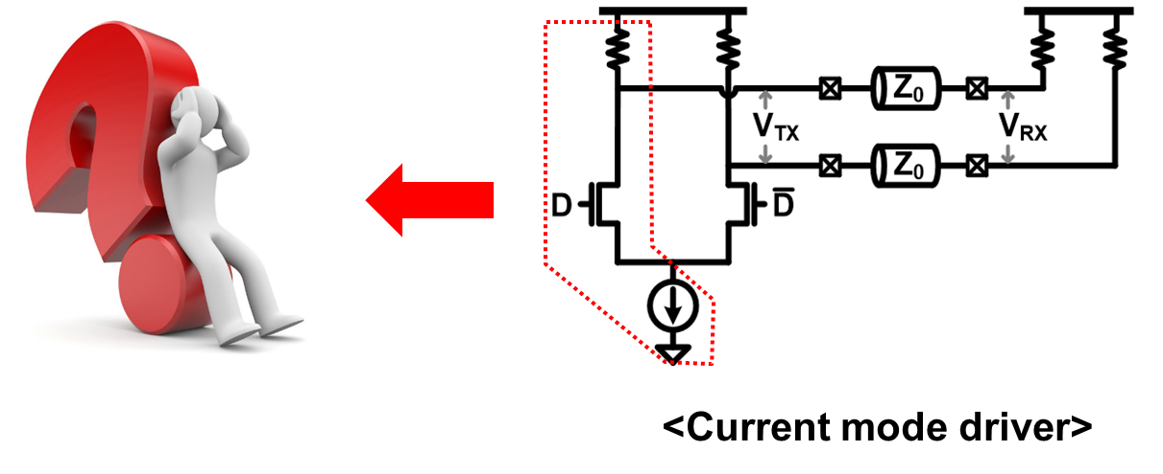
Transmitter output driver
Difficult to implement CM driver using digital std. cells

Slide 5
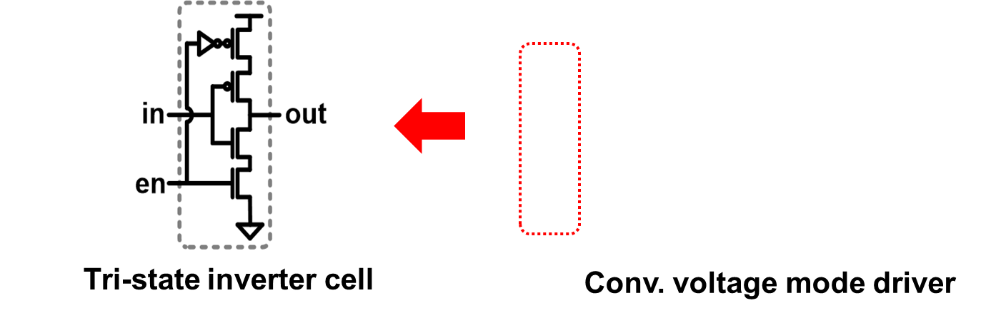
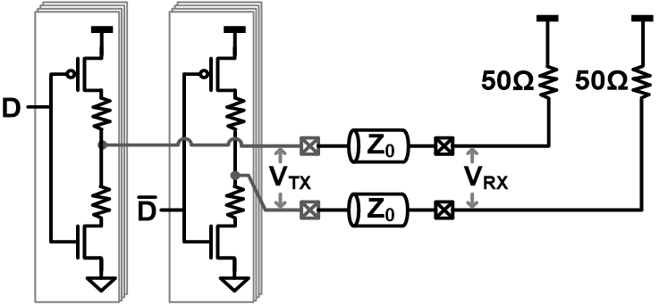
6Gbps synthesizable TX
Voltage mode driver is suitable for digital synthesis
The inverter with source R replaced by tri-state inverter

Slide 6
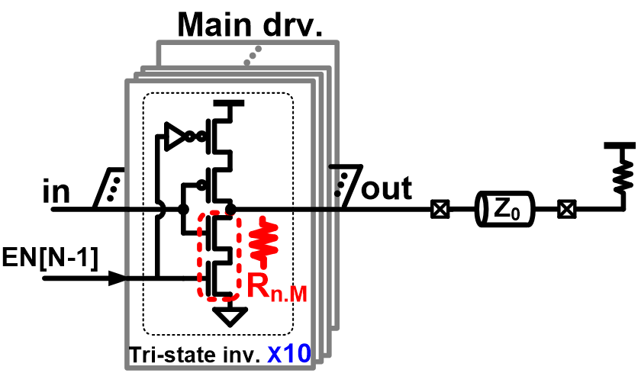
Requirements for 6Gbps synthesizable TX
A branch of differential TX driver
Output impedance matching @ out = ‘0’ by adjusting # of parallel tri-state inverter cells
2-tap feed-forward equalization(FFE) for 20dB loss channel

Slide 7
Output impedance calibration
A 1/10 replica used for impedance matching @ output = ‘0’
After calibration, pull-down resistor of main driver R_{n.M} ≈ 50

Slide 8
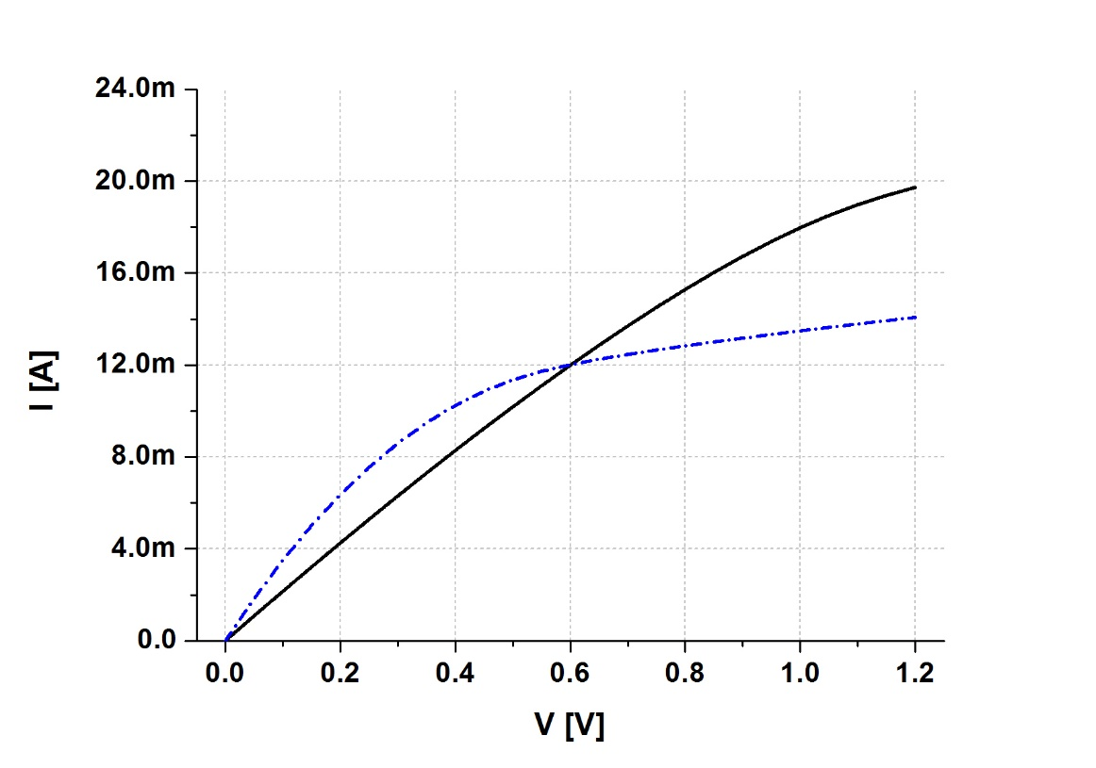
Non-linearity of pull-down DR
Pull-down driver
I-V characteristic of pull-down driver

Slide 9
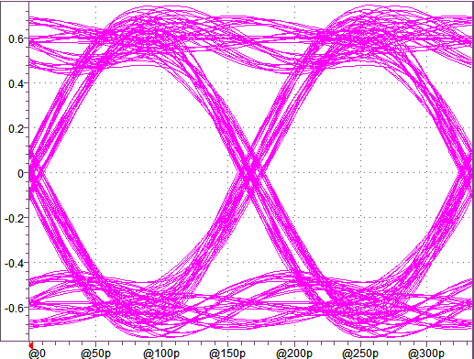
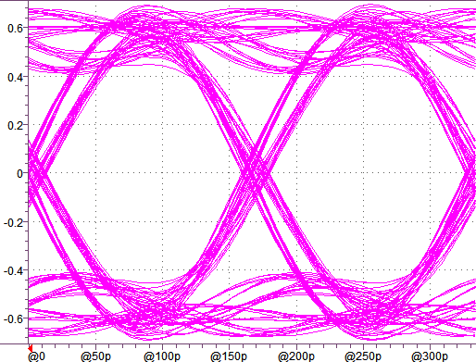
Effect of non-linearity of pull-down DR
Conventional driver
Proposed driver
R_{T} = 50 Ohm, TX pin C = 1.7pF L=2.5nH, RX pin C = 1.7pF L=2.5nH
No appreciable difference between proposed and conventional drivers

Slide 10
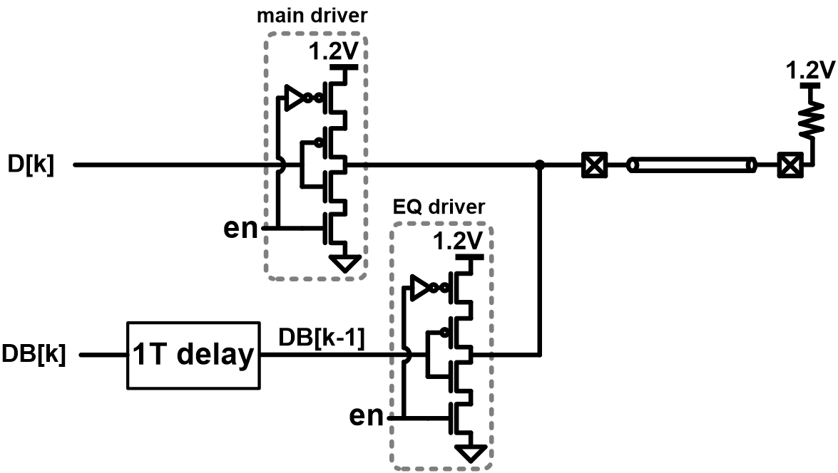
All-synthesizable 2-tap FFE
6Gbps FF not used for 1T delay, because it cannot be implemented by synthesis

Slide 11
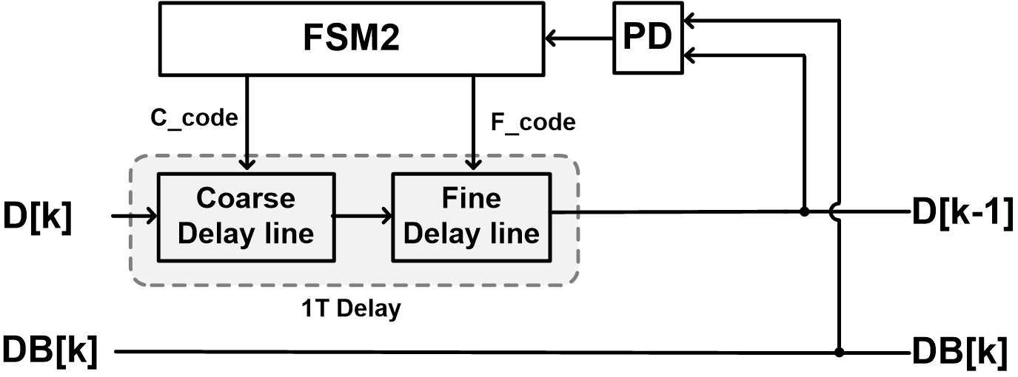
DLL for 1T delay generation
For DLL operation, training patterns are used (1010…)
1T = (delay of coarse delay line + delay of fine delay line)

Slide 12
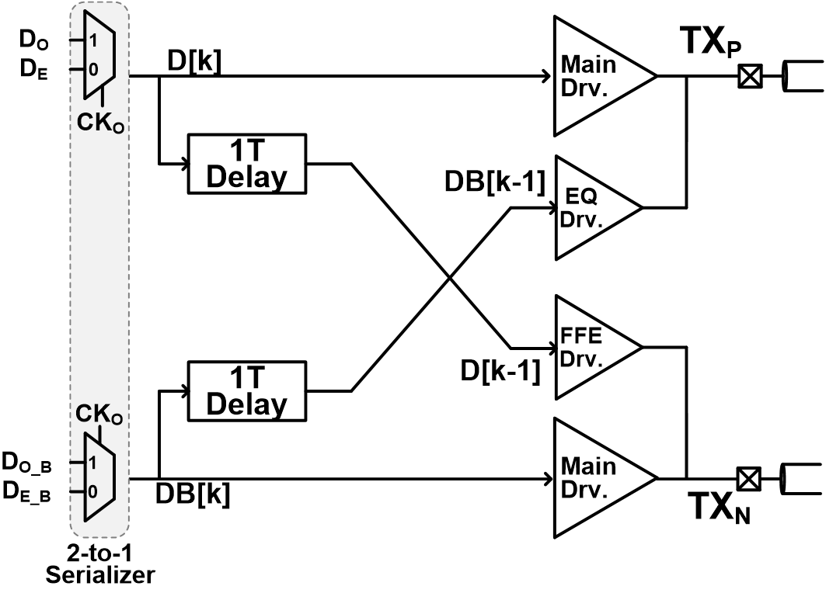
Proposed 2-tap FFE driver with 2-to-1 serializer

Slide 13
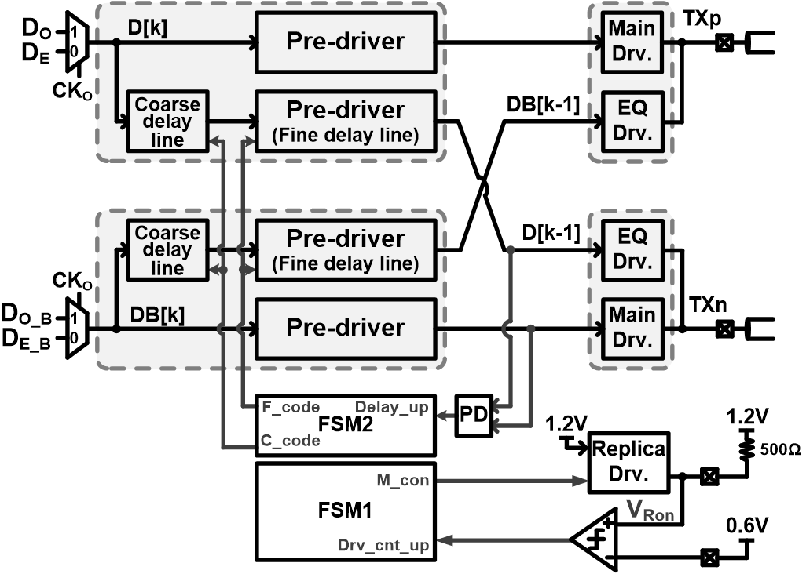
Final proposed all-synthesizable voltage-mode TX

Slide 14
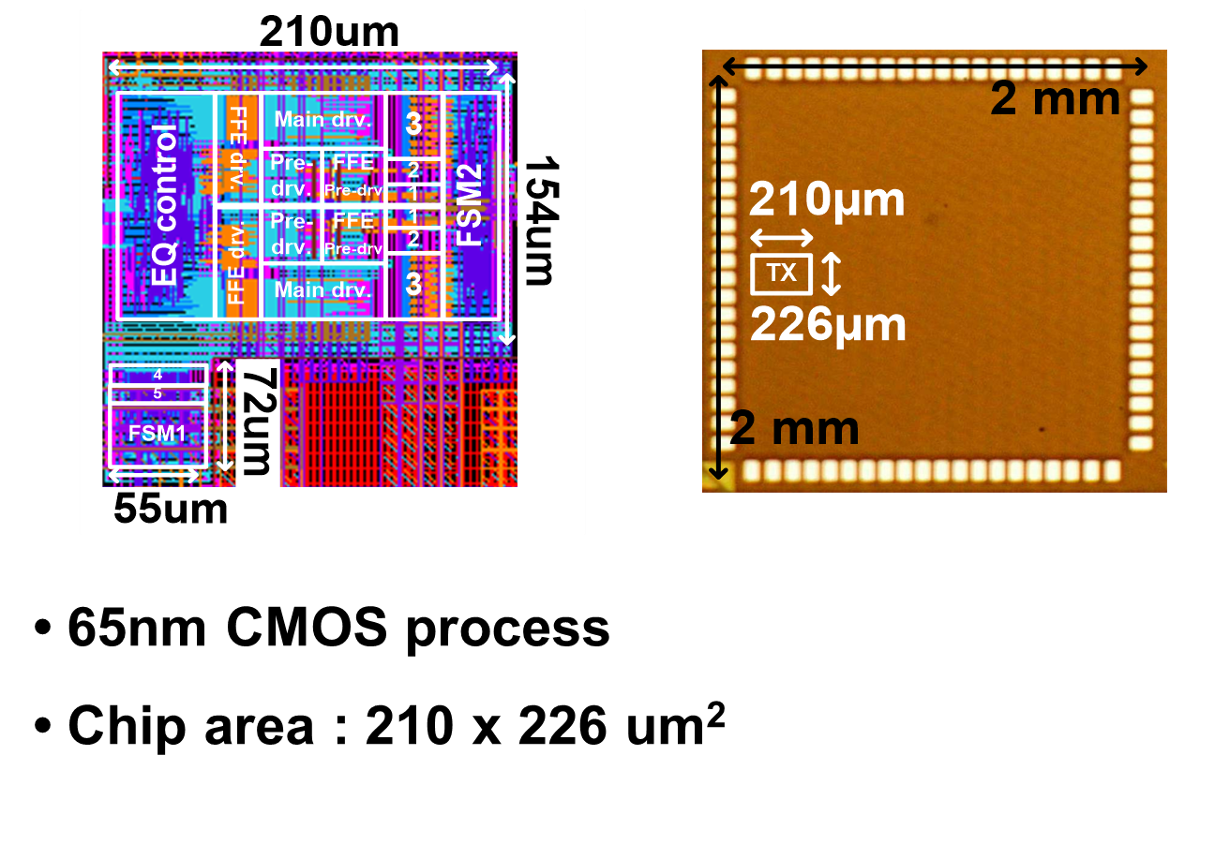
Chip photo and layout

Slide 15
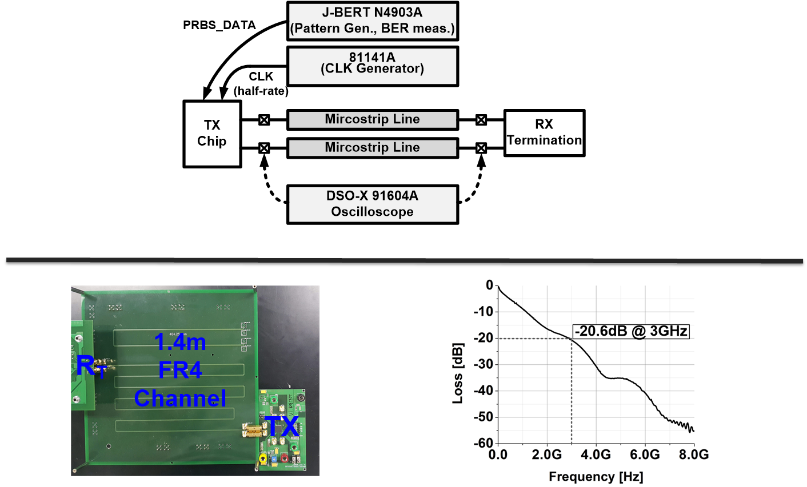
Measurement setup

Slide 16
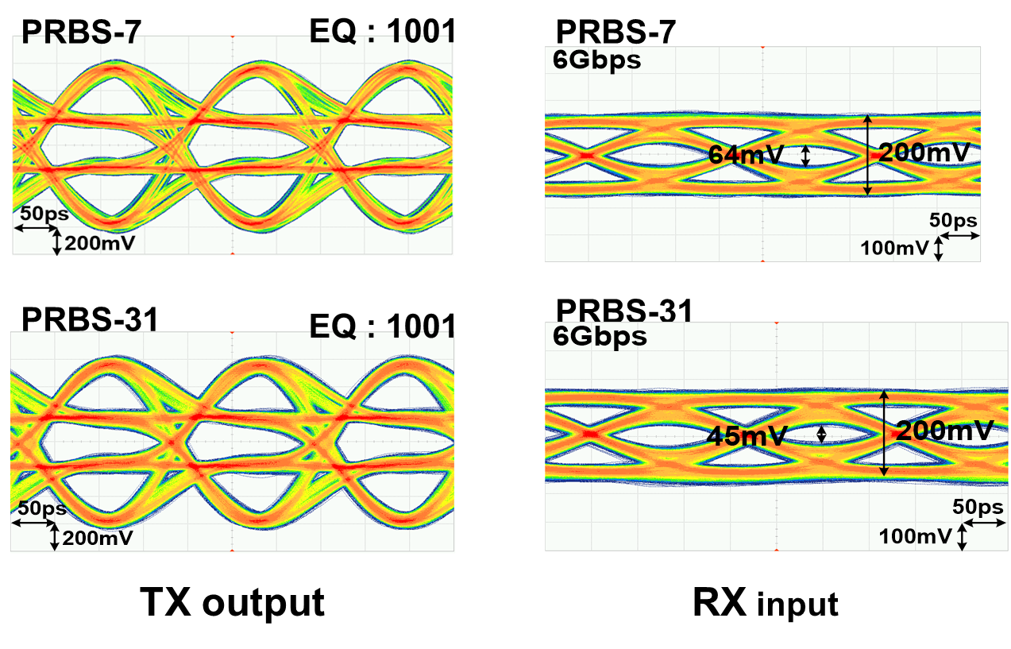
Measured eye-diagram (6Gbps)

Slide 17
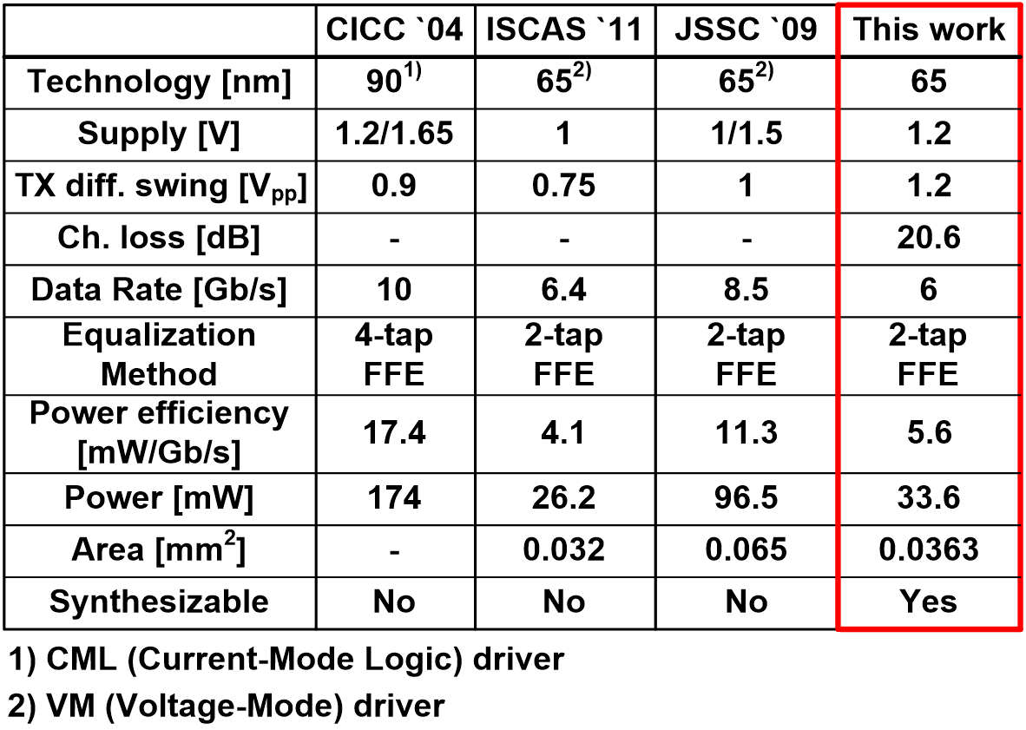
Performance summary

Slide 18
Conclusion
6Gbps voltage-mode TX synthesized with 2-tap FFE
Wide eye-opening achieved @ 1.4m FR4 channel
1-bit-period delay generation circuit for FFE because 6Gbps F/F cannot be implemented by synthesis

