Slide 1

Which Convolutional Neural Model Best and Most Efficiently Classifies Internet-Scale Infected Internet of Things Devices?

Slide 2
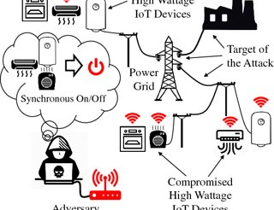
Introduction
IoT Paradigm
Cyber Threat
Infect Critical Infrastructure

