Slide 1
Mine isn’t funny it ius not joak all sexualitys must be respected*

Slide 2

Jewish bruddas
Alfies gay

Slide 3
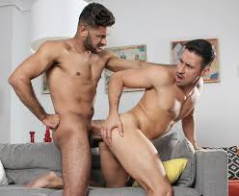


This is Alfie and hiz boyfriend
They like to play with each othjewras bomhules and pretty much

Slide 4
Sorry Alfie jk

Slide 5

Only joke man

Slide 6
We kn ow u not gay

Slide 7
however
Max is moist

Slide 8
We have picture proof ^^

Slide 9
Also shuddup

Slide 10
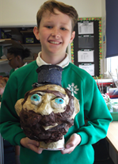
Max wut were u thinking bro
why does arj drink cows piss?

Slide 11

Look at this beest

Slide 12
Sick one maria
Alfies gay

Slide 13
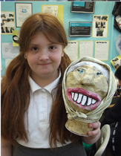
Why she make a self portait tho?

Slide 14
Fuckin stupid ginger cunt im fuming who is this fat bitch

Slide 15
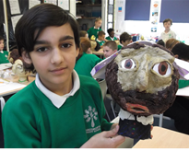
Aj drinks cow piss

Slide 16

Safe u lot

Slide 17
Also paul please stop spenind your life savings on cigs plez we love u we wont u to live maete

