Slide 1

MINOR-1 PROJECT
Under the guidance of
Mr. Deepak Kumar Sharma
Assistant Professor
Department of Informatics

Slide 2

Player selection using clustering algorithm
Presented by:
Lakshay Vasuja(500067177)
Lakshay Sharma (500068760)
Divyansh Chandna(500068095)

Slide 3
Introduction
IPL also known as Indian Premiere league launched in 2008 by BCCI is a professional Twenty20 cricket league in India. IPL consists of 8 different teams representing 8 different cities in India. Players from all over the world take part in this tournament.
During the Auction Phase, Players are selected for every team so some situations may arise where the team doesn’t get their desired player as the bid has maxed out the team’s budget for the particular player and there can be a number of situations where this can happen.

Slide 4

Problem statement
There can be a number of situations where desired players cannot be picked during auction so a substitute player has to be picked.
To make a good and versatile team with different properties is a hard task as team management have to keep track of all the players and bid on them.
Sometimes captains cannot make a well informed decision on what to choose after winning the toss.

Slide 5

Objective
Use K-Means clustering algorithm to create clusters of players based on their similar properties.
Implementation of K-Means to create clusters of players
Making an IPL team for the user and adding functionalities like modifying the selected teams and deleting previous selected teams and searching players in the teams etc.
Capping of players based on their bid to create a Budgeted Team.
Calculate the probability between toss winning vs match winning taking in account different parameters like toss decision, venue, weather conditions etc.

Slide 6
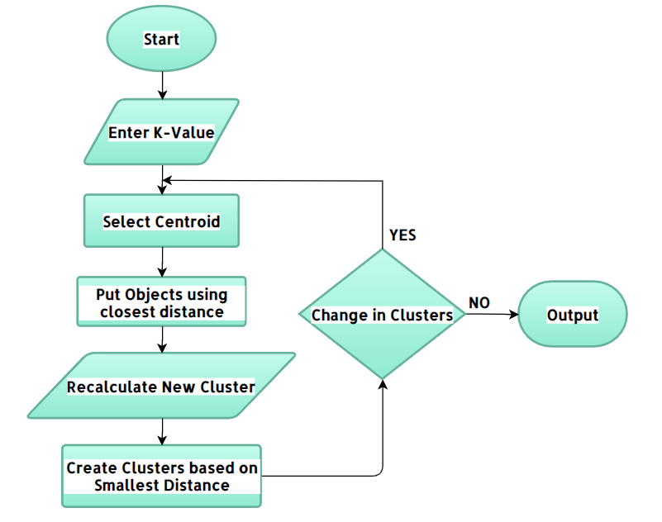
k-means Clustering
K-means clustering is one of the simplest and popular unsupervised machine learning algorithm.

Slide 7
K-Means clustering algorithm
Algorithm
Choose the number of clusters(K) and obtain the data points
Place the centroids c_1, c_2, ..... c_k randomly
For each data point x(i):
find the nearest centroid(c_1, c_2 .. c_k) using Euclidean distance
assign the point to that cluster
For each cluster i= 1..k
new centroid = mean of all points assigned to that cluster
Repeat steps 3 and 4 until convergence or until the end of a fixed number of iterations.
End

Slide 8
Methodology
Predicting the events that may happen IPL follows the past. Cleaning the data and making it ready for the analysis will be the first step.
We created a menu-driven user interface depicting functionalities like
Create your own team
Modification in your team
Show my team
Show previous team
Probability of game winning vs toss winning
In create your own team the formation of team is done by selecting desired players from different clusters wherein clustering is performed on the account of various parameters for batsman(Total runs, Out, Average, Strike rate) and bowlers(Economy, Wickets, Matches, Count, Balls per wicket, SR) separately.

Slide 9
Methodology (continued)
Modification in your team provides you with 3 options: Searching, Adding, Deleting of players.
Show my team displays the players selected in the team along with the total cost of the team and selection of captain can also be done here.
Show previous team displays the previously created teams and the user can view the players in those teams by entering the team name.
Probability of Game winning vs Toss winning can calculate the probability of game winning using the dataset which has the parameters Team1, Team2, Toss winner, Toss loser, Toss decision, Venue, Weather. The probability can only be calculated of the teams that have played in the IPL and are present in the dataset.

Slide 10
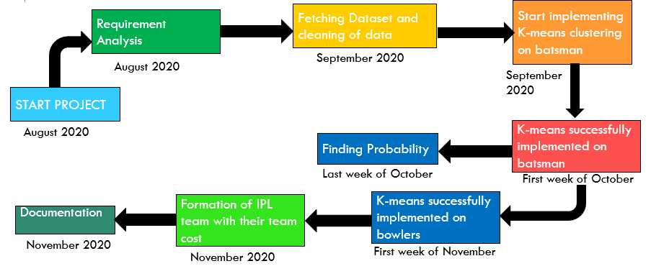
Pert chart

Slide 11
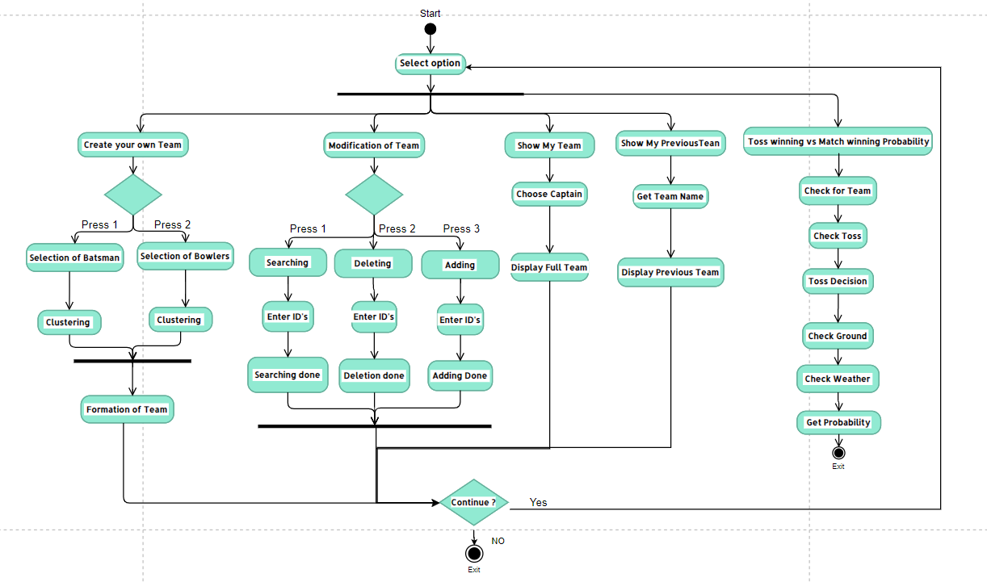
Activity diaGRAM

Slide 12
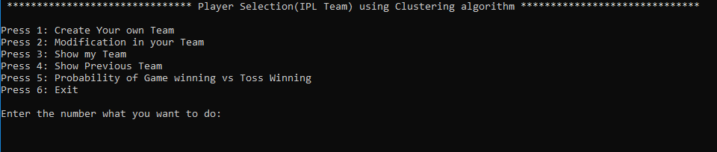
Results

Slide 13
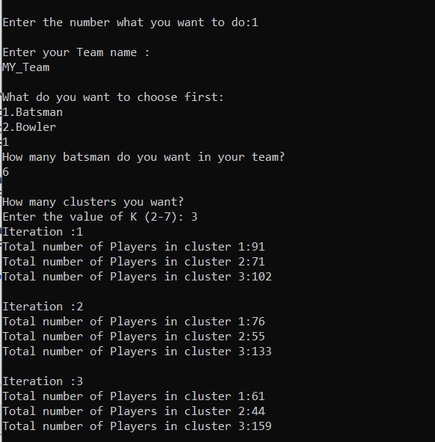
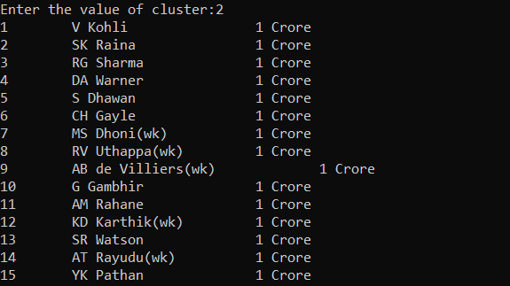
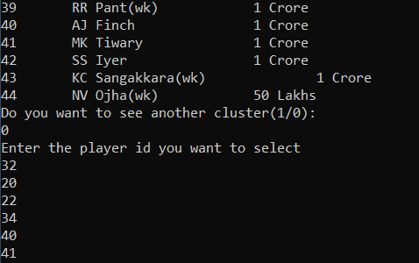
batsman clustering

Slide 14
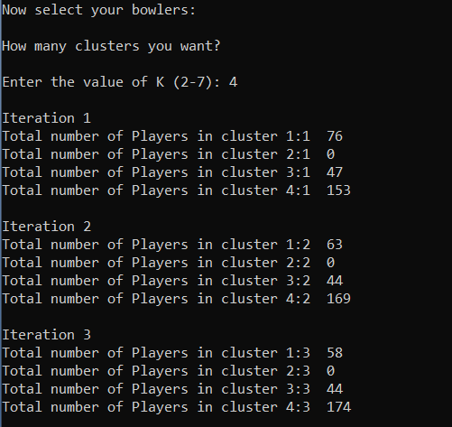
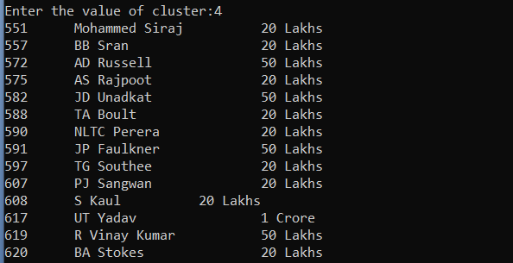
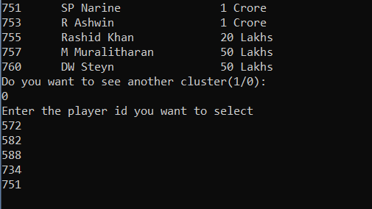
Bowlers clustering

Slide 15
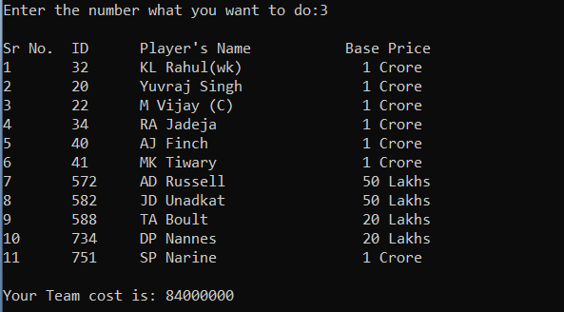
Show my team

Slide 16
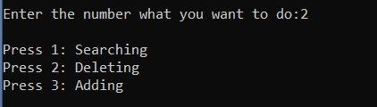


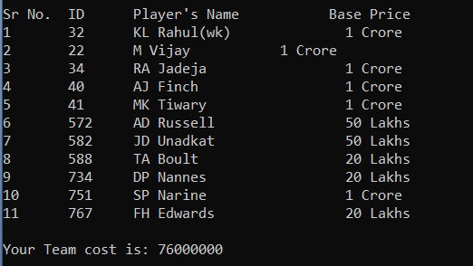
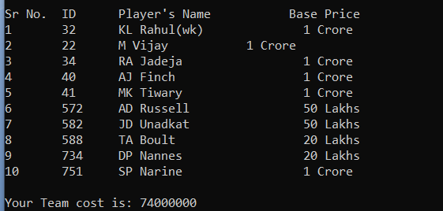
Modification in team

Slide 17
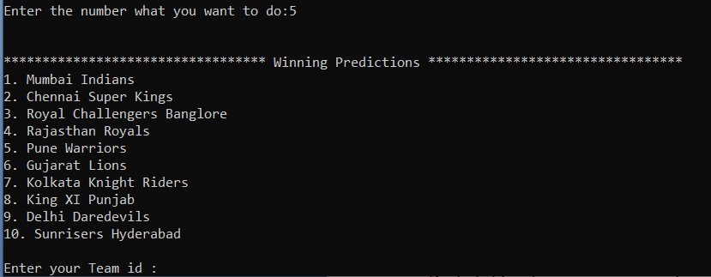
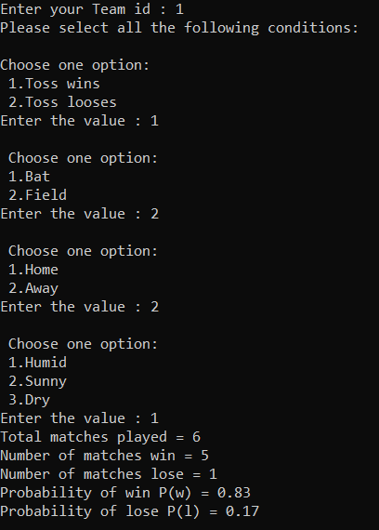
Probability of game winning vs toss winning

Slide 18
Reference links
[1] K. Alsabti S. Ranka and V. Singh, “An Efficient k-means Clustering Algorithm,” Proc. First Workshop High Performance Data Mining, Mar. 1998.
[2] S. Arora P. Raghavan and S. Rao, “Approximation Schemes for Euclidean k-median and Related Problems,” Proc. 30th Ann. ACM Symp. Theory of Computing, pp. 106-113, May 1998.
[3] Dataset Links:
https://data.world/raghu543/ipl-data-till-2016-set-of-csv-files/workspace/file?filename=Toss_Decision.csv
https://data.world/raghu543/ipl-data-till-2017/workspace/file?filename=Match.csv
https://www.kaggle.com/harsha547/indian-premier-league-csv-dataset?select=Player.csv

