Slide 1
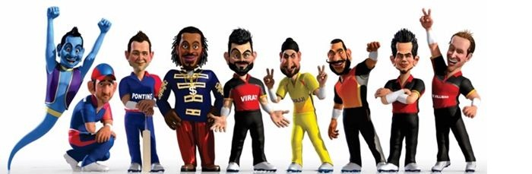
CSE 523 Machine Learning
Winter 2020-21
TEAM CRICGEEKS
1 | Kalki Bhavsar | AU1841029
2 | Harsh Mange | AU1841130
3 | Vardhan Shah | AU1841138
4 | Khushi Shah | AU1841139
Faculty: Mehul S Raval
Teaching Associate: Jay Patel, Arpit Patel
Notes:
Khushi

Slide 2
INTRODUCTION
Easy data acquisition in the sports field
Availability of live as well as historical data
Sports analytics help in decision making of
what to choose after winning the toss
On-field applications:
predicting the performance of a player or a team
predicting the outcome of a match
Off-field business:
understanding sales pattern (tickets, merchandise) and assigning prices accordingly.
Notes:
Khushi:
The data acquisition process has become relatively easy with the advancing of technology over the last few years.
The popular field of sports analytics (SA) has become a trend because of the abundant amount of live as well as past data collection. SA is the process of collecting data of the past matches, analyzing them, and extracting useful inference out of it.
The inference should help in the effective decision making process. For example, whether to select batting or bowling after winning the toss, what should be the order of batting, who will win the match, designing strategies for the forthcoming matches based on the players’ past performances, etc.
The game of cricket also uses sports analytics to predict the outcome of a match even before the match begins as well as while the game is in progress.
Machine learning (ML) can be applied effectively in many areas of sports; both on-the-field and off-the-field.
In the case of on-field, ML can be used to predict the performance of the player or the team, outcome of a match, etc. While in the case of off-field business, ML may turn out to be helpful while understanding the sales patterns of tickets, merchandise and assign the prices accordingly

Slide 3
PROBLEM STATEMENT
Literature survey conclusion:
Need for a machine learning model that could predict the outcome (winner) of an IPL match before the match begins.
Various cricket formats: ODI, T-20, Test, IPL. But here, we selected IPL.
Why IPL?
Various brand companies offers discounts and prizes for marketing their products during the IPL months to the customers who correctly predict the winner. [5]
Help in making decision whether to go to the stadium or not on your favourite team’s match.
Notes:
Khushi:
Machine learning models would help us in predicting the outcome (winner of the match) an IPL match before the match begins.
There are Various type of cricket format like IPL,T-20,ODI,TEST . But we have selected IPL Matches.
Since the league is so popular worldwide, various brands are now offering discounts and prizes to the customers who correctly predict the questions like winner, player of the match, etc. Due to this, predicting the winner of the match well in advance may turn out to be useful to the people as well as the companies. If the match is being played on the home-ground and the home team is likely to win, the ticket price may be charges high; also watching this match will be interesting in the stadium itself rather than choosing to watch a losing match.
Predicting the winner of IPL seems a interesting and useful problem to solve.

Slide 4
EXISTING BODY OF WORK
To solve the problem statement,
Analysis the impact the features on the output variable winner [1].
Used basic five features like team1, team2, toss_winner, venue where SVM resulted highest accuracy upto only 66.23%. [2]
Used dataset of all the IPL matches starting from 2008 to 2020 with an additional feature of powerplay performance of both the teams. [3]
 | Logistic Regression | Random Forest Classifier | Gradient Boosting Classifier | Decision Tree Classifier | SVM | XGBoost Classifier
[2] | 61.59% | 55.63% | - | 62.25% | 66.23% | -
[3] | 70.5% | 64% | 72% | - | - | 74.18%
Notes:
Vardhan
In the first literature we had seen analytics from data like most successful team winner,do winning toss means winning match.
Then in next Literature we had seen that author has prepared dataset with few, basic and essential features.
Then in next literatur author has collected the dataset of year 2008-2020 ipl matches with power play performance because player performance in power play has

Slide 5
EXISTING BODY OF WORK
A Datasets is modelled based on performance of player on the field.
A multivariate regression based solution is suggested to calculate point of each player and then for whole team.
Six machine learning model were trained and used for prediction.
Prediction is done 15 minutes before the match after the tossing happens.[4]
Notes:
Vardhan
Then in next paper a dataset is prepared from the player performance on the field then applying multivariate regression on player performance table we will get points of player and cumulatively we can get the whole team point then Six machine learning models are applied and prediction is done before 15 minutes.

Slide 6

OUR APPROACH
Scraping and understanding the dataset from the official ESPN, IPL website (Web-scraping)
Removing the redundancy inside the data values from manual checking (Data-cleaning)
Finding correlation matrix using
Pearson R Correlation to remove unnecessary columns (Feature Selection)
Step 1
Step 3
Step 5
Step 2 22
Step 4
Step 6
Reading the data-set and replacing the null values manually (Data-cleaning)
Encoding strings into categorical values + adding new derived columns (Feature Engineering)
Solve this classification problem using various algorithms (Building, Training and Testing the model)
Notes:
Kalki

Slide 7
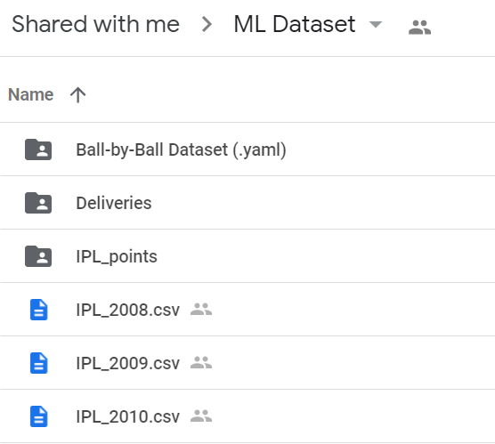
INITIAL RESULTS
Step 1
Web-scraping + Data Collection
Notes:
HArsh
The data is the key to solve this problem. The data of following features id, season, city, date, team1, team2, toss winner, toss decision, result (normal or tie), DL applied, winner, win by runs, win by wickets player of match, venue, home ground advantage, umpire1, umpire2, umpire3, powerplay runs team1, powerplay wickets team1, powerplay runs team2, powerplay wickets team2, pitch type, form of player, etc. was scraped from the official ESPN and IPL website. The first step of data collection ends here.

Slide 8
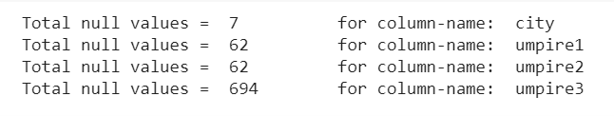
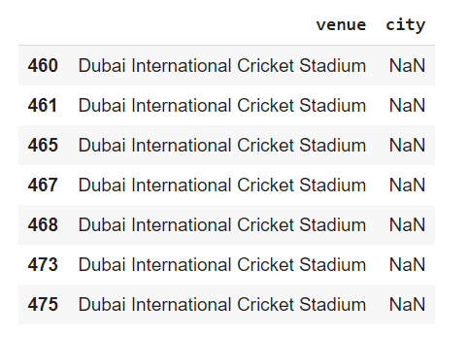
INITIAL RESULTS
Step 2
Data-cleaning
Check for Null Values
The data contains null values in 4 columns.
Drop the feature umpire1, umpire2, and umpire3 since there are lots of null values and these don’t have any impact on the winning team.
Insert values in the column ‘city’ where value is null based on the value of ‘venue’ column. Here, we replace NaN with “Dubai”.
Notes:
HArsh
In the next step, the data was cleaned. The data contained null values for the features like city, umpire1, umpire2, and umpire3. City could had null values where venue was ”Dubai International Cricket Stadium”. The null values were replaced by ”Dubai” for the column city. The features umpire1, umpire2, and umpire3 were dropped since the number of empty columns 62 for umpire1 and umpire2 while 694 for umpire3. The team names were renamed as mentioned in table I. Deccan Chargers (DC) was renamed to Sunrisers Hyderabad (SRH) in 2012 while Delhi Daredevils (DD) was renamed to Delhi Capitals (DC). Keeping this into account the renaming of teams was done. The next step was to remove redundancy in values. For example, ”Feroz Shah Kotla” and ”Feroz Shah Kotla Ground” are same venues in the same city Delhi. Also,

Slide 9

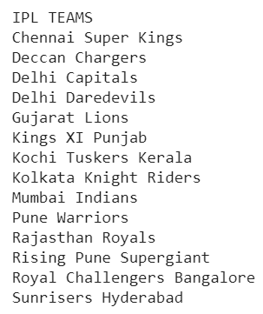
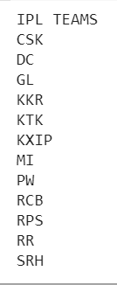
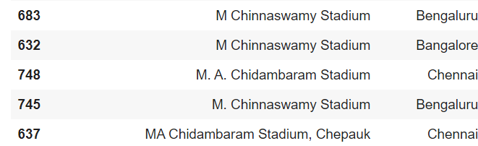
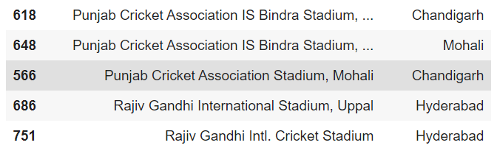
INITIAL RESULTS
Step 3
Data-cleaning
Renaming the team names
Deccan Chargers (DC) was renamed to Sunrisers Hyderabad (SRH) in 2012 [1]
Delhi Daredevils (DD) was renamed to Delhi Capitals (DC) [2]
2. Checking for the rows with
same venue, different venue names
Notes:
Harsh

Slide 10
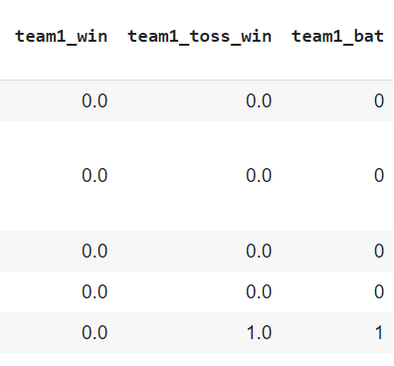


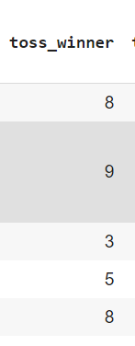


INITIAL RESULTS
Step 4
Feature Engineering
The column values should make some sense to the computers. Since the computer don’t have the ability to understand and draw inference from the text, we need to encode the strings to numeric categorical values. Encoding ways:
1. Manually: Adding new columns
2. Using LabelEncoder() from the Scikit-learn library
Notes:
KAlki
The next step is Feature Engineering. The column values should make some sense to the computers. Since the computer don’t have the ability to understand and draw inference from the text, we need to encode the strings to numeric categorical values. There are two encoding ways. First is manually and second is by using tools LabelEncoder() from the Scikitlearn library in PYTHON. The columns ”team1”, ”team2”, ”winner”, ”toss winner”, ”city”, and ”venue” were encoded using LabelEncoder() while the new columns team1 win, team1 toss win, and team1 bat were encoded using 1’s and 0’s manually. In addition to this, home ground advantage was encoded as +1 if the venue is the home-ground of
team1.
Similarly -1 was used to encode if the venue is the home-ground of team2. If both teams or none of them have home-ground advantage, 0 was used to encode the same. The columns team1 points and team2 points did not make much impact to the accuracy. But when the difference was used i/e team point difference that is equal to team1 points - team2 points, the accuracy was improved of 4:55 12:12%.
Adding the feature of the team strength was also worked upon.

Slide 11
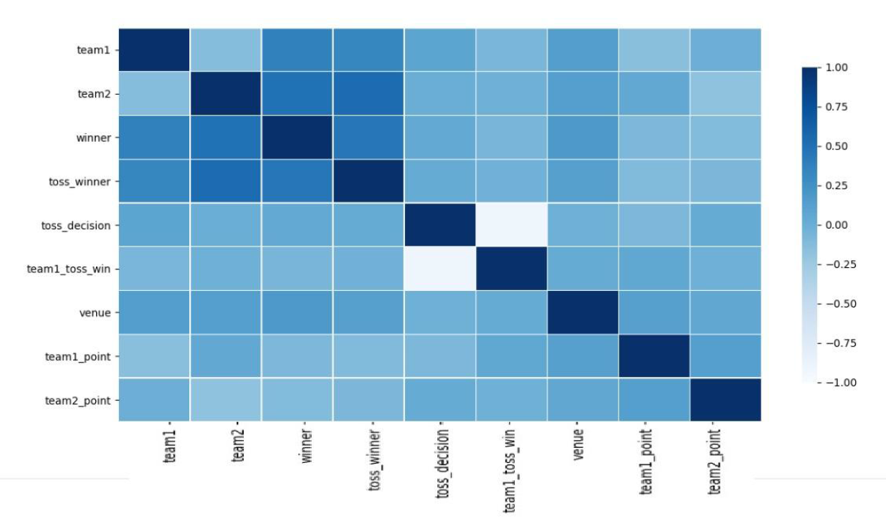
INITIAL RESULTS
Step 5
Feature Selection
In the feature selection step, few unnecessary and redundant columns like season, date, id, play_of_match, etc were removed.
We found the correlation between two variables
using PEARSON R CORRELATION which is mostly used to measure the degree of the relationship between linearly related variables.
When two variables are redundant, we decided a threshold of 0.8 while removing the redundant features.
Notes:
Kalki
In the feature selection step, few unnecessary and redundant
columns like season, date, id, play of match, etc were
removed. We found the correlation between two variables
using PEARSON R CORRELATION which is mostly used to
measure the degree of the relationship between linearly related
variables. When two variables are redundant, we decided a
threshold of 0.8 while removing the redundant features.

Slide 12
INITIAL RESULTS
Step 6
Model Building, Training, & Testing
The following algorithms were used :
 | Logistic Regression | Decision Tree Classifier | Support Vector Machine | Random Forest Classifier
Basic | 50% | 56.06% | 52.07% | 56.82%
+ Team1, 2 points | 61.36% | 56.27% | 59.85% | 60.61%
+Home-ground advantage | 60.61% | 50.76 | 59.85% | 60.61%
+ Points difference | 62.12% | 60.61% | 61.36% | 61.36%
The least performer outperformed when new important features were added
Notes:
Khushi:
Step 6 is model building ,training and testing.
Applied 4 basic algorithms. Logistic regression ,decision tree classifier, svm,random forest classifier and the accuracy is calculated for the data set.
The columns team1 points and team2 points did not make much impact to the accuracy. But when the difference was used i/e team point difference that is equal to team1 points - team2 points, the accuracy was improved of 4.55 ∼ 12.12%.
Logistic Regression outperformed other models like Decision Tree Classifier, SVM and Random Forest Regression when the new features like home ground advantage, teams’ point difference were added. Significant change in the accuracy was seen.

Slide 13
WORK DISTRIBUTION
Dataset Gathering (or scrapping) Harsh
Merging & formation of dataset Kalki Harsh Vardhan
Literature review Khushi Kalki Vardhan
Conceptualizing dataset & sport Vardhan
Data Cleaning Kalki
Data visualization Kalki,Vardhan
Exploratory data analysis of selected features Kalki,Vardhan,Khushi
Feature importance (or weight) in terms of Output Harsh,Kalki
Feature engineering Kalki,Harsh
Feature selection & extraction Kalki,Vardhan,Khushi
Testing the dataset on various models Khushi,Harsh
Notes:
Vardhan Rajnikant Shah
This the overall work right from gathering dataset to to test dataset. which we had distributed among us and work uptill now.

Slide 14
FUTURE WORK
Implementation of models.
K-Cross Fold Validation Implementation.
Working on adding the strength of team feature
Notes:
Vardhan
In near future we are trying to build an existing model.
We will also try to implement k- fold validation to estimate the model on new data.
We will also try to make good performance of model through team perfomance

Slide 15
REFERENCES
Predictive Analysis of an IPL Match
Predicting outcome of IPL match based on variables
IPL Match Prediction based on Powerplay using Machine Learning
Predicting Outcome of IPL Matches Using ML
Notes:
Vardhan - This are References which we refer during this project.

Slide 16
THANK YOU!
Notes:
Vardhan - Thank You

