Slide 1
COMP7106B Big Data Management Lecture 5 Big Text Data
Prof. Reynold Cheng
23th March, 2024
Acknowledgement: This presentation is based on Prof. Nikos Mamoulis’ COMP3323 slides.

Slide 2
Topics
Text databases
Containment and similarity queries
Indexing for containment and similarity
String matching

Slide 3
Text Databases
Document databases
Containment and similarity queries
Indexing for containment and similarity

Slide 4
Text Databases
A text database is a collection of documents.
Each document is considered as a list of words.
Example:
A database of abstracts, legal transcripts, newspaper articles, the WWW.

Slide 5
Search in a Text Database
We usually search in a text database, using interesting keywords.
E.g., find all documents containing “Shakespeare” and “Othello”
Two popular forms of queries
Containment queries
E.g., find documents containing “Shakespeare” and “Othello”
Ranking queries
E.g., rank documents based on their similarity to a list of terms or a sample text
Searching and managing text is a main subject of Information Retrieval

Slide 6
Containment queries
Search terms are expressed in a formula that connects them with AND (∧), OR (∨), NOT (¬) predicates.
A document qualifies the query or does not qualify the query (Boolean answer).
Example:
(“car” ∨ “automobile”) ∧ (“convertible” ∨ “cabriolet”)
Stemming is used to unify different endings of the same word (e.g., remove -ing, -ed, etc.)
....John arrived in a convertible automobile....

Slide 7
Evaluation of containment queries
Given a text database, how do we evaluate containment queries on it?
Naive approach:
Scan each document in the database and verify the query
Expensive: Each document must be parsed and each word must be compared with the query keywords
Better:
Preprocess the documents and extract the words from them.
Index the documents based on the words they contain.
Use the index to evaluate containment queries.

Slide 8
Set comparison
Assume containment queries with only AND predicates (e.g., s = “A” ∧ “D” ∧ “M”)
Each query is a set of keywords s
Each document is a set of words t
Problem: check if s ⊆ t
Algorithm (similar to merge join)
Sort s and t
Scan the words of s and t concurrently until some word of s is not found in t, or all words are found.
Expensive (sorting + 1 pass)
s = A D M
t = A B E F N M O P
stop here! return false

Slide 9
Signatures
Sets can be approximated by signatures.
Signatures are bitmaps generated by some hash function.
Let W be the set of keywords that appear in any document of the database (e.g., the dictionary of terms). In other words, W is the domain of the set elements. Formally, each document/query is a subset of W.
Let b be a signature-length and H a hash function that maps each word e in W to a number from 0 to b-1.
The signature of a set s is a bitmap of length b formed by setting bit H(e) for each e ∈ s.

Slide 10
Signatures
Example:
W= {1,2,...,100}(words encoded by numeric identifiers)
b=10.
H(e) = e modulo 10.
x= {38,67,83,90,97}, sig(x)=.
y= {18,67,70}, sig(y)=1000000110. 1001000110
Signatures are lossy approximations; they do not represent the sets exactly. Two different sets may have the same signature.
E.g., z= {18,27,33,60}: sig(z)=1001000110 = sig(x).

Slide 11
Query processing using signatures
if x ⊆ y then sig(x) ⊆ sig(y)
sig(x) ⊆ sig(y) ⇔ sig(x) & ¬sig(y) = 0
e.g., 0100010000 ⊆ 0110010010
Similarly:
if x = y then sig(x) = sig(y)
if x ∩ y ≠ ∅ then sig(x) & sig(y) ≠ 0
Using bitwise operations on signatures we can determine fast if the sets may qualify the predicate.
Signatures are used as fast filters for set-operations.

Slide 12
Query processing using signatures
Given a text database D, we can create a signature file that stores sequentially the signatures of all documents in D.
A containment query q is then processed in two steps:
sig(q) is computed and the signature file is scanned to find the document-ids which qualify the selection predicate on the signature level (drops)
for each drop, the document is compared to q. If a drop does not pass the refinement step it is called a false drop.
several selection query types exist:
set containment selection (or subset query): Find all documents in D that contain q. The inverse superset query is also useful.
Also: set equality selection, set overlap selection

Slide 13
Example
text database
signature file
doc-id | keywords
1 | a,d,f,h,m,n,p,z
2 | b,c,f,i,m,o
3 | a,c,s,t,v,w
4 | e,l,p,q,t,y,z
... | ....
doc-id | signature
1 | 01000110
2 | 11001000
3 | 01001101
4 | 00010110
... | ....
candidates
doc-id
1
3
...
query
q.sig
scan
verification
{a,m}
01000100
doc-id | keywords
1 | a,d,f,h,m,n,p,z | T
3 | a,c,s,t,v,w | F
... | ....

Slide 14
Updating signature files
Similar to updating of relations. When a document is inserted to the text database a new signature is inserted to the signature file. Deletions are similar.

Slide 15
Signature-based indexes
The signatures can be indexed in order to avoid accessing all of them for a single query.
Several methods exist, among which the bit-sliced signature file dominates.
Given a query signature q.sig, only the columns where q.sig has 1 are accessed and bitwise ANDed.
Example: if q.sig = 0010000110, only columns S₂,S₇,S₈ are accessed.
b=10
S₀
S₁
S₂
S₃
S₄
S₅
S₆
S₇
S₈
S₉
1
2
3
N
1
0
1
0
0
1
0
1
1
0
0
0
0
1
0
0
0
0
1
0
0
1
0
0
1
0
1
1
0
1
1
1
1
0
1
0
0
1
0
1
.
.
.
.
.
.
.
.
.
.
.
.
.
.
.
.
.
.
.
.
.
.
.
.
.
.
.
.
.
.
.
.
.
bit-sliced signature file

Slide 16
Signature-based indexes
Another method is the signature-tree (good for dynamic data).
Similar to the R-tree, but instead of MBRs it uses signatures.
Leaf nodes contain document signatures
Directory nodes contain entries, whose signature is the logical OR or all signatures in the sub-tree pointed by them.
Heuristics similar to R-tree construction are used to insert/update signatures in the tree.

Slide 17
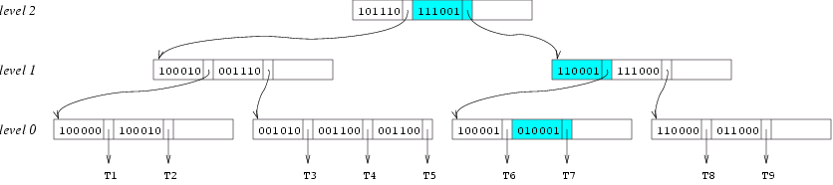
The SG-tree (example)
Example of a set-containment query:
W = {a,b,c,d,e,f}
q = {b,f} (i.e., find all documents that contain b and f)
q.sig = 010001

Slide 18
The Inverted File
Another method to index a collection of sets is to build an inverted file for the set elements in W.
For each word e, the index has an inverted list, which stores the ids of the documents that contain the word e.
A containment query is processed by joining the lists that correspond to the elements of the query.

Slide 19
The Inverted File - Example
ids of documents that contain “ace”
the directory
ace
ant
art
.
zebra
24, 53, 67, 128, 157, ...
inverted list
49, 86, 132, 189, ...
7, 39, 62, 114, 132, 147, ...
12, 27, 54, 95, 134, 195, ...
Query: Find the documents that contain {ant,art}
Method: join the inverted lists that correspond to ant and art. This results in {132}.
The join is cheap because the ids are stored and sorted in the lists (and we can use merge-join)

Slide 20
The Inverted File - Comments
The inverted file was shown superior to signature-based techniques in several studies
It is best for static data. Updates are expensive, thus they are performed in batches

Slide 21
Term Frequency Vector
So far, we have considered a document as a |W|-length bit-vector, indicating which terms it contains from W.
E.g. W={a,b,c,d,e,f}. A document with keywords a,c,f is represented by 101001
Alternatively, a document may be represented by a |W|-length “term frequency vector”, indicating the relevance of each term in the document. The relevance (weight) of a keyword e to a document is e’s frequency in the document.
E.g. W={a,b,c,d,e,f}. A document with vector {3,0,2,0,0,1} contains keyword a 3 times, c 2 times, and f 1 time.

Slide 22



Document ranking
Consider a query text q, with relevance vector to the keywords w_{q}=w_{q,1}, w_{q,2}, ..., w_{q,N}. The similarity of q to a document d is defined by:
Given a database of documents and a query q, we can define a ranking of the documents based on their similarity to q.

Slide 23
Using the Inverted File for ranking
ids of documents + weights
the directory
ace
ant
art
.
zebra
24(2), 53(1), 67(3), 128(5), 157(7), ...
49(1), 86(7), 132(3), 189(5), ...
7(2), 39(1), 62(2), 114(1), 132(4), 147(1), ...
inverted list
12(2), 27(1), 54(3), 95(2), 134(1), 195(1), ...
Query: Find the documents that contain {ant,art}
Method: Accumulate the weights of documents for each term, by accessing and merging the inverted lists.
While measuring the similarity of documents, maintain a set of the k most similar documents to the query.

Slide 24
Problem of Term Frequency Vectors
Consider a 100-document text database
‘the’ occurs in all documents
‘algorithm’ occurs only in one document
Suppose in the only document d which contains ‘algorithm‘, the occurrence of ‘algorithm’ is 1, the occurrence of ‘the’ is 10, we have
W={‘algorithm’, …, ‘the’, …} = {1, …, 10}
Intuitively, ‘algorithm’ should be a stronger indicator for the document compared to ‘the’, but frequency vector fails to do so.

Slide 25
TF-IDF
An improvement over relevance vector
Determines the relevance of words or phrases within a document and among documents.
Frequency of words within individual documents and
their importance across all documents
Intuition
Frequent terms (e.g. the) are less informative than rare terms (e.g. algorithm) in a document

Slide 26
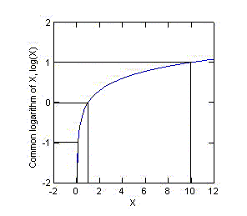
Term Frequency (TF) and Inverted Document Frequency (IDF)
Given a term t, document d, and a corpus of N documents
Term frequency (relative) (TF)
tf(t,d) = # times t occurs in d / total # words in d
Document frequency (DF)
df(t) = # documents containing t
% of N documents in corpus containing t = df(t) / N
Inverted document frequency (IDF)
idf(t) = log (N / (df(t)+1) ) + 1
TF-IDF
tf-idf(t, d) = tf(t, d) * idf(t)
Magnify small values & compress large values

Slide 27
TF-IDF Example (1)
E.g., given a 100-document text database, the term ‘the’ occurs in all documents while ‘algorithm’ occurs only in document d.
df(‘the’)=100; idf(‘the’)=log(100/101)+1=0.996
df(‘algorithm’)=1; idf(‘algorithm’)=log(100/2)+1=2.699
Document d has 50 words; ‘algorithm’ occurs 1, while ‘the’ occurs 10 times.
tf-idf(‘the’,d) = tf(‘the’, d) * idf(‘the’)=10/50*0.996=0.2
tf-idf(‘algorithm’,d) = tf(‘algorithm’, d) * idf(‘algorithm’)=1/50*2.699=0.05

Slide 28
TF-IDF Example (2)
Term-frequency-based:
tf(‘the’, d)=0.2
tf(‘algorithm’, d)=0.02
TF-IDF-based:
tf-idf(‘the’,d) =0.2
tf-idf(‘algorithm’,d) = 0.05
Is df or tf-idf better?

Slide 29
Using the Inverted File for ranking
TF-IDF vectors can substitute term-frequency vectors in document ranking.
ids of documents + weights
the directory
ace
ant
art
.
zebra
24(2.0), 53(0.175), 67(0.3), 128(0.5) ...
49(1.0), 86(0.75), 132(2.0) ...
7(2.0), 39(0.675), 114(2.0), 132(0.425) ...
inverted list
12(2.0), 27(0.135), 54(0.375), 95(2.0) ...

Slide 30
Summary
Text documents are indexed based on interesting keywords.
3 models for representing documents:
as sets of keywords that they contain
as vectors of relevance weights for each keyword (term-frequency, TF-IDF)
Two types of indexing: signature-based indexes and inverted files
Two types of queries: containment queries and ranking (similarity) queries

Slide 31
Topics
Text databases
Containment and similarity queries
Indexing for containment and similarity
String matching

Slide 32
String Matching
We have discussed how to search for documents containing a set of words.
In some cases, we are interested in documents containing a phrase of words.
If a document is a string of words, a phrase in it is a sub-string.
Text searching: given a large collection of documents and some text keywords we want to find the documents which contain these keyword phrases.
We will now discuss searching for sub-strings in a long string.

Slide 33
Search for substrings
A popular data structure for indexing long strings in order to search for sub-strings in them is the suffix tree.
The suffix tree is a compressed form of a trie that indexes all suffixes of the string.
Algorithms for performing approximate search on suffix trees are also available.

Slide 34
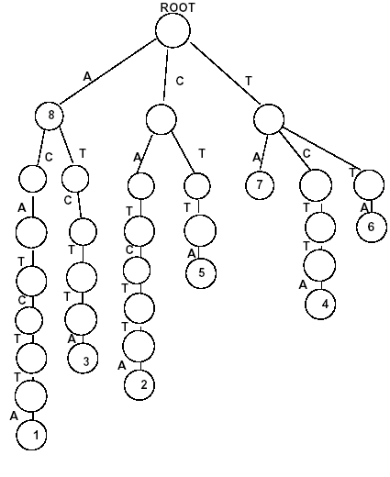
Example of a suffix trie
String
Special termination character
$
1 2 3 4 5 6 7 8
S=A C A T C T T A
8
7
suffixes:
A C A T C T T A C A T C T T A A T C T T A T C T T A C T T A T T A T A A
6
5
4
3
2
1
Suffix trie
Note!! This is an example of a string of characters, but it could be a string of words (document)

Slide 35
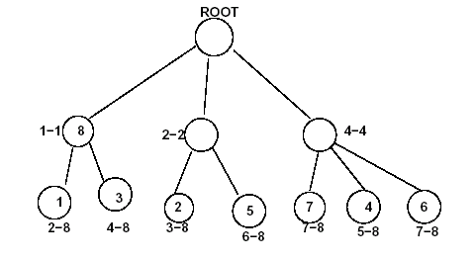
Example of a suffix tree
Each internal node represents a unique substring
String
1 2 3 4 5 6 7 8
S=A C A T C T T A
Suffix tree
The suffix tree is a suffix trie, where unary paths are compressed
1
A
C
T
$
2
2
2
T
T
8
C
A
A
C
T
1
3
8
2
5
7
4
6
Each leaf node is the position of the suffix compressed in the path

Slide 36
Example of a suffix tree search
String
1 2 3 4 5 6 7 8
S=A C A T C T T A
Suffix tree
Search for “CTT”
1
A
C
T
$
2
2
2
T
T
8
C
A
A
C
T
1
3
8
2
5
7
4
6
a) we know that there is a substring CT*, starting at position 5 b) go to that position and scan the string to check for occurrence of “CTT”

Slide 37
Suffix trees are good, but ...
Main memory structures; how to construct and maintain very large trees?
Create suffix arrays instead of suffix trees
suffix array: a lexicographically sorted array of all suffixes and their positions in the string (could be secondary-memory array)
E.g., <A,8>,<AC*,1>,<AT*,3>, etc.
Details are out of the scope of this course

Slide 38
Approximate string matching
Queries on string sequences often allow errors in matches. Therefore an interesting and challenging subject is approximate string matching.
Here we give 3 example applications and outline the main ideas.

Slide 39
Application 1: Information Retrieval
A typical application of information retrieval is text searching; given a large collection of documents and some text keywords we want to find the documents which contain these keywords.
In many cases search should allow errors. For example text collections digitized by OCR contain a large percentage of errors (7-16%). In addition, there could also be typing or spelling errors in documents.
Therefore there are two research directions in text retrieval: exact search and approximate search. Naturally, approximate search is more difficult and expensive than exact search.

Slide 40
Application 2: Computational Biology
The problem is similar in computational biology; here we have a long DNA sequence and we want to find subsequences in it that match approximately a query sequence.
DNA and protein sequences can be seen as long texts over specific alphabets (e.g., {A,C,G,T}). Those sequences represent the genetic code of living beings.
The similarity of two DNA substrings from different organisms may correspond to the same functional or physical relationship between these organisms.
Exact searching here is of little use, since the query patterns rarely match the text exactly; the correct results may have small differences due to mutations and evolutionary alternations.

Slide 41
Application 3: Signal Processing
In Speech Recognition the general problem is to determine a textual message from a transmitted audio signal. The signal could be compressed, or some words may not be pronounced well, so approximate matching is used.
Another related problem is error correction. Compression introduces errors in the transmitted signals, so approximate search is needed for correcting these errors.

Slide 42
Approximate string search
Must first define a similarity function between strings.
The most widely accepted similarity metric is the edit distance.
The edit distance between two strings is defined by the number of primitive operations (insert, delete, replace) necessary to transform one string to the other

Slide 43
Example of edit distance
What is the edit distance between “survey” and “surgery”?
s u r v e y
replace (+1)
s u r g e y
insert (+1)
s u r g e r y
Edit distance = 2

Slide 44
Example of generic edit distance: String Alignment
In biological string matching the similarity metric is often called “string alignment”
Let S and T be strings. An alignment maps S and T into string S' and T' by inserting spaces into S and T, such that |S'|=|T'|.
Example:
S=acgcaggtc
T=agcgtc
acgcaggtc
|||||||||
ag_cg__tc
acgcaggtc
|||||||||
a_gc__gtc
optimal alignment=distance

Slide 45
Remarks
Other string similarity measures include LCS distance, Hamming distance, Episode distance, reversals, block distance, and q-gram distance.
Dynamic programing algorithms can be used to compute edit distance efficiently.

