Slide 1
COMP7106B Big Data Management Lecture 2 Spatial Data Management
Prof. Reynold Cheng
27th January, 2024
Acknowledgement: This presentation is based on Prof. Nikos Mamoulis’ COMP3323 slides.

Slide 2
Spatial Data Management
Spatial Data
Spatial Relationships
Spatial Queries
Issues in Query Processing
The R-tree
Spatial Query Processing
Spatial Selections
Nearest Neighbor Queries
Spatial Joins

Slide 3



Location data
Check-in service usage is increasing a lot. The number has been more than doubled in 9 months.
Source: Pew Research Center’s Internet & American Life Project April 26-May 22, 2011 and January 20-Febrary 19, 2012 tracking surveys
Image source: http://marketingland.com/check-in-service-usage-has-more-than-doubled-in-past-9-months-study-says-11792

Slide 4
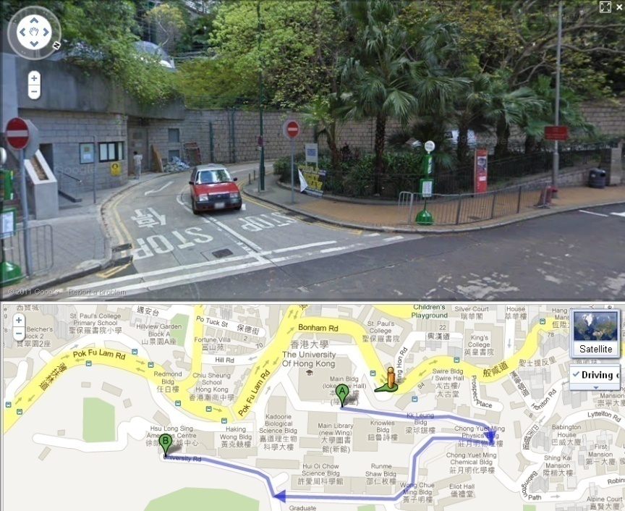
Online Maps
Google Map allows you to
Identify your location and
plan routes.
Route information from
other users provides
suggestions for the best route.
Notes:
Would you allow Online Map providers to make use of your location data to predict the traffic situations (whether or not a road is in traffic congestion) ?
Yes
May be
No

Slide 5


Location-based services
Map services on mobile phones are able to navigate users to their destination.
A company can send SMS promotions to subscribers when they are near to their stores.
Application can suggest a dish to you when you are in a restaurant, notify you that your friends are nearby, or suggest you for places that you may want to visit.
Image source: http://blog.foursquare.com/2013/08/29/a-smarter-foursquare-so-you-dont-miss-a-thing/

Slide 6
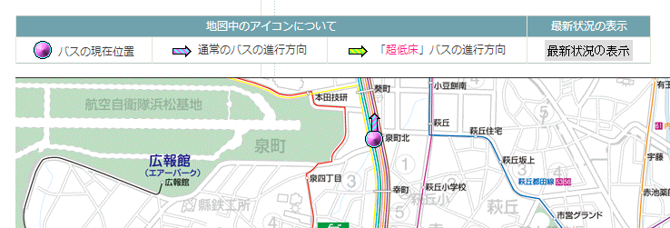
Location tracking
Companies can monitor their delivery truck location with GPS installed on them.
A bus company can also publish such information for passenger on web.
Real time bus location in the web site of Enshu Railway Co., Ltd, Hamamatsu, Shizuoka, Japan
http://info.entetsu.co.jp/navi/pc/location.aspx?no=15 (Only available in Japanese)

Slide 7
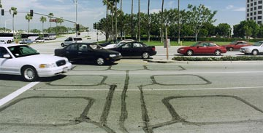
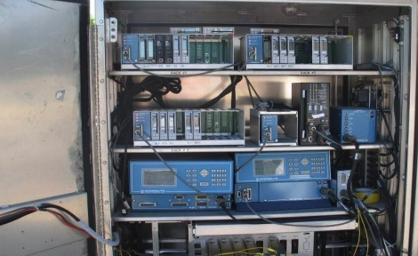
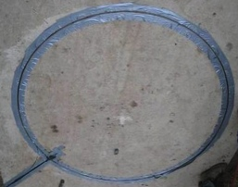
Traffic Data Analysis
Loop detectors are installed to capture real time traffic information
Multiple data sources from different transportation companies and departments are collected
By analyzing these data, we predict the traffic condition which can enhance the quality of suggested routes
Loop Detector
Detector Cabinet
“TransDec: A Big-Data Framework for Decision-Making in Transportation Systems” by Prof. Cyrus Shahabi

Slide 8

Spatial Databases (Free)
PostgreSQL with PostGIS
Neo4J-spatial
HadoopGIS
Ingres
GeoMesa

Slide 9
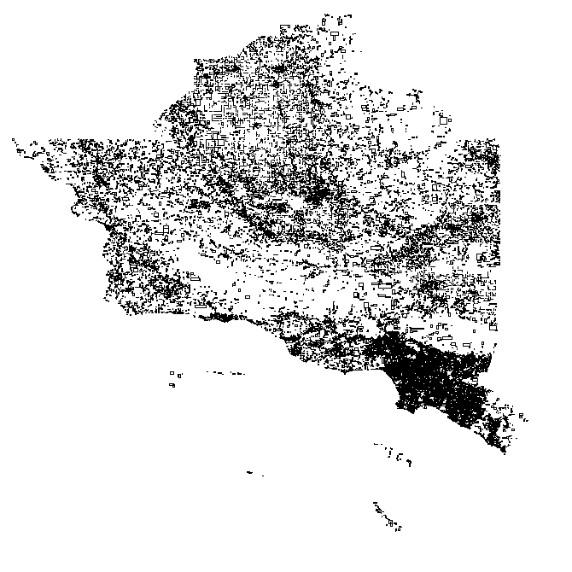
Spatial Data Management
Spatial Database Systems manage large collections of multidimensional objects (typically 2D/3D)
A spatial object contains (at least) one spatial attribute that describes its location and/or geometry
A spatial relation is an organized collection of spatial objects of the same entity (e.g. rivers, cities, road segments)
Road segments from an area in CA
A spatial relation

Slide 10
Spatial Data
Spatial objects may be have spatial extent or they can be points.
Cities in a large-scale map can be modeled by points
Examples of objects with extent, include rivers, forests, districts, buildings in a city, etc.

Slide 11
Spatial Data
Two ways to represent objects with spatial extent
Vector representation: approximation by geometric objects, e.g., polygons, poly-lines, rectangles, circles, etc.
Raster representation: divide the space by a fine grid and approximate the objects by a set of pixels in this grid
object
vector approximation
raster approximation

Slide 12
Spatial Data
Spatial data can be found in many applications
Geographic Information Systems
Segmented images (e.g., objects in X-rays)
Components of CAD constructs or VLSI circuits
Stars on the sky
…
Spatial database systems are used by
Users of mobile devices (find the nearest restaurant)
Geographers, astrologers, life scientists, army commanders, etc.

Slide 13
Spatial Relationships
A spatial relationship associates two objects according to their relative location and extent in space
Example: “My house is close to Central Park”
Sometimes also called “spatial relations”. We will use the term spatial relation to refer to a database relation which stores spatial objects (see slide P. 9)
Spatial relationships are classified to
topological relationships
distance relationships
directional relationships

Slide 14
Topological Relationships
Each object is characterized by the space it occupies in the universe.
a (finite or infinite) set of pixels
Each object has a boundary and an interior
boundary: the set of pixels the object occupies, that are adjacent to at least one pixel not occupied by the object
interior: the set of pixels occupied by the object, which are not part of its boundary
Note: in some representation models, some objects may not have interior
e.g., points, line segments, etc.
boundary
interior

Slide 15
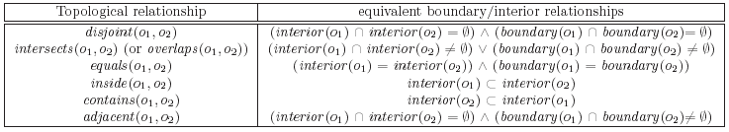
Topological Relationships
A topological relationship between two objects is defined by a set of (set-based) relationships between their boundaries and interiors
E.g., o₁ is inside o₂ if interior(o₁) ⊂ interior(o₂)
intersects (or overlap) means any of equals, inside, contains, adjacent
intersects ⇔ ¬disjoint

Slide 16
Topological Relationships
In fact, there is a hierarchy of topological relationships:
ANY
intersects
disjoint
adjacent
contains
inside
equals

Slide 17
Distance Relationships
Distance relationships associate two objects based on their geometric distance.
The geometric distance is often called Euclidean distance.
Distance is usually abstracted (i.e., discretized) into the human mind.
Example (distances in a city)
0-100m: near
100m-1km: reachable
1km-10km: far
>10km: very far
Distance relationships are expressed either explicitly or by some abstract distance class

Slide 18
Directional Relationships
Directional relationships associate two objects based on their relative orientation according to a global reference system
Example: My house is north of the river
relationship can also be a number:
e.g. house 96 degrees relative to river
Examples of directional relationships:
north, south, east, west, northeast, etc.
left, right, above, below, front, behind, etc.
Topological, distance, and directional relationships can be combined :
My house is disjoint with the park, 100 meters north of it

Slide 19
Spatial Queries
Applied on one (or more) spatial relations
Retrieve objects (or combinations of objects) satisfying some spatial relationships
between them or
with a reference query object
Examples:
Nearest neighbor query: What is the nearest city to my current location?
Spatial join: Find all pairs of hotels and restaurants within 100m distance from each other

Slide 20
Spatial Queries
Range query (spatial selection, window query)
c₁
c₂
W
e.g. find all cities that intersect window W
Answer set: {c₁, c₂}
F
c₃
c₄
Nearest neighbor query
e.g. find the city closest to the forest F
r₁
r₂
Answer: c₂
c₂
c₃
c₁
c₄
Spatial join
e.g. find all pairs of cities and rivers that intersect
c₅
Answer set: {(r₁,c₁), (r₂,c₂), (r₂,c₅)}

Slide 21
What Is Special About Spatial
Dimensionality: There is no total ordering of objects in the multidimensional space that preserves spatial proximity
space-filling curves
z-curve
Hilbert-curve
Complex spatial extent: The spatial extent adds to the complexity of object clustering into disk pages imposed by dimensionality
No standard (closed) definitions of spatial operations and algebra

Slide 22
What Is Special About Spatial
Implication:
Relational indexes (e.g. B+-trees) and query processing methods (e.g. sort-merge join, hash-join) are not readily applicable to spatial data
New, spatial access methods (SAMs) for spatial data have to be defined
SAMs index spatial objects and facilitate efficient processing of simple spatial query types (i.e., range queries)

Slide 23
Two-step Spatial Query Processing
Evaluating spatial relationships on geometric data is slow; a spatial object is approximated by its minimum bounding rectangle (MBR)
The spatial query is then processed in two steps:
1. Filter step: The MBR is tested against the query predicate
2. Refinement step: The exact geometry of objects that pass the filter step is tested for qualification
Example for spatial intersection joins:
filtered pair
non-qualifying pair that passes the filter step
(false hit)
qualifying pair

Slide 24
Two-step Spatial Query Processing
Example 2:
Problem: Find all objects that intersect the query window W
(a) objects and a query | (b) object MBRs | (c) candidates and results

Slide 25
Spatial Access Methods
The problem of indexing spatial data is challenging
No dynamic access method with good theoretical worst-case guarantees for range queries
Therefore Spatial Access Methods aim at the minimization of the expected cost
Early SAMs focused on indexing of multidimensional points
Examples: the grid file, the k-d-B-tree
Point access methods are not effective for extended objects
Objects may need to be clipped into several parts which leads to data redundancy and affects performance negatively

Slide 26
Spatial Access Methods
Point access methods (dynamically) divide the space into disjoint partitions and group the points according to the regions they belong
E.g., the grid-file
Point access methods are not effective for extended objects
Objects may need to be clipped into several parts which leads to data redundancy
disk block 1
disk block 2
disk block 3
object clipping

Slide 27
Spatial Access Methods
Object clipping can be avoided if we allow the regions of object groups to overlap
Problem:
Group the objects below into 3 groups of 4 objects each such that the MBRs of the groups do not overlap
not possible!

Slide 28
Spatial Access Methods
Better:
Group the objects below into 3 groups of 4 objects each such that the MBRs of the groups have the minimum overlap
Hard optimization problem
We can seek for a fast, suboptimal solution

Slide 29
The R-tree
Groups object MBRs to disk blocks hierarchically
Each group of objects (a disk block) is a leaf of the tree
The MBRs of the leaf nodes are grouped to form nodes at the next level
Grouping is recursively applied at each level until a single group (the root) is formed

Slide 30
The R-tree
Leaf node entries: <MBR, object-id>
Non-leaf node entries: <MBR, ptr>
The MBR of a non-leaf node entry is the MBR of all entries in the node pointed by it
Parameters (except root):
M (max no of entries per node)
m (min no of entries per node)
m <= M/2
usually m=0.4M
Root has at least two children
All leaves in same level (balanced tree)
1 node → 1 disk block

Slide 31
The R-tree
exact geometry of object x
pointers to object locations in the spatial relation (for accessing the exact geometry and other attributes)

Slide 32
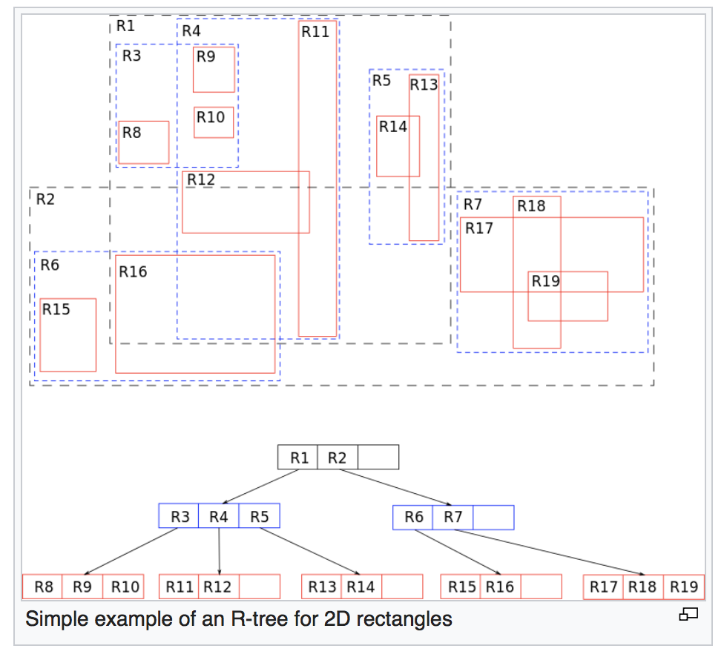
The R-tree
https://en.wikipedia.org/wiki/R-tree

Slide 33
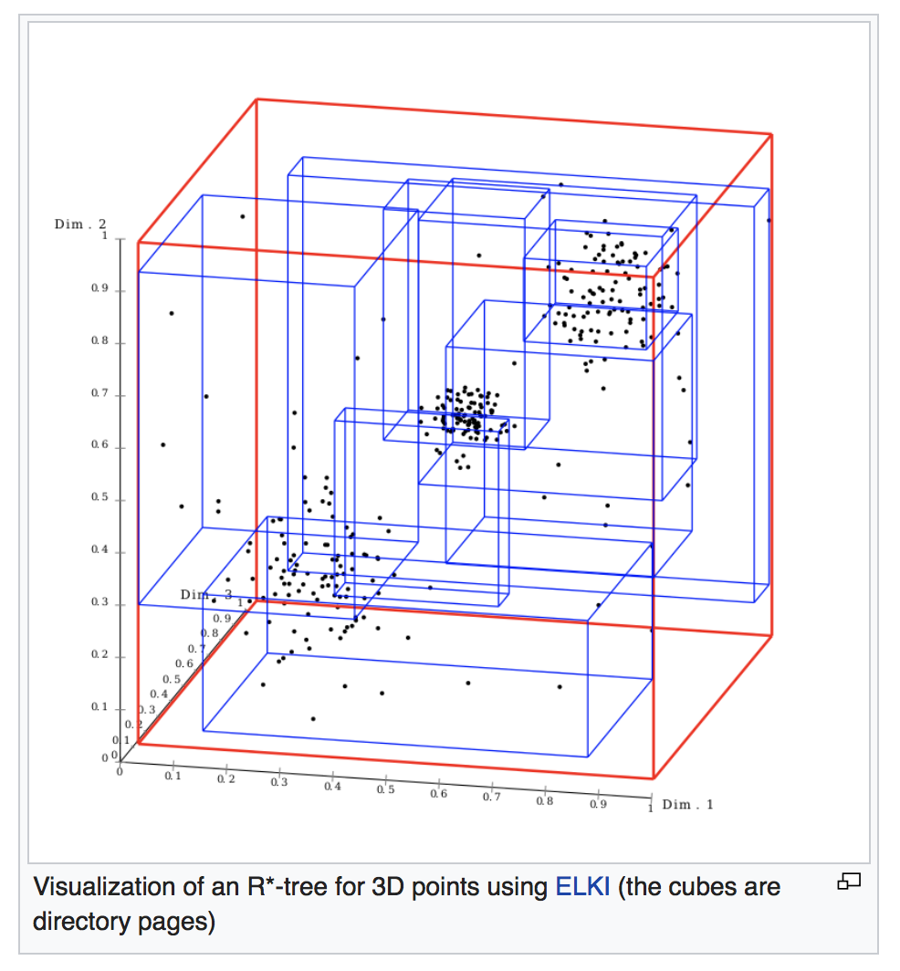
The R-tree
https://en.wikipedia.org/wiki/R-tree

Slide 34
Range searching using an R-tree
Range_query(query W, R-tree node n):
If n is not a leaf node
For each index entry e in n such that e.MBR intersects W
visit node n’ pointed by e.ptr
Range_query(W, n’)
If n is a leaf
For each index entry e in n such that e.MBR intersects W
visit object o pointed by e.object-id
test range query against exact geometry of o; if o intersects W, report o
May follow multiple paths during search
Different search predicates are used for different relationships with W.
What if we want to find all objects inside W?

Slide 35
Searching
W is a window query (range intersection query)
exact geometry of object x

Slide 36
Construction of the R-tree
Dynamically constructed/maintained
Insertions/deletions interleave with search operations
Insertion similar to B⁺-tree
However special optimization algorithms have to be designed for
choosing the path where a new MBR is inserted
splitting overflown nodes
Underflows in deletions are handled by
deleting the underflown leaf node
re-inserting the remaining entries

Slide 37
R*-tree: an optimized version of the R-tree
The R-tree and the R*-tree differ only in the insertion algorithm
The improved insertion algorithm aims at constructing a tree of high quality
A good tree has
nodes with small MBRs
nodes with small overlap
nodes that look like squares
nodes as full as possible

Slide 38
Optimization Criteria
Minimize the area covered by an index rectangle
small area means small dead space
W
dead space
window query intersects node MBR, but no object!

Slide 39
Optimization Criteria
Minimize overlap between node MBRs
Minimizes the number of traversed paths
W
Both nodes intersect query!

Slide 40
Optimization Criteria
Minimize the margins of node MBRs
Square-like nodes, smaller number of intersections for a random query, better structure
W

Slide 41
Effect of Margins Minimization
Problem:
group the rectangles below into groups of 9, such that the expected number of group MBRs intersected by a query is minimized
w₁
w₂
w₃

Slide 42
Effect of Margins Minimization
Grouping 1 (minimal areas of group MBRs)
bad grouping for queries w₁, w₂
w₁
w₂
w₃

Slide 43
Effect of Margins Minimization
Grouping 2 (minimization of margins)
minimizes the expected number of groups touching a random query
w₁
w₂
w₃

Slide 44
Optimization Criteria
Optimize the storage utilization
Nodes in tree should be filled as much as possible
Minimizes tree height and potentially decreases dead space
Sometimes it is impossible to optimize all the above criteria at the same time!

Slide 45
Insertion heuristics
When inserting a new entry e into the tree we follow one path from the root to a leaf
The entry is then inserted to the leaf
Issue: How to choose the path?
Let n be the current node, under which the new entry e will be inserted.
Follow subtree pointed by entry e of n:
whose MBR is enlarged the least after insertion (n is non-leaf)
whose MBR enlargement will cause the minimum overlap with other entries of the same node (n is leaf)
break any ties by choosing MBR with the minimum area

Slide 46
Insertion heuristics
MBR enlargement after insertion
new object
e₁
enlargement
e₂
e₁
e₂
object goes under e₁
e₁
e₂
object goes under e₂

Slide 47
Insertion heuristics
MBR overlap after insertion
new object
e₁
overlap
e₂
e₁
e₂
object goes under e₁
e₁
e₂
object goes under e₂

Slide 48
Node splitting
If a node overflows we need to split it
Issue: distribute (fast!) a set of rectangles into two nodes such that the areas, overlap, and margins are minimized.
Have to give weight on some optimization criteria (conflicting)
Have to perform splitting fast
Distribution may not be even (m<0.5M)
Sort the rectangles with respect to one axis (x or y) and then find the best split distribution from the sorted lists

Slide 49
1. Determine the split axis
For each axis (i.e. x and y axis)
Sum=0;
sort entries by the lower value, then by upper value
for each sorting (e.g. lower value)
for k=m to M+1-m
place first k entries in group A, and the remaining ones in group B
Sum = Sum + margin(A) + margin(B)
Choose axis with the minimum Sum

Slide 50
Determine the split axis (M=5, m=2)
No. objects = 6
Sorted in x-axis
k=3
y
A
2
B
Sum_{x}=margin(A) + margin(B)
(Get the total Sum_{x} for all k in [2, 4])
5
3
4 (new entry)
6
1
x

Slide 51
Determine the split axis (M=5, m=2)
Sorted in y-axis
k=3
y
6
Sum_{y}=margin(A) + margin(B)
(Get the total Sum_{y} for all k in [2, 4])
5
B
4
if Sum_{x} > Sum_{y} then choose y-axis as splitting axis.
3 (new entry)
2
A
1
x

Slide 52
2. Distribute entries along axis
Along the split axis, choose the distribution with minimum overlap
If there are multiple groupings with minimal overlap choose <A,B> such that area(A)+area(B) is minimized

Slide 53
Insertion heuristics: Forced Reinsert
Forced Reinsert:
When R*-tree node n overflows, instead of splitting n immediately, try to see if some entries in n could possibly fit better in another node
Find the 30% furthest entries from the center of the group
Re-insert them to the tree (not to be repeated if another overflow occurs)
Slightly more expensive, but better tree structure:
less overlap
more space is utilized (more full nodes)

Slide 54
Forced Reinsert
Node n (M=5)
2
5
3
4 (new entry)
6
1
Removed from node n (they are the furthest from centre and reinserted to other nodes of the tree)

Slide 55
Bulk-loading R-trees
Given a static set S of rectangles, build an R-tree that indexes S.
Method 1: iteratively insert rectangles into an initially empty tree
tree reorganization is slow
tree nodes are not as full as possible: more space occupied for the tree
Method 2 (x-sorting): bulk-load the rectangles into the tree using some fast (sort or hash-based) process
R-tree is built fast
good space utilization

Slide 56
Bulk-loading R-trees
Method 2 (x-sorting): Sort using only one axis
sort rectangles using the x-coordinate of their center
pack M consecutive rectangles in leaf nodes
build tree bottom-up
…
MBR(o₁,o₂,o₃)
MBR(o₄,o₅,o₆)
MBR(o₇,o₈,o₉)
…
o₁
o₂
o₃
o₄
o₅
o₆
o₇
o₈
o₉
…
M=3
o₁
o₂
o₃
o₄
o₅
o₆
o₇
o₈
o₉
…
sorted list

Slide 57
Bulk-loading R-trees
Method 2 (x-sorting) results in leaf nodes that are have long stripes as MBRs
Method 3 (Hilbert sorting): use a space-filling curve to order the rectangles
Results in better structure than x-sorting
Hilbert-curve

Slide 58
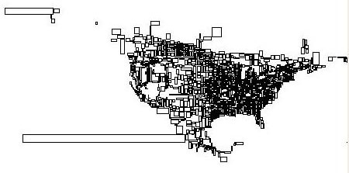
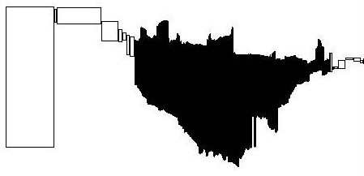
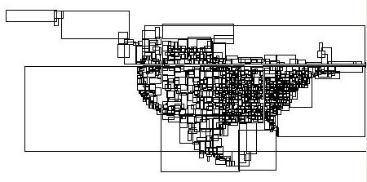
R-tree leaf nodes by different construction methods
(a) R*-tree insertion
(b) x-sorting
(c) Hilbert sorting

Slide 59
Spatial Data Management
Spatial Data
Spatial Relationships
Spatial Queries
Issues in Query Processing
The R-tree
Spatial Query Processing
Spatial Selections
Nearest Neighbor Queries
Spatial Joins

Slide 60
Spatial Selection/ Range Searching
W is a window query (range intersection query)
exact geometry of object x

Slide 61
Nearest neighbor search
Basic problem:
Given a spatial relation R and a query object q, find the nearest neighbor of q in R
Formally:
NN(q,R) = o ∈ R: dist(q,o) ≤ dist(q,o’), ∀ o’ ∈ R
Note:
We can have more than one NN (with equal minimum distance)
q

Slide 62
Nearest neighbor search
Generalized problem:
Given a spatial relation R, a query object q, and a number k <|R|, find the k-nearest neighbors of q in R
Formally:
NN(q,k,R) = S ⊂ R : |S| = k, dist(q,o) ≤ dist(q,o’), ∀ o ∈ S ∀ o’ ∈ R-S
Note:
We can have more than one k-NN sets (with multiple possible equidistant furthest points in them)
Simplification
NN (and k-NN) operations return any NN (and k-NN sets)
We usually focus on point-sets
q
3-NN(q,R)

Slide 63
Distance measures and MBRs
Distances between MBRs lower-bound the distances between the corresponding objects
dist(MBR(o_{i}),MBR(o_{j})) ≤ dist(o_{i}, o_{j})
MBR distance
objects distance

Slide 64
Distance measures and MBRs
Distances between R-tree node MBRs lower-bound the distances between the entries in them
dist(MBR(n_{i}),MBR(n_{j})) ≤ dist(e_{i}.MBR, e_{j}.MBR), ∀ e_{i} ∈ n_{i}, e_{j} ∈ n_{j}
n₁
minimum distance between any pair of entries in n₁, n₂
n₂
MBR distance

Slide 65
Distance measures and MBRs
The distance between a query object q and an R-tree node MBR lower-bounds the distances between q and the objects indexed under this node
dist(q,MBR(n)) ≤ dist(q,o) ∀ o indexed under n
n
dist(q,MBR(n))
q

Slide 66
Questions
What is the distance between MBR(n₁) and MBR(n₂)?
What is the distance between q and MBR(n)?
What can we conclude from these distances?
n₂
n₁
dist(MBR(n₁),MBR(n₂)) = ?
n
q
dist(q,MBR(n)) = ?

Slide 67
Using MBR distances to guide/prune search in an R-tree
Problem: find the NN of q
Do we need to look for it in node M if we know dist(q,p)?

Slide 68
Depth-first NN search using an R-tree
Start from the root and visit the node nearest to q
Continue recursively, until a leaf node n_{l} is visited.
Find the NN of q in n_{l}.
Continue visiting other nodes after backtracking as long there are nodes closer to q than the current NN.

Slide 69
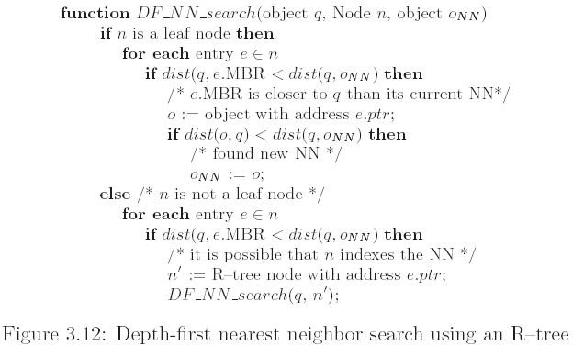
Depth-first NN search using an R-tree
)
Initially an imaginary object with dist(q,o_{NN})= ∞
)

Slide 70
Depth-first NN search using an R-tree

Slide 71
Depth-first NN search using an R-tree
o_{NN} = NULL
dist(q,o_{NN})= ∞
1. visit root
dist(q,M₁)<dist(q,oNN)
must visit node M₁

Slide 72
Depth-first NN search using an R-tree
o_{NN} = NULL
dist(q,o_{NN})= ∞
2. visit M₁
dist(q,m₁)<dist(q,oNN)
must visit node m₁

Slide 73
Depth-first NN search using an R-tree
o_{NN} = NULL
dist(q,o_{NN})= ∞
3. visit m₁
check a,b,c found new NN: oNN = a, dist(q,o_{NN}) = √5

Slide 74
Depth-first NN search using an R-tree
o_{NN} = a
dist(q,o_{NN})= √5
4. backtrack to M₁
check m₂ dist(q,m₂) = 3 ≥ √5:
No need to visit node m₂
check m₃ dist(q,m₃) = √5 ≥ √5:
No need to visit node m₃

Slide 75
Depth-first NN search using an R-tree
o_{NN} = a
dist(q,o_{NN})= √5
5. backtrack to root
check M₂ dist(q,M₂) = √2 < √5:
must visit node M₂

Slide 76
Depth-first NN search using an R-tree
o_{NN} = a
dist(q,o_{NN})= √5
6. visit M₂
check m₄ dist(q,m₄) = √2 < √5:
must visit node m₄

Slide 77
Depth-first NN search using an R-tree
o_{NN} = a
dist(q,o_{NN})= √5
7. visit m₄
check i,j,k found new NN: o_{NN} = k, dist(q,o_{NN}) = √2

Slide 78
Depth-first NN search using an R-tree
o_{NN} = k
dist(q,o_{NN})= √2
8. backtrack to M₂
check m₅ dist(q,m₅) ≥ √2:
No need to visit node m₅
check m₆ dist(q,m₆) ≥ √2:
No need to visit node m₆

Slide 79
Depth-first NN search using an R-tree
o_{NN} = k
dist(q,o_{NN})= √2
9. backtrack to root
check M₃ dist(q,M₃) ≥ √2:
No need to visit node M₃

Slide 80
Depth-first NN search using an R-tree
o_{NN} = k
dist(q,o_{NN})= √2
10. backtrack from root
Algorithm terminates o_{NN} =k with dist(q,o_{NN})= √2 found

Slide 81
Notes on Depth-first NN search
Large space can be pruned by avoiding visiting R-tree nodes and their sub-trees
Should order the entries of a node in increasing distance from q to maximize potential for a good NN found fast
Can be easily adapted for k-NN search (how?)
Requires at most one tree path to be currently in memory – good for small memory buffers
Characteristic of all depth-first search algorithms
Recall that the range search algorithm is also DF
However, does not visit the least possible number of nodes
Also, not incremental – more on this later…

Slide 82
Best-first NN search
A more efficient algorithm (given large enough memory)
Optimal in the number of R-tree nodes visited for a given query q
Uses a priority queue to organize seen entries and prioritize the next node to be visited
Adaptable for k-NN search and incremental NN search

Slide 83
Best-first NN search
Observation about DF-search:
The closest entry to q in the current node is “opened” and control is passed to the node pointed by it
However the entries in that node may not be the closest entries to q from those seen so far
Idea of BF search:
Put all entries in a priority queue and always “open” the closest one, independently of the node that contains it
Thus the best (i.e., closest) entry is always visited first

Slide 84
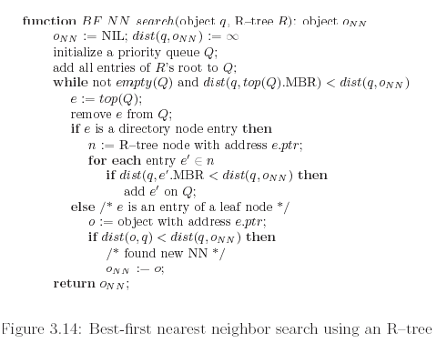
Best-first NN search

Slide 85
Best-first NN search
o_{NN} = NULL
dist(q,o_{NN})= ∞
Step 1: put all entries of root on heap Q
Q = M₁(1), M₂(√ 2), M₃(√ 8)
distance from q

Slide 86
Best-first NN search
o_{NN} = NULL
dist(q,o_{NN})= ∞
Step 2: get closest entry (top element of Q):
M₁(1). Visit node M₁. Put all entries of
visited node on heap Q
Q = M2(√ 2), m1(√ 5), m3(√ 5), M3(√ 8), m2(3)

Slide 87
Best-first NN search
o_{NN} = NULL
dist(q,o_{NN})= ∞
Step 3: get closest entry (top element of Q):
M₂(√ 2). Visit node M₂. Put all entries of
visited node on heap Q
Q =m4(√ 2), m1(√ 5), m3(√ 5), M3(√ 8), m2(3), m5(√ 13), m5(√17)

Slide 88
Best-first NN search
o_{NN} = NULL
dist(q,o_{NN})= ∞
Step 4: get closest entry (top element of Q):
m₄(√ 2). Visit node m₄. m₄ is a leaf node, so update NN if some object in m4 is closer than the current NN:
o_{NN} = k, dist(q,oNN)= √2
Q =m1(√ 5), m3(√ 5), M3(√ 8), m2(3), m5(√ 13), m5(√17)

Slide 89
Best-first NN search
oNN = k, dist(q,oNN)= √2
Step 5: get closest entry (top element of Q):
m₁(√5). Since √5 ≥ dist(q,oNN)= √2, search stops and o_{NN} is returned as the NN of q

Slide 90
Notes on Best-first NN search
In the previous example, we have visited fewer nodes compared to DF-NN algorithm
Only nodes whose MBR intersect the disk centered at q with radius the real NN distance are visited (see if you can you prove this)
The algorithm can be adapted for incremental NN search
After having found the NN can we easily (incrementally) find the next NN without starting search from the beginning?
put objects on the heap
never prune, but wait until an object comes out
The algorithm can be used for k-NN search
use a second heap to organize the NN found so far (same can be done for DF-NN)
no need if we just use the inc. version of the algorithm
… but: The heap can grow very large until the algorithm terminates

Slide 91
Why incremental NN search?
Example 1: find the nearest large city (>10,000 residents) to my current position
Solution 1:
find all large cities
apply NN search on the result
could be slow if many such cities
also R-tree may not be available for large cities only
Solution 2:
incrementally find NN and check if the large city requirement is satisfied; if not get the next NN
Example 2: find the nearest hotel; see if you like it; if not get the next one; see if you like it; …

Slide 92
Spatial Joins
Input:
two spatial relations R, S (e.g., R=cities, S=rivers)
a spatial relationship θ (e.g., θ=intersects)
Output:
{(r,s): r∈R, s∈S, r θ s is true}
Example: find all pairs of cities and rivers that intersect
We will discuss intersection joins (like the example above)

Slide 93
R-tree (Intersection) Join
Applies on two R-trees of spatial relations R and S
Observation:
If a node n_{R} ∈ R does not intersect n_{S} ∈ S, then no object o_{R} ∈ R under n_{R} can intersect any object o_{S} ∈ S under n_{S}
Node MBRs at the high level of the trees can prune object combinations to be checked
We can use this property to design an algorithm that synchronously traverses both trees following only entry pairs that intersect.
n_{R}
n_{S}

Slide 94
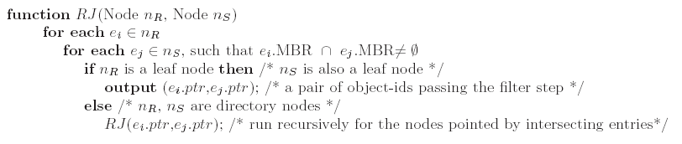
R-tree (Intersection) Join
Initially called taking with parameters the roots of the two trees
This pseudo-code version assumes that the trees have same height
easily extendable to trees of different heights

Slide 95
R-tree (Intersection) Join
Example:
run for root(R_{A}), root(R_{B})
for every intersecting pair there (e.g., A₁, B₁) run recursively for pointed nodes
intersecting pairs of leaf nodes are qualifying object MBR pairs
Level 1 qualifying pairs:
{(A₁, B₁), (A₂, B₂)}
Level 0 qualifying pairs:
{(a₁, b₁), (a₂, b₂)}

Slide 96
Computational issue
How to decrease the cost of comparing entry pairs for a given pair of nodes
E.g., for (A₁, B₁), we need to compare {a₁,a₂,a₃}x{b₁,b₂} = 6 pairs
In real R-trees nodes may have >100 entries (100x100 = 10000 entry pairs!)
Level 1 qualifying pairs:
{(A₁, B₁), (A₂, B₂)}
Level 0 qualifying pairs:
{(a₁, b₁), (a₂, b₂)}

Slide 97
Optimizations (1) space restriction
If an entry in n₁ does not intersect the MBR of n₂ it may not intersect any entry in n₂.
Perform two scans in n₁ and n₂ to prune such entries
n_{S} (M entries)
pruned!
n_{R} (N entries)
pruned!
Restricting the search space
cost: O(N)+O(M)

Slide 98
Optimizations (2) plane sweep
Sort entries in both nodes on their lower-x value (lower bound of x-projection)
Sweep a line to find fast all entry pairs that qualify x-intersection
for each of them check y-intersection
Y
r₁
s₃
s₂
s₁
r₃
N entries
M entries
r₂
sweep line
X
Spatial sorting and plane sweep
cost: O((N+M)⋅log(max(N,M))+k)

Slide 99
Sweep example
sorted lists:
R={r1,r2,r3}
S={s1,s2,s3}
last sweep line position in R: r1 last sweep line position in S: s1
r1<s1: scan S from s1 until s_{i}>r₁ on x-axis for each seen s_{i} check y-intersection: pair <r₁,s₁> found!
increase position in R to r2
Y
r₁
s₃
s₂
s₁
r₃
r₂
sweep line
X

Slide 100
Sweep example
sorted lists:
R={r1,r2,r3}
S={s1,s2,s3}
last sweep line position in R: r2 last sweep line position in S: s1
s1<r2: scan R from r2 until r_{i}>s₁ on x-axis for each seen r_{i} check y-intersection: pair <r₂,s₁> found!
increase position in S to s2
Y
r₁
s₃
s₂
s₁
r₃
r₂
sweep line
X

Slide 101
Sweep example
sorted lists:
R={r1,r2,r3}
S={s1,s2,s3}
last sweep line position in R: r2 last sweep line position in S: s2
r2<s2: scan S from s2 until s_{i}>r₂ on x-axis for each seen s_{i} check y-intersection: no pair found!
increase position in R to r3
Y
r₁
s₃
s₂
s₁
r₃
r₂
sweep line
X

Slide 102
Sweep example
sorted lists:
R={r1,r2,r3}
S={s1,s2,s3}
last sweep line position in R: r3 last sweep line position in S: s2
s2<r3: scan R from r3 until r_{i}>s₂ on x-axis for each seen r_{i} check y-intersection: no pair found!
increase position in S to s3
Y
r₁
s₃
s₂
s₁
r₃
r₂
sweep line
X

Slide 103
Sweep example
sorted lists:
R={r1,r2,r3}
S={s1,s2,s3}
last sweep line position in R: r3 last sweep line position in S: s3
r3<s3: scan S from s3 until s_{i}>r₃ on x-axis for each seen s_{i} check y-intersection: pair <r3,s3> found!
increase position in R: no more rectangles: algorithm terminates
Y
r₁
s₃
s₂
s₁
r₃
r₂
sweep line
X

Slide 104
The refinement step
Most join algorithms focus on the filter step; how do we process the refinement step?
A multi-step process is adopted for spatial joins
How can we distinguish these 2 cases?
filtered pair
non-qualifying pair that passes the filter step
(false hit)
qualifying pair

Slide 105
Multi-step join processing
Step 1: find MBR pairs that intersect
Step 2: compare some more detailed approximations to make conclusions
(a.k.a. geometric filter)
conservative approximations
e.g., convex hull
progressive approximation
e.g., maximum enclosed rectangle

Slide 106
Multi-step join processing
Step 3: if still join predicate inconclusive, perform expensive refinement step
can be processed by computational geometry algorithms
Multi-step processing (R-tree join as example):
Step 2
Step 3
Step 1

Slide 107
Other Spatial Joins
Also:
Semi-join: Find the cities that intersect a river
Similarity join: Find pairs of hotels, restaurants close to each other (with distance smaller than 100m)
Closest pairs: Find the closest pair of hotels, restaurants
All-NN: For each hotel find the nearest restaurant
Iceberg distance join: Find hotels close to at least 10 restaurants

Slide 108
Summary
Topological, distance and directional spatial relationships are used as predicates in spatial queries
The dimensionality and extent of spatial data makes their indexing challenging
The R-tree is the most popular spatial access method
Popular algorithms for Nearest Neighbor and Spatial Join queries are based on the R-tree

