Slide 1
COMP7106B Big Data Management Lecture 3 Spatial Networks
Prof. Reynold Cheng
24th February, 2024
Acknowledgement: This presentation is based on Prof. Nikos Mamoulis’ COMP3323 slides.

Slide 2
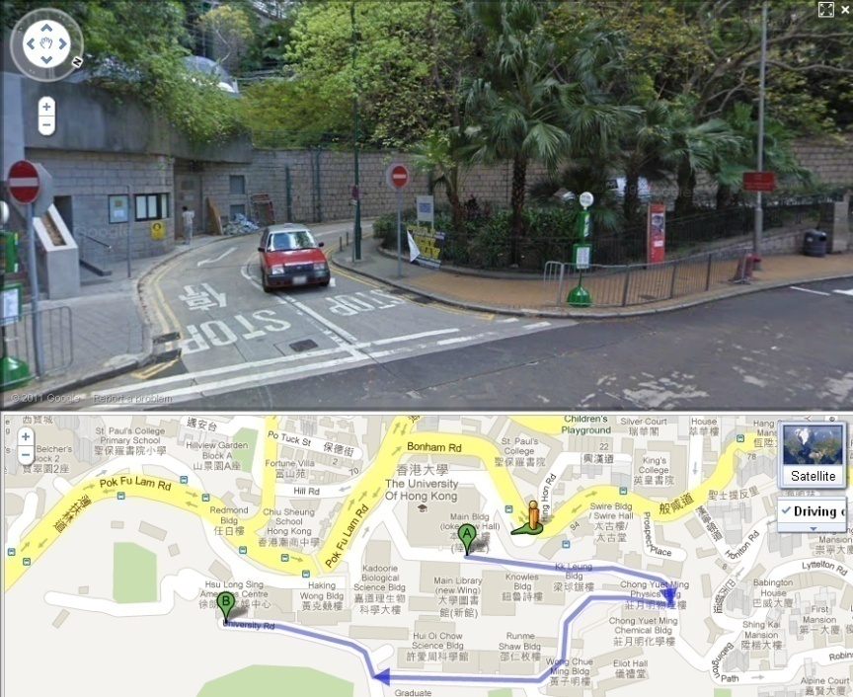
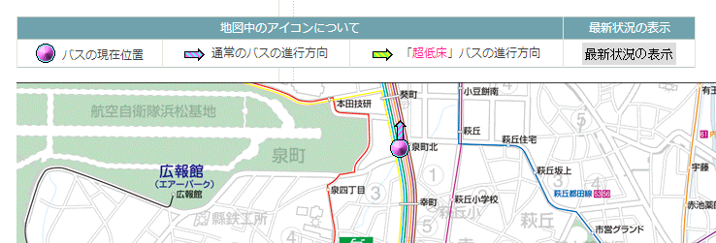
Spatial Networks

Slide 3
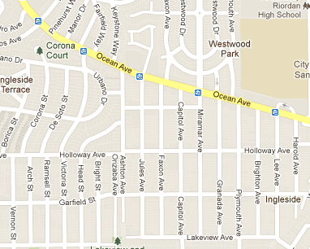
Spatial Networks
Modeling and storing spatial networks
Shortest path search
Spatial queries over spatial networks
Advanced indexing techniques for spatial networks
r₁
r₂
q
r₃

Slide 4
Network Distance
In many real applications accessibility of objects is restricted by a spatial network
Examples
Driver looking for nearest gas station
Mobile user looking for nearest restaurant
Shortest path distance used instead of Euclidean distance
SP(a,b) = path between a and b with the minimum accumulated length
r₁
q
r₂
r₃

Slide 5
Challenges
Euclidean distance is no longer relevant
R-tree may not be useful, when search is based on shortest path distance
Graph cannot be flattened to a one-dimensional space
Special storage and indexing techniques for graphs are required
Graph properties may vary
directed vs. undirected
length, time, etc. as edge weights

Slide 6
Modeling Spatial Networks
Adjacency matrix only appropriate for dense graphs
Spatial networks are sparse: use adjacency lists instead
 | n₁ | n₂ | n₃ | n₄ | n₅ | n₆
n₁ | 0 | 1 | ∞ | ∞ | ∞ | ∞
n₂ | 2 | 0 | 1 | 3 | 4 | ∞
n₃ | ∞ | ∞ | 0 | ∞ | ∞ | ∞
n₄ | ∞ | ∞ | ∞ | 0 | 2 | ∞
n₅ | ∞ | ∞ | ∞ | ∞ | 0 | 5
n₆ | ∞ | ∞ | ∞ | ∞ | ∞ | 0
2
n₂
n₁ | (n₂, 1)
n₂ | (n₁, 2), (n₃, 1), (n₄, 3), (n₅, 4)
n₄ | (n₅, 2)
n₅ | (n₆, 5)
1
4
n₁
n₅
1
3
n₃
2
5
n₄
n₆
adjacency lists
graph
adjacency matrix

Slide 7
Storing Large Spatial Networks
Problem: adjacency lists representation may not fit in memory if graph is large
Solution:
partition adjacency lists to disk blocks [based on proximity]
create B⁺-tree index on top of partitions [based on node-id]
a | (s, 4), (d, 5), (b, 10)
s | (d, 2), (a, 4), (c, 6)
d | (s, 2), (a, 5), (e, 9)
a
b
c
d
b
4
f
e
10
5
c | (e, 3), (f, 4) (b, 5), (s, 6)
e | (c, 3), (t, 5), (d, 9)
t | (e, 5), (f, 6)
a
4
6
c
4
s
6
3
e
f
s
t
5
5
t
2
e
b | (f, 4), (c, 5) (a, 10)
f | (b, 4), (c, 4), (t, 6)
d
9
graph
B⁺-tree

Slide 8
Shortest Path Computation
Given a graph G(V,E), and two nodes s,t in V, find the shortest path from s to t
A classic algorithmic problem
Studied extensively since the 1950’s
Several methods
Dijkstra’s algorithm
A*-search
Bi-directional search

Slide 9
Dijkstra’s Shortest Path Search
Idea: incrementally explore the graph around s, visiting nodes in distance order to s until t is found (like NN)
b
4
f
10
5
a
4
6
c
4
s
6
3
5
5
t
2
e
d
9
a
a
c
s
4
c
4
6
3
4
s
6
s
2
2
2
e
d
d
2
d
d
f
b
b
a
f
f
c
4
4
s
6
3
5
5
e
a
4
a
4
2
c
c
d
4
s
6
3
4
s
6
3
5
t
2
e
2
e
d
d
https://en.wikipedia.org/wiki/Edsger_W._Dijkstra

Slide 10
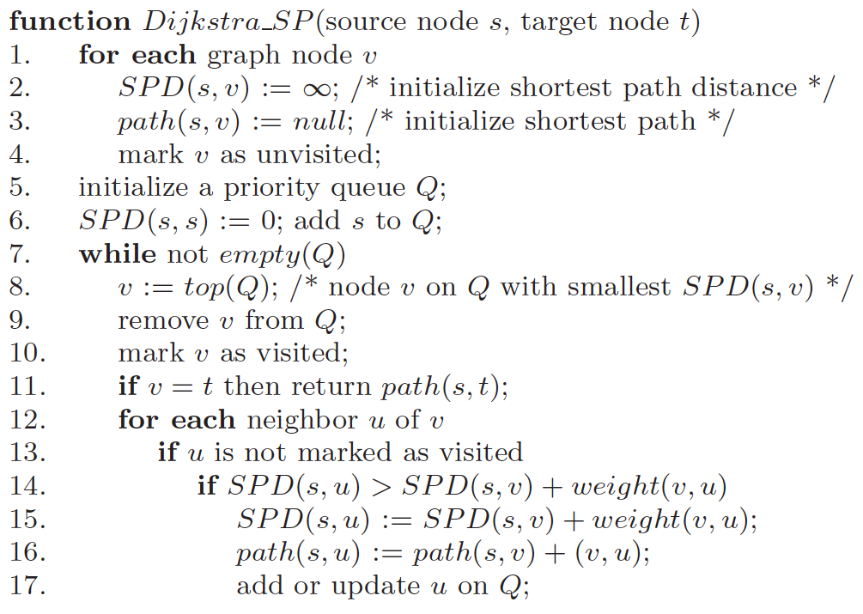
Dijkstra’s Shortest Path Search

Slide 11
Dijkstra’s Shortest Path Search
b
Current node
Queue
4
f
s (0)
d (2), a (4), c (6)
10
5
a
4
6
c
d (2)
a (4), c (6), e (11)
4
s
6
3
5
5
t
2
e
a (4)
c (6), e (11), b (14)
9
d
c (6)
e (9), f (10), b (11)
s
e (9)
f (10), b (11), t (14)
4
2
6
f (10)
b (11), t (14)
a
d
c
5
3
4
b (11)
t (14)
b
e
f
5
t (14)
t
t is de-queued: shortest path has been found!
shortest path tree of node s

Slide 12
Illustrating Dijkstra's algorithm
Find the shortest path between a and b.
Worst-case performance O ( | E | + | V | log | V | )

Slide 13
A*-search
A* was invented by AI researchers working on Shakey the Robot's path planning in 1968.
https://en.wikipedia.org/wiki/A*_search_algorithm

Slide 14
A*-search
Dijkstra’s search explores nodes around s without a specific search direction until t is found
Idea: improve Dijkstra’s algorithm by directing search towards t
Due to triangular inequality, Euclidean distance is a lower bound of network distance
Use Euclidean distance to lower bound network distance based on known information:
Nodes are visited in increasing SPD(s,v)+dist(v,t) order
SPD(s,v): shortest path distance from s to v (computed by Dijkstra)
dist(v,t): Euclidean distance between v and t
Original Dijkstra visits nodes in increasing SPD(s,v) order
v'
s
t
v

Slide 15
A*-search: Example
SPD(s,c)+dist(c,t)
b
Current node
Queue
4
f
s (0)
d (2+14), a (4+15), c (6+7)
10
5
a
4
6
c
c (6)
a (4+15), d (2+14), b (11+9), f (10+6), e (9+5)
4
s
6
3
5
5
t
2
e
e (9)
a (4+15), d (2+14), b (11+9), f (10+6), t (14)
9
d
t (14)
t is de-queued: shortest path has been found!

Slide 16
Illustrating A* search algorithm
Find the shortest path between s and t.
f(p) = Dijkstra_dist(s, p) + Euclidean_dist(p, t)
s
t

Slide 17
Bi-directional search
Dijkstra’s search explores nodes around s without a specific search direction until t is found
Idea: search can be performed concurrently from s and from t (backwards)
The shortest path tree of s and the (backward) shortest path tree of t are computed in concurrently
One queue Q_{s} for forward and one queue Q_{t} for backward search
Node visits are prioritized based on min(SPD(s,v), SPD(v,t))
If v already visited from s and v is in Q_{t}, then candidate shortest path: p(s,v)+p(v,t) [if v already visited from t and v in Q_{s} symmetric]
If v is visited by both s and t terminate search; report best candidate shortest path
s
s
v
t
t

Slide 18
Bi-directional search: Example
b
Current node
Q_{s}
Q_{t}
4
f
s (0), t (0)
d (2), a (4), c (6)
e (5), f (6)
10
5
a
4
6
e (5), f (6)
c
d (2) [s]
a (4), c (6), e (11)
4
s
6
3
5
5
t
e (5), f (6)
2
e
a (4) [s]
c (6), e (11), b (14)
9
d
e (5) [t]
c (6), e (11), b (14)
f (6), c (8), d (14)
c (6) [s]
e (9), f (10), b (11)
f (6), c (8), d (14)
c (8), b (10), d (14)
candidate shortest path: s➔d➔e➔t (16)
f (6) [t]
e (9), f (10), b (11)
c (8) [t]
candidate shortest path: s➔c➔e➔t (14)
c is visited from both s and t! terminate and report shortest path

Slide 19
Discussions
A* and bi-directional search can be combined to powerful search techniques
A* can only be applied if lower distance bounds are available
All versions of Dijkstra’s search require non-negative edge weights
Bellman-Ford is an algorithm for arbitrary negative edges

Slide 20
Source/Destination on Edges
We have assumed that points s and t are nodes of the network
In practice s and t could be arbitrary points on edges
Mobile user locations
Solve problem by introducing 2 more nodes
b
4
f
en-heap g (2) and c (4) first
t is reached from f or h
10
5
a
4
6
t
s
c
4
g
6
3
5
5
h
2
e
d
9

Slide 21
Spatial Queries over Spatial Networks
Data:
A (static) spatial network (e.g., city map)
A (dynamic) set of spatial objects
Spatial queries based on network distance:
Selections. Ex: find gas stations within 10km driving distance from here
Nearest neighbor search. Ex: find k nearest restaurants from present position
Joins. Ex: find pairs of restaurants and hotels at most 100m from each other
b
r₃
4
f
r₁
10
r₁
r₂
h₁
5
a
6
c
4
r₂
4
s
6
3
q
5
h₂
5
t
2
e
r₃
d
9

Slide 22
Methodology
Store (and index) the spatial network
Graph component (indexes connectivity information)
Spatial component (indexes coordinates of nodes, edges, etc.)
Store (and index) the sets of spatial objects
Ex., one spatial relation for restaurants, one spatial relation for hotels, one relation for mobile users, etc.
Given a spatial location p, use spatial component of network to find the network edge containing p
Given a network edge, use network component to traverse neighboring edges
Given a neighboring edge, use spatial indexes to find objects on them

Slide 23
Evaluation of Spatial Selections (1)
Query: find all objects in spatial relation R, within network distance ε from location q
Method:
Use spatial index of network (R-tree indexing network edges) to find edge n₁n₂, which includes q
Use adjacency index of network (graph component) and apply Dijkstra’s algorithm to progressively retrieve edges that are within network distance ε from location q
For all these edges apply a spatial selection on the R-tree that indexes R to find the results

Slide 24
Evaluation of Spatial Selections (1)
Example: Find restaurants at most distance 10 from q
Step 1: find network edge which contains q
q
b
r₃
4
f
edge R-tree
10
5
r₁
a
6
c
4
r₂
4
s
6
3
q
5
5
t
b
2
e
4
f
d
9
10
5
a
4
6
c
q
4
s
6
3
5
5
t
2
e
d
9

Slide 25
Evaluation of Spatial Selections (1)
Example: Find restaurants at most distance 10 from q
Step 2: traverse network to find all edges (or parts of them within distance 10 from q)
b
r₃
4
f
10
5
r₁
a | (s, 4), (d, 5), (b, 10)
s | (d, 2), (a, 4), (c, 6)
d | (s, 2), (a, 5), (e, 9)
a
6
a
b
c
d
c
4
r₂
4
s
6
3
q
5
5
t
2
e
e
9
c | (e, 3), (f, 4) (b, 5), (s, 6)
e | (c, 3), (t, 5), (d, 9)
t | (e, 5), (f, 6)
d
b
4
f
e
f
s
t
10
5
a
4
6
b | (f, 4), (c, 5) (a, 10)
f | (b, 4), (c, 4), (t, 6)
c
q
4
s
6
3
5
5
t
2
e
B⁺-tree
d
9

Slide 26
Evaluation of Spatial Selections (1)
Example: Find restaurants at most distance 10 from q
Step 3: find restaurants that intersect the subnetwork computed at step 2
b
r₃
4
f
10
5
r₁
a
6
c
4
r₂
4
s
6
3
q
5
5
t
2
e
d
9
restaurants R-tree
r₃
r₁
r₂

Slide 27
Evaluation of Spatial Selections (2)
Query: find all objects in spatial relation R, within network distance ε from location q
Alternative method based on Euclidean bounds:
Assumption: Euclidean distance is a lower-bound of network distance:
dist(v,u) ≤ SPD(v,u), for any v,u
Use R-tree on R to find set S of objects such that for each o in S: dist(q,o) ≤ ε
For each o in S:
find where o is located in the network (use Network R-tree)
compute SPD(q,o) (e.g. use A*)
If SPD(q,o) ≤ ε then output o

Slide 28
Evaluation of Spatial Selections (2)
Example: Find restaurants at most distance 10 from q
Step 1: find restaurants for which the Euclidean distance to q is at most 10: S={r₁,r₂,r₃}
b
q
10
r₃
4
f
10
5
r₁
a
6
c
4
r₂
4
s
6
3
q
5
5
t
2
e
d
9
restaurants R-tree
r₃
r₁
r₂

Slide 29
Evaluation of Spatial Selections (2)
Example: Find restaurants at most distance 10 from q
Step 2: for each restaurant in S, compute SPD to q and verify if it is indeed a correct result
Ex. for r₂, first find where r₂ is located (edge f,t), then SP
b
r₃
4
f
10
5
r₁
a | (s, 4), (d, 5), (b, 10)
s | (d, 2), (a, 4), (c, 6)
d | (s, 2), (a, 5), (e, 9)
a
6
a
b
c
d
c
4
r₂
4
s
6
3
q
5
5
t
2
e
e
9
c | (e, 3), (f, 4) (b, 5), (s, 6)
e | (c, 3), (t, 5), (d, 9)
t | (e, 5), (f, 6)
d
b
4
f
e
f
s
t
10
5
a
6
b | (f, 4), (c, 5) (a, 10)
f | (b, 4), (c, 4), (t, 6)
c
4
r₂
4
s
6
3
q
5
5
t
2
e
B⁺-tree
d
9

Slide 30
Evaluation of NN search (1)
Query: find in spatial relation R the nearest object to a given location q
Method:
Use spatial index of network (R-tree indexing network edges) to find edge n₁n₂, which includes q
Use adjacency index of network (graph component) and apply Dijkstra’s algorithm to progressively retrieve edges in order of their distance to q
For each edge apply a spatial selection on the R-tree that indexes R to find any objects
Keep track of nearest object found so far; use its shortest path distance to terminate network browsing

Slide 31
Evaluation of NN search (1)
Example: Find nearest restaurant to q
b
f
f
b
c
e
r₃
4
f
c
t
10
r₁
s
5
c
e
d
c
a
6
c
4
r₂
e
4
6
q
t
s
3
5
5
t
2
e
d
9
restaurants R-tree
current NN = r₂ SPD(q, r₂)=5
√
r₃
r₁
r₂

Slide 32
Evaluation of NN search (2)
Query: find in spatial relation R the nearest object to a given location q
Alternative method based on Euclidean bounds:
Assumption: Euclidean distance lower-bounds network distance:
dist(v,u) ≤ SPD(v,u), for any v,u
Use R-tree on R to find Euclidean NN p_{E1} of q;
CurrentNN= p_{E1}; bound=SPD(q,p_{E1}); //e.g. use A*
Find next Euclidean NN p_{Ei} of q
If dist(q,Ei)≥bound, then report (CurrentNN,bound) as result;
Compute SPD(q,p_{Ei}); if bound>SPD(q,p_{Ei}) then CurrentNN= p_{Ei}; bound=SPD(q,p_{Ei});
Goto step 3

Slide 33
Evaluation of NN search (2)
Example: Find nearest restaurant to q
b
r₃
4
f
10
5
r₁
find 1st Euclidean NN of q
find 2nd Euclidean NN of q
a
6
4
r₂
c
6
4
6
q
s
3
3
t
5
e
5
2
9
restaurants R-tree
d
current NN = r₂ SPD(q, r₂)=5
√
r₃
r₁
dist(q, r₁) ≥ SPD(q, r₂) !
r₂

Slide 34
Spatial Join Queries
Query: find pairs (r,s), such that r in relation R, s in relation S, and SPD(r,s)≤ε
Methods:
For each r in R, do an ε-distance selection queries for objects in S (Index Nested Loops)
For each pair (r,s), such that Euclidean dist(r,s)≤ε compute SPD(r,s) and verify SPD(r,s)≤ε

Slide 35
Notes on Query Evaluation based on Network Distance
For each query type, there are methods based on network browsing and methods based on Euclidean bounds
Network browsing methods are fast if network edges are densely populated with points of interest
A limited network traversal can find the result fast
Methods based on Euclidean bounds are good if the searched POIs are sparsely distributed in the network
Few verifications with exact SP searches are required
Directed SP search (e.g. using A*) avoids visiting empty parts of the network

Slide 36
Shortest Path Materialization and Indexing in Large Graphs
Dijkstra’s algorithm and related methods could be very expensive on very large graphs
(Partial) materialization of shortest paths in static graphs can accelerate search
b
4
f
 | a | b | c | s | …
a | 0, - | 10, ab | 10, asc | 4, as | …
b | 10, ba | 0, - | 5, bc | 11, bcs | …
c | 10, csa | 5, cb | 0, - | 6, cs | …
s | 4, sa | 11, scb | 6, sc | 0, - | …
… | … | … | … | … | …
 | a | b | c | s | …
a | 0, - | 10, b | 10, s | 4, s | …
b | 10, a | 0, - | 5, c | 11, c | …
c | 10, s | 5, b | 0, - | 6, s | …
s | 4, a | 11, c | 6, c | 0, - | …
… | … | … | … | … | …
10
5
a
4
6
c
4
s
6
3
5
5
t
2
e
d
9
graph
brute-force materialization O(n³) space, O(1) time
distance matrix with successors O(n²) space, O(n) time

Slide 37
Summary
Indexing and search of spatial networks is different than spatial indexing
Shortest path distance is used instead of Euclidean distance, to define range queries, nearest neighbor search, and spatial joins
Spatial networks could be too large to fit in memory
Disk-based index for adjacency lists is used
Several shortest path algorithms
Spatial queries can be evaluated using Euclidean bounds

