Slide 1
Lecture 6 Uncertain Databases: An Overview
University of Hong Kong
COMP7106B (Spring 2024)
Big Data Management
Prof. Reynold Cheng
13th April, 2024

Slide 2
Lecture Objectives
In this lecture, you will learn:
Uncertainty in Applications
Problems on Managing Uncertain Data
Uncertainty Models

Slide 3
New Applications: Location-based Services and Sensor Networks
Find a cab within 2 miles of my location.
What is the region that gives max temperature?
GPS
sensor
network
Service
Provider
RF-ID
Notes:
Positioning technologies like GPS, GSM, RF-ID and WiFi have developed rapidly in recent years.
They allow locations of users to be decided, and enable a new class of applications know as Location-based-service.
Examples:
A moving object database monitors locations of mobile devices
An air-conditioning system uses temperature sensors to adjust the temperature of each room
Sensors are used to detect if hazardous materials are present and how they are spreading

Slide 4
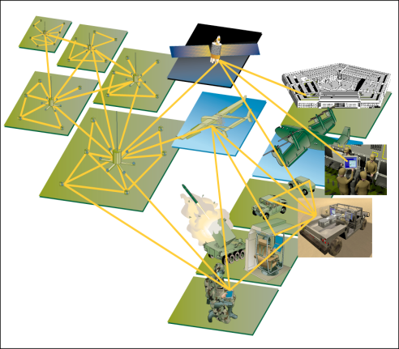
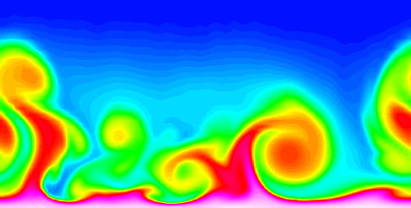
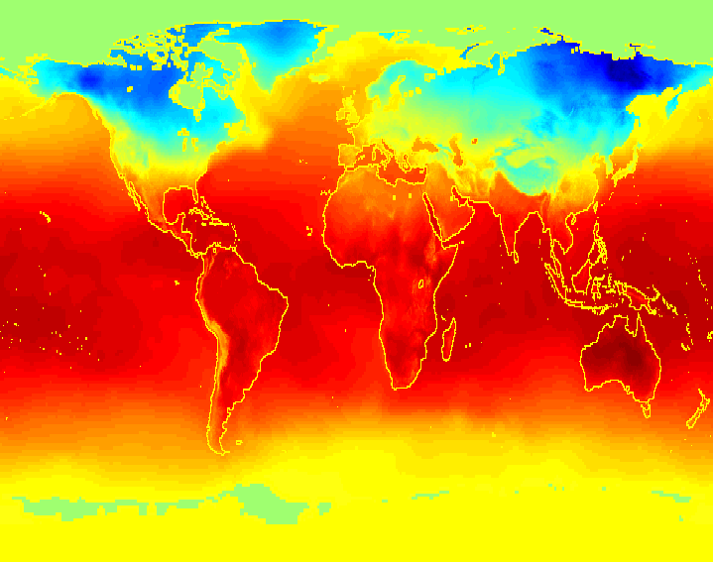
New Applications: Scientific Databases
Data collected and stored at enormous speeds (GB/hour)
remote sensors on a satellite
telescopes scanning the skies
microarrays generating gene expression data
scientific simulations generating terabytes of data
Biological databases
courtesy of Chapter 1 notes of “Introduction to Data Mining” by Tan, Steinbach, Kumar

Slide 5
System Goal
These new applications have to provide services with 3 main objectives:
Correctness
Efficiency
Scalability
Due to the vast amount of data, a DBMS may be used to satisfy the above objectives.

Slide 6
However, traditional DBMS can fail to satisfy these system goals.
Data uncertainty, imprecision, noise, missing values

Slide 7
Example 1: Sampling Accuracy
In location and sensor applications, due to limited network bandwidth and battery power, readings are just sampled
The value of the entity being monitored (e.g., temperature, location) is changing
The database stores old values only
Query results can be incorrect, resulting in poor service quality

Slide 8
Which room gives a lower temperature reading?
Recorded Temperature 30 min ago
Current Temperature
15
10
Database answer:x
Correct answer: y
5
0
ºC
x
y
Notes:
Q at time t₁: Reading of which sensor gives the minimum reading?
(a) Based on recorded values answer is incorrect
Providing correct answers for sensor-based data appears to be infeasible

Slide 9
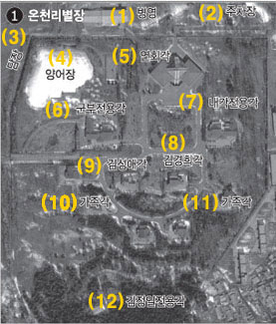
Example 2: Uncertainty in Satellite Images
Due to transmission noise, an image is blurred
Objects recognized can be incorrect
Landmark ID | X-coordinate | Y-coordinate | Type | probability
10 | x1 | y1 | bunker | 0.8
courtesy of Prof. Ben Kao (HKUCS)

Slide 10
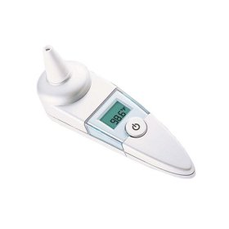
Example 3: Measurement Errors
courtesy of Prof. Ben Kao (HKUCS)
Measurements by physical devices are often imprecise due to measurement errors.

Slide 11
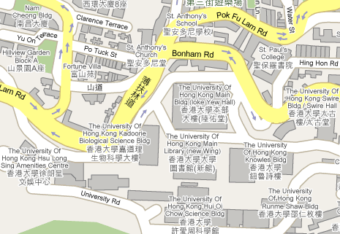
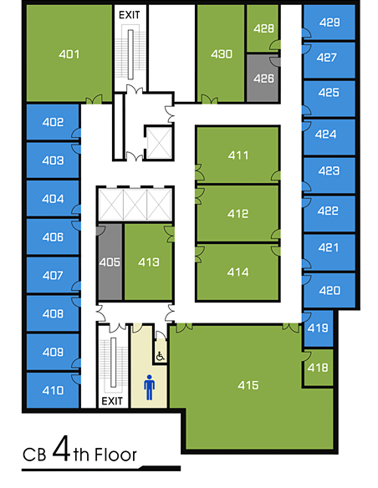
Example 3: Measurement Errors
The Global Positioning System (GPS) does not give a very accurate position in outdoors.
RF-ID for indoor positioning may not be accurate, if a location can be sensed by different RF-ID readers.

Slide 12
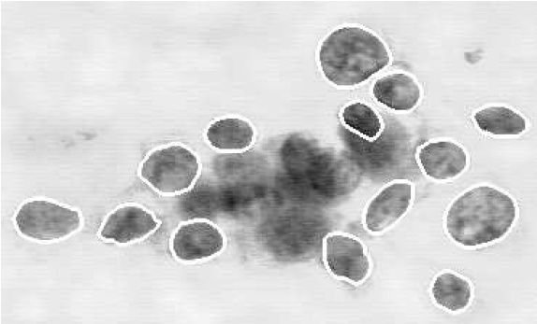
Example 3: Uncertainty in repeated measurements
What is the radius of a nucleus in this image?
courtesy of Prof. Ben Kao (HKUCS)

Slide 13
Example 4: Text Extraction
Information Extraction
Text segmentation
Integrate unstructured data from multiple sources
Segment the above text into (House_No, Street, City)
﻿...52 A Goregaon West Mumbai ...
courtesy of Dan Suciu (University of Washington)

Slide 14
Example 4: Text Extraction
﻿...52 A Goregaon West Mumbai ...
[Gupta&Sarawagi’2006]
﻿ID | House-No | Street | City | P
1 | 52 | Goregaon West | Mumbai | 0.1
1 | 52-A | Goregaon West | Mumbai | 0.4
1 | 52 | Goregaon | West Mumbai | 0.2
1 | 52-A | Goregaon | West Mumbai | 0.2
2 | . . . . | . . . . | . . . . | . . . .
2 | . . . .
≈20% of such extractions are correct
courtesy of Dan Suciu (University of Washington)

Slide 15

Example 5: Data Integration
From AddAll.com
Item | Price
Effective C++ in AMAZON | 27.49
 | 30.68
 | 30.99
 | 33.68
Notes:
What is (IDi, vi, ei, xi)?
15

Slide 16
Example 5: Data Integration
courtesy of Ihab Ilyas (University of Waterloo)

Slide 17



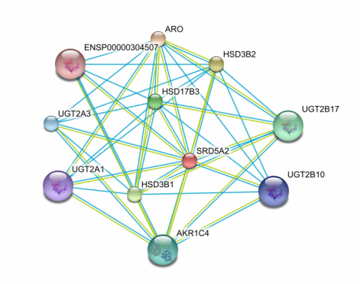
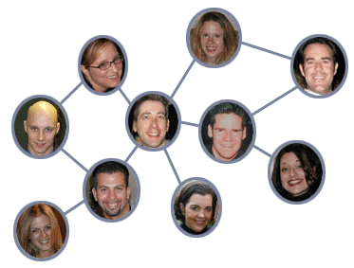
Example 6: Uncertain Graphs
Influence in social networks can only be estimated
Protein-protein interaction is probabilistic

Slide 18


Example 7: Criminal Databases
?
…
From the point of view of the investigator, an unsolved
criminal case contains uncertainty, in terms of the involved suspect(s)
Uncertainty is inherent and prevalent in many new database applications, which is not carefully treated in a traditional DBMS.
Notes:
1 Is the book’s price lower than $30
2 Who is the offender?
3 Where is the person?

Slide 19
Lecture Objectives
In this lecture, you will learn:
Uncertainty in Applications
Problems on Managing Uncertain Data
Uncertainty Models

Slide 20
Problem #1: Modeling Data Uncertainty
How to capture and represent uncertain data?
Many models exist, from simple to complicated ones
Simple models may not reflect the true fact
Complicated models are different and expensive to evaluate
We study two common and useful models: attribute and tuple uncertainty

Slide 21
Problem #2: Probabilistic Queries
Storing and querying data is a basic functionality of a DBMS
Interesting to study how to perform queries on a DBMS that stores uncertain data
Uncertain data are more difficult and expensive to handle
We will study efficient techniques for evaluating important queries on a very large uncertain database
These are probabilistic queries, which produce statistical guarantees on correctness of query results

Slide 22
Problem #3: Data Quality & Cleaning
Uncertain data are not exact and perfect
How to measure the quality of data, and the quality of queries that are evaluated on them?
If some uncertain data can be removed (with some effort), query quality can be improved.
Which part of the database should be cleaned first? How to clean it?

Slide 23
More about Uncertainty Management
An area that touches different fields
Other interesting topics:
Modeling of correlation among data items
Probabilistic query language
Fuzzy logic and fuzzy databases
Uncertainty in text extraction
Probabilistic data streams
Uncertainty in data integration and deduplication
Mining uncertain data
Handling missing values in data

Slide 24
Lecture Objectives
In this lecture, you should learn:
Uncertainty in Applications
Problems on Managing Uncertain Data
Uncertainty Models

Slide 25
Attributes and Tuples
An attribute is a property or characteristic of an object
Examples: eye color of a person, temperature, etc.
Attribute is also known as variable, field, characteristic, or feature
Attributes
schema
Tuples/
Objects
courtesy of “Introduction to Data Mining” by Tan, Steinbach, Kumar

Slide 26
Discrete and Continuous Attributes
Discrete Attribute
Has only a finite or countably infinite set of values
e.g., zip codes, counts, or the set of words in a collection of documents
Often represented as integer variables.
Note: binary attributes are a special case of discrete attributes
Continuous Attribute
Has real numbers as attribute values
e.g., temperature, height, or weight.
Practically, real values can only be measured and represented using a finite number of digits.
Continuous attributes are typically represented as floating-point variables.

Slide 27
Data uncertainty models
2 main types:
Attribute uncertainty (value uncertainty)
Tuple uncertainty (existential uncertainty)
Sources of uncertainty
Data staleness
Measurement errors
Repeated measurements
Data integration

Slide 28
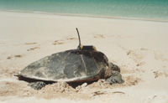
Two types of uncertainty
antenna
courtesy of Prof. Ben Kao (HKUCS)
Attribute uncertainty
I know it exists, but I am not sure about its value.

Slide 29
Two types of uncertainty
uncertainty region
antenna
estimated max. distance travelled
location recorded 10 minutes ago
assume a distribution e.g., uniform pdf,
Gaussian pdf, etc.
courtesy of Prof. Ben Kao (HKUCS)
Attribute uncertainty
I know it exists, but I am not sure about its value.

Slide 30
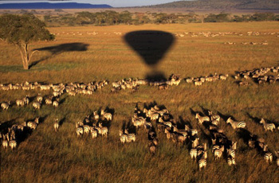
Two types of uncertainty
Serengeti Plains
Wildebeest
Lion
courtesy of Prof. Ben Kao (HKUCS)
Attribute uncertainty
I know it exists, but I am not sure about its value.

Slide 31
Two types of uncertainty
Serengeti Plains
periodically sample the locations of the lion over an extensive period of time. The sample points give a pdf of the uncertainty region.
Wildebeest
Lion
Attribute uncertainty
I know it exists, but I am not sure about its value.

Slide 32
Two types of uncertainty
Tuple uncertainty
I know its value … if it exists at all.
(“Is that a bunker there in the satellite picture?” Expert: Hmmm, I am 80% sure it is one.)

Slide 33
Two types of uncertainty
Tuple uncertainty
I know its value … if it exists at all.
Landmark ID | X-coordinate | Y-coordinate | Type | probability
10 | x1 | y1 | bunker | 0.8
(“Is that a bunker there in the satellite picture?” Expert: Hmmm, I am 80% sure it is one.)

Slide 34
Uncertainty – data staleness
Location-based tracking systems
Mobile devices
Location is estimated by a last reported location + an uncertainty model
an uncertainty region
+ a pdf defined on the
region

Slide 35
Uncertainty – measurement errors
Measurements by physical devices are often imprecise due to measurement errors.
A typical thermometer
Calibration error = ±0.2°C
Normal body temperature = 37°C ±0.7°C
24% of measurements are off by more than 0.5°C, or about 36% of the normal temperature range.

Slide 36
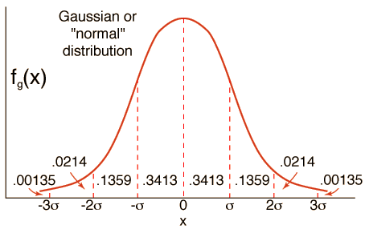
Uncertainty – measurement errors
x = a random variable that represents the error compensation expressed
in number of standard deviation (σ).
Value = measured value (v) + x
Errors can usually be modeled as e.g., Gaussian distributions.

Slide 37
Uncertainty – repeated measurements
What is the radius of a nucleus?

Slide 38
Uncertainty – repeated measurements
take samples from perimeter
What is the radius of a nucleus?

Slide 39
Uncertainty – repeated measurements
find the center (average) of the sample points
What is the radius of a nucleus?

Slide 40
Uncertainty – repeated measurements
measure the distances from the center to the samples
What is the radius of a nucleus?

Slide 41
Uncertainty – repeated measurements
average all those distances to get a “radius” (r1) of a cell
r1
What is the radius of a nucleus?

Slide 42
Uncertainty – repeated measurements
repeat on other cells and take the overall average “R”
r1
r2
r3
r10
r4
r11
r5
r14
r6
r13
r9
r7
r12
r8
What is the radius of a nucleus?

Slide 43
Uncertainty – repeated measurements
repeat on other cells and take the overall average “R”
r1
r2
r3
r10
r4
r11
r5
r14
r6
r13
r9
r7
r12
r8
Essentially, R is the average of a large number of averages of a large number of measurements. So, is a single value R representative enough?
What is the radius of a nucleus?

Slide 44
Uncertainty – repeated measurements
With data uncertainty, a data item is not represented by a single “point value” but by a distribution of values instead --- a probability density function (pdf).
density
distance
With n cells and k samples taken each, there are n × k measured distances.
Would it be better to represent the radii of cells by a distribution derived from those distances?

Slide 45
Formal definition of attribute uncertainty
f_{i}(x) – uncertainty pdf
Attribute
(temperature, locations) of object T_{i}
(GPS, sensor)
v_{i}
[L_{i}
uncertainty interval
R_{i}]
f_{i}(x) can be arbitrary, e.g., continuous, uniform, Gaussian, histogram, and discrete
Used in various domains, e.g.,
location uncertainty [DPD99, ISSD99]
biometric databases [ICDE06, ICDE07b]
Notes:
This model can be extended to n dimensions.

Slide 46
Examples of attribute uncertainty (1)
pdf
(pdf)
y
Uncertainty region of 2D location

Slide 47
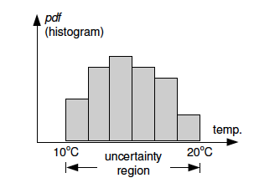
Examples of attribute uncertainty (2)
pmf (probability mass function)
Basketball hit per NBA game
Temperature of a forest
(continuous attribute)
NBA player statistics
(discrete attribute)
Notes:
Which one is continuous? Which one is discrete?

Slide 48
How to define uncertainty pdf/pmf?
The form of uncertainty pdf depends on the application e.g., Gaussian distribution models measurement error.
If no information about pdf is known, a simple way is to assume uniform pdf – a pessimistic estimation
Can also use more sophisticated techniques, based on time-series analysis on past data for pdf derivation [CH89]

Slide 49
Tuple Uncertainty
Prices of products collected from different websites are uncertain
Key | Product ID | Price ($) | Prob.
a1 | a | 120 | 0.7
a2 | a | 80 | 0.3
b1 | b | 110 | 0.6
b2 | b | 90 | 0.4
c1 | c | 140 | 0.5
c2 | c | 110 | 0.3
c3 | c | 100 | 0.2
d1 | d | 10 | 1
The price of product c is a distribution
Product Quotations

Slide 50
Summary
Uncertainty is inherent in new applications, and it cannot be ignored.
Traditional DBMS usually does not handle uncertain data.
Probabilistic uncertainty models can be used when we are not 100% about the exact attribute value, or the existence of a tuple.
Next, we will study probabilistic queries.

Slide 51
References
[CH89] C. Chatfield. The analysis of time series an introduction. Chapman and Hall, 1989.
[DPD99] O. Wolfson, P. Sistla, S. Chamberlain, and Y. Yesha. Updating and querying databases that track mobile units. Distributed and Parallel Databases, 7(3), 1999.
[ISSD99] D. Pfoser and C. S. Jensen. Capturing the Uncertainty of Moving-Object Representations, in Proc. of the Sixth International Symposium on Spatio Databases, Hong Kong, July 20-23, 1999, pp. 111-132.
[ICDE06] C. Bohm, A. Pryakhin, and M. Schubert. The gauss-tree: Efficient object identification in databases of probabilistic feature vectors. In Proc. ICDE, 2006.
[ICDE07b] V. Ljosa and A. K. Singh. APLA: Indexing arbitrary probability distributions. In Proc. ICDE, 2007.
[SIGMOD08] S. Singh et al. Orion 2.0: Native support for uncertain data. In Proc. SIGMOD, Vancouver, Canada, 2008.

Slide 52
References
"Managing and Mining Uncertain Data", by Charu C. Aggarwal, Springer, 2009. http://www.springerlink.com/content/978-0-387-09689-6
“A survey of uncertain data algorithms and applications”, by C. Aggarawal and P. Yu, IEEE TKDE, 21(5), pp. 609-623, May 2009.

