Slide 1
Lecture 7: Probabilistic Queries
COMP7106B (Spring 2024)
Big Data Management
Prof. Reynold Cheng
20th April, 2024

Slide 2
Learning Outcomes
Query Classification
Query Evaluation

Slide 3
Part 1: Query Classification

Slide 4
Lecture Objectives
In this lecture, you will learn:
A review of traditional database queries
Classification of probabilistic queries
Basics of the ORION system

Slide 5
Answering Minimum Query with Database Readings
Recorded Temperature
Current Temperature
15
10
Database answer:x
Correct answer: y
5
0
ºC
x
y
Notes:
Q at time t₁: Reading of which sensor gives the minimum reading?
(a) Based on recorded values answer is incorrect
Providing correct answers for sensor-based data appears to be infeasible

Slide 6
Answering MIN Query with Error-Bounded Readings
Recorded Temperature
Bound for Current Temperature
15
10
Answer:x
5
0
ºC
x
y
Notes:
(b) If bounds are known we are 100% sure x is min
(c) For such bounds, if values are uniformly distributed, x is more likely to be the min

Slide 7
Probabilistic MIN queries on attribute uncertainty
probability
Distribution
(pdf)
Recorded Temperature
Bound for Current Temperature
15
10
(x,0.7), (y,0.3)
Answers augmented with probabilistic guarantees
5
0
ºC
x
y
Notes:
In general, however, uncertainty of objects may not allow us to identify a single object that has the minimum value.
For such bounds, if values are uniformly distributed, x is more likely to be the min
Idea: attach probability to answer: Probabilistic Queries
Measurement error also a source of uncertainty

Slide 8
Probabilistic Queries
In uncertain databases, data uncertainty is treated as a first-class citizen
A data value attribute is modeled as
closed region + probability distribution function (pdf)
A probabilistic query
answers with probabilities for reflecting confidence on the data
imprecise but correct
Notes:
Different types of queries have different answers in probabilistic form, and evaluation techniques

Slide 9
Lecture Objectives
In this lecture, you will learn:
A review of traditional database queries
Classification of probabilistic queries
Basics of the ORION system

Slide 10
Traditional Query Review
We now review 7 fundamental queries that have been commonly used in database applications
Single value query
Range query
AVG/SUM query
VMin/VMax query
Emin/EMax query
Nearest neighbor query
Join
We will then study the probabilistic version of these queries

Slide 11
Non-Probabilistic Query #1: Single Value Query
This query returns a single value
Example: What is the temperature of CB-B?
Answer: 29ºC
Name | Temperature
CB-A | 25
CB-B | 29
CB-C | 24
KK-102 | 35
Table
T
SQL:
SELECT temperature FROM T WHERE name = “CB-B”;

Slide 12
Non-Probabilistic Query #2: Range Query
This query returns a set of objects whose values fall within some specified range
Example: What is the classroom whose temperature reading is between [20ºC, 30ºC]?
Answer: {CB-A, CB-B}
Name | Temperature
CB-A | 25
CB-B | 29
CB-C | 19
KK-102 | 35
Table
T
SQL:
SELECT name FROM T WHERE temperature BETWEEN 20 and 30;

Slide 13
Non-Probabilistic Query #3: AVG/SUM Query
The AVG (SUM) query returns the average(sum) of a set of a values
Example: What is the average temperature readings of the classrooms in T?
Answer: 27ºC
Name | Temperature
CB-A | 25
CB-B | 29
CB-C | 19
KK-102 | 35
Table
T
SQL:
SELECT AVG(temperature) FROM T;

Slide 14
Non-Probabilistic Query #4: VMin/VMax Query
This query returns the lowest (highest) attribute value.
Example (VMin): What is the lowest temperature reading of the classrooms in T?
Answer: 19ºC
Name | Temperature
CB-A | 25
CB-B | 29
CB-C | 19
KK-102 | 35
Table
T
SQL:
SELECT MIN(temperature) FROM T;
To find the maximum temperature:
SELECT MAX(temperature) FROM T;

Slide 15
Non-Probabilistic Query #5: EMin/EMax Query
This query returns the entity whose attribute value is the lowest (highest).
Example: Which classroom records the lowest temperature reading?
Answer: {CB-C}
Name | Temperature
CB-A | 25
CB-B | 29
CB-C | 19
KK-102 | 35
Table
T
SQL:
SELECT name FROM T,
((SELECT MIN(temperature) as “minTemp” FROM T) as result)
WHERE temperature = result.minTemp;

Slide 16
Non-Probabilistic Query #6: Nearest Neighbor (NN) Query
This query returns the object whose attribute value is closest to some given value q
Example: Which classroom’s temperature reading is the closest to 30ºC?
Answer: {CB-B}
Example: which restaurant is the closest to me?
Name | Temperature
CB-A | 25
CB-B | 29
CB-C | 19
KK-102 | 35
Table
T
SQL:
SELECT name
FROM T, (SELECT MIN(NN.diff) as NNtemp FROM
(SELECT ABS(temperature-30) as “diff” FROM T as NN)) as result
WHERE ABS(temperature-30) = result.NNtemp;

Slide 17
Non-Probabilistic Query #7: Join
This query returns tuples from 2 tables, whose attribute values satisfy some join conditions (e.g., =, ≠, >, <).
Example: Return the pair of classrooms whose temperature readings are the same, from T and U
Answer: {(CB-B, MH-105), (CB-B, MH-101), (CB-C, HW-208)}
Name | Temperature
CB-A | 25
CB-B | 29
CB-C | 19
KK-102 | 35
Name | Temperature
HW-301 | 20
HW-208 | 19
MH-105 | 29
MH-101 | 29
Table T
Table U
SQL:
SELECT T.name, U.name
FROM T, U
WHERE T.temperature = U.Temperature;

Slide 18
Lecture Objectives
In this lecture, you will learn:
A review of traditional database queries
Classification of probabilistic queries
Basics of the ORION system

Slide 19
Attribute Uncertainty Model
f_{i}(x) – uncertainty pdf
Attribute a
(temperature, locations) of object T_{i}
(GPS, sensor) from T
v_{i}
[L_{i}
uncertainty interval
R_{i}]
f_{i}(x) can be arbitrary, e.g., continuous, uniform, Gaussian, discrete, histogram
Notes:
This model can be extended to n dimensions.

Slide 20
Classification of Probabilistic Queries
There are many kinds of probabilistic queries.
To understand them, we classify probabilistic queries according to their evaluation methods and quality
Our query classification scheme contains 2 dimensions of classes:
Nature of answers: value-based and entity-based
Dependence of computation: whether a query result is determined by the interplay between objects/tuples

Slide 21
Value- and Entity-based Queries
2 ways of returning a query answer
Value-based: Returns a single value
Entity-based: Returns a set of objects/entities
This difference leads to distinct ways of evaluating a query and analyzing the quality of a query answer.

Slide 22
Value-based Independent Class
Returns the attribute value of an object
Involves no other objects in evaluation (“independent”)
e.g., Probabilistic Single Value Query (VSingleQ)
Given an object T_{k}, returns l, u, {p(x) | x in [l,u]} where p(x) is pdf of T_{k}.a, with p(x)=0 when x<l or x>u
What is the temperature of sensor x?
Non-probabilistic single value query: 29ºC
VSingleQ: [28ºC, 30ºC], with a uniform distribution
28ºC
30ºC

Slide 23
Entity-based Independent Class
Returns a set of objects that satisfy some condition
Computation independent of other objects (explained later)
e.g., Probabilistic Range Query (ERQ)
Given [l, u], return a set {(T_{i}, p_{i})}, where p_{i} is the non-zero probability that T_{i}.a is in [l, u]
Example: What are the sensors whose temperature readings are within [20, 30]?
Answer: {(x, 30%), (y, 40%), (z, 60%)}

Slide 24
Traditional Range Query vs. ERQ
Recorded Temperature
Uncertainty for
Current Temperature
30
u
20
10
Range Query: {T₂}
ERQ: {(T₁,0.2),(T₂,0.8)}
l
0
ºF
T₁
T₂
Notes:
Prune I/O!

Slide 25
Entity-based Dependent Class
Returns a set of entities which satisfy some function of one or more entities (e.g., MIN)
The interplay of objects is important in deciding the query answer (will be elaborated)
e.g., Probabilistic Minimum Query (EMinQ) returns a set {(T_{i}, p_{i})} where p_{i} is the non-zero prob. that T_{i}.a is the minimum value of in T
EMaxQ can be similarly defined
e.g., Probabilistic Nearest Neighbor Query (ENNQ): Given q, return a set {(T_{i}, p_{i})} where p_{i} is the non-zero prob. that |T_{i}.a-q| is the minimum in T

Slide 26
Traditional vs. Probabilistic EMinQ
Recorded Temperature
Bound for Current Temperature
15
10
Traditional: x
EMinQ: {(x,0.7), (y,0.3)}
Observe that 0.7+0.3=1 (Why?)
EMaxQ:{(x,0.3), (y,0.7)}
5
0
ºC
x
y
Notes:
In general, however, uncertainty of objects may not allow us to identify a single object that has the minimum value.
For such bounds, if values are uniformly distributed, x is more likely to be the min
Idea: attach probability to answer: Probabilistic Queries
Measurement error also a source of uncertainty

Slide 27
Traditional NN Query vs. ENNQ
Recorded Temperature
Bound for Current Temperature
15
10
q
NNQ: y
ENNQ: {(x,0.2), (y,0.8)}
0.2+0.8=1
5
0
ºC
x
y
Notes:
In general, however, uncertainty of objects may not allow us to identify a single object that has the minimum value.
For such bounds, if values are uniformly distributed, x is more likely to be the min
Idea: attach probability to answer: Probabilistic Queries
Measurement error also a source of uncertainty

Slide 28
Traditional NNQ in 2D space
T₁.a: (x,y) coordinate of T₁
Query Answer: T₁
T₁.a
q
T₂.a
T₃.a

Slide 29
ENNQ in 2D space
T₁.a: (x,y) coordinate of T₁
Query Answer:
(T₁,50%), (T₂,30%), (T_{3,} 20%)
T₁.a
q
T₂.a
T₃.a

Slide 30
Probabilistic Comparison
Consider the following:
SELECT a FROM T where a > 5;
Since a is uncertain, we are not clear whether T_{i}.a > 5!
Example: T_{i}.a = [3, 7], uniform pdf
Then, P(T_{i}.a > 5)=50%
In general, comparison (=,≠, >,<) yields a probabilistic result.

Slide 31
Entity-based Dependent Class: Join
Comparison (=,≠, >,<) between two uncertain items is probabilistic.
Equality (=)
TableT
Table U
T1 | [2,4],pdf
T2 | [4,6],pdf
T3 | [6,8],pdf
= (70%)
U1 | [0,3],pdf
U2 | [4,7],pdf
U3 | [7,9],pdf
= (80%)
Returns pairs of tuples (entities):
e.g., {(T1,U1, 0.7), (T2,U2, 0.8)}
The join probability depends on 2 sets of values

Slide 32
Value-based Dependent Class
Involves aggregate operators (e.g., SUM, MIN) to get a single value
e.g., Value-based Average Query (VAvgQ): Returns l, u, {p(x)|x in [l,u]}, where X is a random variable for the average of values of a in T
VSumQ can be defined in a similar way
e.g., Probabilistic Minimum Value Query (VMinQ): Returns l, u, {p(x)|x in [l,u]}, where X is a random variable for the minimum value of a in T
VMaxQ can be defined in similar way

Slide 33
VSumQ and VAvgQ
Recorded Temperature
Bound for Current Temperature
15
10
VSumQ
Traditional: 5+13 = 18
Probabilistic: [6, 23], pdf
VAvgQ
Traditional: (5+13)/2 = 9
Probabilistic: [6/2, 23/2], pdf
5
0
ºC
x
y
Notes:
In general, however, uncertainty of objects may not allow us to identify a single object that has the minimum value.
For such bounds, if values are uniformly distributed, x is more likely to be the min
Idea: attach probability to answer: Probabilistic Queries
Measurement error also a source of uncertainty

Slide 34
VMinQ and VMaxQ
Recorded Temperature
Bound for Current Temperature
15
10
VMinQ
Traditional: 5
Probabilistic: [1, 9], pdf
VMaxQ
Traditional: 13
Probabilistic: [6, 14], pdf
5
0
ºC
x
y
Notes:
In general, however, uncertainty of objects may not allow us to identify a single object that has the minimum value.
For such bounds, if values are uniformly distributed, x is more likely to be the min
Idea: attach probability to answer: Probabilistic Queries
Measurement error also a source of uncertainty

Slide 35
Query Classification: Summary
Nature of answer
Value-based: returns a single value
e.g.,VAvgQ ([l,u], pdf)
Entity-based: returns a set of objects
e.g., ERQ ({(T_{i},p_{i}), p_{i}>0})
Dependence
Dependent: interplay between objects decides result e.g., ENNQ
Independent: whether an object satisfies a query is independent of others
e.g., ERQ
This concept will be clearer when we discuss query evaluation
Notes:
An algorithm developed for one query can be applied to another in the same class. e.g., max, min and nearest-neighbor
Quality metrics, which measures the ambiguity of a query, are applicable to the same class.

Slide 36
4 Classes of Probabilistic Queries
 | Value-based answer | Entity-based answer
Independent | VSingleQ What is the temperature of sensor x? | ERQ Which sensor has temperature between 10ºF and 30ºF?
Dependent | VAvgQ, VSumQ, VMinQ, VMaxQ What is the average temperature of the sensors? | ENNQ, EMinQ, EMaxQ, Join (=,≠, >,<) Which sensor gives the highest temperature?
Notes:
Now let us look at this table that gives us query examples for the 2 dimensions of classifications.

Slide 37
Lecture Objectives
In this lecture, you will learn:
A review of traditional database queries
Classification of probabilistic queries
Basics of the ORION system

Slide 38
The ORION Database
Based on an open-source database (PostgreSQL 8.0)
Enhances SQL by providing uncertainty management functionalities
Extended to support 2D data and tuple uncertainty
The ORION project won the Pan-Pearl IT Project Competition, China in 2007
Notes:
Recently supports 2D uncertainty

Slide 39
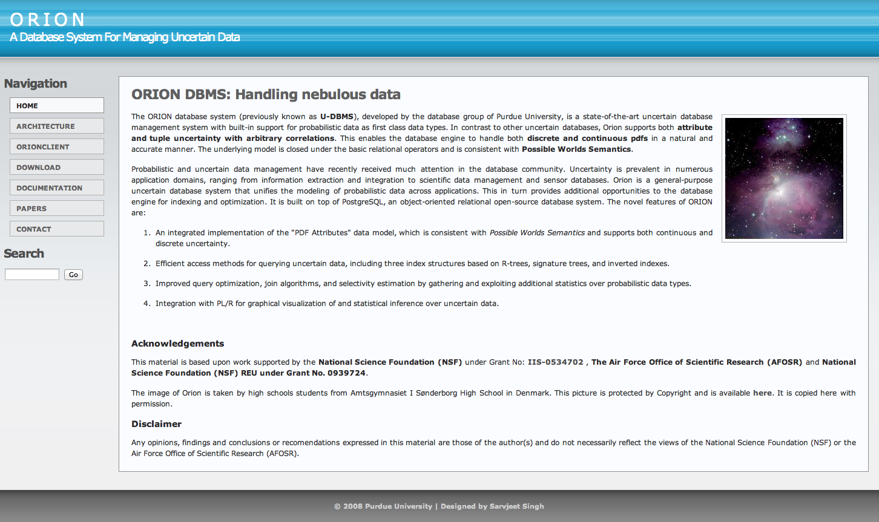
The ORION database http://orion.cs.purdue.edu

Slide 40
Queries in ORION
k | a
1 | U[5,10]
2 | G(2, 0.1)
Create a table with UNCERTAIN type | CREATE table T( k INTEGER primary key, a UNCERTAIN);
Insert Gaussian pdf (mean μ, variance σ) | Insert into T values (2,‘(g,μ,σ)’);
Display uncertain info. of a if a> 5 | SELECT a FROM T where a > 5;
Equality join of uncertain attributes (=% returns probability of equality) | SELECT R.k, S.k, R.a =% S.a FROM R,S WHERE R.a = S.a;
Entities with prob. giving min value of a (e.g., {(3,0.5), (5,0.3), (11,0.2)}) | SELECT Emin(T.a) from T;
Min value of a for table T (UNCERTAIN) | SELECT Vmin(T.a) from T;

Slide 41
Architecture of ORION
PostgreSQL 8.0
Notes:
Built on PostgreSQL 8.0, an object-oriented open-source database
UNCERTAIN class: data structures (e.g., histogram) and access methods (e.g., find variance of uncertainty)
New data types and operators do not interfere with the original DBMS
Implemented with PL/SQL and external C codes

Slide 42
Remarks
The classification scheme characterizes main features of probabilistic queries.
The ORION database treats uncertainty as a “first class citizen”, by providing uncertain data models and probabilistic query operators.
Next, we will study the evaluation of probabilistic queries.
Notes:
: query classification, quality metrics, efficient query computation and indexing, system implementation

Slide 43
Part 2: Query Evaluation

Slide 44
Lecture Objectives
You will learn different query algorithms for attribute uncertainty:
Queries that can be evaluated easily
Entity-based dependent queries
Nearest neighbor queries for 2D objects
Joins

Slide 45
2A. Probabilistic Query Evaluation: Basics

Slide 46
Simple queries
You will learn:
Computing answers for:
VSingleQ
VSumQ and VAvgQ
ERQ
Efficient evaluation of probabilistic queries on large databases
Fast probability computation
Data pruning

Slide 47
Attribute Uncertainty Model
f_{i}(x) – uncertainty pdf
T_{i}.a
[l_{i}
uncertainty interval
u_{i}]
Attribute a
(temperature, locations) of object T_{i}
(GPS, sensor) from T
Notes:
This model can be extended to n dimensions.

Slide 48
4 Classes of Probabilistic Queries
 | Value-based answer | Entity-based answer
Independent | VSingleQ What is the temperature of sensor x? | ERQ Which sensor has temperature in 10ºF and 30ºF?
Dependent | VAvgQ, VSumQ, VMinQ, VMaxQ What is the average temperature of the sensors? | ENNQ, EMinQ, EMaxQ, Join (=,≠, >,<) Which sensor gives the highest temperature?
Notes:
Now let us look at this table that gives us query examples for the 2 dimensions of classifications.

Slide 49
VSingleQ Evaluation
Definition: Given an object T_{k}, returns l, u, {p(x) | x in [l,u]} where p(x) is pdf of T_{k}.a, with p(x)=0 when x<l or x>u
What is the temperature of sensor T_{k}?
To evaluate VSingleQ, simply retrieve the uncertain information of T_{k}
e.g., [28, 30], 1/2
28ºC
30ºC

Slide 50
Scalable VSingleQ Execution
With a large database, it is too slow to scan it once in order to locate T_{k}
We need a faster data structure, or index, to speed up the lookup of T_{k}
Can use a disk-based hash index
Dynamic hashing, e.g., extendible hashing for tuple insertion/deletion

Slide 51
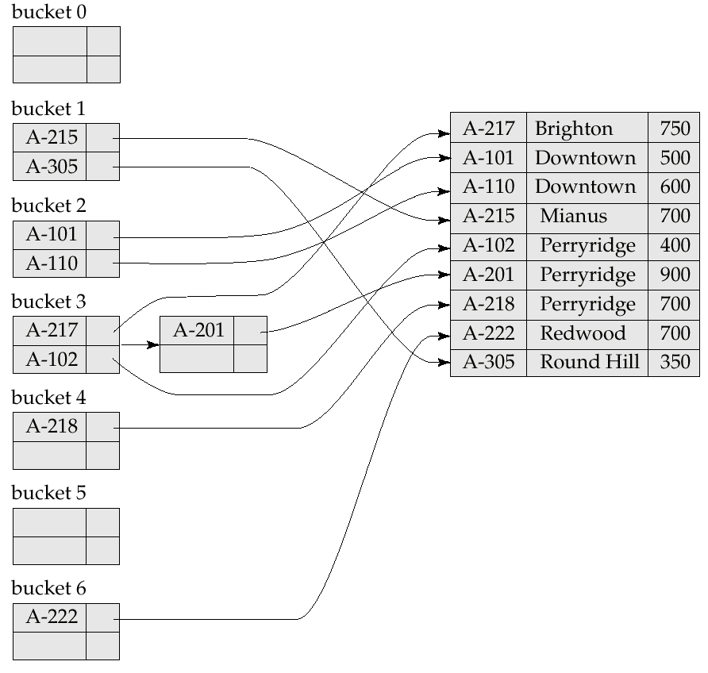
Illustrating a Hash Index
Based on the Ch. 12 notes of “Database System Concepts” by A. Silberschatz et al.
Disk page (bucket)
h(A-215) = 8 mod 7
= 1
Hash function on search key A-215

Slide 52
4 Classes of Probabilistic Queries
 | Value-based answer | Entity-based answer
Independent | VSingleQ What is the temperature of sensor x? | ERQ Which sensor has temperature in 10ºF and 30ºF?
Dependent | VAvgQ, VSumQ, VMinQ, VMaxQ What is the average temperature of the sensors? | ENNQ, EMinQ, EMaxQ, Join (=,≠, >,<) Which sensor gives the highest temperature?
Notes:
Now let us look at this table that gives us query examples for the 2 dimensions of classifications.

Slide 53
VSumQ Evaluation (1)
A VSumQ returns l, u, {p(x)|x in [l,u]}, where X is a random variable for the sum of values of a in T
T₁: [2, 10]
T₂: [6, 15]
VSumQ answer bound:
[2+6, 10+15], or
[8, 25]
15
10
5
0
ºC
T₁ [2,10]
T₂ [6,15]

Slide 54
VSumQ Evaluation (2)
VSumQ: [8, 25]
p(x) in [8,25] is the pdf of random variable X,
X=T₁.a+T₂.a
15
10
5
0
ºC
T₁ [2,10]
T₂ [6,15]

Slide 55
VSumQ Evaluation (3)
15
x is in [8, 25]
Let y in [2,10] (T₁.a)
IfX=T₁.a+T₂.a, then:
6 <x-y< 15 (T₂.a)
x-15 <y< x-6
10
5
0
ºC
T₁ [2,10]
T₂ [6,15]

Slide 56
VSumQ Evaluation (4)
To sum up attribute values of |T| objects,
pick two objects at a time
Sum up their attribute values
Add the result to another object’s attribute
Repeat 1-3 until all objects are consumed
Interval of VSumQ result:

Slide 57
VAvgQ Evaluation
VSumQ answer bound:
[8, 25]
VAvgQ answer bound:
[8/2, 25/2]
VAvgQ pdf can be similarly scaled from VSumQ pdf
No index needed for VSumQ and VAvgQ
15
10
5
0
ºC
T₁ [2,10]
T₂ [6,15]

Slide 58
Overhead of VSumQ / VAvgQ
To compute p(x), we need to integrate over some integration function (e.g., f₁(y)f₂(x-y))
Solution 1: Evaluate integral by hand
Applicable to simple pdf types (e.g., uniform)
Difficult for most queries
Solution 2: Change the integration function to mathematical series (e.g., Taylor’s series)
Truncate the series to some required accuracy
Applicable for algebraic functions
Solution 3: Use numerical methods
Applicable for arbitrary pdf (e.g., histogram)

Slide 59
Numerical Method
f(x)
histogram
a
Δ
b
Integral = sum of the area of stripes of width Δ
Δ small ➔more accurate but slow
Δ large ➔ less accurate but fast
Fixing Δ is problematic for PNNQ (discuss later)

Slide 60
4 Classes of Probabilistic Queries
 | Value-based answer | Entity-based answer
Independent | VSingleQ What is the temperature of sensor x? | ERQ Which sensor has temperature in 10ºF and 30ºF?
Dependent | VAvgQ, VSumQ, VMinQ, VMaxQ What is the average temperature of the sensors? | ENNQ, EMinQ, EMaxQ, Join (=,≠, >,<) Which sensor gives the highest temperature?
Notes:
Now let us look at this table that gives us query examples for the 2 dimensions of classifications.

Slide 61
Evaluating ERQ
Definition: Given a range R (e.g., [l, u], an area), return a set {(T_{i}, p_{i})}, where p_{i} is the non-zero probability that T_{i}.a is in [l, u]
Example: Which sensors have temperature readings between [20, 30]?
Answer: {(x, 30%), (y, 40%), (z, 60%)}
The probability of each object can be independently obtained through integration

Slide 62
ERQ Evaluation (1D Uncertainty)
Recorded Temperature
Uncertainty for
Current Temperature
30
20
{(T₁,0.2),(T₂,0.8)}
10
0
ºF
T₁[0,12]
T₂ [15,28]
Notes:
Prune I/O!

Slide 63
ERQ Evaluation (2D Uncertainty)
Let A_{i}= overlap of uncertainty region of T_{i} and R
p_{i}= ∫_{Ai} f_{i}(x,y) dxdy
If p_{i} ≠ 0, return (T_{i}, p_{i})
(A₃, 0.3)
(A₁,0.8)
R
(A₂,0.6)
(A₄,0)

Slide 64
Scalable ERQ execution
Evaluating an ERQ over a large DB can be expensive
Need to find out the objects whose uncertainty regions overlap with R
An interval index (e.g., B-tree, R-tree) can speed up this process
We consider the R-tree [SIGMOD84], since it can handle multi-dimensional data

Slide 65
Filtering and Refinement
Evaluating an uncertainty region of arbitrary shape can be slow
Approximate the region by minimum bounding rectangle (MBR)
Processing of ERQ:
1. Filtering: Each MBR is tested against the query range, with the aid of R-tree. Objects not filtered are called candidate objects.
2. Refinement: The probability values of candidate objects that pass the filter step are computed.
R
R
R
T_{k}
T_{k}
filtered object
non-qualifying candidate object that passes the filter step
(false hit; prob. = 0)
Qualifying candidate object (prob. > 0)
Based on Dr. Mamoulis’ slides on spatial data management

Slide 66
The Filtering Step
Find all objects whose uncertainty overlap with the query range R
Can be efficiently supported by R-tree
R
R
R
(a) objects and ERQ | (b) object MBRs | (c) candidates and results

Slide 67
The R-tree
uncertainty region of object x
pointers to objects in the DB (for accessing uncertainty pdf and other attributes)

Slide 68
R-tree-based Filtering
Range_query(query R, R-tree node n):
If n is not a leaf node
For each index entry e in n such that e.MBR intersects R
visit node n’ pointed by e.ptr
Range_query(R, n’)
If n is a leaf
For each index entry e in n such that e.MBR intersects R
visit object o pointed by e.object-id
test range query against exact uncertainty region of o; if o intersects R, return o
May follow multiple paths during search

Slide 69
Filtering
R
uncertainty region of object x

Slide 70
Refinement
Courtesy of Dr. Mamoulis (HKU)
ERQ processing:
1. Filtering: Each MBR is tested against the query range, with the aid of R-tree. Objects not filtered are called candidate objects.
2. Refinement: The probability values of candidate objects that pass the filter step are computed
For each object T_{k} returned from the filtering step:
Check uncertainty region of T_{k}(e.g.,[l_{k},u_{k}]) against R
If [l_{k},u_{k}] and R overlaps, then compute p_{k}
p_{k} can be obtained by using any probability computation methods (e.g., numerical methods)

Slide 71
Efficiency of ERQ
Even with the use of the R-tree, evaluating an ERQ can still be expensive
May have many false hits
May need to compute many integrals
Answer probabilities may be too small
A user may want to know: Does the probability of the answer exceed a given threshold?
➔Probabilistic Threshold ERQ (PTRQ)
An advanced index called “Probability Threshold Index” can be used.
Due to time limitation, we will skip it here.

Slide 72
Summary
Efficient computation of query answer probabilities is important to the design of an uncertain database.
We study the efficient and scalable evaluation of probabilistic queries.
Next, we study dependent queries, which are more challenging!

Slide 73
2B. Entity-based Dependent Queries

Slide 74
Attribute Uncertainty Model
A continuous function
f_{i}(x) – uncertainty pdf
T_{i}.a
[l_{i}
uncertainty interval
u_{i}]
Attribute a
(temperature, locations) of object T_{i}
(GPS, sensor) from T
Uncertainty region in 2D space
Notes:
This model can be extended to n dimensions.

Slide 75
Uncertainty pdf and cdf (1D)
f_{i}(x) – uncertainty pdf
Attribute a
(temperature, locations) of object T_{i}
(GPS, sensor) from T
T_{i}.a
[l_{i}
uncertainty interval
u_{i}]
F_{i}(x):
cumulative distribution function (cdf)
1
0
[l_{i}
uncertainty cdf
u_{i}]
Notes:
This model can be extended to n dimensions.

Slide 76
4 Classes of Probabilistic Queries
 | Value-based answer | Entity-based answer
Independent | VSingleQ What is the temperature of sensorx? | ERQ Which sensor has temperature in 10ºF and 30ºF?
Dependent | VAvgQ, VSumQ, VMinQ, VMaxQ What is the average temperature of the sensors? | ENNQ, EMinQ, EMaxQ, Join (=,≠, >,<) Which sensor gives the highest temperature?
Notes:
Now let us look at this table that gives us query examples for the 2 dimensions of classifications.

Slide 77
EMinQ
Recorded Temperature
Bound for Current Temperature
15
Probabilistic Minimum Query (EMinQ): returns a set {(T_{i}, p_{i})} where p_{i} is non-zero prob. that T_{i}.a is the min. value of a in T
Example: {(x,0.7), (y,0.3)}
10
5
0
ºC
x
y
Notes:
In general, however, uncertainty of objects may not allow us to identify a single object that has the minimum value.
For such bounds, if values are uniformly distributed, x is more likely to be the min
Idea: attach probability to answer: Probabilistic Queries
Measurement error also a source of uncertainty

Slide 78
3-Phase Evaluation
Interval elimination
Reduce no. of objects to handle
Interval bounding
Probability computation
A systematic and generic way of computing probabilities

Slide 79
Phase 1: Interval Elimination
Eliminate objects with zero prob. of yielding min. value
To handle a large DB, adapt a nearest-neighbor search algorithm for R-tree over uncertainty intervals [CKP07]
I may be minimum
Minimum of u_{i}’s
I cannot be minimum
0
upper limit
Notes:
Now let me talk about evaluation algorithms of probabilistic queries. Because of time limitation, I’ll only illustrate the evaluation of probabilistic minimum queries, or EMinQ in short.

Slide 80
Search in an R-tree (Review)
Problem: find the NN of q
Depth-first vs. Best-first NN search

Slide 81
3-Phase Evaluation
Interval elimination
Reduce no. of objects to handle
Interval bounding
Probability computation
A systematic and generic way of computing probabilities

Slide 82
Phase 2: Interval Bounding
T₄
T₃
T₂
T₁
0
0
Cut off portions that are beyond the “upper limit”
Sort intervals using lower bounds
Rename objects as T₁,T₂,T₃,T₄ in ascending order of lower bounds

Slide 83
3-Phase Evaluation
Interval elimination
Reduce no. of objects to handle
Interval bounding
Probability computation
A systematic and generic way of computing probabilities

Slide 84
Phase 3: Evaluating p_{i} for T_{i}
T₄
f₂(x)
T₃
F₁(x)
T₂
1-F₁(x)
T₁
x
0
x
x+dx
If T₂.a ∈ [x, x+dx], T₂.a is the minimum when T₁.a > T₂.a with probability f₂(x) * (1-F₁(x)) dx
Notes:
The 3rd step of EMinQ is to evaluate probability pi of Ti for being the minimum object.
For illustration purpose, I’ll only demonstrate how to get p₂, the probability for T₂.
First, let f₂(x) be the pdf of T₂.a.
Consider the interval [x, x+dx]. If T₂.a is in this interval, then T₂.a...

Slide 85
Exercise: probability of T₂
T₄
T₃
T₂
T₁
0
l₁
l₂
l₃
l₄
l₅
x
x+dx
If T₂.a∈[l₂,l₃], T₂.a is the min with probability
Question: What is the probability T₂.a is the min (i.e., p₂)?
Answer:
Notes:
Continue with our discussions. If T₂.ais in the interval [l₂,l₃], then T₂.a is the minimum value with probability given by this formula: integrating the expression given by the previous slide from l₂ to l₃.
For T_{2.}a in [l₃,l₄], this is the probabiilty that T₂.a is the minimum
For T_{2.}a is in [l₄,l₅], this is the probabiilty that T₂.a is the minimum
p₂ is then the sum of these probability values from these three intervals.
From this example, I would like to point out that the solutions of probabilistic queries depend on knowing three factors:
bound
pdf
cdf
Now my colleague Mr. Dmitri Kalashnikov will continue the talk by presenting the quality and performance issues of probabilistic queries.

Slide 86
Probability Computation (1)
f(x)
stripe
a
Δ
b
Numerical method for calculating p_{i}: sum up stripes with a fixed width Δ
Problem: Every interval has a different width and integration function
e.g., [l₂,l₃], [l₃,l₄], and [l₄,l₅] have varying widths
Choosing a reasonable Δ can be difficult!

Slide 87
Probability Computation (2)
Problem: Choosing a reasonable Δ can be difficult
Solution: Make Δ adaptive to interval length
Let ε be the inverse of no. of stripes used in integration
e.g., if ε=0.1, then 1/0.1 = 10 stripes are used
Δ = integration interval width x ε
e.g., if [l₂, l₃]=[2,4], Δ = (4-2) * 0.1 = 0.2
ε, which controls precision, is adaptive to integration interval width

Slide 88
2C. Probabilistic Nearest Neighbor Queries for Moving Objects

Slide 89
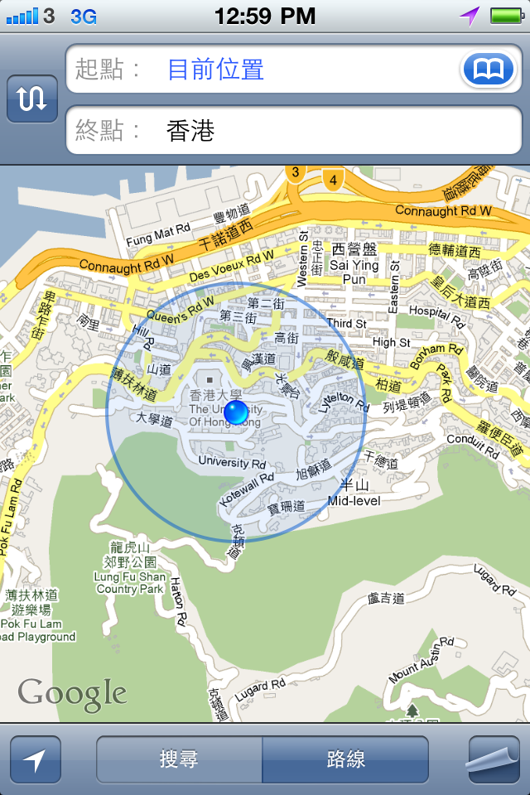
Uncertainty of Moving Object Locations
My location captured by the GPS on my phone is not precise!
The uncertainty region is a circle.

Slide 90
Uncertainty of Moving Object Locations
How to model location uncertainty for moving objects obtained from GPS devices and satellites?
U_{i}(t): uncertainty region of object T_{i} at time t
A closed region where T_{i} is found only inside this region.
f_{i}(x,y,t): uncertainty pdf of object T_{i}
pdf of T_{i}'s location (x,y) at time t
f_{i}(x,y,t)
U_{i}(t)
T_{i}
Recorded location at time t=0

Slide 91
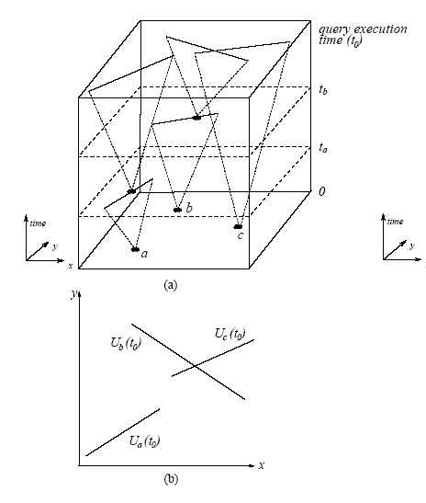
Line-Segment Uncertainty
Assume objects move along straight line paths
U_{i}(t) is a line segment [WS99]
Length of segment is 2S_{max}(t-t_{update})
If f_{i}(x,y,t) is uniform, then:

Slide 92
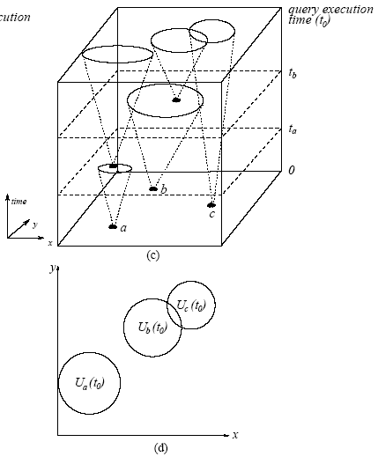
Free-Moving Uncertainty
Assume objects are free to move in any direction
U_{i}(t) is a circle [WS99]
Center of circle is the last reported location.
radius = S_{max}(t-t_{update})
f_{i}(x,y,t) is uniform:

Slide 93
ENNQ for 2D Location Uncertainty [TKDE04]
INPUT
A query point q
A set of n objects T₁,T₂,…, T_{n} with uncertainty regions and pdfs known at time t₀
OUTPUT
A set of (T_{i},p_{i}) tuples
p_{i} is the non-zero probability that T_{i} is the nearest neighbor of q at time t₀
SOLUTION
Similar to EMinQ
Notes:
Prior work addresses range queries over a limited model of uncertainty (normal distribution and straight line movement). Here we illustrate a more difficult query, involving interaction between objects to derive a result (nearest neighbor).

Slide 94
ENNQ Solution Idea (1)
At distance r, T₁ is the nearest neighbor of q if:
T₁ is at distance r from q
T₂, T₃, T₄ are all at distances > r from q
Derive pdf q₁(r) for T₁ on the above event
T₃
T₁
r
q
T₄
T₂

Slide 95
ENNQ Solution Idea (2)
Compute q₁(r)
From the shortest distance of T₁ to q (n₁)
To the longest distance of T₁ to q (f₁)
T₃
f₁
T₁
n₁
q
T₄
T₂

Slide 96
ENNQ Solution Details
d_{i}(r): distance pdf of T_{i} from q
D_{i}(r): distance cdf of T_{i} from q
n_{i}: smallest distance of T_{i} from q
f:shortest max distance of all objects from q
T₅
T₃
f
T₁
n₁
q
T₄
q₁(r)
T₂
T₆
Notes:
Once we know these values of these functions from the particular uncertainty model (line uncertainty and free-moving uncertainty), we can plug in the values to this algorithm and compute the probabilities.
As an illustration, we briefly describe how these four parameters are derived for free-moving uncertainty.

Slide 97
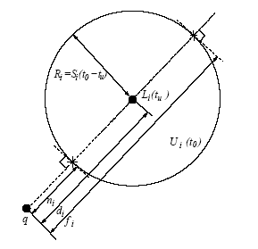
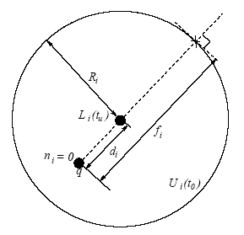
ENNQ for Free-Moving Uncertainty: n_{i} and f
Case 1: q is outside U_{i}(t₀)
Case 2: q is inside U_{i}(t₀)

Slide 98
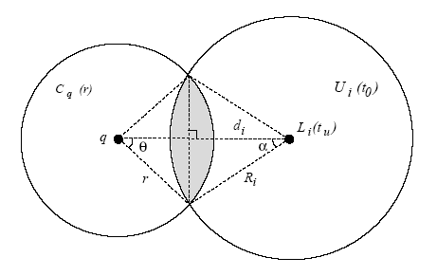
PNNQ for Free-Moving Uncertainty: D_{i}(r) and d_{i}(r) (for Case 1)
Notes:
just by doing the math

Slide 99
ENNQ, EMaxQ, and Other Queries
ENNQ:
For every object, find its distance pdf d_{i}(x) and cdf D_{i}(x) from q, which can be obtained from f_{i}(x)
Use the EMinQ solution, by replacing f_{i}(x) with d_{i}(x), and F_{i}(x) with D_{i}(x)
EMaxQ:
Based on EMinQ solution, by reversing the roles of lower and upper bounds
VMinQ and VMaxQ: Can also adapt EMinQ ideas
See [CKP03] for more details

Slide 100
2D. Probabilistic Join

Slide 101
4 Classes of Probabilistic Queries
 | Value-based answer | Entity-based answer
Independent | VSingleQ What is the temperature of sensor x? | ERQ Which sensor has temperature in 10ºF and 30ºF?
Dependent | VAvgQ, VSumQ, VMinQ, VMaxQ What is the average temperature of the sensors? | ENNQ, EMinQ, EMaxQ, Join (=,≠, >,<) Which sensor gives the highest temperature?
Notes:
Now let us look at this table that gives us query examples for the 2 dimensions of classifications.

Slide 102
Join
Join is an important database problem
Join operator: =, !=, >, <
3
5
7
1
5
8
=

Slide 103
Probabilistic Join
Comparison (=,!=, >,<) between two uncertain attributes is probabilistic.
Equality (=)
TableT
Table U
T1 | [2,4],pdf
T2 | [4,6],pdf
T3 | [6,8],pdf
= (70%)
U1 | [0,3],pdf
U2 | [4,7],pdf
U3 | [7,9],pdf
= (80%)
Returns pairs of tuples (entities):
e.g., {(T1,U1, 0.7), (T2,U2, 0.8)}
The join probability depends on 2 sets of values

Slide 104
Probabilistic Equality
If f_{i}(x) is continuous pdf, the probability that x=x₀ for any real value x₀ is zero.
The probability that a = b is always zero!
How to have a reasonable definition of equality?
a
b

Slide 105
Probabilistic Equality
In continuous attribute uncertainty, a and b are equal at any point with zero probability
Resolution c: a=b if they are within c of each other.
a
c
c
b
c
c

Slide 106
Probabilistic Equality
In continuous attribute uncertainty, a and b are equal at any point with zero probability
Resolution c: a=b if they are within c of each other.
pdf of a
Prob. b is located in [x-c, x+c]
a
c
c
b
c
c

Slide 107
Efficient Join Processing
How to process a join efficiently if the 2 relations are extremely large?
If relations are indexed (by R-trees), multi-step join processing algorithms can be used.

Slide 108
Multi-step join processing
R-tree
R-tree
(Filtering)
(Refinement) We covered
this for prob. equality join

Slide 109
Summary
Dependent queries (e.g., Joins and EMinQ) are more difficult to handle than independent queries (e.g., ERQ)
We use resolution to provide a sound and reasonable definition of join
We examine a solution of EMinQ
Need to know integration bounds, pdf, and, cdf
Can be adapted to EMaxQ, ENNQ, VMinQ, VMaxQ
For 2D ENNQ, use distance pdfs and cdfs
Notes:
: query classification, quality metrics, efficient query computation and indexing, system implementation

Slide 110
References
[CKP07] R. Cheng, D. V. Kalashnikov, and S. Prabhakar. Evaluation of Probabilistic Queries over Imprecise Data in Constantly-Evolving Environments. In Information Systems (IS), Vol. 32, No. 1, pp. 104-130, Mar 2007.
[TKDE04] R. Cheng, S. Prabhakar and D. V. Kalashnikov. Querying imprecise data in moving object environments. InTKDE, 2004.
[CPK03] R. Cheng, S. Prabhakar and D. V. Kalashnikov. Querying imprecise data in moving object environments. In Proc. of the 19th IEEE ICDE, India, 2003.
[CIKM06] R. Cheng, S. Singh, S. Prabhakar, R. Shah, J. Vitter and Y. Xia. Efficient Join Processing over Uncertain Data. In ACM 15th Conf. on Information and Knowledge Management (CIKM 2006), Arlington, USA 2006. http://i.cs.hku.hk/~ckcheng/papers/join-cikm06.pdf
[WS99] O. Wolfson and A. Sistla. Updating and Querying Databases that Track Mobile Units. In Distributed and Parallel Databases, 7(3), 1999.
[OW03] C. Olston and J. Widom. Best-effort cache synchronization with source cooperation. In Proc. Of the ACM SIGMOD 2002.

Slide 111
References
[FOCS96] L. Arge and J. S. Vitter. On dynamic interval management in external memory (extended abstract). In FOCS, p. 560-569, 1996.
[TKDE92] D. Barbara, H. Garcia-Molina and D. Porter. The management of probabilistic data. IEEE TKDE, 4(5):487-502, 1992.
[BK00] M. Berg, M. Kreveld, M. Overmars and O. Schwarzkopf. Computational Geometry – Algorithms and Applications. 2nd ed., Springer Verlag (2000).
[ICDE06] C. Bohm, A. Pryakhin, and M. Schubert. The gauss-tree: Efficient object identification in databases of probabilistic feature vectors. In Proc. ICDE, 2006.
[SSTD05] X. Dai, M. L. Yiu, N. Mamoulis, Y. Tao, and M. Vaitis. Probabilistic Spatial Queries on Existentially Uncertain Data. Proc. SSTD, pp. 400-417, August 2005.
[VLDB04b] N. Dalvi and D. Suciu. Efficient Query Evaluation on Probabilistic Databases. VLDB 2004.
[VLDB04c] A. Deshpande, C. Guestrin, S. Madden, J. Hellerstein and W. Hong. Model-Driven Data Acquisition in Sensor Networks. In VLDB, 2004.
[IDG06] J. Galindo, A. Urrutia and M. Piattini. Fuzzy Databases: Modeling, Design, and Implementation. Ideas Group Publishing, 2006.
[SIGMOD84] A. Guttman. R-trees: A dynamic index structure for spatial searching. Proc. of the ACM SIGMOD Int’l. Conf., 1984.

Slide 112
References
[ICDE03] E. Hung, L. Getoor and V. S. Subrahmanian. PXML: A Probabilistic Semistructured Data Model and Algebra. In ICDE 2003.
[VLDB06] O. Mar, A. Sarma, A. Halevy, and J. Widom. ULDBs: databases with uncertainty and lineage. In VLDB, 2006.
[ICDE07b] V. Ljosa and A. K. Singh. APLA: Indexing arbitrary probability distributions. In Proc. ICDE, 2007.
[ADI00] Y. Manolopoulos, Y. Theodoridis, and V. J. Tsotras. Chapter 4: Access methods for intervals. In Advanced Database Indexing, Kluwer, 2000.
[VLDB07] J. Pei, B. Jiang, X. Lin, and Y. Yuan. Probabilistic skylines on uncertain data. In Proc. VLDB, 2007.
[ISSD99] D. Pfoser and C. S. Jensen. Capturing the Uncertainty of Moving-Object Representations, in Proc. of the Sixth International Symposium on Spatio Databases, Hong Kong, July 20-23, 1999, pp. 111-132.

