Slide 1
Título legal
nós

Slide 2
R Markdown
Oi http://rmarkdown.rstudio.com.
When you click the Knit button a document will be generated that includes both content as well as the output of any embedded R code chunks within the document.

Slide 3
Slide with Bullets
Bullet 10
Bullet 20
Bullet 30

Slide 4
Slide with R Output
summary(cars)
## speed dist ## Min. : 4.0 Min. : 2.00 ## 1st Qu.:12.0 1st Qu.: 26.00 ## Median :15.0 Median : 36.00 ## Mean :15.4 Mean : 42.98 ## 3rd Qu.:19.0 3rd Qu.: 56.00 ## Max. :25.0 Max. :120.00

Slide 5
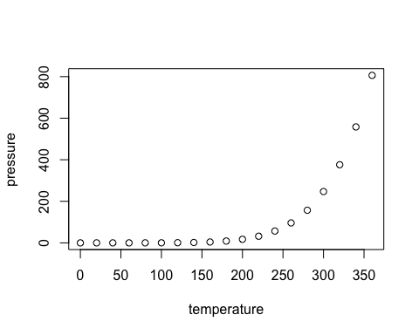
Slide with Plot

