Slide 1
Zugversuch
ISO 527: E-Modul 1 mm/min, 50 mm/min

Slide 2
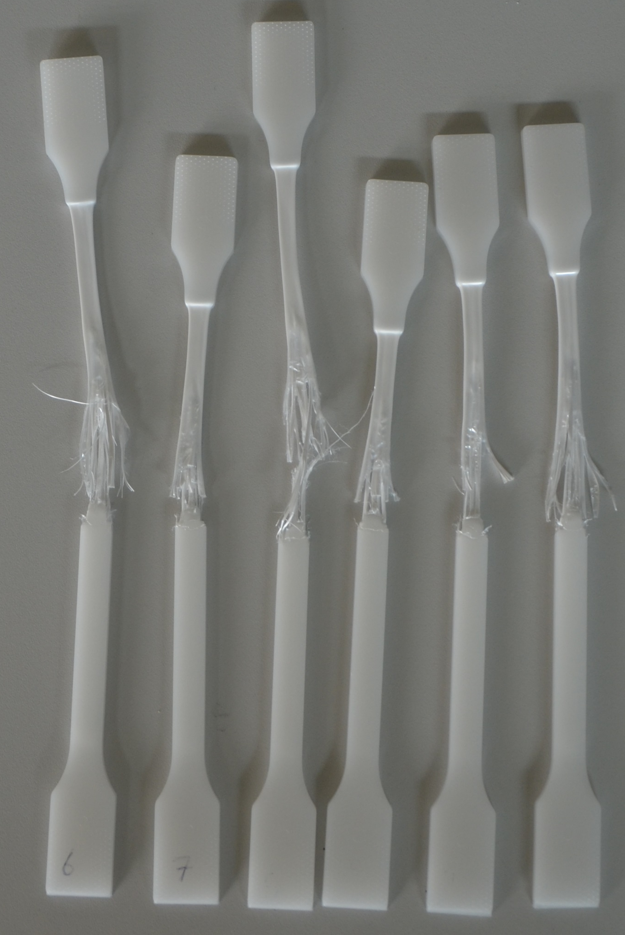
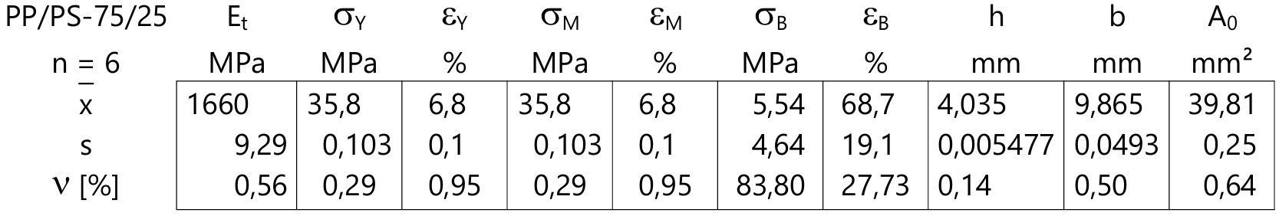
PP/PS_75/25
1 2 3 4 5 6

Slide 3
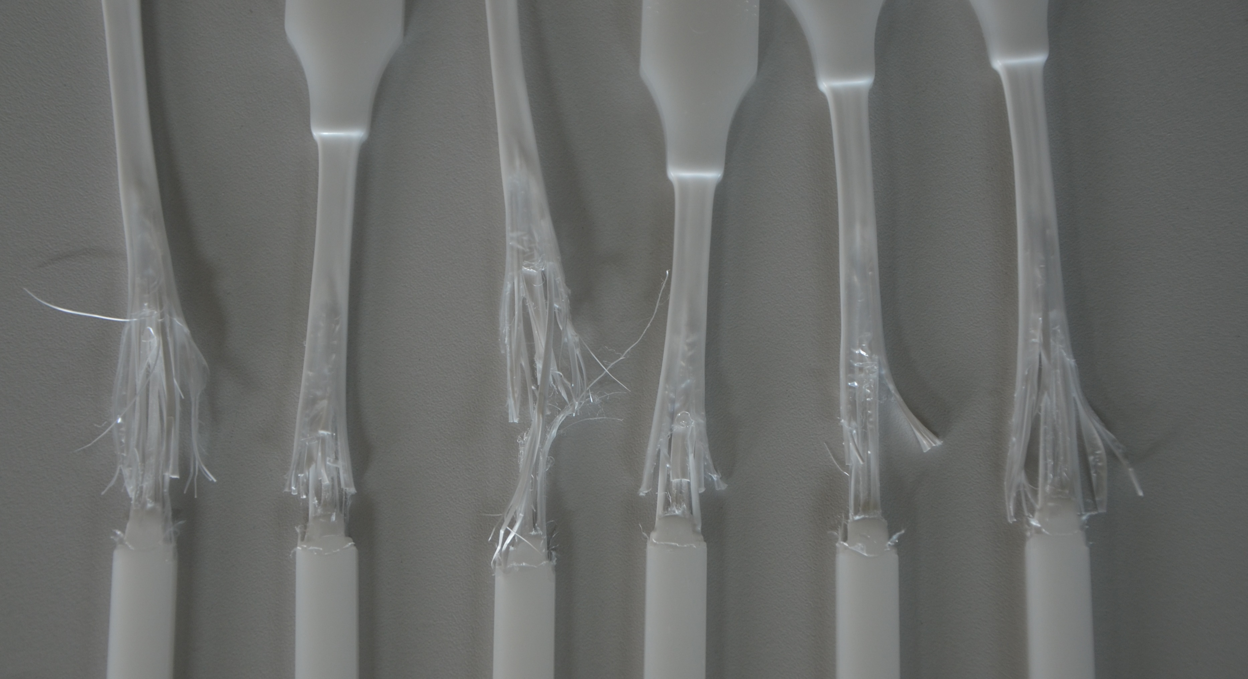

Slide 4
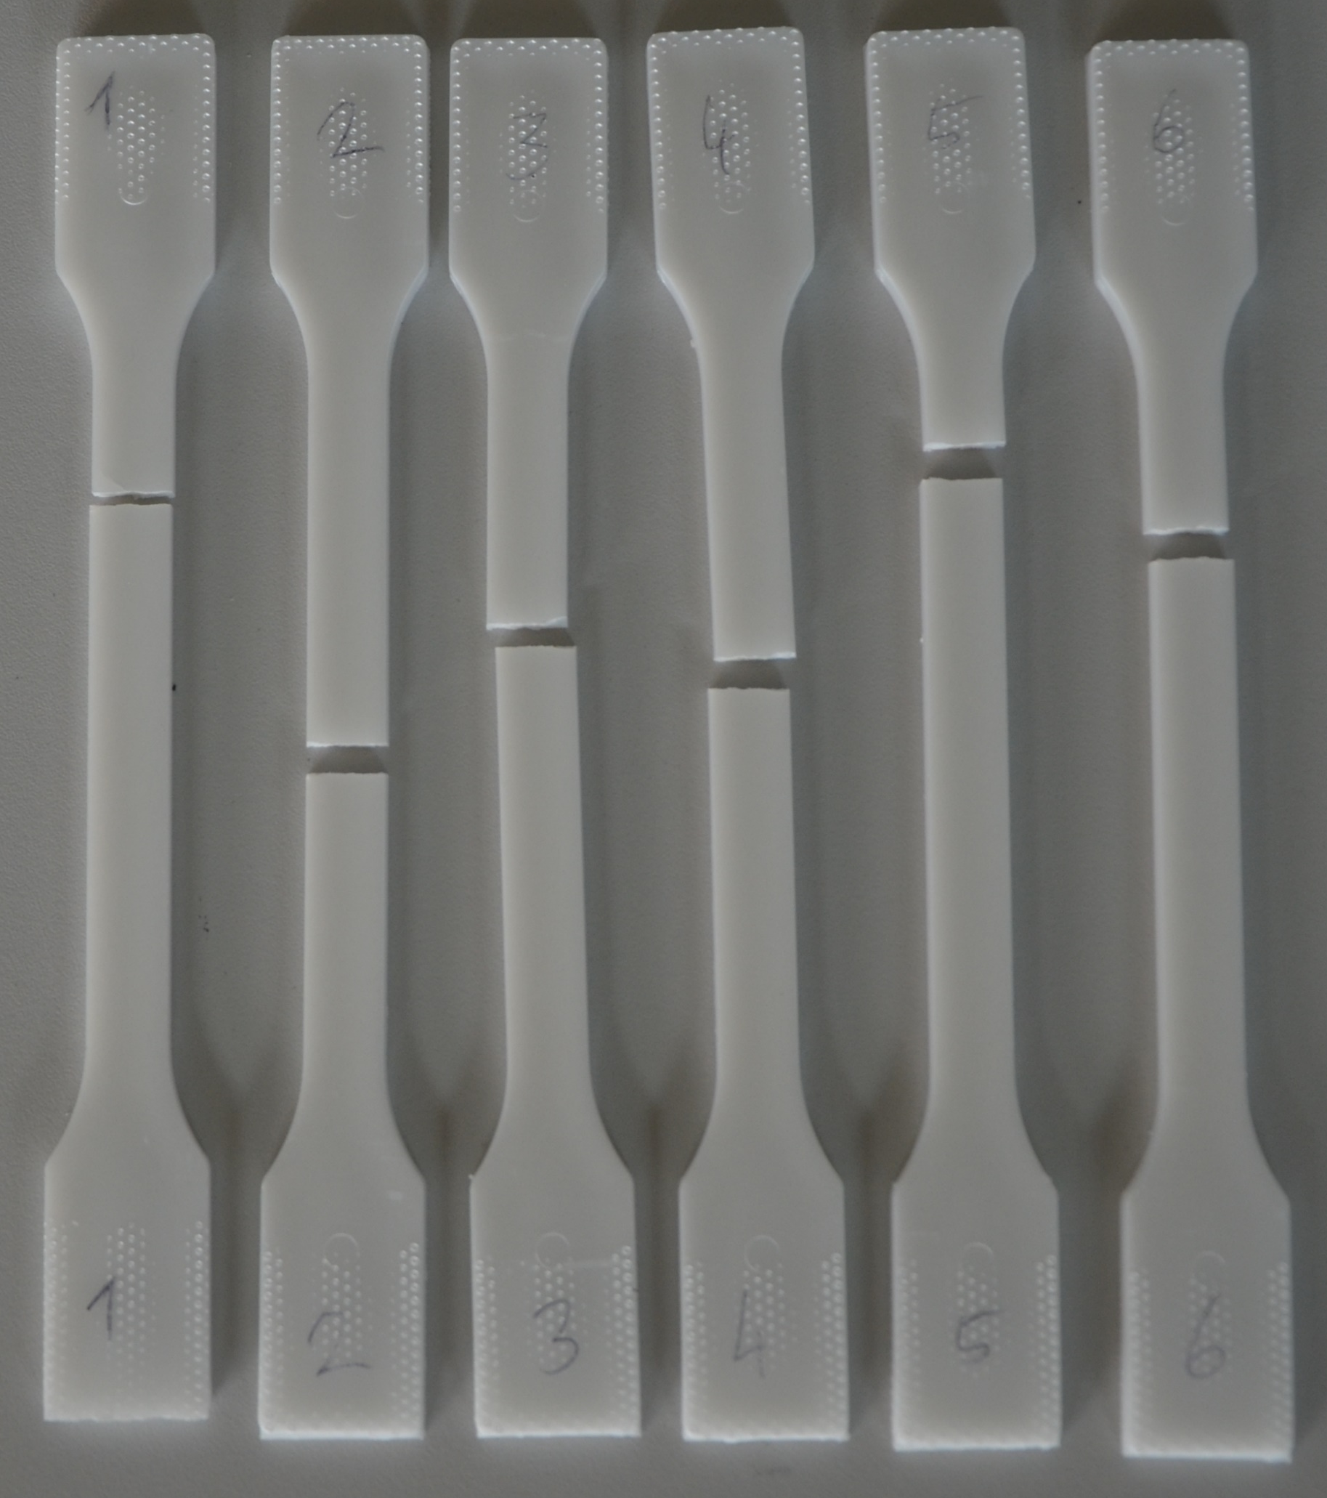
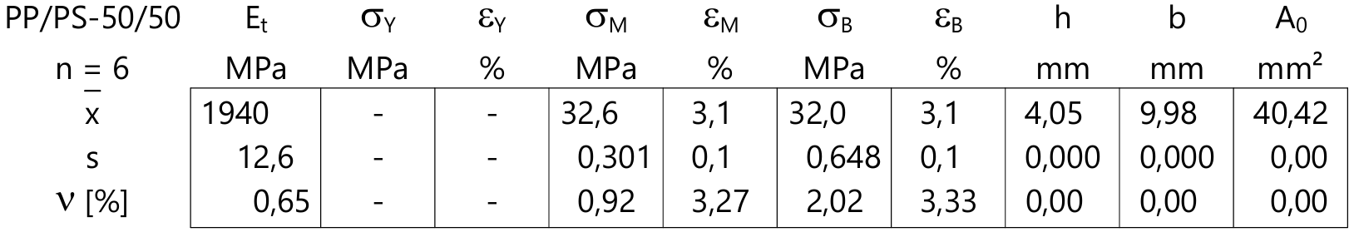
PP/PS_50/50

Slide 5
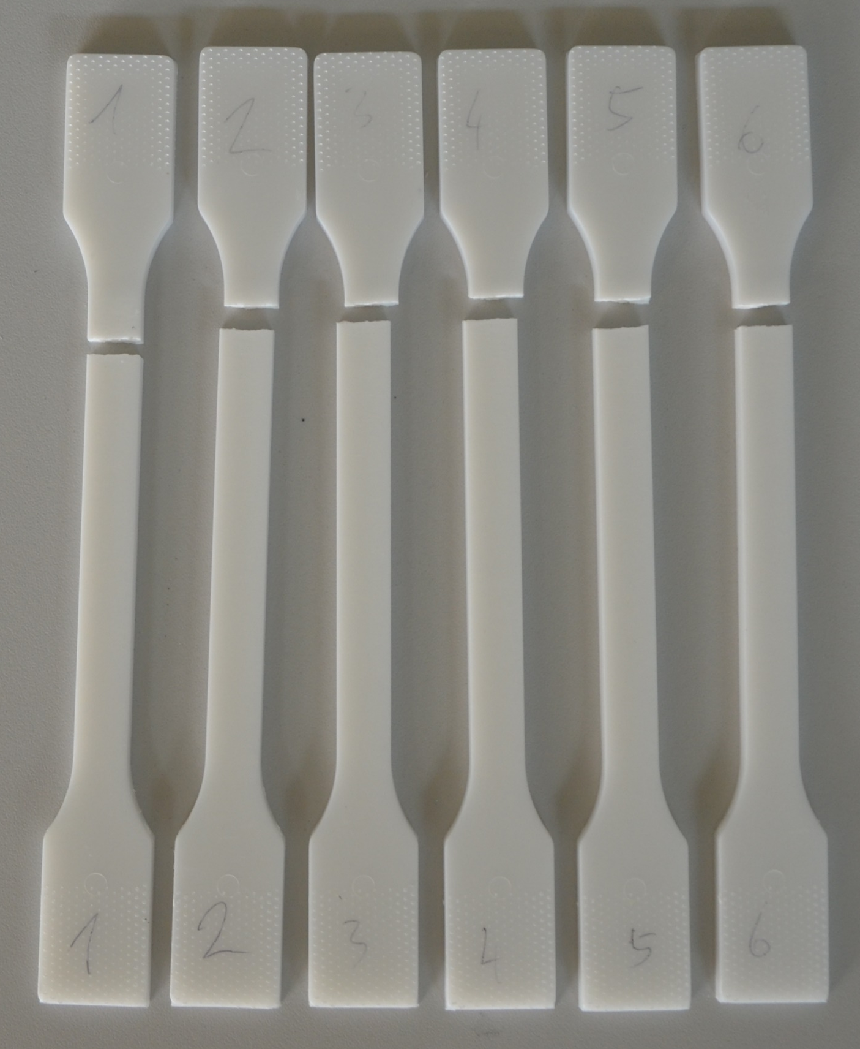
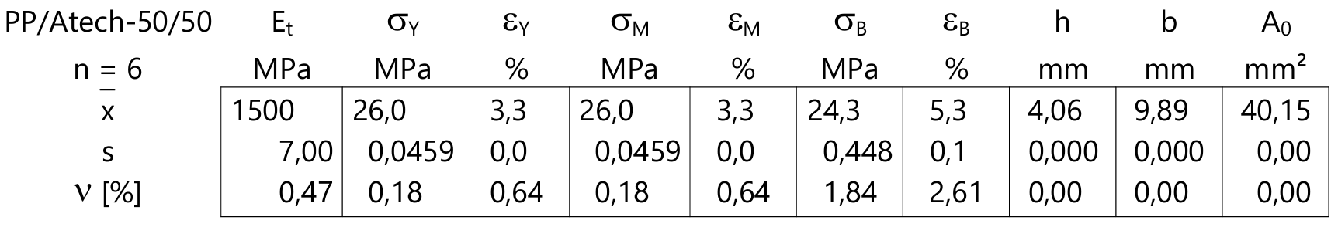
PP/Atech_50/50

