Slide 1
Jan-Mar
2020
April-Jun
2020
July-Sept
2020
Oct-Dec
2020
Jan-Mar
2021
Longitudinal Datasets
JM 2020 – JM 21 Cohort
JM 2019 – JM 20 Cohort
AJ 2020 – AJ 21 Cohort
AJ 2019 – AJ 20 Cohort
JS 2020 – JS 21 Cohort
JS 2019 – JS 20 Cohort
OD 2020 – OD 21 Cohort
OD 2019 – OD 20 Cohort
OD 2020 – OD 21 Cohort
Quarterly Cross-Sectional Datasets

Slide 2
Universal Credit conditionality regime
Benefit categories
Legacy benefits
Replaced by Universal Credit
Searching for work
Unemployed
Jobseekers Allowance (JSA)
No work requirements
Employment and Support Allowance (ESA)
Sick/Inactive
Incapacity Benefit
Planning for work
Sick/Ill/Disabled
Income Support (IS)
(for illness/disability)
Severe Disablement Allowance
Preparing for work
Income Support (IS)
(for carers/lone parents)
Lone parents / carers
Carers Allowance
Housing Benefit (not included)
Working (with requirements)
Child Tax Credit
In-work
Working (no requirements)
Working Tax Credit

Slide 3
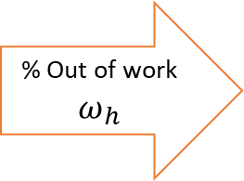


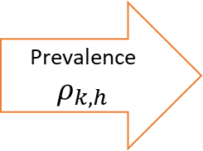











Total population in local authority
$$N_{k}$$
Number with health condition
$$N_{k,h}$$
Number with health condition out of work
$$N_{k,h,oow}$$
% Unemployment $θ_{h}^{(U)}$
$$N_{k,h,oow}^{(U)}$$
Prevalence $ρ_{k,h}$
% Out of work $ω_{h}$
% Sick / ill / disabled $θ_{h}^{(S)}$
$$N_{k,h,oow}^{(S)}$$
% Lone parent / carer ${ θ}_{h}^{(I)}$
$$N_{k,h,oow}^{(I)}$$
% Other benefits ${ θ}_{h}^{(O)}$
$$N_{k,h,oow}^{(O)}$$
% No benefits ${ θ}_{h}^{(N)}$
$$N_{k,h,oow}^{(N)}$$
Source:
ONS population counts
OHID
Fingertips
Health Survey for England (HSE)
Family Resources Survey (FRS)

Slide 4


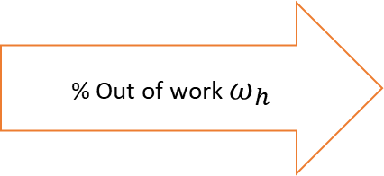
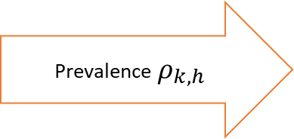

Total population in local authority
$$N_{k}$$
Number with health condition
$$N_{k,h}$$
Number with health condition out of work
$$N_{k,h,oow}$$
Prevalence $ρ_{k,h}$
% Out of work $ω_{h}$
Source:
ONS population counts
OHID
Fingertips
Health Survey for England (HSE)

Slide 5
Population ${(N}_{k}$)
Population with health condition ${(N}_{k,h}$)
Population with health condition OOW ${(N}_{k,h,oow}$)
Prob(E -> U)
At t=0, everyone begins
as non-employed
Employed (E)
Non-Employed (U)
Prob(E -> E)
Prob(U -> U)
- QALYs (Q)
- Income (Y)
- Tax (T)
- Benefits (B)
- QALYs (Q)
- Income (Y)
- Tax (T)
- Benefits (B)
Prob(U -> E)

Slide 6
Modelling probability of job start (health condition)
Population
Number of non-employed with health condition who start work
Number with health condition out of work
% JSA
Unemployed (JSA)
Prob(Job Start)
Local authority total population
Number with health condition
Prev
%NEET
Sick/Inactive (ESA, IS)
Prob(Job Start)
% ESA/IS
% No ben
No/Other benefits
Prob(Job Start)
Data:
Population size by local authority (ONS)
Parameters:
%NEET, Proportion of individuals with health condition who are out of work (Health Survey for England / Family Resources Survey)
Prev, prevalence of individuals with health condition by local authority (OHID Fingertips)
% JSA, % ESA/IS, % No ben Of those out of work, proportion who are i) on JSA, ii) on other out of work benefits e.g. ESA/IS, or iii) not receiving benefits. (Family Resources Survey)
Prob(Job Start) For each benefit recipient grouping, a probability of starting a job (Labour Force Survey)
Outcomes:
Number of people who start a job

Slide 7
Modelling job sustainment for those who find work
Number of non-employed with health condition who start work
Number in work at 13 weeks
% sustain work for 13 weeks
% sustain work for 26 weeks
Number in work at 26 weeks
% sustain work for 39 weeks
Number in work at 39 weeks
% sustain work for 52 weeks
Number in work at 52 weeks
Data:
Weekly earnings (Labour Force Survey)
Hours worked per week (Labour Force Survey)
Assumptions:
Assume hours per person per week and weekly earnings both remain constant over time for those who remain employed.
To calculate accurate total earnings, need to know the number of people still in work at more granular (1-week) time steps. Assume the attrition out of employment over 13 weeks is linear (divide 13-week sustainment equally over each individual week).
Parameters:
% sustain work for X weeks, proportion of individuals who start a job who are still employed after X weeks (Labour Force Survey)
Outcomes:
Total earnings (annualised)

Slide 8
Description of Universal Credit conditionality regimes (from DWP Stat Xplore)
Conditionality Regime | Description
Searching for work | Not working, or with very low earnings. Claimant is required to take action to secure work - or more / better paid work. The Work Coach supports them to plan their work search and preparation activity.
Working - with requirements | In work but could earn more, or not working but has a partner with low earnings
No work requirements | Not expected to work at present. Health or caring responsibility prevents claimant from working or preparing for work.
Working - no requirements | Individual or household earnings over the level at which conditionality applies. Required to inform DWP of changes of circumstances, particularly if at risk of decreasing earnings or losing job.
Planning for work | Expected to work in the future. Lone parent / lead carer of child aged 1^{(a)}. Claimant required to attend periodic interviews to plan for their return to work.
Preparing for work | Expected to start preparing for future even with limited capability for work at the present time or a child aged 2^{(b)}, the claimant is expected to take reasonable steps to prepare for work including Work Focused Interview.

