Slide 1
Traffic road signs detection
Theoretical foundations

Slide 2
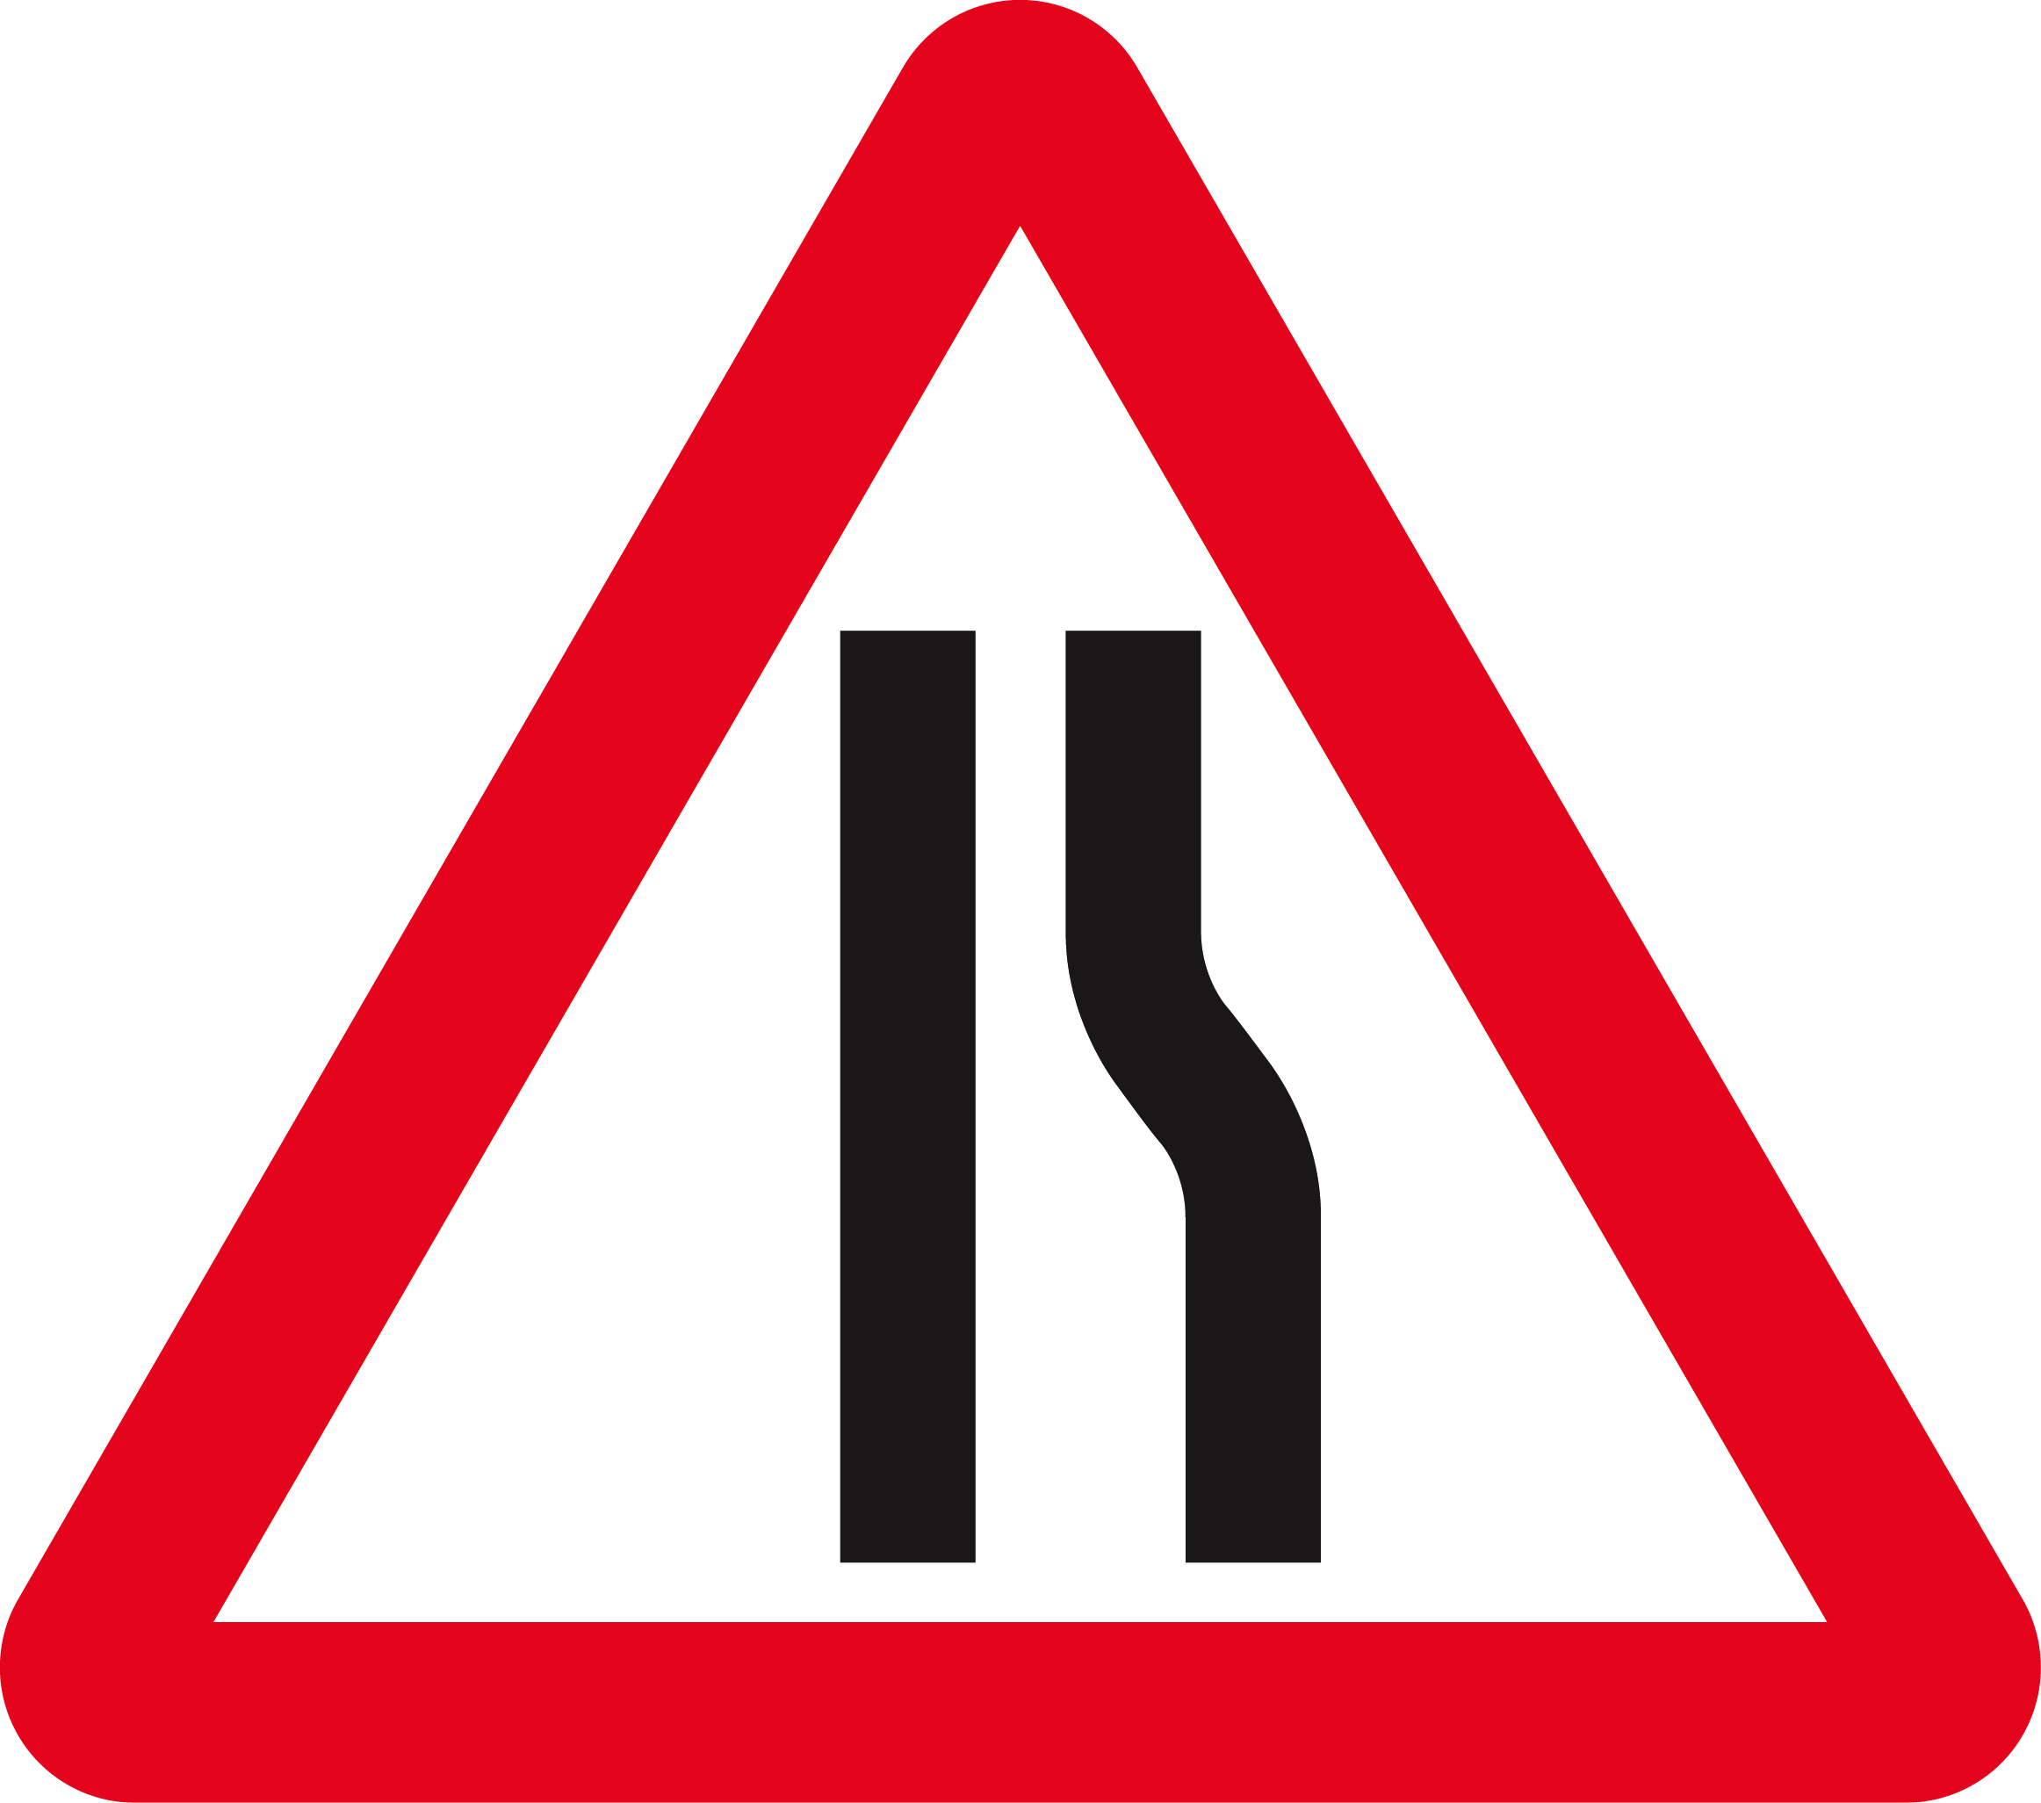
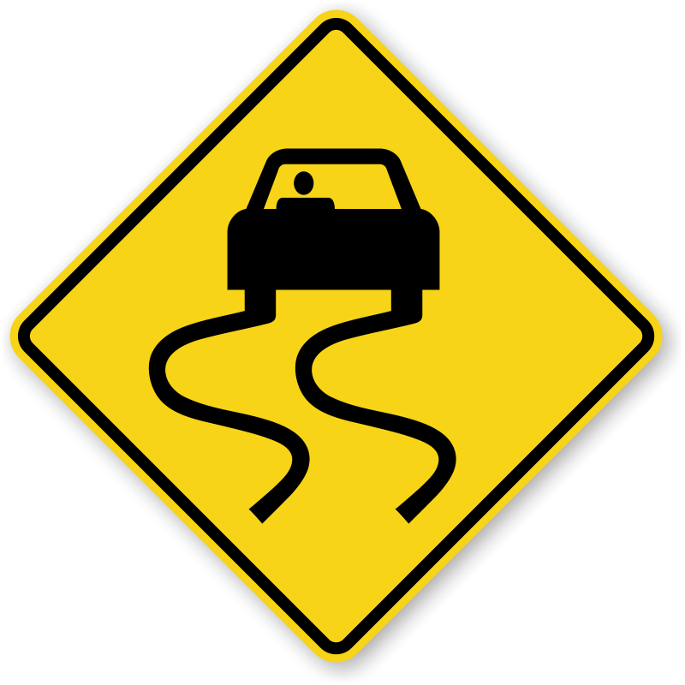
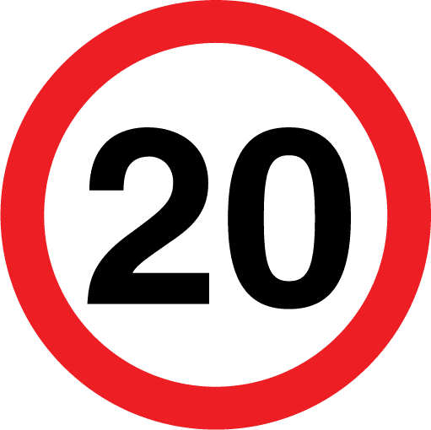
Problem
Detect road signs in color images
Road sign shapes: circular, triangular, rectangular
Evidently road signs have different colors

Slide 3
Proposed solution
Pre-process the image
Image segmentation based on color
Noise removal
Convex hull
Filter objects by area
Shape detection
At this point we should only remain with the desired road signs

Slide 4
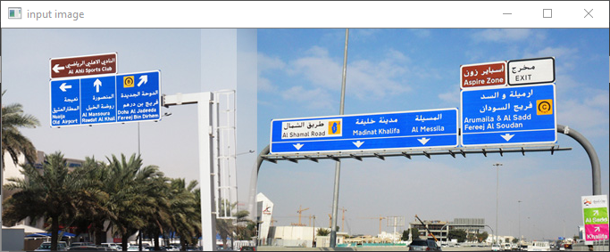
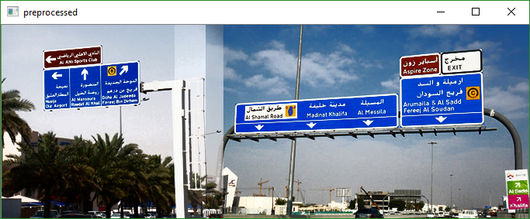
Pre-process the image
Using a bilateral filter to smooth the image but preserve edges.
A bilateral filter uses a weighed average to compute the resulting intensity value, it takes into account the differences between pixel values.
Histogram equalization on YCrCb color space
The Y component (luminance) is equalized -> lighting conditions are improved for subsequent operations

Slide 5
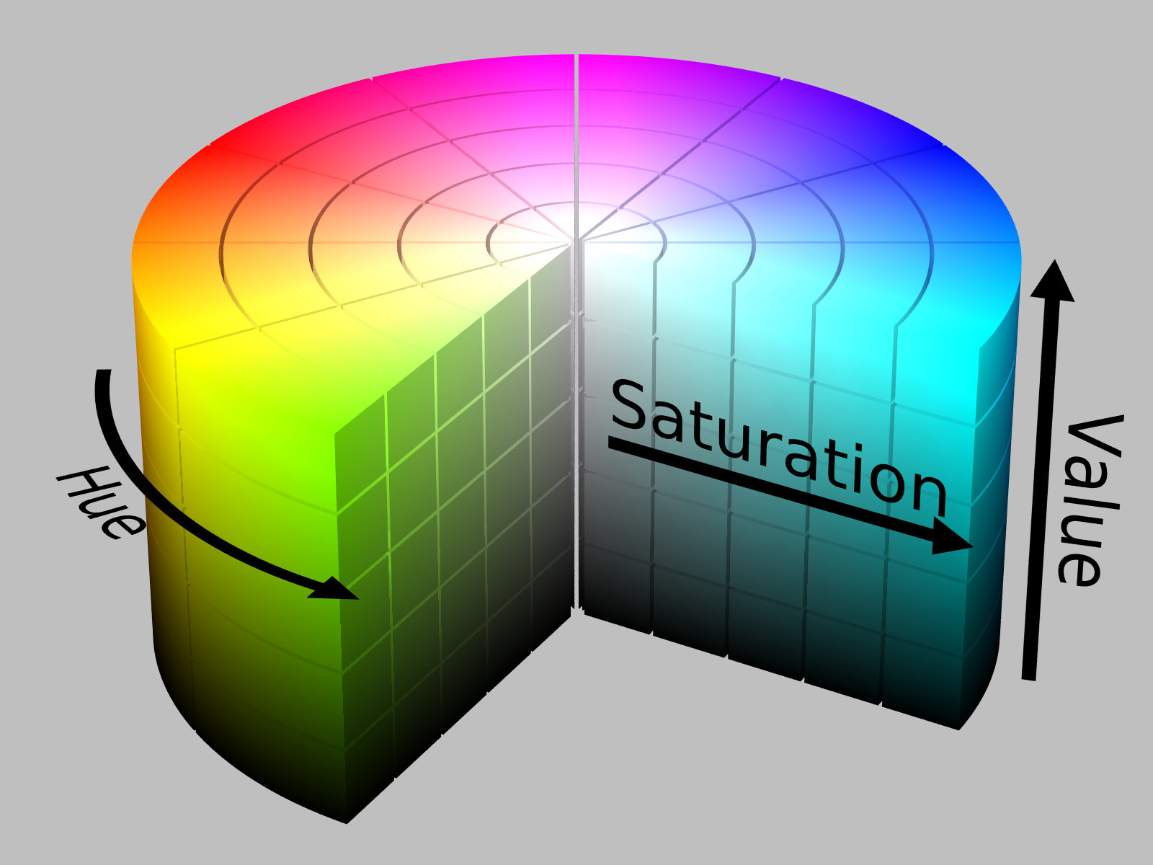
Color detection
Detect color in any lighting condition: HSV

Slide 6

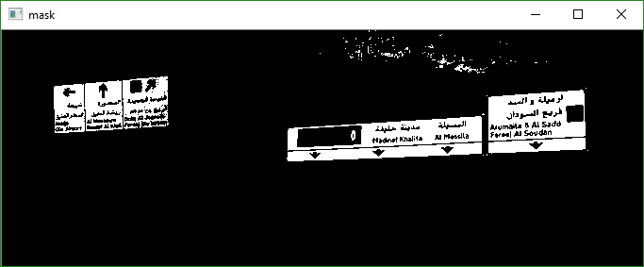
Color detection – HSV
HSV representation is useful for this task:
Hue: similar to perceived color (what we want to detect)
Saturation: colorfulness relative to lightness (we can mostly ignore it if it is high enough)
Value: lightness – varies greatly depending on light
This way color is detected despite lighting conditions.
Here we are trying to detect blue road signs:

Slide 7
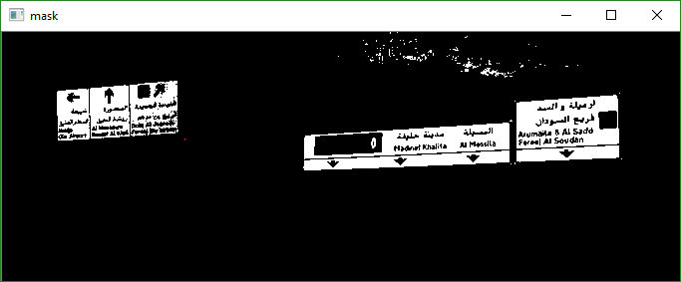
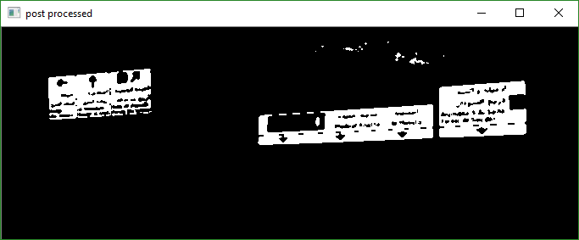
Post processing
You may have observed on the previous picture, that there was some noise, remaining from the sky, we will try to remove it in the next step.
Apply a median filter
Apply the opening morphological operation

Slide 8
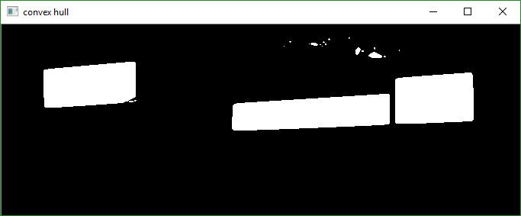
Convex hull
Using the objects we found until now, we would like to prepare for the next step: shape detection.
To calculate the area of a road sign, we need to have an object that is filled (we usually detect the outer part of a road sign, where it is colored)
Solution: calculate the convex hull of the object.
A drawback is that is amplifies noise in the image.

Slide 9

Filter objects by area
Using the area of the object we may filter object which are too small to be considered significant or are too large to be a road sign.
Area is calculated as a percentage of the total image size.
In this example all object smaller than 1% of the total image area are discarded.

Slide 10


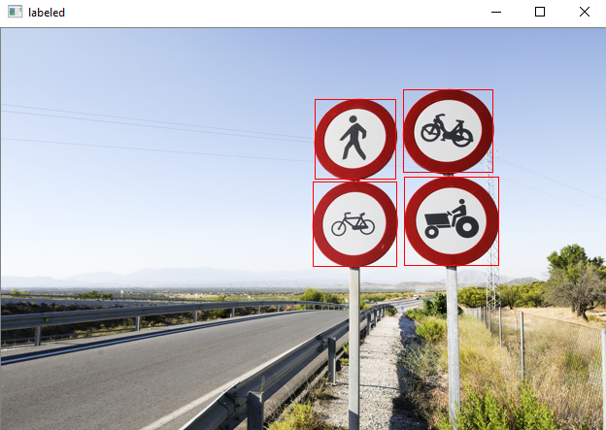
Shape detection
Until now only the color or area of the image interested us
We would like to detect two kinds of road signs:
Circular: detect using thinness ratio
First, we calculate the area and the perimeter of the object enclosed by the bounding-box – having these 2 values we can calculate the thinness ratio
If the thinness ratio is higher than a certain threshold we consider the object to be a circle (preferably above 0.8 – the objects detected are not perfect geometrical shapes, thus we cannot assume that their thinness ratio is exactly one)

Slide 11
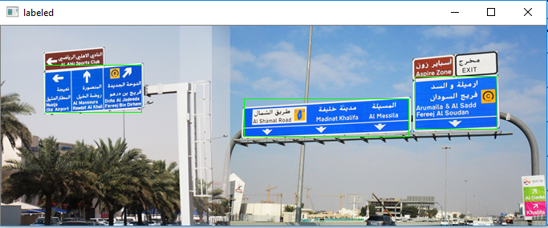
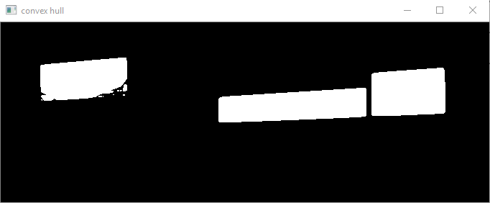
Triangular or Square: detect using number of lines needed to draw the contour.
First, find the contours in the image region enclosed by particular bounding boxes (each box contains a part of the binary image with a single object).
Second, approximate the polygon needed to draw the shape defined by the found contours, resulting in the approximation lines.
If the number of lines needed is smaller than a threshold, we consider it to be an object of this type.

Slide 12
Conclusion
The system is able to detect road signs, although it is sometimes susceptible to noise.

Slide 13
References
Road sign recognition system: https://sites.google.com/site/mcvibot2011sep/Modules/PostProcessing
ROAD AND TRAFFIC SIGN DETECTION AND RECOGNITION: http://www.iasi.cnr.it/ewgt/16conference/ID31.pdf
Bilateral filter: https://www.tutorialspoint.com/opencv/opencv_bilateral_filter.htm
YCrCb: https://en.wikipedia.org/wiki/YCbCr
HSV color space: https://en.wikipedia.org/wiki/HSL_and_HSV
Contours and convex hulls: https://docs.opencv.org/master/d4/d73/tutorial_py_contours_begin.html

