Slide 1
JPA 2.1
JSR-338 Specification

Slide 2
Why JPA ?
Java Persistence API (JPA), was introduced into the platform to bridge the gap between object-oriented domain models and relational database systems
API is part of javax.persistence.* package distributed by different vendors hibernate-jpa-2.1-api.jar

Slide 3
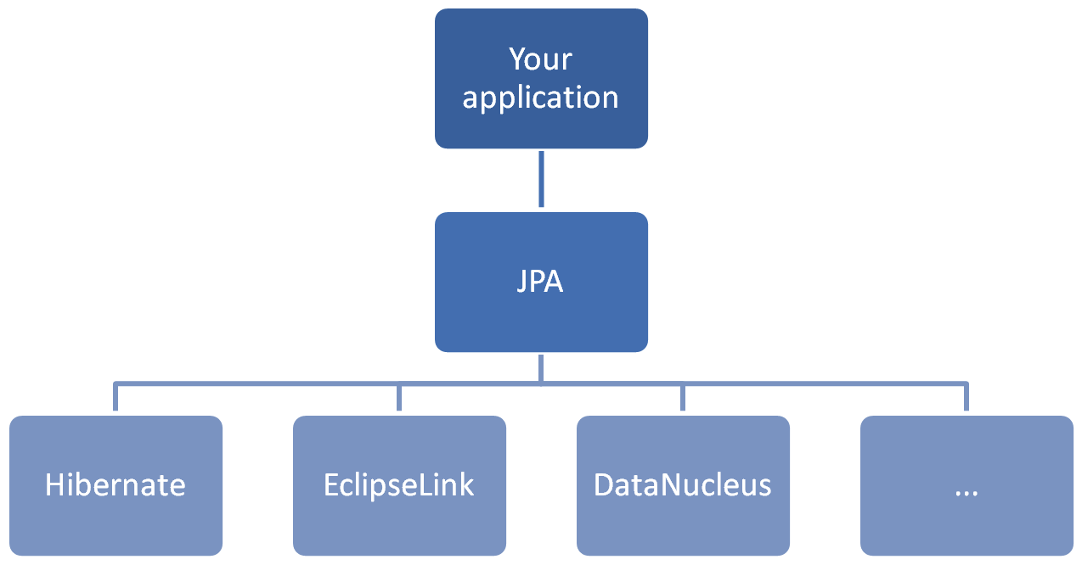

Slide 4
JPA Terminology
Entity: It is nothing but a java representation of the database table that should have characteristics like persist ability, identity, transactional and granularity.
EntityManager: Different API calls performed on entities are managed by the single interface called EntityManager.
PersistenceContext: Set of entities which are managed by the entity manager are called persistence context.
Persistence Provider: provides underlying implementation to the APIs.
EntityManagerFactory and Persistence Unit: PU is DB information from which we can get EntityManagerFactory. There is one-to-one mapping between EMF and PU.

Slide 5
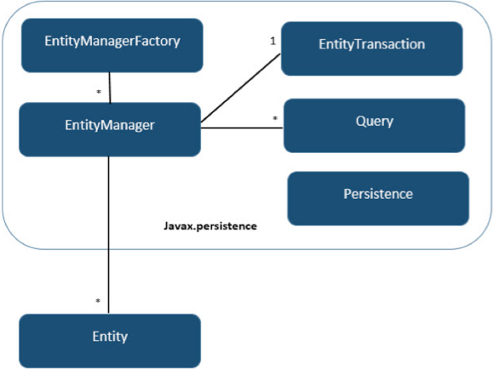

Slide 6
Persistence UNIT and Context
A persistence unit is a named configuration of entity classes.
A persistence context is a managed set of entity instances.
Every persistence context is associated with a persistence unit, restricting the classes of the managed instances to the set defined by the persistence unit.
Saying that an entity instance is managed means that it is contained within a persistence context and it can be acted upon by an entity manager. It is for this reason that we say that an entity manager manages a persistence context.
The entity manager type determines the lifetime of a persistence context

Slide 7
Entity Manager types
Container Managed Entity Managers: Lifecycle of the entity manager managed by the container.
@PersistenceContext(unitName="MysqlPU")
EntityManager entityManager;
Transaction-scoped: This means that the persistence contexts managed by the entity manager are scoped by the active JTA transaction, ending when the transaction is complete.
Extended: persistence context of an extended entity manager will last for the entire length of the conversation of service (ex: Stateful session bean )
Application Managed Entity Manager : application will manages the lifecycle of the entity manager.
final EntityManagerFactory emf = Persistence.createEntityManagerFactory("MysqlPU");
final EntityManager em = emf.createEntityManager();

Slide 8
Transaction Managers
There are two types of transaction managers supported by the JPA
Resource Local : native transactions of the JDBC drivers that are referenced by a persistence unit.
JTA: transactions of the Java EE server, supporting multiple participating resources, transaction lifecycle management, and distributed XA transactions.
Container-managed entity managers always use JTA transactions, while application-managed entity managers can use either type. Because JTA is typically not available in Java SE applications, the provider needs to support only resource-local transactions in that environment. The default and preferred transaction type for Java EE applications is JTA. As we will describe in the next section, propagating persistence contexts with JTA transactions is a major benefit to enterprise persistence applications.

Slide 9
Resource Local Transaction IN JEE container
@PersistenceUnit(unitName="logging")
EntityManagerFactory emf;
public void logAccess(int userId, String action) {
EntityManager em = emf.createEntityManager();
…….
}

Slide 10
JPQL (Java Persistence query Language)
It is similar to SQL queries but it refers Entity names instead of table names.
@Entity(name="Employee")
@Table(name = "employee_tbl")
public class EmployeeEntity { }
JPQL: SELECT e FROM Employee e;

Slide 11
QUERY PARAMETERS NOTATION
POSITIONAL PARAMETERS
final Query positionalParamQuery = em.createQuery("SELECT e FROM Employee e WHERE e.id>?1", EmployeeEntity.class);
positionalParamQuery.setParameter(1, 1600l);
NAMED PARAMETERS
final Query namedParameterQuery = em.createQuery("SELECT e FROM Employee e WHERE e.id>=:id", EmployeeEntity.class);
namedParameterQuery.setParameter("id", 1700l);

Slide 12
Named Queries (Recommended)
Persistence providers will often take steps to precompile JP QL named queries to SQL as part of the deployment or initialization phase of an application
@Entity(name = "Employee")
@Table(name = "employee_tbl")
@NamedQuery(name = "employeeById", query = "SELECT e FROM Employee e WHERE e.id=:id")
public class EmployeeEntity {}
final Query namedQuery = em.createNamedQuery("employeeById");
namedQuery.setParameter("id", 1801l);

Slide 13
Query Hints
Query hints are the JPA extension point for query features. A hint is simply a string name and object value. Hints allow features to be added to JPA without introducing a new API.
namedQuery.setHint("javax.persistence.query.timeout", 1);

