Slide 1
JPA 2.1
JSR-338 Specification

Slide 2
Why JPA ?
Java Persistence API (JPA), was introduced into the platform to bridge the gap between object-oriented domain models and relational database systems
API is part of javax.persistence.* package distributed by different vendors hibernate-jpa-2.1-api.jar

Slide 3
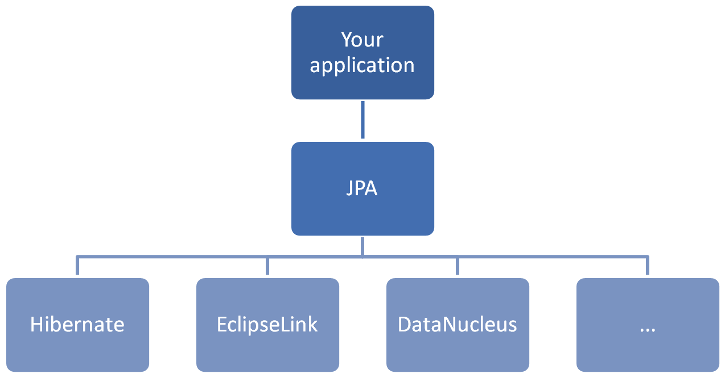

Slide 4
JPA Terminology
Entity: It is nothing but a java representation of the database table that should have characteristics like persist ability, identity, transactional and granularity.
Persistence Unit: Configuration of Entities and DB access information. (persistence.xml file)
EntityManagerFactory: Factory of Entity Managers which we can create by passing Persistence Unit.
EntityManager: Different API calls performed on entities are managed by the single interface called EntityManager.
PersistenceContext: Set of entities which are managed by the entity manager are called persistence context.
Persistence Provider: Provides underlying implementation to the APIs. (hibernate, eclipse link etc..)

Slide 5
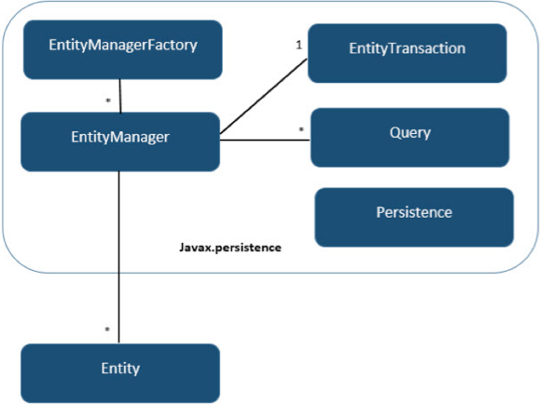

Slide 6
Persistence UNIT and Context
A persistence unit is a named configuration of entity classes.
A persistence context is a managed set of entity instances.
Every persistence context is associated with a persistence unit, restricting the classes of the managed instances to the set defined by the persistence unit.
Saying that an entity instance is managed means that it is contained within a persistence context and it can be acted upon by an entity manager. It is for this reason that we say that an entity manager manages a persistence context.
The entity manager type determines the lifetime of a persistence context

Slide 7
Entity Manager types
Container Managed Entity Managers: Lifecycle of the entity manager managed by the container.
@PersistenceContext(unitName="MysqlPU")
EntityManager entityManager;
Transaction-scoped: This means that the persistence contexts managed by the entity manager are scoped by the active JTA transaction, ending when the transaction is complete.
Extended: persistence context of an extended entity manager will last for the entire length of the conversation of service (ex: stateful session bean)
Application Managed Entity Manager : application will manages the lifecycle of the entity manager.
final EntityManagerFactory emf = Persistence.createEntityManagerFactory("MysqlPU");
final EntityManager em = emf.createEntityManager();

Slide 8
Transaction Managers
There are two types of transaction managers supported by the JPA
Resource Local : native transactions of the JDBC drivers that are referenced by a persistence unit.
JTA: transactions of the Java EE server, supporting multiple participating resources, transaction lifecycle management, and distributed XA transactions.
Container-managed entity managers always use JTA transactions, while application-managed entity managers can use either type.
Because JTA is typically not available in Java SE applications, the provider needs to support only resource-local transactions in that environment.
The default and preferred transaction type for Java EE applications is JTA. propagating persistence contexts with JTA transactions is a major benefit to enterprise persistence applications.

Slide 9
Resource Local Transaction IN JEE container
@PersistenceUnit(unitName="logging")
EntityManagerFactory emf;
public void logAccess(int userId, String action) {
EntityManager em = emf.createEntityManager();
…….
}

Slide 10
JPQL (Java Persistence query Language)
It is similar to SQL queries but it refers Entity names instead of table names.
@Entity(name="Employee")
@Table(name = "employee_tbl")
public class EmployeeEntity { }
JPQL: SELECT e FROM Employee e;

Slide 11
QUERY PARAMETERS NOTATION
POSITIONAL PARAMETERS
final Query positionalParamQuery = em.createQuery("SELECT e FROM Employee e WHERE e.id>?1", EmployeeEntity.class);
positionalParamQuery.setParameter(1, 1600l);
NAMED PARAMETERS
final Query namedParameterQuery = em.createQuery("SELECT e FROM Employee e WHERE e.id>=:id", EmployeeEntity.class);
namedParameterQuery.setParameter("id", 1700l);

Slide 12
Named Queries (Recommended)
Persistence providers will often take steps to precompile JPQL named queries to SQL as part of the deployment or initialization phase of an application
@Entity(name = "Employee")
@Table(name = "employee_tbl")
@NamedQuery(name = "employeeById", query = "SELECT e FROM Employee e WHERE e.id=:id")
public class EmployeeEntity {}
final Query namedQuery = em.createNamedQuery("employeeById");
namedQuery.setParameter("id", 1801l);

Slide 13
Query Hints AND ADVANCED QUERY
Query hints are the JPA extension point for query features. A hint is simply a string name and object value. Hints allow features to be added to JPA without introducing a new API.
namedQuery.setHint("javax.persistence.query.timeout", 1);
query.setHint("org.hibernate.cacheable", Boolean.TRUE);
Advanced Query:
SELECT NEW com.innominds.dto.Employee(e.id,e.name,e.salary,e.joinDate) FROM Employee e

Slide 14
INHERITANCE AND POLYMORPHISM
SELECT p FROM Project p WHERE p.employees IS NOT EMPTY
SELECT p FROM Project p WHERE TYPE(p) = DesignProject OR TYPE(p) = QualityProject
INNER JOIN QUERY EXAMPLE
SELECT pFROM Employee e JOIN e.phones p

Slide 15
SUB QUERIES
SELECT e FROM Employee e WHERE e.salary = (SELECT MAX(emp.salary) FROM Employee emp)

Slide 16
COLLECTION EXPRESSION
SELECT e FROM Employee e WHERE e.directs IS NOT EMPTY
SELECT m FROM Employee m WHERE
(SELECT COUNT(e) FROM Employee e WHERE e.manager = m) > 0

Slide 17
MEMBER OF
The MEMBER OF operator and its negated form NOT MEMBER OF are a shorthand way of checking whether an entity is a member of a collection association path.
SELECT e FROM Employee e WHERE e MEMBER OF e.directs

Slide 18
Enabling SECOND LEVEL CACHE IN 4.0 (3.3.x) or higher
Hibernate has its own EHCache implementation from version 4 onwards.
Add below properties to configuration
<property name="hibernate.cache.region.factory_class" value="org.hibernate.cache.ehcache.EhCacheRegionFactory"/>
<property name="hibernate.cache.use_second_level_cache" value="true" />
<property name="hibernate.cache.use_query_cache" value="true" />
<property name="hibernate.generate_statistics" value="true" />

Slide 19
Second LEVEL CACHE MODES
Second level cache can be controller using property "javax.persistence.sharedCache.mode".
Following values are allowed
ALL: All entity data is stored in the 2nd level cache
NONE: No data is cached
ENABLE_SELECTIVE: Entities marked with @Cachable are cached
DISABLE_SELECTIVE: All entities except @Cachable(false) are cached
UNSPECIFIED: Caching behavior is not specified, Persistence provider’s default caching behavior is used.
final Properties additionalConfig = new Properties();
additionalConfig.put("javax.persistence.sharedCache.mode", "DISABLE_SELECTIVE");

Slide 20
Cache Retrieval and Store Modes
When the second level cache is enabled for a persistence unit, we’re now able fine-tune the caching behavior by setting retrieval-mode and store-mode-properties at persistence context level or for each entity-manager operation or query level by setting below properties.
Retrieve Mode can be set using below property
javax.persistence.cache.retrieveMode
Store Mode can be set using below property
javax.persistence.cache.storeMode

Slide 21
Retrieve MODES
Following options are available for Retrieve mode
BYPASS: The cache is bypassed and a call to the database is used to retrieve the data.
USE: If the data is available in the cache, it is read from this location, else it is fetched from the database.
EX: config.put("javax.persistence.cache.retrieveMode", CacheRetrieveMode.USE);

Slide 22
CACHE STORE MODES
Following options are available for store mode
BYPASS: Don’t put anything into the cache
REFRESH: Data is put/updated in the cache when read and committed into the database a refresh enforced
USE: Data is put/updated in the cache when read and committed into the database

