Slide 1
Spring Basics annotation based application development
https://github.com
/Innominds-jee
/spring-java-training.git

Slide 2
Index
Introduction
Spring Containers
Spring Bean Lifecycle
Spring Annotations
Spring Bean Scopes
Profiles & Conditional Beans
Spring AOP
Spring Expression Language (SpEL)

Slide 3
IoC Introduction (from spring docs)
IoC is also known as dependency injection (DI).
It is a process whereby objects define their dependencies, that is, the other objects they work with, only through constructor arguments, arguments to a factory method, or properties that are set on the object instance after it is constructed or returned from a factory method.
The container then injects those dependencies when it creates the bean.
This process is fundamentally the inverse, hence the name Inversion of Control (IoC)

Slide 4
Types of Containers
Spring follows Ioc Priciple and implements its container.
There are two types of containers
BeanFactory Container: This is the simplest container providing basic support for DI. It creates beans on demands
ApplicationContext Container: This container adds more enterprise-specific functionality such as the ability to resolve textual messages from a properties file and the ability to publish application events to interested event listeners.
It creates beans upon starting the application.

Slide 5
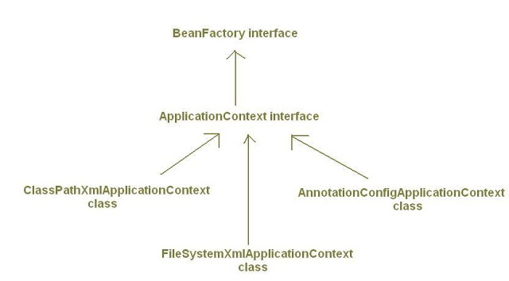
Spring container hierarchy

Slide 6
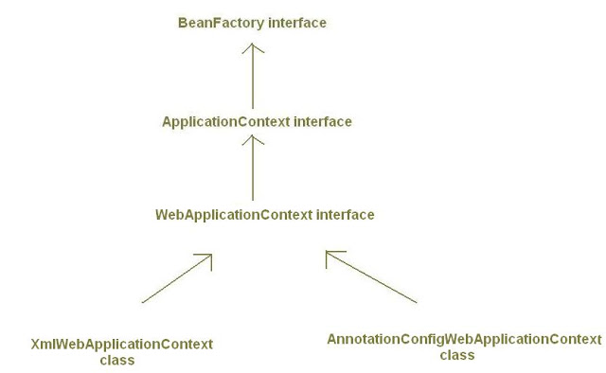
Spring web application containers hierarchy

Slide 7
Spring Bean Lifecycle
Unlike normal java beans spring has various life cycle phases in which we can enhance spring bean.
Instantiation: instantiation of the bean
Populates properties: spring inject the properties and other object references.
Interface BeanNameAware : setBeanName method
Interface BeanFactoryAware :setBeanFactory method
Interface ApplicationContextAware: setApplicationContext method
Pre-initialization of BeanPostProcessor
Interface InitializingBean : afterPropertiesSet
Custom init method: incase any custom init methods
Post initialization of BeanPostProcessor
<<<<<<< BEAN IS READ TO USE >>>>>>>
Interface DisposableBean : destroy method
Custom Destroy methods

Slide 8
Java based configuration
Java based spring container can be created using below class
final AnnotationConfigApplicationContext aCtx
= new AnnotationConfigApplicationContext();
aCtx.register(CoreConfiguration.class); //pass the configuration
aCtx.refresh();// it will creates the registered beans

Slide 9
Spring Annotation
@Configuration: Configuration file
@Bean: to declare a bean in Java configuration
@Import : import another Java Configuration
@ImportResource : import XML configuration
@ComponentScan: scans the beans starting with given base package
@Scope: to define Scope of a bean
@Conditional: this works with Condition interface
@EnableAspectJAutoProxy: enabling auto proxy, @Aspect
@Primary: works with @Component
@Qualifier: works with @Autowired and @Inject
@Value: annotation spring express Language
@ActiveProfiles: choose profiles in Test cases
@ContextConfiguration: To load with configuration test cases
@Runwith: Runwith(SpringJUnit4ClassRunner)

Slide 10
Basic Java based Annotations in Spring
@Configuration: Indicates that a class declares one or more @Bean methods and may be processed by the Spring container to generate bean definitions and service requests for those beans at runtime
@Bean: Creates Spring bean from java object
@Import: Used to import configuration file
@ImportResource: Used to import XML Based Configuration file
ComponentScan: scans the spring beans on the given base package. It looks for @Service, @Component, @Controller, @Repository .

Slide 11
Spring Bean Scope Managing
Singleton: Single bean per IOC container (default)
Prototype: creates new bean each time
WEB APPLICATION SCOPES
Request: each request new bean created
Session: for each user session new bean created
Global Session: Typically only valid when used in a portlet context.
NOTE: you can also create your own scope if these are not fit to your requirement
There are two types of scope available in spring core container
@Scope(ConfigurableBeanFactory.SCOPE_SINGLETON)
@Scope(ConfigurableBeanFactory.SCOPE_PROTOTYPE)

Slide 12
Enabling profile
Spring Profiles were introduced in spring 3.1.
It allows us to define beans by deployment regions such as “dev” , “qa”, “prod” etc.
Spring profiles are enabled using the case insensitive tokens spring.profiles.active or spring_profiles_active.
Profile can be activated with below mentioned ways
an Environment Variable
a JVM Property
Web Parameter
Programmatic
@Profile Annotation used to create bean for specific environment

Slide 13
Conditional Beans
Conditional Beans were introduced in spring 4.0
It works together with @Conditional annotation and Condition interface
It allows developer to define strategy to create bean. These are not limited to environment
Spring boot framework extensively uses this feature to create bean based on properties file information
@Bean
@Conditional(StudentCondition.class)
StudentService studentService() {
return new StudentService();
}

Slide 14
Aspect Oriented Programming
Cross-cutting Concerns impact the application in many points. Ex: Logging, Security, Caching and Transaction Management are called cross-cutting concerns.
Using AOP we can define common functionality in one place and we can declaratively define how and where this functionality can be applied.
Cross cutting concerns are modularized into special classes are called aspects.

Slide 15
AOP Terminology
Aspect: modularization of cross-cutting concern
ex: security Aspect will check whether calling person has privileges to access checkBalance() method
Advice: Job of an Aspect called advice.
Joinpoints: In an application there are many places where we can apply aspect. These points are called join points.
Pointcuts: point cuts are the join points where we can woven advice.
Introductions: inject new methods and attributes into existing classes are called introductions.
Weaving: process of applying aspects to target classes to create new proxies.

Slide 16
Types of Weaving
Compile time Weaving: Aspects are woven when the target class is compiled. It requires special kind of compiler. (works only on AspectJ programming model).
Classloading time: Aspects are weaving when the class loaded by the class loader. This kind of weaving requires special kind of classLoader. (works only with AspectJ )
Runtime weaving: Aspects are woven during the runtime of the program execution. AOP container dynamically generates proxy objects that delegate the requests to target objects. (Spring AOP supports only this)

Slide 17
Types of Advice
@Before
@After
@AfterReturning
@AfterThrowing
@Around

Slide 18
Configuring AOP in spring project
It is just adding below annotations to configuration file
@Aspect
@EnableAspectJAutoProxy(proxyTargetClass = true)
And Writing some pointcuts and advice annotations
@Before("execution(** com.innominds.aop.service.*.*())")
public void beforeMethod() { }
NOTE: Spring doesn’t provide its own annotations instead it depends on AspectJ annotations.

Slide 19
In Spring, aspects are woven into spring-managed beans at runtime by wrapping them with a proxy class.
There are two types of proxy creation possible
JDK Dynamic proxy: If we the services are invokes based on interfaces it creates proxy by implementing that interface.
CGLIB Proxy: it extends the existing target class and calls super class methods.
Proxy class poses as the target bean intercepting advised method calls and forwarding those calls to the target bean.

Slide 20
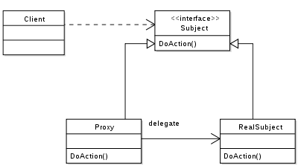
How JDK Proxy works

Slide 21
Spring Expression Language with @Value annotation
A powerful expression language that supports querying and manipulating an object graph at runtime.
syntax to define the expression is of the form #{ <expression string> }.
@Value annotation used to bound the value from the spring expression language.

Slide 22
@Primary and @Qualifier
@Primary: used to select one default implementation when multiple concrete classes available for single interface.
@Qualifier: Used to select one of the implementation at the time of @Autowiring

Slide 23
Spring Testing
@Runwith : Used to select spring test runner with Junit Test cases
@ContextConfiguration: take spring configuration and creates container with test beans
@ActiveProfiles: enables profiles form test cases
@RunWith(SpringJUnit4ClassRunner.class)
@ContextConfiguration(classes = { PaymentConfig.class })
@ActiveProfiles(profiles = { "dev" })
public class PaymentServiceTest {}

