Slide 1
Spring Basics annotation based application development
https://github.com
/Innominds-jee
/spring-java-training.git

Slide 2
Index
Introduction
Spring Containers
Spring Bean Lifecycle
Spring Annotations
Spring Bean Scopes
Profiles & Conditional Beans
Spring AOP
Spring Expression Language (SpEL)

Slide 3
Introduction
Spring started as a lightweight alternative to Java Enterprise Edition (using EJBs).
Spring offered a simpler approach to enterprise Java development, utilizing dependency injection and aspect-oriented programming to achieve the capabilities of EJB with plain old Java objects (POJOs).
Spring 2.5 introduced annotation-based component-scanning, which eliminated a great deal of explicit XML configuration for an application’s own components. And Spring 3.0 introduced a Java-based configuration as a type-safe and refactorable option to XML.

Slide 4
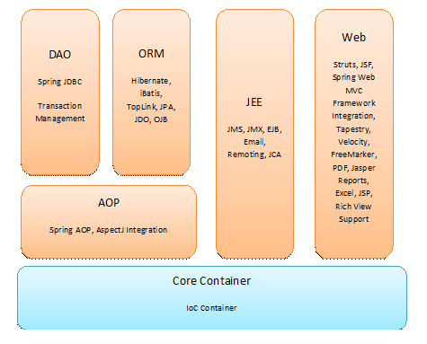

Slide 5
Spring as an integration framework
Spring has support in different areas
Web Layer: we can integrate with HTML,JSP, thymeleaf, velocity, freemarker, tiles etc.
Scripting : groovy, JRuby, BeanShell
Messaging: supports ActiveMQ, RabbitMQ
Security Method level and Http URLs
ORM : hibernate, eclipselink with JPA
NoSQL: supports MongoDB, elastic search
Popular frameworks are also dependent on spring. Ex: Hybris, Mule ESB, Liferay, Magnolia

Slide 6
IoC Introduction (from spring docs)
IoC is also known as dependency injection (DI).
It is a process whereby objects define their dependencies, that is, the other objects they work with, only through constructor arguments, arguments to a factory method, or properties that are set on the object instance after it is constructed or returned from a factory method.
The container then injects those dependencies when it creates the bean.
This process is fundamentally the inverse, hence the name Inversion of Control (IoC)

Slide 7
Types of Containers
There are two types of containers
BeanFactory Container: This is the simplest container providing basic support for DI.
It creates beans on demand.
ApplicationContext Container: This container adds more enterprise-specific functionality such as the ability to resolve textual messages from a properties file and the ability to publish application events to interested event listeners. It creates beans upon starting the application.

Slide 8
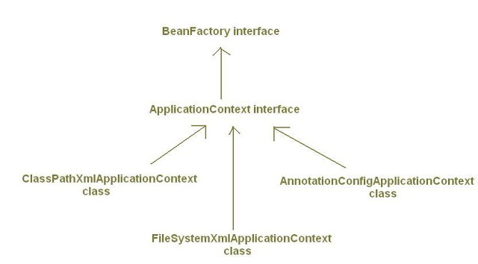
Spring container hierarchy

Slide 9
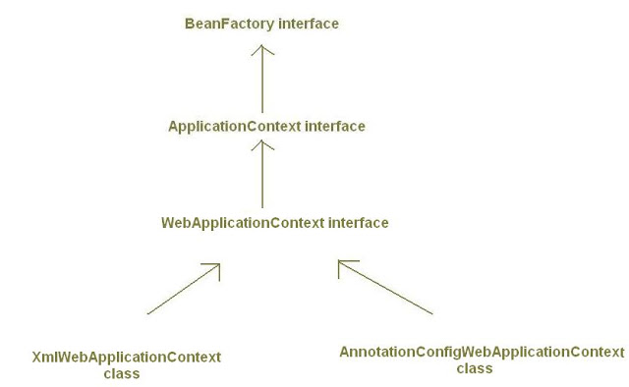
Spring web application containers hierarchy

Slide 10
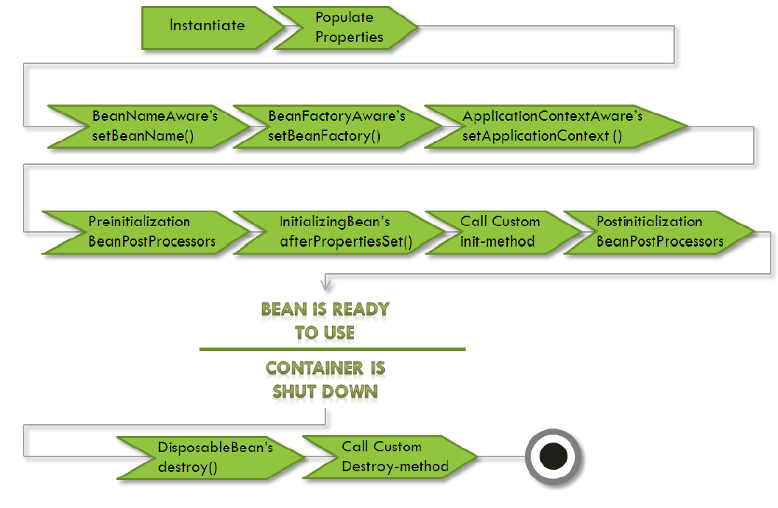
Spring bean lifecycle

Slide 11
Java based configuration
Java based spring container can be created using below code
AnnotationConfigApplicationContext aCtx
= new AnnotationConfigApplicationContext();
aCtx.register(MySpringConfig.class); //pass the configuration
(OR)
aCtx.scan(“com.innomnids.lifecycle”);//pass base package
aCtx.refresh();// it will creates the registered beans

Slide 12
Spring Annotation
@Configuration: Configuration file
@Bean: to declare a bean in Java configuration
@Import : import another Java Configuration
@ImportResource : import XML configuration
@ComponentScan: scans the beans starting with given base package
@Scope: to define Scope of a bean
@Conditional: this works with Condition interface
@EnableAspectJAutoProxy: enabling auto proxy, @Aspect
@Primary: works with @Component
@Qualifier: works with @Autowired and @Inject
@Value: annotation spring express Language
@ActiveProfiles: choose profiles in Test cases
@ContextConfiguration: To load with configuration test cases
@Runwith: Runwith(SpringJUnit4ClassRunner)

Slide 13
Basic Annotations in Spring
@Configuration: Indicates that a class declares one or more @Bean methods and may be processed by the Spring container to generate bean definitions and service requests for those beans at runtime
@Bean: Creates Spring bean from java object
@Import: Used to import configuration file
@ImportResource: Used to import XML Based Configuration file
ComponentScan: scans the spring beans on the given base package. It looks for @Service, @Component, @Controller, @Repository .

Slide 14
Spring Bean Scopes
Singleton: Single bean per IOC container (default)
Prototype: creates new bean each time
WEB APPLICATION SCOPES
Request: each request new bean created
Session: for each user session new bean created
Global Session: Typically only valid when used in a portlet context.
NOTE: you can also create your own scope if these are not fit to your requirement
There are two types of scope available in spring core container
@Scope(ConfigurableBeanFactory.SCOPE_SINGLETON)
@Scope(ConfigurableBeanFactory.SCOPE_PROTOTYPE)

Slide 15
Enabling profile
Spring Profiles were introduced in spring 3.1.
It allows us to define beans by deployment regions such as “dev” , “qa”, “prod” etc.
Spring profiles are enabled using the case insensitive tokens spring.profiles.active or spring_profiles_active.
Profile can be activated with below mentioned ways
an Environment Variable
a JVM Property
Web Parameter
Programmatic
@Profile Annotation used to create bean for specific environment

Slide 16
Conditional Beans
Conditional Beans were introduced in spring 4.0
It works together with @Conditional annotation and Condition interface
It allows developer to define strategy to create bean. These are not limited to environment
Spring boot framework extensively uses this feature to create bean based on properties file information
@Bean
@Conditional(LinuxMailConditon.class)
MailService mailService() {
return new LinuxMailServiceImpl();
}
@Bean
@Conditional(WindowsMailConditon.class)
MailService mailService() {
return new WindowsMailServiceImpl();
}

Slide 17
JDBC Template condition
public class JdbcTemplateCondition implements Condition {
@Override
public boolean matches(ConditionContext context, AnnotatedTypeMetadata metadata) {
try { context.getClassLoader().loadClass("org.springframework.jdbc. core.JdbcTemplate");
return true;
} catch (Exception e) {
return false;
}
}
}

Slide 18
Aspect Oriented Programming
Cross-cutting Concerns impact the application in many points. Ex: Logging, Security, Caching and Transaction Management are called cross-cutting concerns.
Using AOP we can define common functionality in one place and we can declaratively define how and where this functionality can be applied.
Cross cutting concerns are modularized into special classes are called aspects.

Slide 19
AOP Terminology
Aspect: modularization of cross-cutting concern
ex: security Aspect will check whether calling person has privileges to access checkBalance() method
Advice: Job of an Aspect called advice.
Joinpoints: In an application there are many places where we can apply aspect. These points are called join points.
Pointcuts: point cuts are the join points where we can woven advice.
Introductions: inject new methods and attributes into existing classes are called introductions.
Weaving: process of applying aspects to target classes to create new proxies.

Slide 20
Types of Weaving
Compile time Weaving: Aspects are woven when the target class is compiled. It requires special kind of compiler. (works only on AspectJ programming model).
Classloading time: Aspects are weaving when the class loaded by the class loader. This kind of weaving requires special kind of classLoader. (works only with AspectJ )
Runtime weaving: Aspects are woven during the runtime of the program execution. AOP container dynamically generates proxy objects that delegate the requests to target objects. (Spring AOP supports only this)

Slide 21
Types of Advice
@Before
@After
@AfterReturning
@AfterThrowing
@Around

Slide 22
Configuring AOP in spring project
It is just adding below annotations to configuration file
@Aspect
@EnableAspectJAutoProxy(proxyTargetClass = true)
And Writing some pointcuts and advice annotations
@Before("execution(** com.innominds.aop.service.*.*())")
public void beforeMethod() {
//write JOB of aspect
}
NOTE: Spring doesn’t provide its own annotations instead it depends on AspectJ annotations.

Slide 23
In Spring, aspects are woven into spring-managed beans at runtime by wrapping them with a proxy class.
There are two types of proxy creation possible
JDK Dynamic proxy: If the services are invokes based on interfaces it creates proxy by implementing that interface.
CGLIB Proxy: it extends the existing target class and calls super class methods.
Proxy class poses as the target bean intercepting advised method calls and forwarding those calls to the target bean.

Slide 24
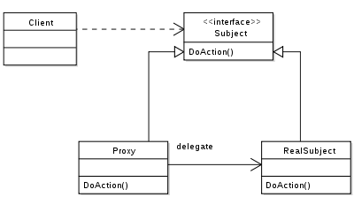
How JDK Proxy works

Slide 25
Spring Expression Language with @Value annotation
A powerful expression language that supports querying and manipulating an object graph at runtime.
syntax to define the expression is of the form #{ <expression string> }.
@Value annotation used to bound the value from the spring expression language.

Slide 26
@Primary and @Qualifier
@Primary: used to select one default implementation when multiple concrete classes available for single interface.
@Qualifier: Used to select one of the implementation at the time of @Autowiring

Slide 27
Spring Testing
@Runwith : Used to select spring test runner with Junit Test cases
@ContextConfiguration: take spring configuration and creates container with test beans
@ActiveProfiles: enables profiles form test cases
@RunWith(SpringJUnit4ClassRunner.class)
@ContextConfiguration(classes = { PaymentConfig.class })
@ActiveProfiles(profiles = { "dev" })
public class PaymentServiceTest {}

