Slide 1
Annotation based Spring web
https://github.com
/Innominds-jee
/spring-web-training.git

Slide 2
Index
Spring MVC
Traditional Java web application
Servlet 3.0 container
Customizing web app with Spring Adapters (available in spring 3.1)
Securing your web pages
Creating simple REST API
Exception handling

Slide 3
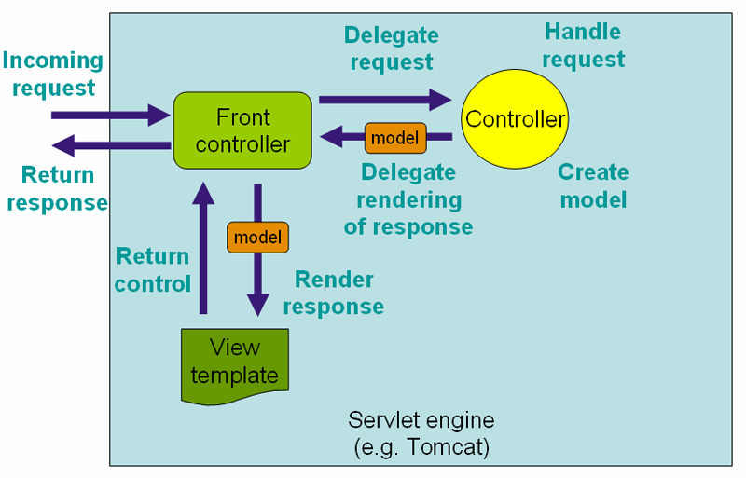
How Spring MVC works

Slide 4
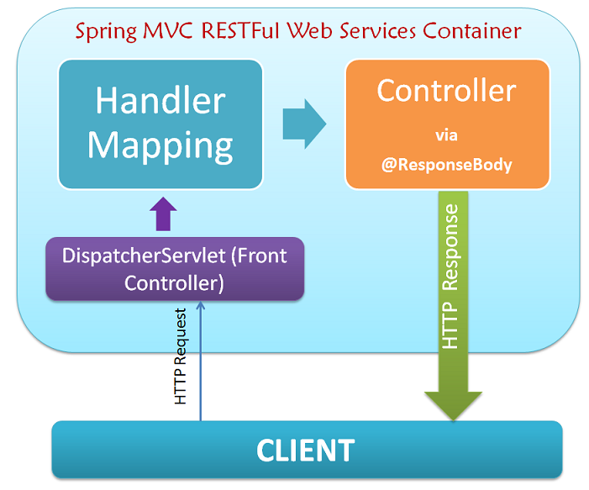

Slide 5
Traditional Web application
-myApp
|-static/ *.css, *.js
|-views/*.jsp,*.html
|-WEB-INF
|-classes/ *.class
|-lib/*.jar
|-web.xml

Slide 6
Configuring Front Controller in web.xml
<web-app id="WebApp_ID" version="2.4”>
<context-param>
<param-name>contextConfigLocation</param-name>
<param-value>/WEB-INF/applicationContext.xml</param-value>
</context-param>
<listener>
<listener-class>org.springframework.web.context.ContextLoaderListener</listener-class>
</listener>
<servlet>
<servlet-name>dispatcher</servlet-name>
<servlet-class>
org.springframework.web.servlet.DispatcherServlet
</servlet-class>
<load-on-startup>1</load-on-startup>
</servlet>
<servlet-mapping>
<servlet-name>dispatcher</servlet-name>
<url-pattern>/*</url-pattern>
</servlet-mapping>
</web-app>

Slide 7
How Servlet 3.0 container works (tomcat 7 +)
In a Servlet 3.0 environment, the container looks for any classes in the class path that implement the javax.servlet.ServletContainerInitializer interface; if any are found, they’re used to configure the servlet container.
Spring supplies an implementation of that interface called SpringServletContainerInitializer that, in turn, seeks out any classes that implement org.springframework.web.WebApplicationInitializer and delegates to them for configuration.
Spring 3.2 introduced a convenient base implementation of WebApplicationInitializer called AbstractAnnotationConfigDispatcherServletInitializer

Slide 8
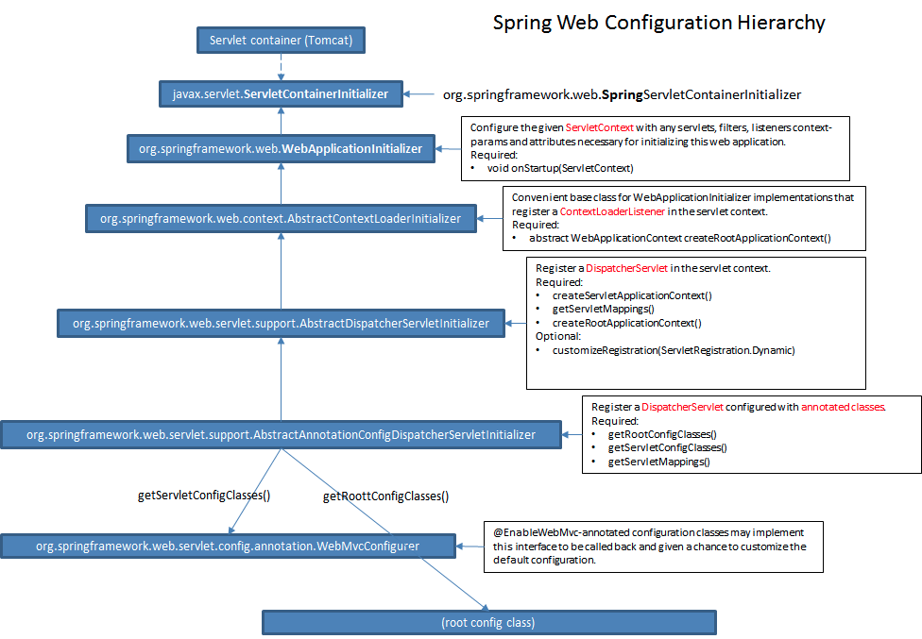

Slide 9
AbstractAnnotationConfigDispatcherServletInitializer creates both a DispatcherServlet and a ContextLoaderListener.
getServletConfigClasses(): Create and Return Java configuration files.
These files read by DispatcherServlet
➔ equals to dispatcher-servlet.xml
getRootConfigClasses(): Create and return Java Configuration files. These file read by ContextLoaderListener
➔ equals to applicationContext.xml
getServletMappings() will provde URL Mappings for dispatcherServlet.
➔equals to <url-pattern>/</url-pattern>

Slide 10
Adapters
Spring comes with different adapters to customize spring web applications.
There are alternative to xml based spring bean configurations in web applications.
It allows us to customize …..
View Resolvers
CORS filters
Exception resolvers
Static Resource configuration
Message converters
Locale configuration
Enabling security to the web URLs or methods
And more….

Slide 11
Two important adapters
WebMvcConfigurerAdapter which implements WebMvcConfigurer.
WebSecurityConfigurerAdapter which implements WebSecurityConfigurer

Slide 12
Customizing web
Web customization can achieved by writing a class and annotate with @EnableWebMvc and Extend this class with WebMvcConfigurerAdapter
With this annotation container will look for a class in the class path which implements WebMvcConfigurer or extends WebMvcConfigurerAdapter to load the customized settings for web application.

Slide 13
CORS Mapping
Cross-origin resource sharing (CORS) is a mechanism that allows restricted resources on a web page to be requested from another domain outside the domain from which the resource originated
@Override
public void addCorsMappings(CorsRegistry registry) {
registry.addMapping("/cors/**");
}

Slide 14
Resource Handlers
resource handlers for serving static resources such as images, CSS files and others through Spring MVC including setting cache headers optimized for efficient loading in a web browser. Resources can be served out of locations under web application root, from the class path, and others.
@Override
public void addResourceHandlers(ResourceHandlerRegistry registry) {
registry.addResourceHandler("/static/**").
addResourceLocations("classpath:/static/");
}

Slide 15
Writing simple REST service
Writing REST Service is simple with below steps…
Annotate your controller with @RestController
This is equals to @Controller +@ResponseBody
Make sure appropriate message converters available in the class path. Spring will automatically creates message converters for you.
Return required DTO Objects from the class methods

Slide 16
Web application scopes
Spring web application has two additional scopes ::
Session scope: objects created per session based.
@Scope(value = WebApplicationContext.SCOPE_SESSION)
Request scope: objects created per request based.
@Scope(value = WebApplicationContext.SCOPE_REQUEST)

Slide 17
Steps to enable Spring Security
Write a class and annotate with @EnableWebSecurity and extend that class with WebSecurityConfigurerAdapter
This annotation looks for a instance of class WebSecurityConfigurer to read the security settings
Override configure(HttpSecurity http) method
Ex: http.authorizeRequests().
antMatchers("/secure/**").
hasRole("ADMIN").
and().formLogin().
and().logout().logoutUrl("/logout");
Configure Security filter proxy in the WEBXMLConfig file
Add authenticationProvider or inMemoryManager by overriding below method
configure(AuthenticationManagerBuilder auth);
Ex: auth.inMemoryAuthentication().
withUser("admin").password("1234").roles("ADMIN");

Slide 18
Customizing spring security
Following interfaces from spring security framework need to implement to customize spring security framework
UserDetails: contains username ,password and other account enable disable locking kind of properties.
GrantedAuthority: contains roles based we can grant access to the resources
UserDetailService: loads the user based on username and returns UserDetails object.
AuthenticationProvider: contains authenticate method to do check username and password against DB. If credentials are valid it has to return object of type UsernamePasswordAuthenticationToken which takes valid username , password, authorities

Slide 19
Exception handing
Web exception can be handled by overriding method below method in WebMvcConfigurerAdapter
@Override
public void configureHandlerExceptionResolvers(List<HandlerExceptionResolver> exceptionResolvers) {
super.configureHandlerExceptionResolvers(exceptionResolvers);
exceptionResolvers.add(new CustomExceptionResolver());
}

Slide 20
Writing custom exception resolver
public class CustomExceptionResolver implements HandlerExceptionResolver {
@Override
public ModelAndView resolveException(HttpServletRequest request, HttpServletResponse response, Object handler, Exception ex) {
final ModelAndView mv = new ModelAndView("exception");
mv.addObject("name", ex.getClass().getSimpleName());
mv.addObject("message", ex.getMessage());
mv.addObject("errorCode", response.getStatus());
return mv;
}
}

Slide 21
RESTful service exception handling
If you want exception message as JSON then write a class which extends ResponseEntityExceptionHandler and annotate that class with @ControllerAdvice.
Override methods available in above handler class
@ControllerAdvice
public class RESTExceptionHandler extends ResponseEntityExceptionHandler{
}

