Slide 1

Visualization and Analysis – is the a correlation between population size and violent crime rate in the United States?
Group Id: A303 Date: 20/11/2024 Name of Student Presenting: IQBAL UD DIN

Slide 2
We are using the dataset DS 285 and Crimes dataset.csv to answer our Research Question “Is there a correlation between population size and violent crime rate in the United States? ” ¹
The dataset contains 20 rows, The variables we use are Violent Crime Rate (Interval) (dependent variable) and Population (Interval) (independent variable)
¹ Be sure you follow one of the three prescribed RQ Templates – identifying the type of statistical analysis you will be using. If you do not have the correct RQ, we will stop your presentation here.
² The variable name in your RQ may be different from the column name in cases where the column names are abbreviations.
^{3.4.}Be sure to identify which variable is your dependent variable and which one is your independent variable on this slide

Slide 3
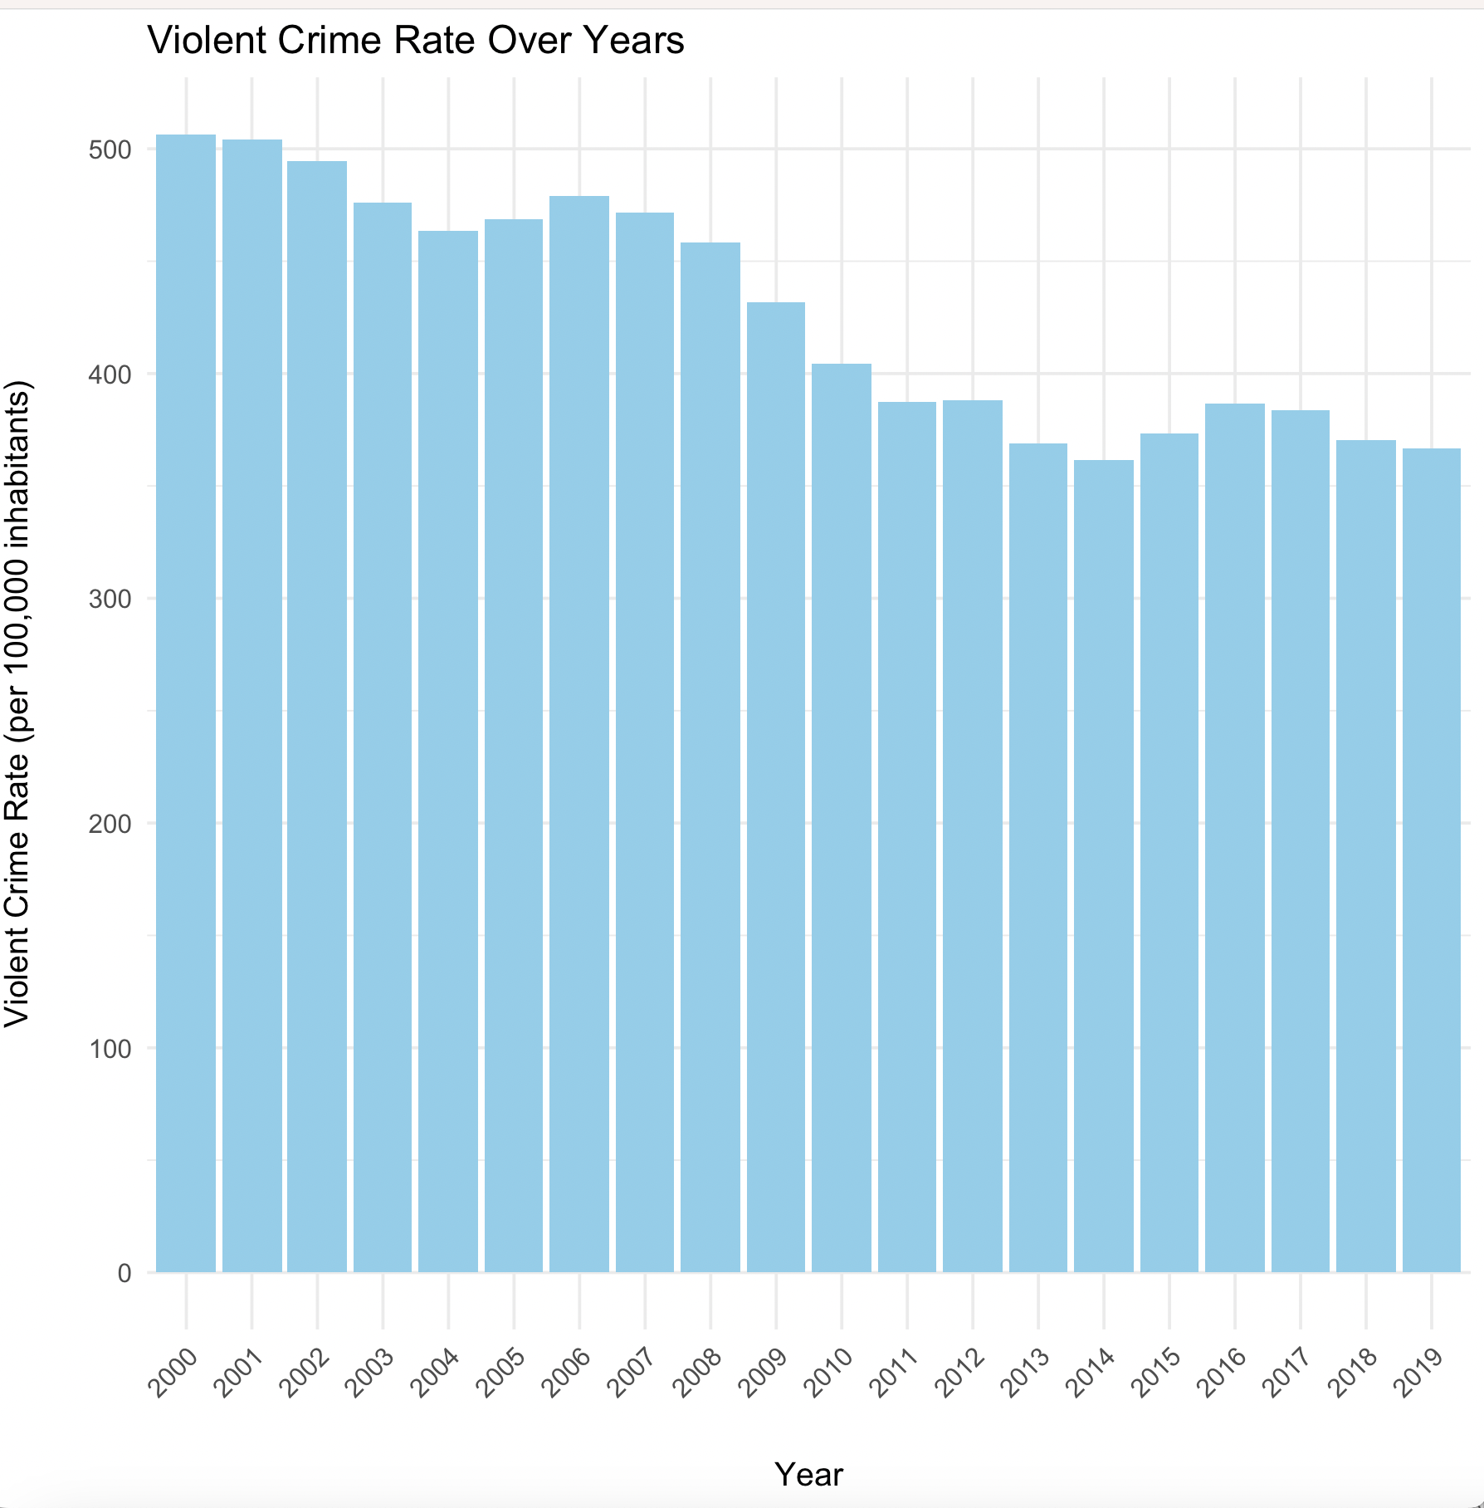

Slide 4
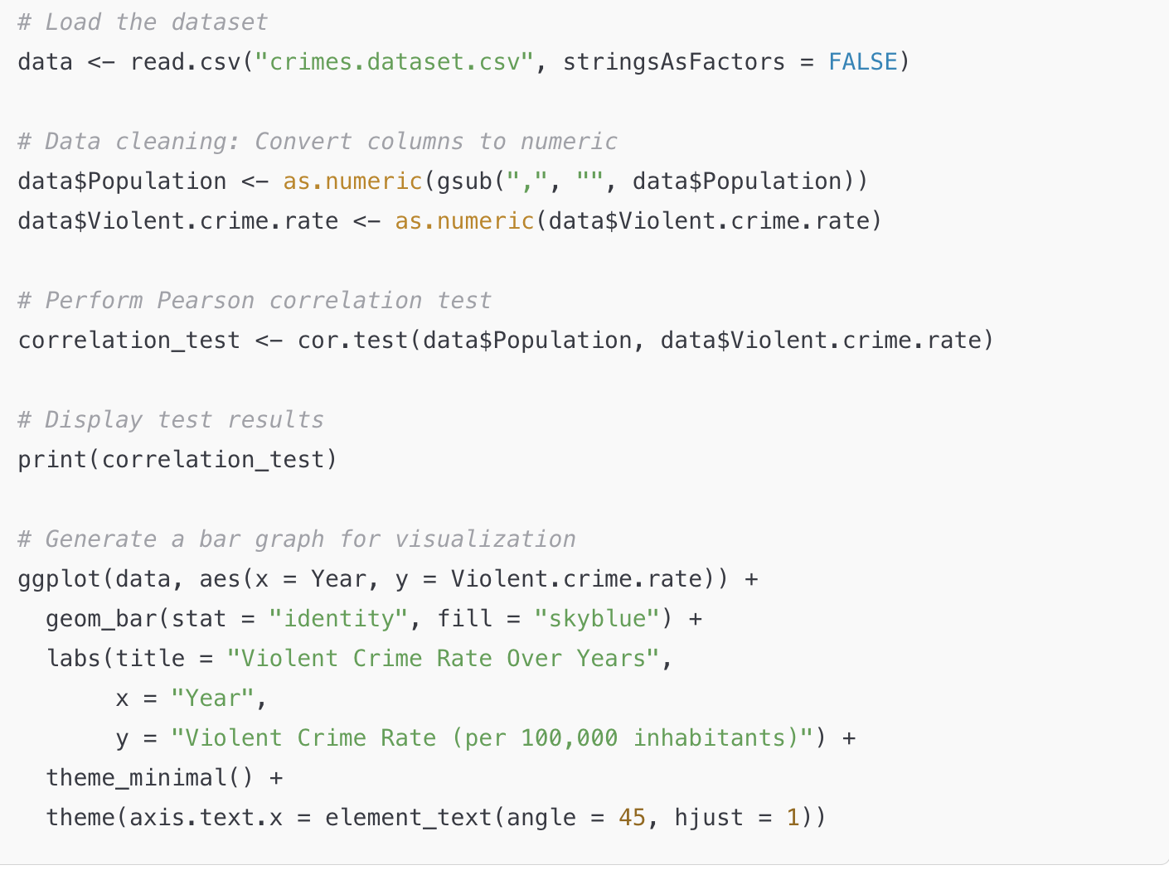

Slide 5
The Pearson correlation coefficient is -0.948, indicating a strong negative linear relationship between population size and violent crime rate.
The p-value is 2.18 × 10⁻¹⁰, which is far less than 0.05.
The result is statistically significant as the p-value < 0.05.
The null hypothesis (H₀: no correlation) is rejected.

Slide 6
Result
The results suggest a strong negative correlation between population size and violent crime rate in the United States. This implies that as the population increases, the violent crime rate per 100,000 inhabitants decreases. This finding could reflect broader socioeconomic trends or improved efficiency in crime prevention with larger populations.

