Slide 1



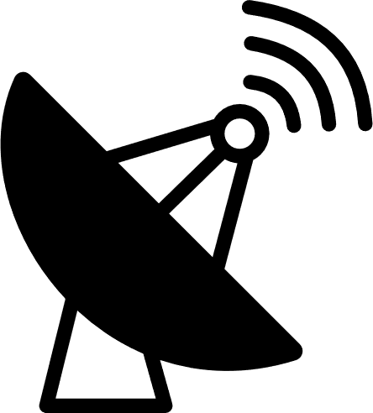











What is SigMF?
Benefits
Describe RF recordings
Software interoperability
Prevent bitrot of datasets
Binary IQ File
One RF Recording Consists of
IQIQ
IQIQ
1x
1x
.sigmf-data
IQIQ
+
IQIQ
JSON
Content:
I Q I Q I Q I Q I Q…
.sigmf-data
.sigmf-meta
int8
int16
float32
or
Metadata File
JSON
or
.sigmf-meta
{
"global": {
"core:datatype": "cf32_le",
"core:sample_rate": 1000000,
"core:hw": "PlutoSDR with 915 MHz whip",
"core:author": "Art Vandelay",
"core:version": "1.0.0"
},
"captures": [
{
"core:sample_start": 0,
"core:frequency": 915000000
}
],
"annotations": []
}
1
2
3
global
captures
annotations
freq
description: LTE,
freq_lower_edge: 847e6,
freq_upper_edge: 837e6,
sample_count: 40960,
sample_start: 839680
time
Extensions
github.com/sigmf/SigMF
signal spatial antenna

