Slide 1
Structure of package screenshot
Dependency structure (notes)
DESCRIPTION
Overload functions
This is also known as overloading
Simplify function available (“HelloWorld”)
Download a package and edit it

Slide 2
Why Zelig?
Framework for statistical models
Increase visibility
Dataverse bindings (without additional code)
Framework supports (without additional code)
Rapid package builder
Multiple Imputation
Plotting

Slide 3
Programming Statistical Models with Zelig 4
Creating Statistical Packages External Models
The "zelig2" Method

Slide 4
Outline
What is a statistical package?
What is a Zelig model?
Creating a statistical package
Model fitting functions
The zelig2 method
Workflow for creating a statistical package
Looking ahead
Design (a.k.a. model) matrices
Counterfactuals and interaction terms

Slide 5
What is a statistical package?

Slide 6
Structure of a Package
Simply a directory
Has two important folders:
R/
man/
And two important files:
DESCRIPTION
NAMESPACE

Slide 7
Structure of a Package (the "R" folder)
Contains the R source code for the entire package
All files end with ".R"
Code written in R should always be kept in this folder

Slide 8
Structure of a Package (the "man" folder)
Contains the help documentation
All files end with ".Rd"
Rd documents are written in a LaTeX-like language
http://cran.r-project.org/doc/manuals/R-exts.html#Rd-format

Slide 9
Structure of a Package (the "DESCRIPTION" file)
Contains several fields used to specify information about the statistical package
Most important are:
Package
Depends
Author
http://cran.r-project.org/doc/manuals/R-exts.html#The-DESCRIPTION-file

Slide 10
Structure of a Package (the "NAMESPACE" file)
For the novice, the default "NAMESPACE" file should suffice
Advanced users may want to keep some functions hidden from users
http://cran.r-project.org/doc/manuals/R-exts.html#Package-namespaces

Slide 11
Example: ZeligDEMO
Consider the package “ZeligDEMO"
This package can be found in the folder "___"
Note its directory structure
Open the "DESCRIPTION" file
Package
Author
Depends

Slide 12
Example: ZeligDEMO
Package: ZeligDEMO
Maintainer: Matt Owen <mowen@iq.harvard.edu>
License: GPL (>=2)
Title: A Zelig Model
Author: Matt Owen
Description: A Zelig Model
Version: 0.2
Packaged: Tue Nov 8 12:42:13 2011
URL: http://gking.harvard.edu/zelig
Date: 2011-12-12
Depends: Zelig (>= 4.0-6), systemfit
Note that the bold text is strictly for emphasis. That is, the actual DESCRIPTION file is plain-text.

Slide 13
Example: ZeligDEMO
(Picture of directory structure)
(Highlight important areas)

Slide 14
What is a Zelig Model?

Slide 15
Structure of a Zelig Package
A Zelig package is an R package
Each package contains one or more models
Each model comprises three methods:
zelig2<model-name> (Fitting the statistical model)
param.<model-name> (Simulate parameters)
sim.<model-name> (Simulate quantities of interest)
An R package can contain multiple Zelig models
“ZeligDEMO” is an R package containing 1 model

Slide 16
A Typical Zelig Program
Users use three functions:
zelig
setx
sim
Developers write three methods:
zelig2<model-name>
param.<model-name>
qi.<model-name>
Users do not have access to these methods

Slide 17
A Typical Zelig Program
zelig
Fit statistical model
Call external model fitting function
setx
Specify values for explanatory variables
Build design matrix
sim
Simulate expected values
Simulate other quantities of interest

Slide 18
A Typical Zelig Program
> library(Zelig)
> data(turnout)
> zout <- zelig( vote ~ race + educate, model = "logit", data = turnout, )
> xout <- setx(zout, educate = 10)
> sout <- sim(zout, xout)
> summary(sout)
zelig
setx
sim
Note that the "zelig", "setx" and "sim" methods are each called

Slide 19
A Typical Zelig Program
zelig
Calls "zelig2logit"
setx
Calls nothing
sim
Calls "param.logit"
Calls "qi.logit"

Slide 20
An Atypical Zelig Program
"setx" and "sim" are generic functions
A model can override the default "setx" and "sim" functions, by writing the functions:
setx.<model-name>
sim.<model-name>
This will not be covered today

Slide 21
Overview
Writing a zelig model is a three-stage process:
zelig2 method
param method
qi method
These correspond to
Fitting the statistical model (zelig2)
Parameter simulation (param)
Quantity of interest simulation (qi)
Users do not directly call these methods

Slide 22
Creating a Statistical Package

Slide 23
Basics
help("package.skeleton")
"package.skeleton" creates the outline of a statistical package (creates all necessary files/folders)
help("zelig.skeleton", "Zelig")
"zelig.skeleton" behaves identically except it follows a pattern more useful for Zelig packages

Slide 24
Using "package.skeleton"
This creates a folder titled "SomePackage"
Create an R package with a single function "f"
Titles the package "SomePackage"
This package will not be "installable" until the author edits the ".Rd" files (found in the "man/" directory)

Slide 25
Using "package.skeleton"
> f <- function (...) 1
> package.skeleton("SomePackage", "f")
Creating directories ...
Creating DESCRIPTION ...
Creating Read-and-delete-me ...
Saving functions and data ...
Making help files ...
Done.
Further steps are described in './SomePackage/Read-and-delete-me'.
>

Slide 26
Using "package.skeleton"
Slightly more cumbersome than "zelig.skeleton"
Requires that users have:
A name for their package
At least 1 function defined and named
Packages made this way cannot be immediately installed.

Slide 27
Using "zelig.skeleton"
We will not be using "package.skeleton" to build our packages
"zelig.skeleton" provides functionality specifically catered towards developing statistical models and Zelig-dependent packages

Slide 28
Using "zelig.skeleton"
Pick a name for the Zelig package.
"ZeligLeastSquares"
Pick a model name
"twostage"
Determine package dependencies
"systemfit"

Slide 29
zelig.skeleton Example
# The first parameter is the package name
> pkgName <- "ZeligLeastSquares"
> model <- "twostage"
> dependencies <- "systemfit"
>
> zelig.skeleton(pkgName, model, depends = dependencies)
This example will create a folder named "ZeligLeastSquares" in your current working directory.
If you need to go back later and change the package’s name, author’s name or the package’s dependencies, edit the file:
"ZeligLeastSquares/DESCRIPTION"

Slide 30
Model Fitting Functions

Slide 31
Outline for Model Fitting Functions
What is linear regression?
Generalized Linear Models (GLM)
Example

Slide 32
What is linear regression?
A method for explaining and predicting observations using data
A method for determining unknown parameters derived from a data set
How dependent is my response variable on a particular parameter?
Specifically, a method for determining conditional expected values
"Given x and y, the expected value is…"

Slide 33
What is linear regression?
There are three necessary components to any generalized linear model:
A formula specifying predictor and response variables: y ~ x1 + x2 + x3
A model – logit, probit, gamma, normal
Data – a data-set stored as a data.frame

Slide 34
Basics
The "lm" model finds the function that best approximates the observed data with a line
Other regression models approximate observe data with a nonlinear function that takes a line as its parameter
f(y) = X B
Where X is a matrix and B is a vector

Slide 35
Generalized Linear Models
The "least squares" method is the foundation of fitting generalized linear models (GLM's)
And information on how significantly the response variables varies with the predictor variables

Slide 36
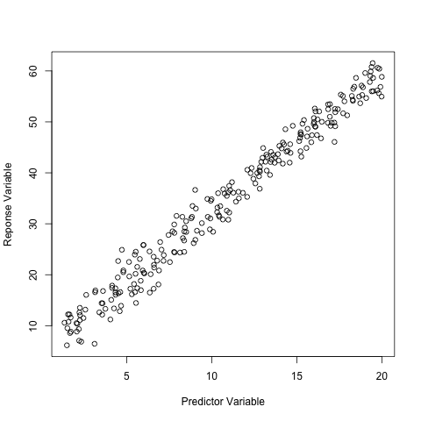
Example: Data

Slide 37
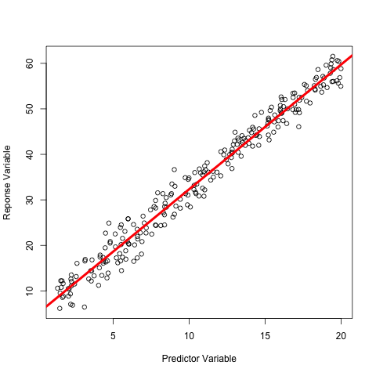
Example: Data (and Linear Regression)

Slide 38
The zelig2 Method

Slide 39
Outline
Overview
What is a zelig2 method?
Format of a zelig2 method
Writing the zelig2 method

Slide 40
Overview
Today we are focusing on fitting the statistical model
Zelig requires (typically) that the model is fitted externally
Most models are based on "lm" or "glm" because of their general nature

Slide 41
Structure of a zelig2 function
zelig2logit <- function(formula, weights=NULL, ..., data)
{
if (!is.data.frame(data))
stop("`data` is not a data-frame")
# Some other computations
list(.function = "glm",
formula = formula,
weights = weights,
family = binomial(link="logit"),
model = F,
data = data
)
}
SIGNATURE
FUNCTION BODY
RETURN VALUE
Tip: Use the method "args" to determine the parameters that can be submitted to your external model.

Slide 42
Writing the "zelig2" Method
Has three parts
Function signature
Function Body
Return Value

Slide 43
Format of a zelig2 function
zelig2logit <- function(formula, weights=NULL, ..., data)
list(.function = "glm",
formula = formula,
weights = weights,
family = binomial(link="logit"),
model = F,
data = data
)
SIGNATURE
EXTERNAL MODEL
PARAMETERS
Tip: Use the method "args" to determine the parameters that can be submitted to your external model.

Slide 44
zelig2: Function Signature
"formula" specifies the model formula
"data" specifies the data.frame
All other parameters are optional
Other parameters are determined by the model fitting function's requirements
Use "args" to determine what parameters are available for the model-fitting function

Slide 45
zelig2: Function Body
Typically does very little
Can be used to
Print-out error and warning messages
Manipulate model formulae
Assign default values that do not exist for the model-fitting function

Slide 46
zelig2: Return Value
".function" specifies the name of model-fitting function
All other entries specify values to be explicitly set for the model-fitting function

Slide 47
zelig2
Does not fit models itself
Uses outside models to fit data
"lm", "glm", "nlme", etc.
Manages how zelig interacts with these models:
Specifies what function will fit the model
Specifies parameters
Manipulates objects

Slide 48
Miscellaneous Topics

Slide 49
Family Objects
Store information about link functions
"Link" functions help specify the relationship between the observed value and the underlying linear predictors
"Inverse Link" simply inverse this process
Used by model-fitting functions
Inverse link functions are used in qi simulation
See help documentation: "?family"

Slide 50
Workflow

Slide 51
Workflow
Find existing model
Determine what the arguments are
Return a list at the bottom of the function
Manipulate objects
Write warnings
Document

Slide 52
Workflow
Write demo code
Develop code (in the “R/” directory)
Install (or re-install) package
Test demo code
Go back to step 2

Slide 53
Workshop Goals
We are going to focus on simulating individual statistical models
Each student will create an R package
Each student will implement a single statistical model
This model will be made up of 3 methods:
zelig2<model-name>
param.<model-name>
qi.<model-name>

