Slide 1
Programming Statistical Models with Zelig 4
Creating Statistical Packages, External Models and the "zelig2" Function

Slide 2
Outline
Introduction
What is a statistical model?
Overview of R packages
Model Fitting Functions
Fitting data
Examples
The zelig2 method
Looking ahead: Design matrices and predictor variables

Slide 3
Outline
What is a statistical package
Creating a statistical package
Model fitting functions
Writing the zelig2 function
Looking adhead
Design (a.k.a. model) matrices
Counterfactuals and interaction terms

Slide 4
Introduction

Slide 5
What is linear regression?
A method for explaining and predicting observations using data
A method for determining unknown parameters derived from a data set
How dependent is my response variable on a particular parameter?
Specifically, a method for determining conditional expected values
"Given x and y, the expected value is…"

Slide 6
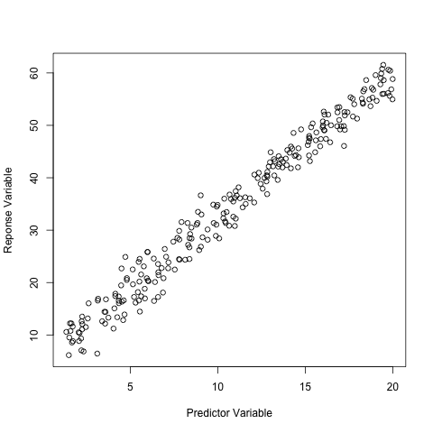
Example: Data

Slide 7
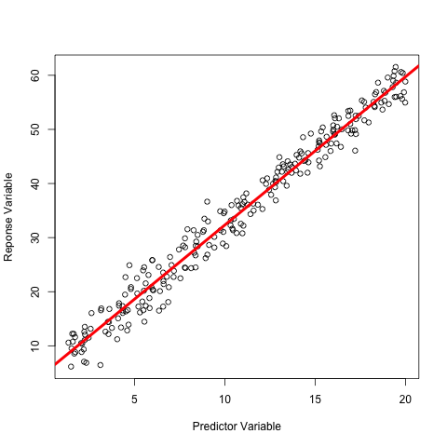
Example: Data (and Linear Regression)

Slide 8
Basics
There are three necessary components to any statistical model:
A formula specifying predictor and response variables: y ~ x1 + x2 + x3
A model – logit, probit, gamma, normal
Data – a data-set stored as a data.frame

Slide 9
Generalized Linear Models
The "least squares" method is the foundation of fitting generalized linear models (GLM's)
Provides information on the correlation of predictor variables
And information on how significantly the response variables varies with the predictor variables

Slide 10
Basics
Consider the linear regression:
lm(y ~ x)
This means, the variable "y" is dependent on the variable "x"

Slide 11
Basics
The "lm" model (as all models do) finds the function that best interpolates the observed data.

Slide 12
About Fitting Models
# Load the data set
> load("SimpleQuasipoisson.Rdata")
> data(SimpleQuasipoisson)
# Fit the data using a quasi-poisson link function
> fit <- glm(Predictor ~ Respose, quasipoisson(), SimpleQuasipoisson)

Slide 13
Overview
Writing a zelig model is a three-stage process:
zelig2 method
param method
qi method
These correspond to
Fitting the statistical model (zelig2)
Parameter simulation (param)
Quantity of interest simulation (qi)

Slide 14
Overview
Today we are focusing on fitting the statistical model
Zelig requires (typically) that the model is fitted externally
Most models are based on "lm" or "glm" because of their general nature

Slide 15
zelig2

Slide 16
zelig2
Does not fit models itself
Uses outside models to fit data
"lm", "glm", "nlme", etc.
Manages how zelig interacts with these models:
Specifies what function will fit the model
Specifies parameters
Manipulates objects

Slide 17
Why Zelig2

Slide 18
Workflow
Find existing model
Determine what the arguments are
Return a list at the bottom of the function
Manipulate objects
Write warnigns
Document

Slide 19
Features of a zelig2 function
zelig2logit <- function(formula, weights=NULL, ..., data){
list(
.function = "glm",
formula = formula,
weights = weights,
family = binomial(link="logit"),
model = F,
data = data
)
}

Slide 20
Features of a zelig2 function
zelig2logit <- function(formula, weights=NULL, ..., data)
list(.function = "glm",
formula = formula,
weights = weights,
family = binomial(link="logit"),
model = F,
data = data
)
SIGNATURE
EXTERNAL MODEL
PARAMETERS
Tip: Use the method "args" to determine the parameters that can be submitted to your external model.

Slide 21
Family Objects
Store information about link functions
"Link" functions help specify the relationship between the observed value and the underlying linear predictors
"Inverse Link" simply inverse this process
Used by model-fitting functions
Inverse link functions are used in qi simulation
See help documentation: "?family"

Slide 22
Zelig Format
For any "model" three functions must be written:
zelig2: linearly fit the data
param: simulate parameters
qi: simulate quantities of interest (expected value, etc.)

Slide 23
Naming files
Note that "<model-name>" should be replaced with the name of your model.
zelig2<model-name>
param.<model-name>
qi.<model-name>
Use "zelig.skeleton" as an aid to generate all these files.

Slide 24
Using zelig.skeleton
Getting started:
Pick a name for the Zelig package. For example:
"ZeligBayesian"
"ZeligLeastSquares"
Pick a model name:
"logit"
"gamma"

Slide 25
R Package Checklist
Package Name, e.g. "ZeligLeastSquares"
Model Names, e.g. "logit" or "gamma"
R-package dependencies, e.g. "lme4"
Author Name
Author Email (for use with CRAN)

Slide 26
Format for Slides
Regular text will be presented just like this.
# Comments will be grayed-out and preceded by a hash
# Code will be in preceded by “> ”
> sin(1.3)
Results from code example will be in a grayed out box with a dashed border.
[1] 0.9635582
Notes:
26

Slide 27
zelig.skeleton Example
# The first parameter is the package name
> pkgName <- "ZeligLeastSquares"
> model <- "twostage"
> author <- "Matt Owen"
> email <- "mowen@iq.harvard.edu"
> zelig.skeleton(pkgName, model, author = author, email = email)
This example will create a folder named "ZeligLeastSquares" in your current working directory.
If you need to go back later and change these values, they will be saved in the file "ZeligLeastSquares/DESCRIPTION"

Slide 28
Structure of a Package
Is simply a directory with folders:
R
man
And important files:
DESCRIPTION
NAMESPACE

Slide 29
Structure of a Package
The important files and folder are:
The "R" folder will contain ALL source code written in R
The "man" folder holds documentation
"DESCRIPTION" gives information about authorship and package dependency
"NAMESPACE" specifies what functions should be visible by EXTERNAL packages

Slide 30
Structure of a Package (The "R" Folder)
Holds all documents ending with ".R"
Comprises the R source code for the entire package
Code written in R should always be kept in this folder

Slide 31
Structure of a Package (The "man" Folder)
Stores the help documentation
All files should have the extension "Rd"
Rd documents are written in a LaTeX-like language
http://cran.r-project.org/doc/manuals/R-exts.html#Rd-format

Slide 32
Structure of a Package (The "DESCRIPTION" File)
Contains several fields used to specify information about the statistical package
Most important are:
Depends
Author
Version
http://cran.r-project.org/doc/manuals/R-exts.html#The-DESCRIPTION-file

Slide 33
Structure of a Package (The "NAMESPACE" File)
For the novice, the default "NAMESPACE" file should suffice
Advanced users may want to keep some functions hidden from users
http://cran.r-project.org/doc/manuals/R-exts.html#Package-namespaces

Slide 34
Installing a Package
Find the parent directory of your package
Type: R CMD INSTALL <package-name>
Additional useful commands:
R CMD check
R CMD BUILD

Slide 35
Installing a Package (Example)

