Slide 1

Supporting reproducibility with a connected electronic lab notebook
Rory Macneil
Harvard DataFest 2019
February 22, 2019

Slide 2
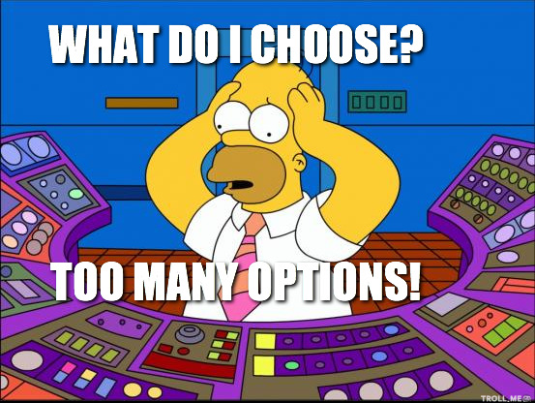

Slide 3

How to differentiate?
Who is the ELN for and what environment will it be used in?
Does the ELN support reproducibility?

Slide 4
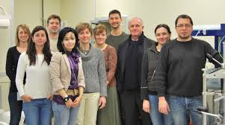

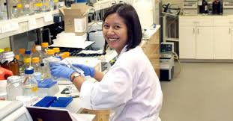
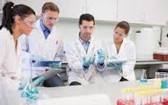
1. Who is the ELN for?

Slide 5
2. Does the ELN support reproducibility?
Connectivity is the key
Connectivity to other data sources
Connectivity to other tools
Connectivity to data repositories

Slide 6
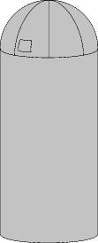
Unfortunately most ELNs have something in common . . . And it’s not a good thing

Slide 7

What about Jupyter?
What makes Jupyter different?
Code not data
Connectivity!

Slide 8
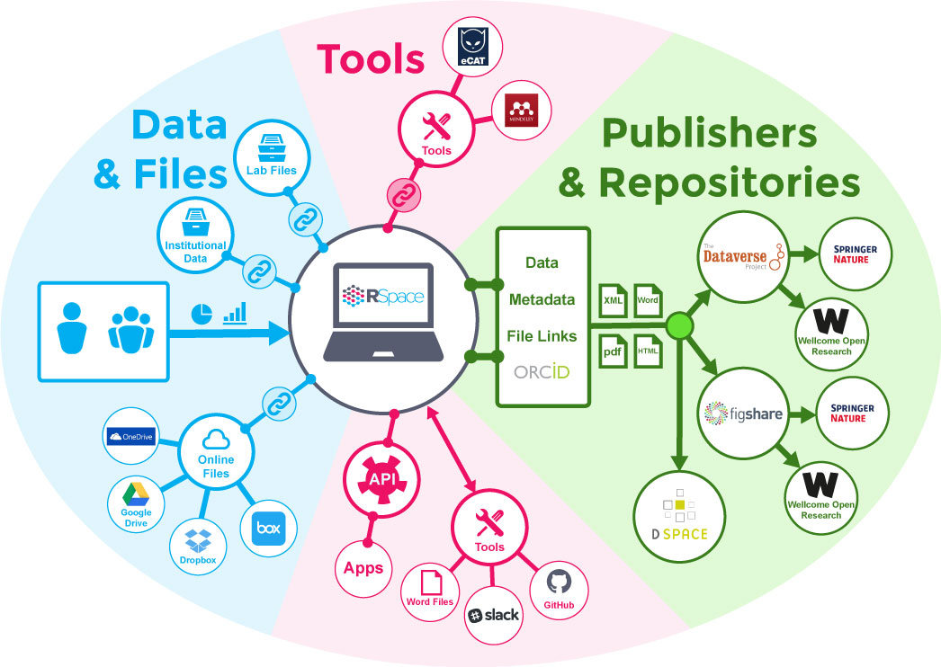



RSpace: An ELN designed around connectivity

Slide 9


Whence RSpace?

Slide 10
Three kinds of connectivity
Connectivity to other data sources
Connectivity to other tools
Connectivity to data repositories

Slide 11
Connectivity to other data sources

Slide 12
Connectivity to other tools

Slide 13
Connectivity to data repositories 1:
Powerful, flexible export
Export capabilities
  Multiple formats
  Any selection of documents/files
  All roles
  Easy to do
  Export locations and export to data repositories
  Use API to schedule regular exports
Benefits
  Avoid lock in
  Get data out at any time/for any purpose
  ELN becomes a conduit rather than a silo
  Support active data to archival data workflow

Slide 14
Connectivity to data repositories 2:
Integrations with repositories
Interface in RSpace enables
  Selection of documents/files for deposit
  Addition of required metadata
  Association with ORCID ID with export
  Direct deposit in data repository
Benefits
  Increase in amount and quality of data deposited
  Better/more efficient curation
  Enhanced reproducibility

Slide 15
What’s next for RSpace?
More and better connectivity!
Deeper integration with file stores
Additional integrations with tools
  Gitlab
  Jupyter
  Tableau
  Globus
Enhancements to data export
Automated ingest of data and workflows
  From instruments
  From other tools

Slide 16
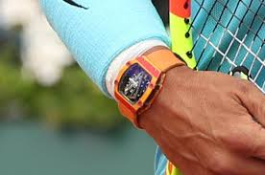
Concluding thought
As research tools become conduits for
(increasingly automated) flows of data, (new kinds of) listening will become even more important

Slide 17
Thank you!
rmacneil@researchspace.com

