Slide 1
MyData Overview
Dataverse 4.1

Slide 2
Goal
Display/Filter/Search a User’s Data
Do this (relatively) fast

Slide 3
Two Main Challenges
#1 - Retrieval:
How do we find all of a user’s data?
#2 - Rendering:
Can we use JSON instead of XHTML?

Slide 4
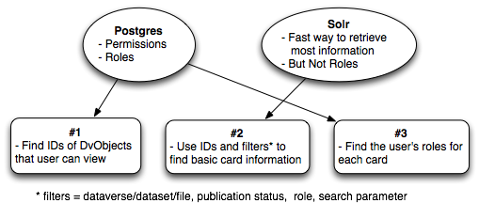
Retrieval: Postgres + Solr

Slide 5
Retrieval: JSON for a Dataset Card
{ "name": "Wouldn't Take Nothing for My Journey Now", "type": "dataset", "url": "http://dx.doi.org/10.5072/FK2/OWJOSP", "image_url": "https://localhost/api/access/dsCardImage/431", "global_id": "doi:10.5072/FK2/OWJOSP", "description": "description test dataset for the book: Wouldn't Take Nothing for My Journey Now", "citation": "MAYA ANGELOU, 2015, \"Wouldn't Take Nothing for My Journey Now\", http://dx.doi.org/10.5072/FK2/OWJOSP, Root Dataverse, DRAFT VERSION ", "matches": [], "score": 1, "entity_id": 456, "api_url": "https://RAD-rprasad/api/datasets/456",
"authors": [ "MAYA ANGELOU" ], "publication_statuses": [ "Unpublished", "Draft" ], "is_draft_state": true, "is_unpublished_state": true, "is_published": false, "is_deaccesioned": false, "date_to_display_on_card": "Jun 8, 2015", "parentId": "1", "parentName": "Root", "user_roles": [ "Admin", "Contributor", "File Downloader" ] },
#3 - Postgres
#2 - SOLR

Slide 6
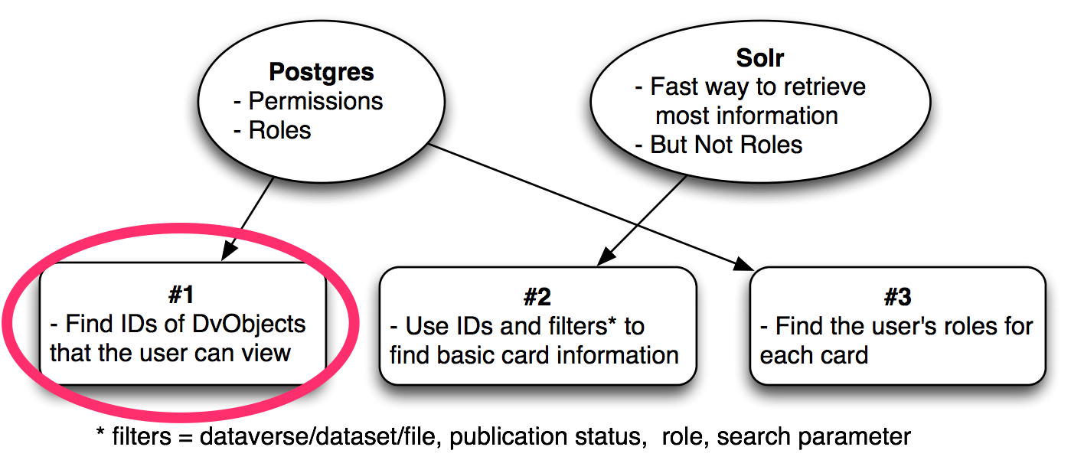
Retrieval: Permissions
Find IDs of a User’s DvObjects
How do you find Gary King’s 1,981 objects?
In a timely way, can we find Sonia’s 37,614 objects?
Notes:
Pre-launch attempts taking minutes to check object by object...

Slide 7
Retrieval: 1st Query - Role Assignments
RoleAssignment Table:
 | Assignee | Role | DV Object ID
Sample Data | @fred | 1 | 101
What it means | user: Fred | role: Administrator | DvObject 101
Notes:
Example of a direct assignment

Slide 8
Retrieval: Questions to Answer for Role Assignments
What is object 101? (Dataverse? Dataset? File?)
Can it have child objects?
Does the role* apply to child objects?
including custom roles
Assignee | Role | DV Object ID
user: Fred | role: Administrator | DvObject 101
Notes:
Questions to ask for every direct assignment

Slide 9
Retrieval: Answering the Questions
RoleAssignmentTable
DvObject Table
Assignee | Role | DV Object ID
user: Fred | role: Administrator | DvObject 101
DV Object ID | dtype | Parent ID
101 | Dataset | 7

Slide 10
Retrieval: Answering the Questions
RoleAssignmentTable
DvObject Table
What is object 101? Dataset
Can it have child objects? Yes, Files
Does the role apply to child objects? ???
Assignee | Role | DV Object ID
user: Fred | role: Administrator | DvObject 101
DV Object ID | dtype | Parent ID
101 | Dataset | 7

Slide 11
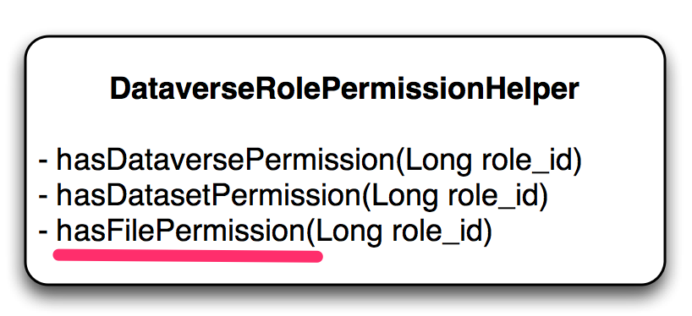
Retrieval: Answering the Questions
What is object 101? Dataset
Can it have child objects? Yes, Files
Does the Administrator role apply to File objects? Yes
Notes:
Role Permission Helper contains Role Objects. Single query to get all of the Role objects. Used over and over.

Slide 12
Retrieval: How does this relate to Solr?
what we know
solr query
(id : 101) or
((parent id : 101)
get Dataset
get Files
DvObject ID | 101
Type | Dataset
Role | Administrator
Can object have Children? | Yes, Files
Does Role Apply to Children? (Files) | Yes

Slide 13
Retrieval: Another Example (#2)
what we know
solr query
(id : 7)
get Dataverse
DvObject ID | 7
Type | Dataverse
Role | Dataset Creator
Can object have Children? | Yes, Datasets + Files
Does Role Apply to Children? (Files) | No

Slide 14
Retrieval: Another Example (#3)
what we know
solr query
(id : 9) or (parent id : 9)
or (parent id : dataset ids)
get Dataverse + Datasets
files: extra postgres query to get dataset ids
DvObject ID | 9
Type | Dataverse
Role | Contributor
Can object have Children? | Yes: Datasets, Files
Does Role Apply to Children? (Files) | Yes: Datasets, Files

Slide 15
Retrieval: How do we do this “en masse”?
RoleAssignmentTable
DvObject Table
What is object 101? Dataset
Can it have child objects? Yes, Files
Does the role apply to child objects? ???
Assignee | Role | DV Object ID
user: Fred | role: Administrator | DvObject 101
DV Object ID | dtype | Parent ID
101 | Dataset | 7

Slide 16
Retrieval: How do we do this “en masse”?
Assumptions:
All dataverses are permission root
Limited inheritance

Slide 17
Retrieval: How do we do this “en masse”?
Role Permission Helper (1 query)
Find IDs Directly or by Parent (2 queries)
Find via Grandparent (1 query)
 | Direct Assignment | Via Dataverse | Via Dataset
Dataverse | Yes | -- | --
Dataset | Yes | Yes (parent) | --
File | Yes | Yes (grandparent) | Yes (parent)

Slide 18
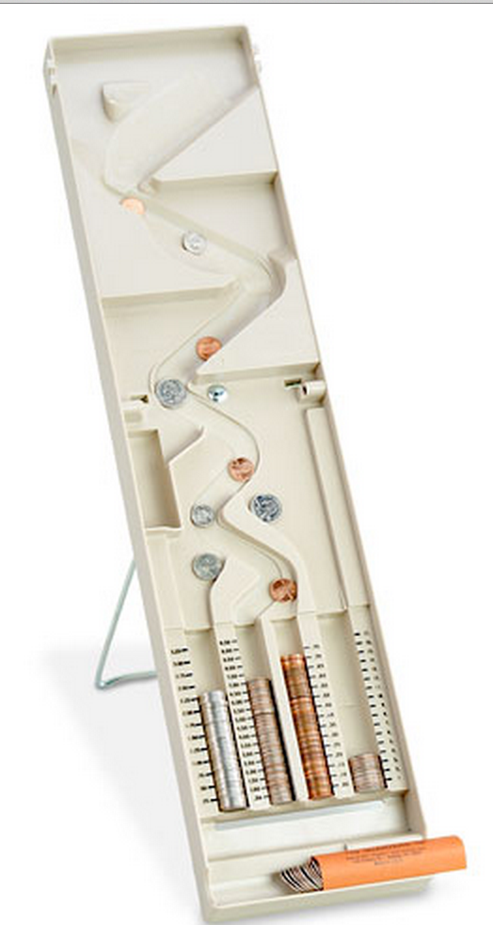
“DvObject Sorting”
MyDataFinder.java
Step 1 - Role Assignments
Step 2 - Direct + Parent
Step 3 - Grandparent
- File Perms @ Dataverse
Create Solr Query

Slide 19
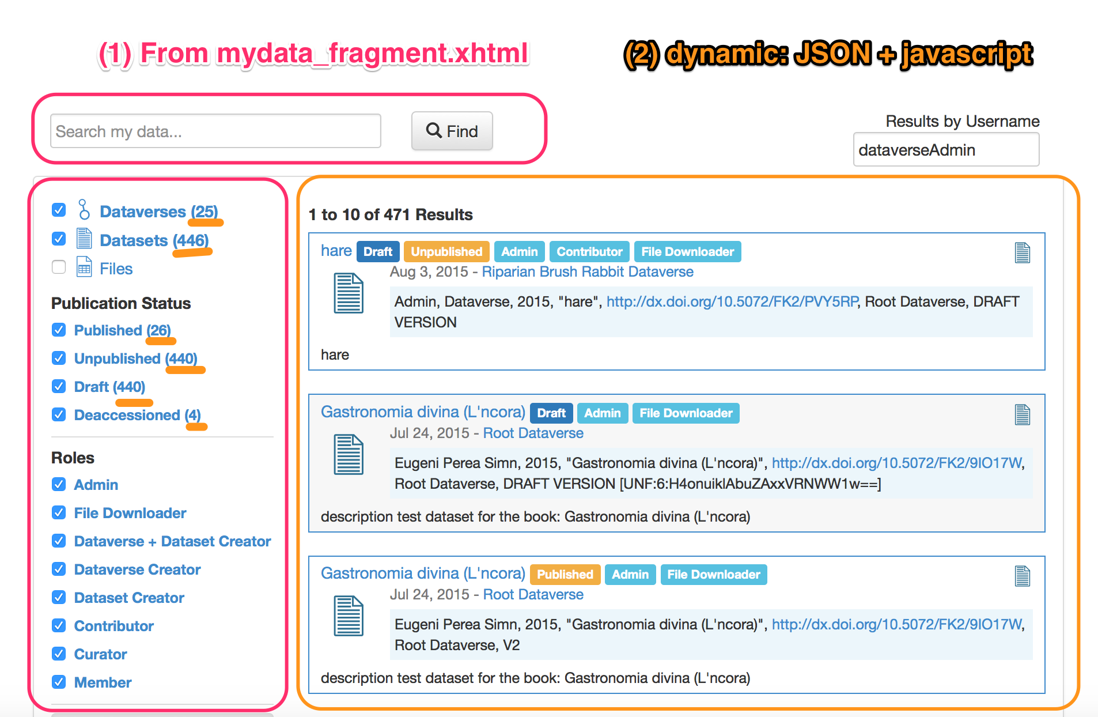
#2: Rendering

Slide 20
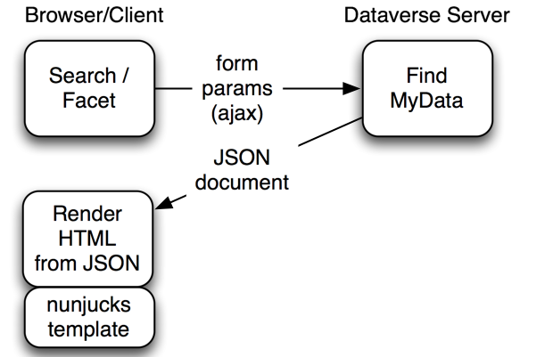
Rendering: Basic Flow
local example
Notes:
How do I send this back w/o making it into Java again?

Slide 21
Rendering: JSON -> String
mustache (java server side, twitter)
https://github.com/spullara/mustache.java
handlebars:
https://github.com/jknack/handlebars.java
Jinja (very nice): http://jinja.pocoo.org/
java server side: https://github.com/HubSpot/jinjava
only Java 8

Slide 22
Rendering: JSON -> String
Jinja (very nice): http://jinja.pocoo.org/
used by interns (python)
java server side: https://github.com/HubSpot/jinjava
only Java 8
Nunjucks - https://mozilla.github.io/nunjucks/
client side, .js file

Slide 23
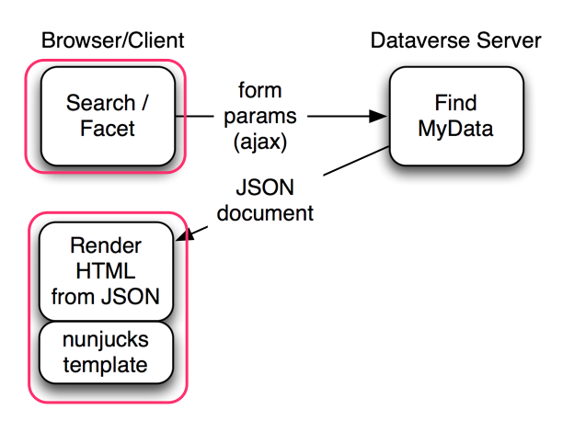
Rendering
mydata.js
submit search
card rendering
.js templates

Slide 24
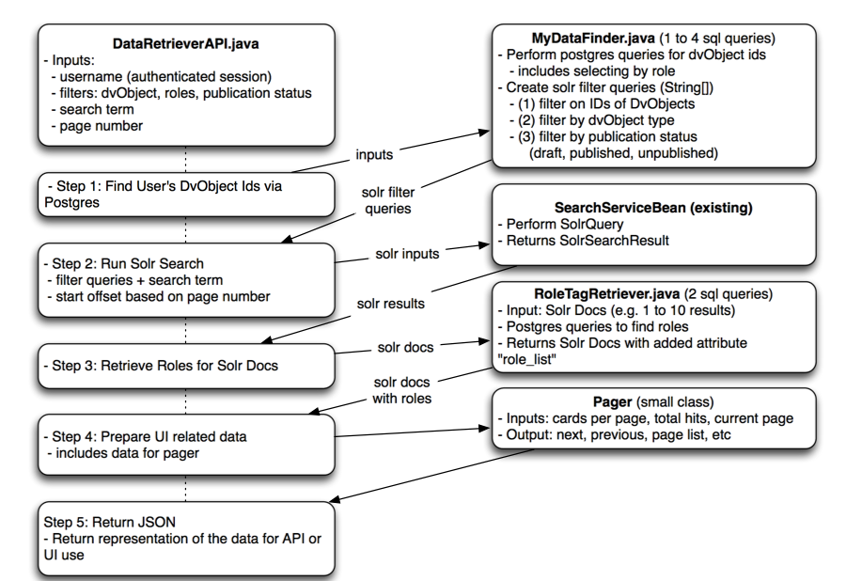
Overview

