Slide 1

Introduction to Citation Analysis with Sci²
Ista Zahn and Steve Worthington

Slide 2
Download Sci²
https://sci2.cns.iu.edu
Free registraton required
Download then unzip
No need to install just run the sci2 executable from the unziped sci2 directory

Slide 3
Analyses Available in Sci²
Temporal: When did activity occur?
Geospatial: Where did activity occur?
Topical: What occurred?
Network: How are entities related?

Slide 4
Workflow Overview
Obtain citation data to be analyzed
Load data in Sci²
Prepare and pre-process data: remove duplicates, extract networks, aggregate etc.
Analyze: burst detection, geocoding, clustering etc.
Visualize: Time series, geospatial, network

Slide 5
Example 1: Temporal Analysis
Examine trends in publications in the Journal “Scientometrics”
Main questions:
What are the trends in topics studied over time?
Who are the authors with the most longevity?

Slide 6
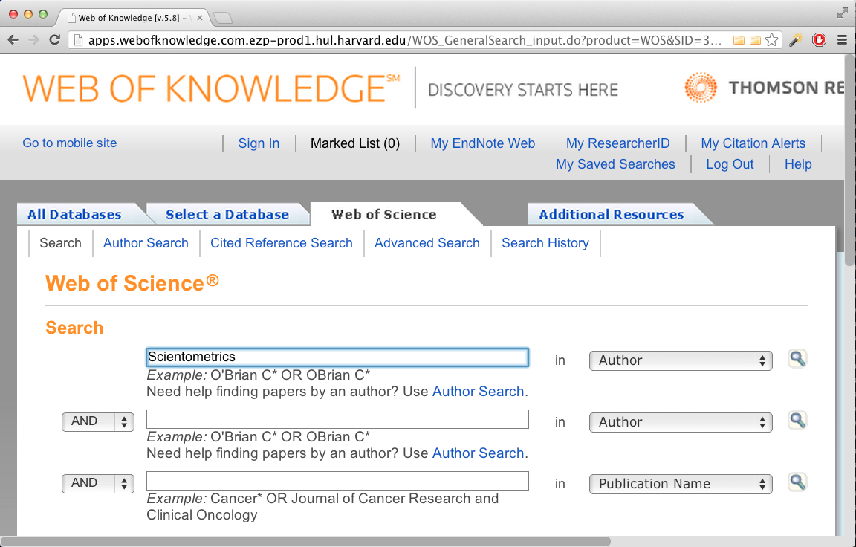
Locate Citations to be Analyzed
http://apps.webofknowledge.com.ezp-prod1.hul.harvard.edu/

Slide 7
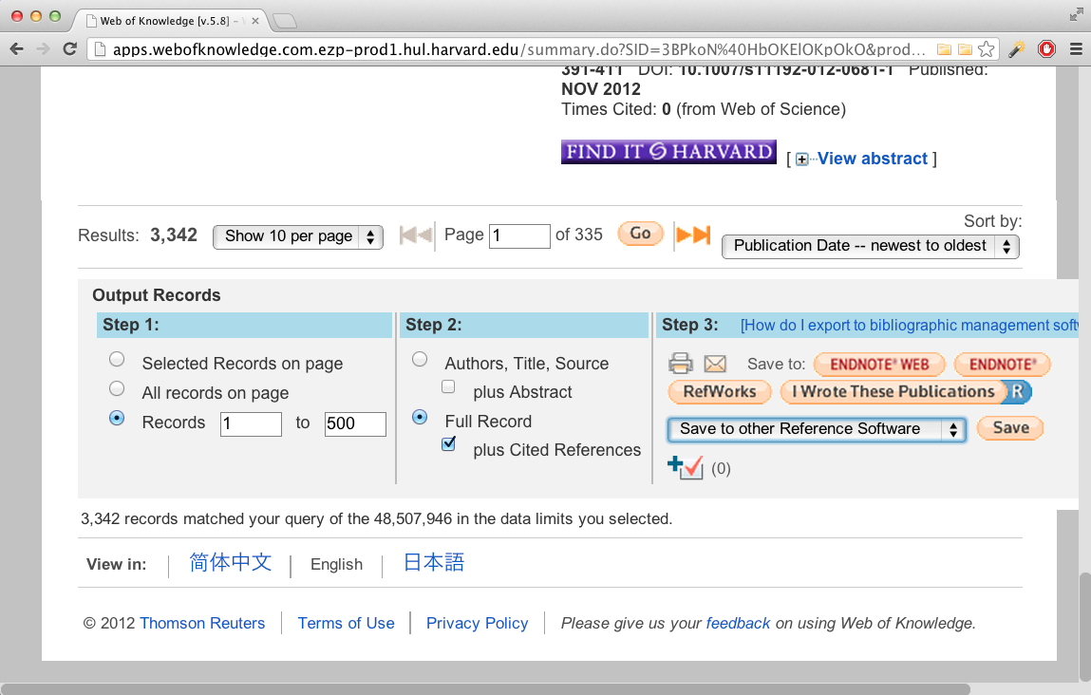
Download Citations
Download to a delimited plain text format
WoS only allows 500 records to be exported at a time

Slide 8

Rename and Load Saved Records
Rename the save records from “filename.txt” to “filename.isi”
If you have multiple record files, merge them
Load records in Sci²
Check console log for errors or warnings

Slide 9
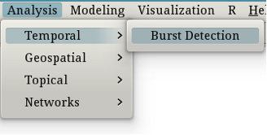
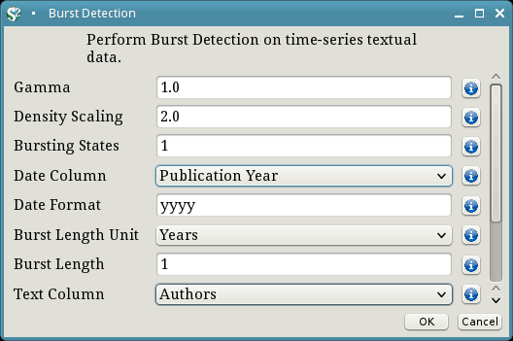
Temporal Analysis: Author Longevity
Burst detection for authors

Slide 10
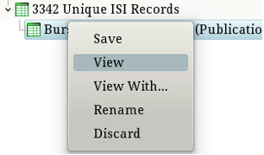

Clean Burst Detection Results
Often you will need to export data from Sci2, perform calculations/manipulations in another program, and reload the data
In this case we need to add the end date for authors who published in 2012

Slide 11
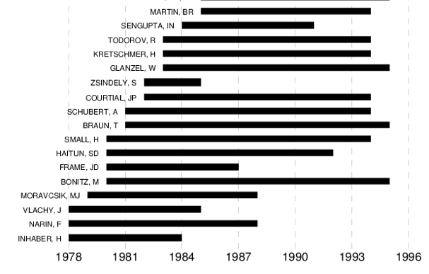
Plot Author Longevity

Slide 12
Your Turn!
Create a plot showing the temporal extent of Scientometrics article keywords

Slide 13
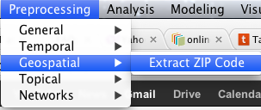
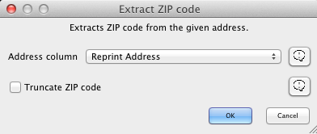
Example 1: Geospatial Analysis
Examine origin of “Scientometrics” publications
Start by extracting zip codes:

Slide 14
Remove Extraneous Data
Open the data in a spreadsheet and remove all but the zip code column
Create a new column named “Records” and set all values to 1
Save the file and load it in Sci²

Slide 15
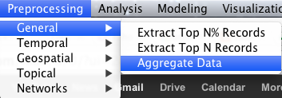
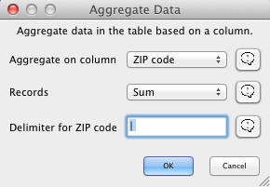
Aggregate Records by Zip Code

Slide 16
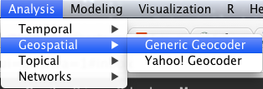
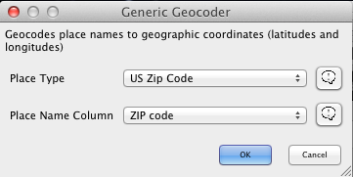
Extract Latitude and Longitude

Slide 17
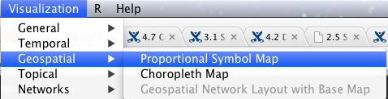
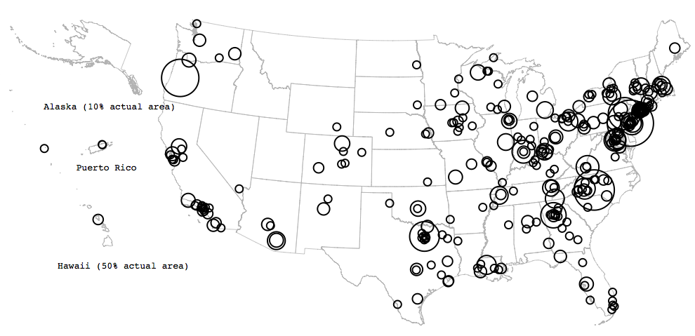
Visualize Article Origins

Slide 18
Your Turn!
Visualize influence (operationalized as number of times cited) by geographical location

