Slide 1

Introduction to Citation Analysis with Sci2
Ista Zahn and Steve Worthington

Slide 2
Download Sci2
https://sci2.cns.iu.edu
Free registration required
Download then unzip
No need to install – just run the sci2 executable from the unziped sci2 directory

Slide 3
Analyses Available in Sci2
Temporal: When did activity occur?
Geospatial: Where did activity occur?
Topical: What occurred?
Network: How are entities related?

Slide 4
Workflow Overview
Obtain citation data to be analyzed
Load data in Sci2
Prepare and pre-process data: remove duplicates, extract networks, aggregate etc.
Analyze: burst detection, geocoding, clustering etc.
Visualize: Time series, geospatial, network

Slide 5
Example 1: Temporal Analysis
Examine trends in publications in the Journal “Scientometics”
Main questions:
What are the trends in topics studied over time?
When did top authors rise to prominance?

Slide 6
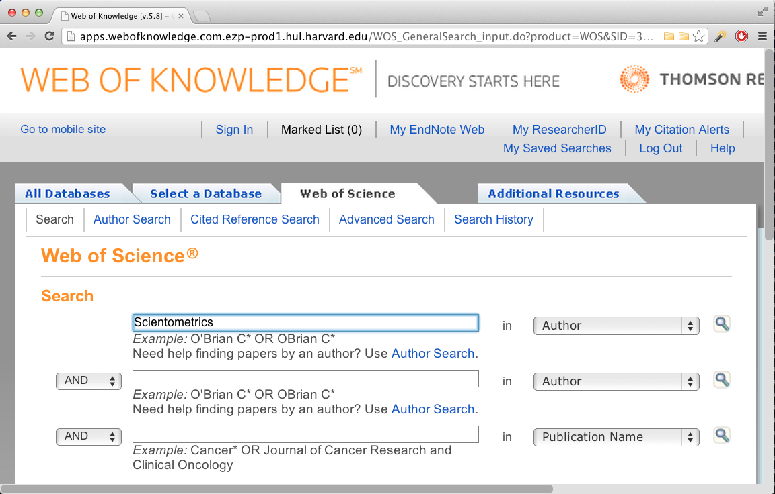
Locate Citations to be Analyzed
http://apps.webofknowledge.com.ezp-prod1.hul.harvard.edu/

Slide 7
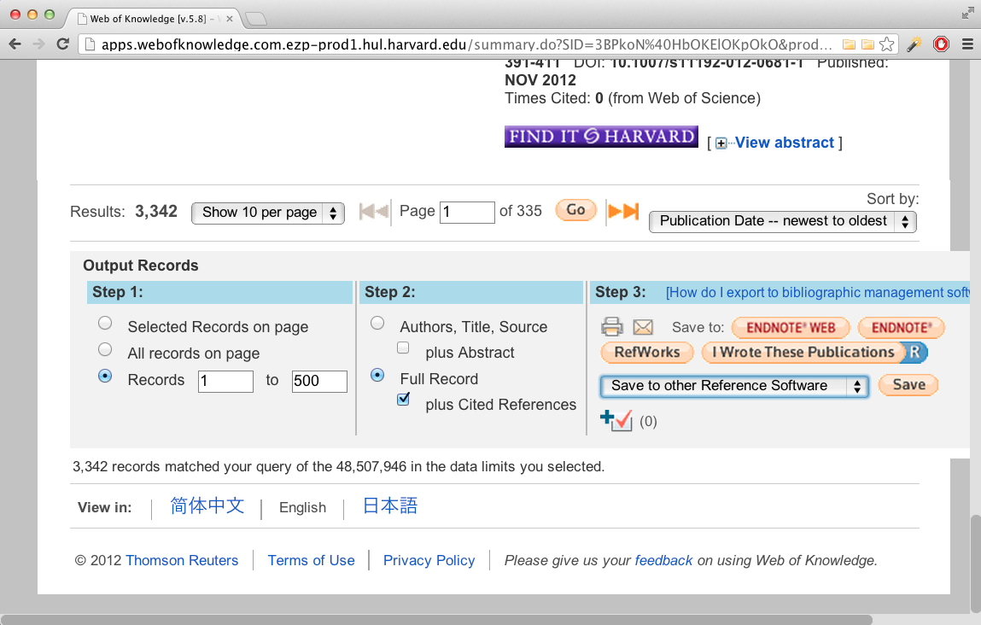
Download Citations
Download to a delimited plain text format
WoS only allows 500 records to be exported at a time

Slide 8

Rename and Load Saved Records
Rename the save records from “filename.txt” to “filename.isi”
If you have multiple record files, merge them
Load records in Sci2
Check console log for errors or warnings

Slide 9
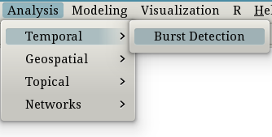
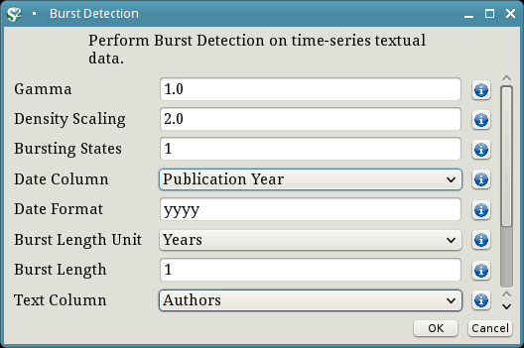
Temporal Analysis: Author Longevity
Burst detection for authors

Slide 10
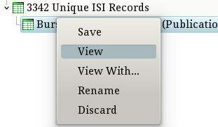

Temporal Analysis: Author Prominence
Clean up burst detection results
Replace blank End date with “2012”
Save and re-load into Sci2

Slide 11
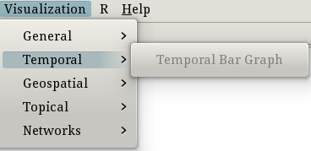
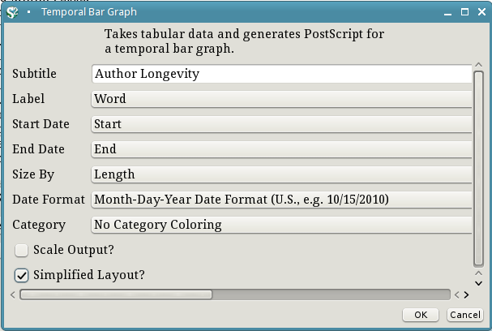
Temporal Analysis: Author Longevity
Visualize author longevity

Slide 12
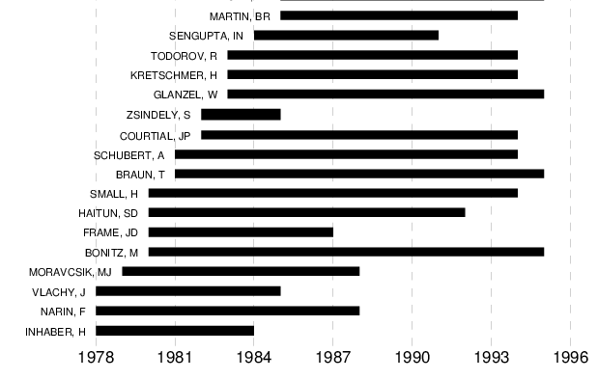
Temporal Analysis: Author Longevity
Visualize author longevity

