Slide 1
pq-dnssec side meeting at IETF 125
March 17, 2026, 8:00 (local time)
Wiki page: https://wiki.ietf.org/group/pq-dnssec
Mailing list: pq-dnssec@ietf.org
Archive: https://mailarchive.ietf.org/arch/browse/pq-dnssec/

Slide 2
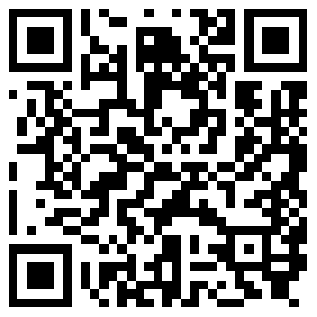
Note Well
By participating in the IETF you agree to follow IETF processes and policies. This Note Well is a reminder
of some of those policies. For a linked version of this text, please visit www.ietf.org/note-well or use the QR code below.
IETF participants are expected to behave in a professional manner and extend respect and courtesy to their colleagues at all times (see RFC 7154: IETF Guidelines for Conduct and IETF Anti-Harassment Policy). If you have any concerns about behavior, please contact the Ombudsteam who have a duty of confidentiality and extensive powers to act, as set out in RFC 7776: IETF Anti-Harassment Procedures.
If you are aware that any IETF contribution (as defined in RFC 5378: Rights Contributors Provide to the IETF Trust) is covered by patents or patent applications that are owned or controlled by you, your employer or your sponsor, you must disclose that fact, or not participate in the discussion
(see RFC 8179: Intellectual Property Rights in IETF Technology).
For detailed process information consult RFC 2026: Internet Standards Process and
RFC 2418: IETF Working Group Guidelines and Procedures and updates to those.
The IETF routinely makes public written, audio, video, and photographic records
of IETF activities, including your personal information as set out in the IETF Privacy Statement.
For advice, please talk to Working Group chairs or Area Directors.
www.ietf.org/note-well

Slide 3
IETF Code of Conduct Guidelines RFC7154
1. Treat colleagues with respect
2. Speak slowly and limit the use of slang
3. Dispute ideas by using reasoned argument
4. Use best engineering judgment
5. Find the best solution for the whole Internet
6. Contribute to the ongoing work of the group and the IETF
We take this very seriously. If you feel the Code has been violated,
please reach out to the chairs or the IETF ombuds team.
"We work as Individuals, let's remember to be nice to each other”

Slide 4
Welcome
Chairs:
  Caspar Schutijser <caspar.schutijser@sidn.nl>
  Peter Thomassen <peter@desec.io>
Note taker?

Slide 5
Agenda
5’ Note Well / Agenda Bashing
15'+q Minh Hoang Tran (Virginia Tech): Backwards compatible ladders in MTL-mode for SLA-compliant PQ-DNSSEC
15'+q Elmer Lastdrager (SIDN Labs): Simulating DNSSEC on a testbed based on real resolver data
15'+q Elmer Lastdrager (SIDN Labs) presenting Eline Stehouwer's work: DNSSEC and PQC: practical impact of increased TCP in DNS
AOB

