Slide 1
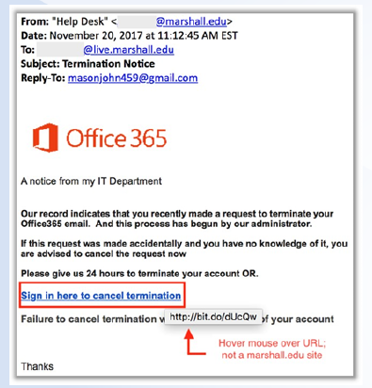
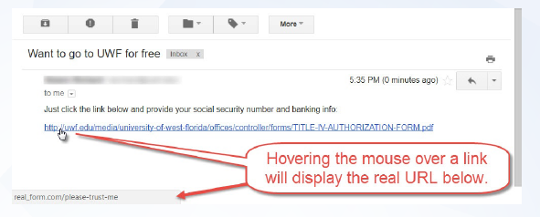
Motivation

Slide 2

Sr.No | Components | URL
1. | Protocol | https
2. | Top-Level Domain | Com
3. | Primary Domain | rajupadhyay.com
4. | Sub-domain | www
5. | Path | Report.pdf

Slide 3
Literature Survey
Many researchers all over the world have proposed different approaches for classification and detection of malicious URLs let’s see one by one.

Slide 4
1. Detecting Malicious Web Links and Identifying Their Attack Types
Author: Hyunsang Choi, Bin B. Zhu, Heejo Lee
Conclusion:
They have proposed a method using machine learning to detect malicious URLs of all popular attack types like spam, phishing, malware. They have used features like lexical, link popularity, Webpage content, DNS, DNS fluxiness and network traffic. SVM was used to detect malicious URLs. Their method achieved an accuracy of over 98% in detecting malicious URLs.
2. Malicious URLs Detection Using Decision Tree Classifiers and Majority Voting Technique
Author: Dharmaraj R. Patil, J. B. Patil
Conclusion:
They have performed the static and dynamic analysis of URLs for the detection of URL as benign or malicious. They have extracted 117 static and dynamic features of the URLs, among which 44 are new features. The decision tree learning classifiers have achieved good detection rate between 98-99% with very low FPR and FNR.

Slide 5
3 Malicious-URL Detection using Logistic Regression Technique
Author: Vanitha and Vinodhini
Conclusion:
The majority of computer attacks are launched by visiting a malicious webpage. A user can be tricked into voluntarily giving away private information on a phishing page or become target to a drive-by download resulting in a malware infection. They have used logistic Regression and it obtains maximum learning accuracy comparing to other algorithms such as naïve bays, decision tree.
4. Phishing Websites Detection Using Machine Learning
Author: R. Kiruthiga, D. Akila
Conclusion:
They have used various machine learning algorithms like SVM, decision tree, random forest etc. They have proposed to use PhishScore and PhishChecker for phishing detection and it’s probably new approach from other researcher.

Slide 6
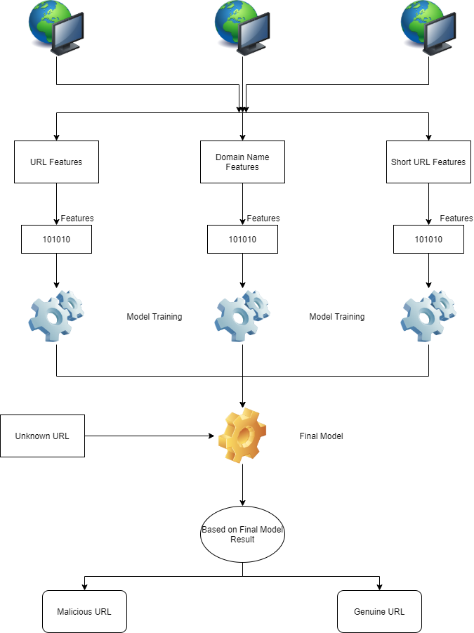

Slide 7
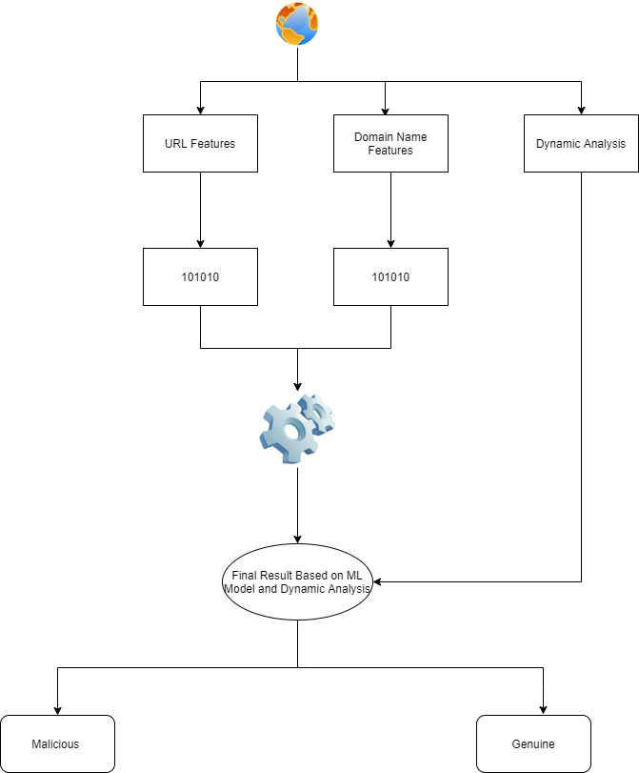

Slide 8
Tools & Technology
Technology:
Python
Machine Learning
Tools:
Jupyter Notebook
Google Colab

Slide 9
Implementations
Dataset
Applied Feature Extraction on Dataset.
Data Visualization
Implemented ML Algorithm on pre-processed dataset.
Decision Tree
Random Forest

Slide 10
Dataset
So far I have collected 10000+ URLs and created CSV file. URLs I have collected from below mention sources.
www.phishtank.com
www.malwaredomainlist.com
dataverse.harvard.edu/dataset.xhtml
www.kaggle.com

Slide 11
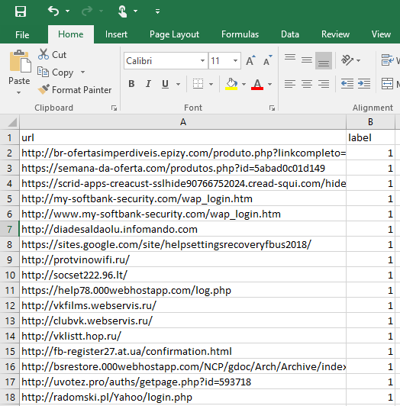

Slide 12
Let’s see Feature Extraction

Slide 13
Sr. No | Feature Name | Type
1 | Protocol “http” | Binary
2 | Protocol “https” | Binary
3 | Url Length | Numeric
4 | Hostname Length | Numeric
5 | Path Length | Numeric
6 | TLD Length | Numeric
7 | Number of ‘-‘ in URL | Numeric
8 | Number of ‘@‘ in URL | Numeric
9 | Number of ‘%’ in URL | Numeric
10 | Number of ‘.‘ in URL | Numeric
11 | Number of ‘_‘ in URL | Numeric
12 | Number of ‘=‘ in URL | Numeric
13 | Number of ‘?‘ in URL | Numeric
14 | Number of ‘;‘ in URL | Numeric
15 | Number of ‘(‘ in URL | Numeric
16 | Number of ‘)’ in URL | Numeric
17 | Number of ‘&‘ in URL | Numeric
18 | .exe | Binary
19 | .zip | Binary
20 | .rar | Binary
21 | Secure | Binary
22 | Logn | Binary
23 | Ebayisapi | Binary
24 | Login.asp | Binary
25 | Login.php | Binary
26 | .jpg | Binary
27 | .gif | Binary
28 | .php | Binary
29 | .bin | Binary
30 | Number of digits present | Numeric
31 | Number of characters present | Numeric
32 | Number of Directory present | Numeric

Slide 14
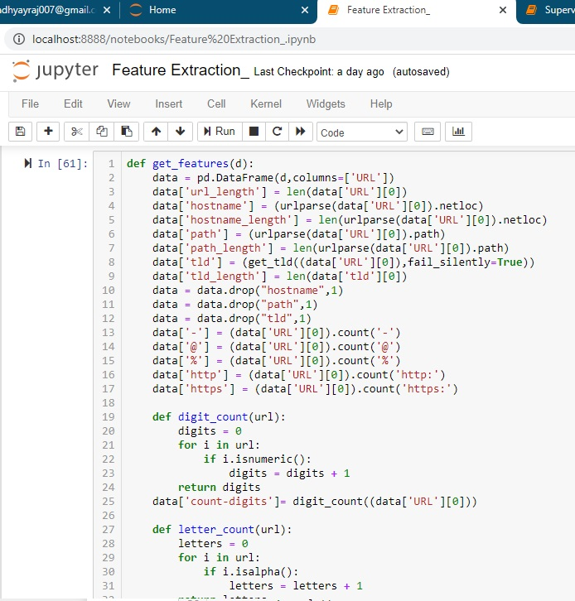

Slide 15
Let’s See Data Visualization

Slide 16
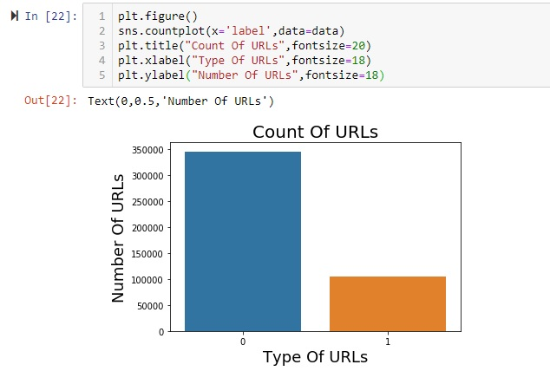

Slide 17
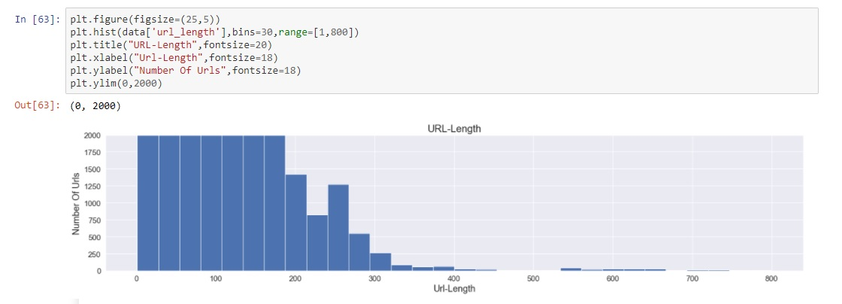

Slide 18
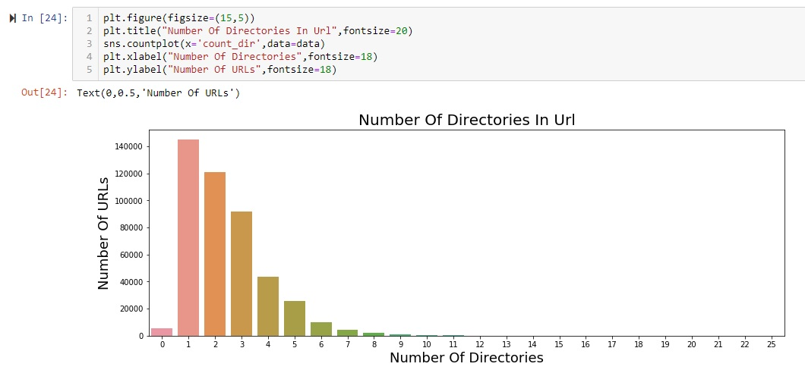

Slide 19
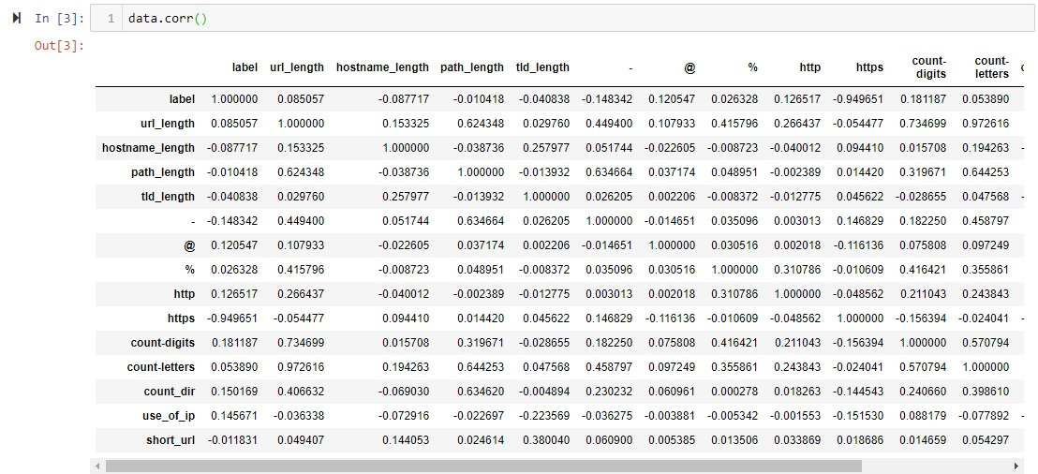

Slide 20
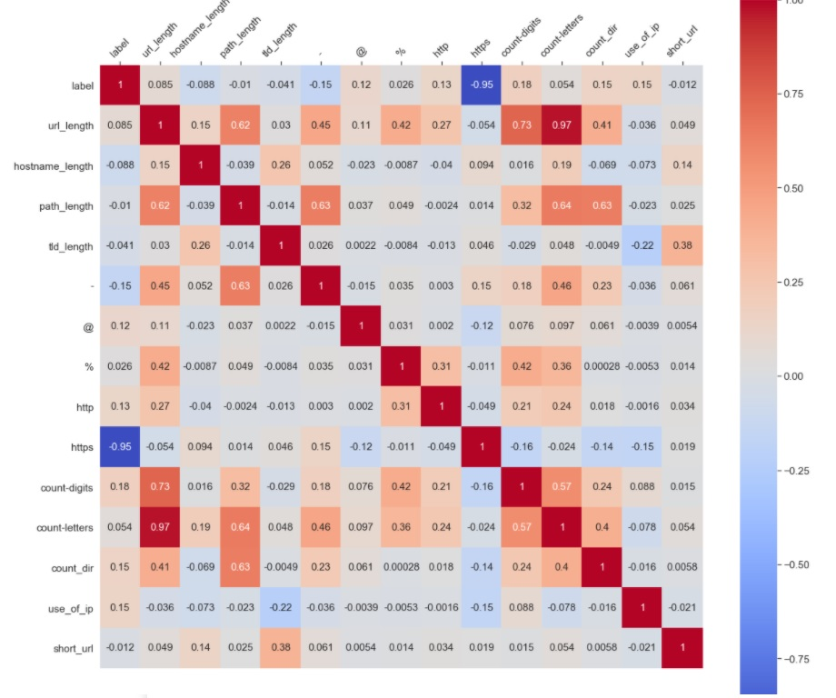

Slide 21
Let’s see Results of 1. Decision Tree 2. Random Forest 3. Logistic Regression

Slide 22
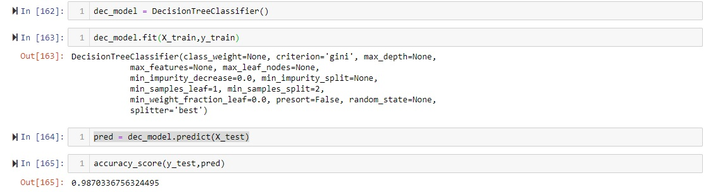
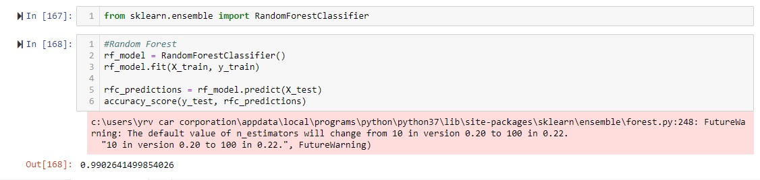

Slide 23
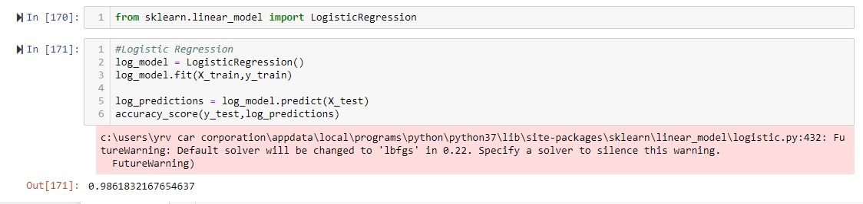

Slide 24
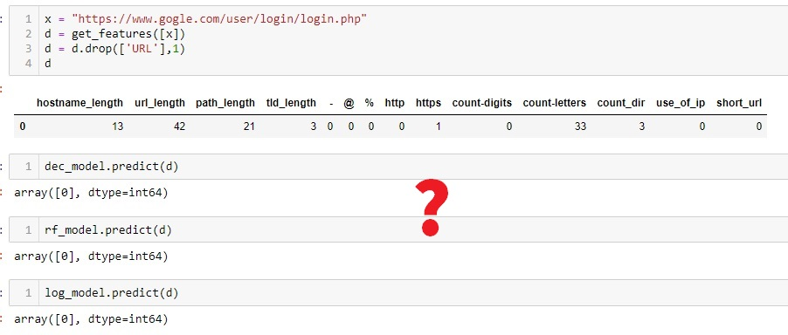

Slide 26
1. Update in Dataset 2. Update in Feature Extraction 3. Creation of web application.

Slide 27
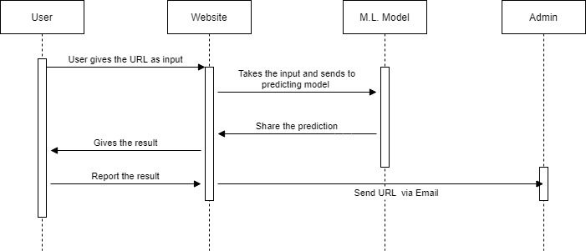

Slide 28
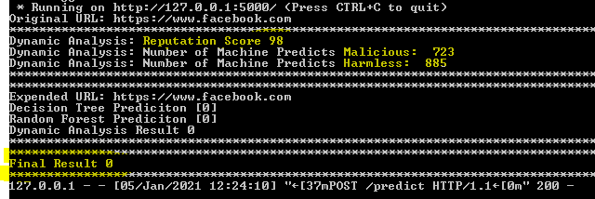

Slide 29
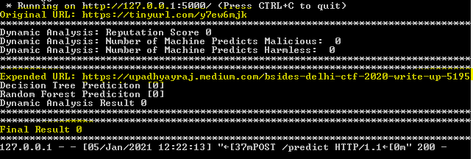

Slide 30
Reference
https://www.researchgate.net/publication/324014302_Malicious_URLs_Detection_Using_Decision_Tree_Classifiers_and_Majority_Voting_Technique
http://gauss.ececs.uc.edu/Courses/c6055/pdf/webapps.pdf
https://jupyter.org/
https://towardsdatascience.com/machine-learning-an-introduction-23b84d51e6d0
https://www.youtube.com/playlist?list=PLZoTAELRMXVPBTrWtJkn3wWQxZkmTXGwe
https://towardsdatascience.com/types-of-machine-learning-algorithms-you-should-know-953a08248861
https://www.guru99.com/supervised-machine-learning.html

Slide 31
Thank you

